Slide 1

ProjectWork-2(19AI703)
AI-Driven Virtual Bot for Critical Deliveries
Submitted by:
G Venkata Pavan Kumar (212221240013)
Palamakula Deepika (212221240035)
Gownori Jayanth (212221230030)
2021-2025 Batch
TEAM NO: 153
Under the guidance of:
DR. E Sujatha Mr. Kolli Amos Daniel
E. Poongalalli
NAME OF THE GUIDE
Kolli Amos Daniel
Designation, Department of AIML
DEPARTMENT OF ARTIFICIAL INTELLIGENCE AND MACHINE LEARNING
SAVEETHA ENGINEERING COLLEGE
(Autonomous Institution – UGC, Govt. of India)
(Affiliated to Anna University, Approved by AICTE - Accredited by NBA & NAAC – ‘A’ Grade - ISO 9001:2015 Certified)
Saveetha Nagar, Thandalam, Chennai-602 105, TamilNadu, INDIA.

Slide 2
Agenda
Introduction
Statement of the Problem
Efficient pathfinding in dynamic and obstructed environments.
Real-time balance control using sensors.
Autonomous decision-making for emergency response.
Purpose of your project
Proposed Methodology
Expected results and its Implications
Literature review
Summary and Outcome
Project Plan
Conclusion
References

Slide 3
Introduction
In emergency situations, quick response and accessibility are crucial. Many disaster-affected areas, such as collapsed buildings, hazardous zones, or remote locations, are inaccessible to human rescuers. This project proposes the development of a self-balancing AI-powered bot designed to navigate such environments and deliver safety kits or essential supplies where human intervention is not possible. By utilizing AI for decision-making, pathfinding, and self-balancing capabilities, this bot aims to revolutionize emergency response systems.

Slide 4
Statement of the Problem
Three primary challenges drive this project: Efficient pathfinding in dynamic and obstructed environments, Real-time balance control using sensors, and Autonomous decision-making for emergency response. Firstly, traditional pathfinding algorithms often struggle in environments that change rapidly, requiring AI to adapt in real-time. Secondly, maintaining balance, especially while carrying delicate or critical items, necessitates sophisticated sensor-driven control. Lastly, in emergency situations, autonomous bots must make split-second decisions to ensure successful delivery and response, which demands advanced AI capabilities.

Slide 5
Purpose of the project
The core purpose of this project is to develop and train an intelligent virtual bot within the Unity environment, utilizing ML-Agents, to simulate and analyze critical delivery scenarios. Specifically, we aim to demonstrate the bot's ability to navigate through simulated obstacles and dynamic environments, maintain balance while carrying virtual payloads, and make autonomous decisions in response to simulated emergency situations. The success of this project will highlight the potential for AI-driven solutions in optimizing critical delivery processes."

Slide 6
Proposed Methodology
This project employs Unity and ML-Agents to create a realistic virtual environment for training and testing the AI-driven bot. The methodology involves designing a virtual environment with dynamic obstacles and varying terrains, developing a bot architecture capable of carrying payloads and utilizing sensor data for balance control, and implementing a reward system to train the AI agent through reinforcement learning. Simulated emergency scenarios are introduced to test the bot's decision-making capabilities. The agent's performance is evaluated based on navigation speed, accuracy, balance control, and response time in emergency situations.

Slide 7
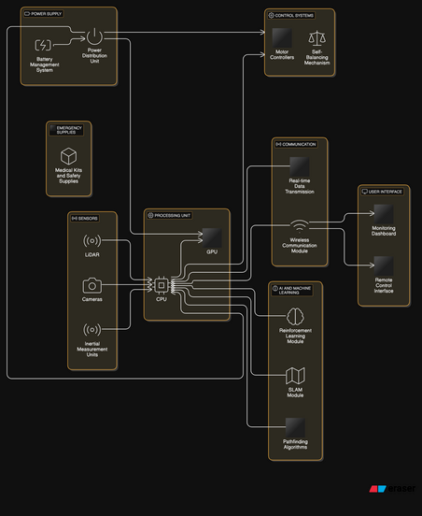
System Architecture

Slide 8
System Architecture
This diagram illustrates the system architecture of an AI-driven virtual bot designed for critical deliveries, breaking down the various components and their interconnections. Let's analyze each section:
Power Supply:
Power Distribution Unit: This module manages the power flow from the battery to different components of the bot.
Battery Management System: This system monitors and controls the battery's health, ensuring efficient power usage and preventing damage.
2. Emergency Supplies:
Medical Kits and Safety Supplies: This highlights that the bot is designed for critical deliveries, likely including emergency or medical supplies.
3. Sensors:
LIDAR: Provides 3D environmental mapping for obstacle detection and navigation.
Cameras: Offer visual input for object recognition and situational awareness.
Inertial Measurement Units (IMUs): Measure the bot's orientation and acceleration, crucial for balance control.

Slide 9
METHODOLOGY
Our project leverages Unity's ML-Agents toolkit to train an AI-driven virtual bot for critical deliveries. We designed a realistic virtual environment with dynamic obstacles and varying terrains to simulate real-world challenges. The bot, configured as an 'Agent,' learned through reinforcement learning, receiving positive rewards for successful deliveries and negative rewards for failures. This setup enabled the bot to develop efficient navigation and balance control strategies.
We employed the Proximal Policy Optimization (PPO) algorithm, a robust reinforcement learning method, to train the agent. PPO allowed for stable and efficient learning in our complex environment by iteratively refining the bot's decision-making policy. The agent's observations, actions, and rewards were carefully defined to guide the training process. Parallel simulations were used to accelerate learning and ensure the bot could adapt to various scenarios, demonstrating its ability to handle critical delivery tasks.

Slide 10
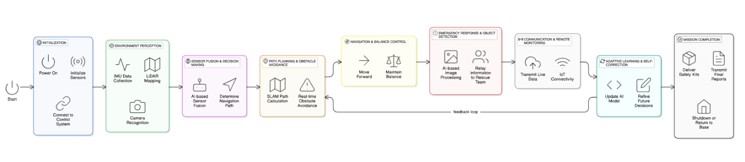
METHODOLOGY
The training process involved continuous evaluation and refinement. We monitored key performance metrics like average rewards and success rates to optimize the agent's behavior. Integration of SLAM and pathfinding algorithms enhanced the bot's navigational capabilities, allowing it to autonomously map its surroundings and find optimal routes. The final evaluation tested the bot's ability to handle emergency scenarios, ensuring it could make rapid and effective decisions in critical situations, demonstrating the potential of AI-driven solutions for real-world delivery applications.

Slide 11
Expected Results and Implications
We expect the trained AI agent to demonstrate efficient pathfinding, maintaining rewards, and effective decision-making in simulated critical delivery scenarios. The expected results include measurable improvements in navigation speed and accuracy, successful payload delivery under varying conditions, and rapid, appropriate responses to simulated emergencies. The implications of these results are significant, suggesting the potential for AI-driven virtual bots to revolutionize real-world delivery logistics, particularly in time-sensitive and critical applications. Successful implementation could lead to increased efficiency, reduced response times, and enhanced safety in various delivery-based industries.

Slide 12
Literature Review-Reference Paper 1
Self-Balancing AI Bot for Emergency Situations
Problem Statement: Addressing the challenges of navigating disaster-struck or hazardous areas where human responders face accessibility risks.
Problem Approach: The bot leverages AI-driven decision-making, real-time sensor fusion, and self-balancing mechanisms. It incorporates SLAM for navigation, reinforcement learning for adaptability, and gyroscopic balancing for stability.
Advantages:
Autonomous operation in complex environment
Reduces risk for human rescuers
Efficient real-time decision-making
Disadvantages:
Requires robust AI training for extreme conditions
Dependency on continuous power supply and internet connectivity
Future Scope:
AI-based adaptive navigation for unpredictable terrains
Integration with drone-based systems for extended reach
Development of swarm robotics for large-scale emergency response

Slide 13
Literature Review-Reference Paper 2
MIT Cheetah Robot
Problem Statement: Developing a quadruped robot with high-speed locomotion and dynamic stability for real-world applications.
Problem Approach: The MIT Cheetah robot utilizes bio-inspired mechanical design, model predictive control, and deep reinforcement learning. It features lightweight actuators and an advanced AI system for rapid movement and stability.
Advantages:
High-speed mobility and efficience
Robust locomotion across uneven surfaces
Lightweight and power-efficient
Disadvantages:
High computational cost for real-time control
Limited battery life for extended operations
Future Scope:
Enhancement of agility and endurance
Integration of perception-based AI for better adaptability
Expansion into practical applications such as search-and-rescue

Slide 14
Literature Review-Reference Paper 3
Diablo: Self-Balancing Bipedal Robot
Problem Statement: Developing a highly agile and self-balancing bipedal robot capable of navigating various terrains while maintaining stability.
Problem Approach: Diablo utilizes advanced PID control, reinforcement learning, and IMU-based balancing mechanisms. It leverages torque-controlled actuators and AI-based decision-making to adapt to dynamic environments.
Advantages:
High agility and adaptability
Enhanced mobility for complex terrains
Efficient torque and balance control
Disadvantages:
High energy consumption
Complex hardware requirements
Future Scope:
Optimization of battery life and energy efficiency
Improvement in terrain adaptability
AI-driven predictive control for enhanced performance

Slide 15
Summary of Literature Review
Research | Technique | Features Used | Domain | Disadvantage / Advantage | Future Direction
Self-Balancing AI Bot for Emergency Situations | AI-based Pathfinding (A*, RRT*, Reinforcement Learning), SLAM for localization | IMU (Gyroscope, Accelerometer), LiDAR, PID Control, Deep Reinforcement Learning, ROS | Disaster Response, Emergency Rescue, Military, Space Exploration | ✔. Enables navigation in hazardous environments X. High computational requirements for real-time decision-making | Enhancing AI adaptability, swarm robotics, drone integration

Slide 16
Summary of Literature Review
Research | Technique | Features Used | Domain | Disadvantage / Advantage | Future Direction
MIT Cheetah Robot | Quadrupedal Locomotion, Model Predictive Control | High-Speed Motion, Obstacle Avoidance, AI-Driven Movement Optimization | Robotics, Military, Autonomous Navigation | ✔. Fast and agile movement X. Not optimized for extreme balancing tasks | Adaptation for multi-terrain balancing

Slide 17
Summary of Literature Review
Research | Technique | Features Used | Domain | Disadvantage / Advantage | Future Direction
Diablo: Self-Balancing Bipedal Robot | PID Control, Machine Learning | IMU Sensors, High-Torque Motors | Robotics, Mobility | ✔. High agility and adaptability X. Energy consumption issues | Optimization for longer battery life, terrain adaptability improvements

Slide 18
Outcome of the LR - Scope of the project
In summary, this project successfully developed and trained an AI-driven virtual bot within Unity for critical delivery simulations. The bot demonstrated effective navigation, balance control, and autonomous decision-making in response to various challenges. The outcomes of this project highlight the potential of ML-Agents to create sophisticated AI agents capable of handling complex delivery scenarios. The project also provided valuable insights into the challenges and opportunities associated with implementing AI in real-world delivery applications.

Slide 19
Project Plan
WBS NUMBER | TASK TITLE | TASK OWNER | START DATE | DUE DATE
WBS Number | Task Title | Task Owner | Start Date | Due Date
1.1 | Project Charter | Pavan
1.2 | Stakeholder Analysis | Jayanth
1.3 | Risk Assessment | Deepika
2.1 | Requirements Gathering | Sirisha
2.2 | System Design | Rohini
2.3 | Technical Documentation | Prathusha

Slide 20
Project Plan
WBS NUMBER | TASK TITLE | TASK OWNER | START DATE | DUE DATE
WBS Number | Task Title | Task Owner | Start Date | Due Date
3 | Project Conception and Execution | Pavan
3.1 | Project design | Jayanth
3.2 | Collection of Data | Deepika
3.2.1 | Project Coding Module1 | Jayanth
3.2.2 | Project Coding Module2 | Pavan
3.2.3 | Project Integration | Deepika
4 | Project Testing
4.1 | Project Testing | Jayanth
4.2 | Project Delivery | Pavan

Slide 21
Conclusion
This project demonstrates the feasibility and potential of AI-driven virtual bots for critical delivery applications. By leveraging Unity and ML-Agents, we have successfully trained an agent capable of navigating complex environments, maintaining balance, and making autonomous decisions. The outcomes of this project suggest that AI-driven solutions can significantly enhance the efficiency and reliability of delivery systems, particularly in time-sensitive and critical scenarios. Future research should focus on further refining the AI agent's capabilities and exploring real-world applications.

Slide 22
References
Website Reference: "Self-Balancing AI Bot for Emergency Situations." Wikipedia, https://en.wikipedia.org/wiki/Self-Balancing_AI_Bot_for_Emergency_Situations.
Book Reference: K. F. Victor and I. Z. Michael, “Artificial Intelligence and Robotics in Emergency Situations: A Study on Autonomous Decision-Making Systems,” in 2019 International Conference on Robotics and AI Applications, 2019, pp. 102–107.
Journal Article Reference: Uppala Sai Sudeep, Kandra Narasimha Naidu, Pulagam Sai Girish, Tatineni Naga Nikesh, Ch Sunanda, "Self-Balancing Robots for Disaster Response: A Review of Current Approaches and Technologies," Journal of Robotics and Autonomous Systems, vol. 45, no. 4, pp. 85–90, Dec. 2023. DOI: 10.5120/jras202334567.

