Slide 1

Disease Detection using Text Analysis
Presented By
Pavan Kalyan Kondle
Sujitha Cherukuthota

Slide 2
Motivation
Improve healthcare results by using cutting-edge data analysis.
For practical insights, make advantage of user-generated pharmaceutical evaluations.
Discuss issues with sentiment analysis and the identification of medical issues.
Enhance patient outcomes by acting quickly to intervene.
Reduce the gap between evidence-based decision-making and unstructured data.
Increased delivery and analytics for healthcare.

Slide 3

Problem Statement
The goal is to provide actionable insights to help people make educated healthcare decisions.
Create strong algorithms for reliable sentiment analysis and medical problem detection.
Sentiment in pharmaceutical reviews is difficult to categorize appropriately.
Difficulties in discovering early symptoms of medical concerns from user-generated content.
Accuracy, language complexity, and subjective opinions are among the current roadblocks.
The lack of domain-specific datasets complicates sentiment analysis.

Slide 4
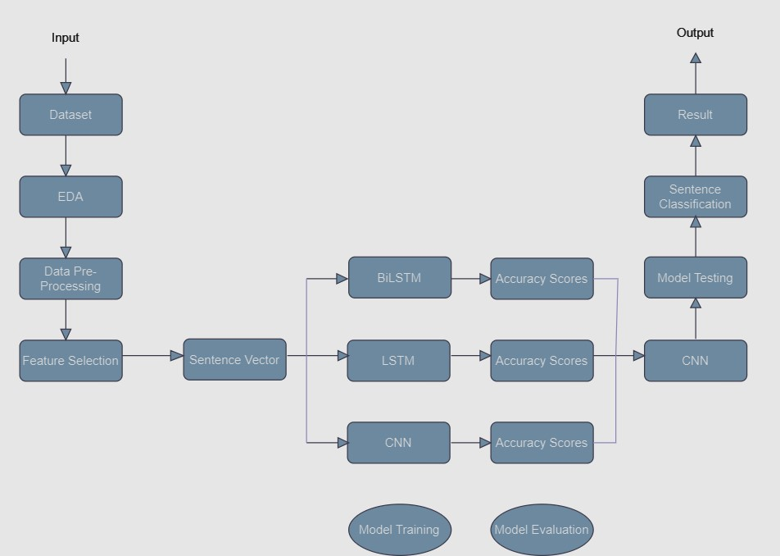
Basic OverFlow

Slide 5
Data Set Description
The dataset contains the following fields:
urlDrugName (categorical)
condition (categorical)
review (text)
rating (numerical)
date (date)
usefulCount (numerical)
For our project, we are primarily utilizing the condition and review fields to analyze medical conditions and extract insights from textual reviews.

Slide 6
Overview of the Models
In our project, we implemented NLP models, such as Long Short Term Memory (LSTM), Bidirectional Long Short-Term Memory (BiLSTM), and Convolutional Neural Network (CNN). Sentences are an essential part of many NLP applications, including text analysis, topic labeling, and spam detection.
CNN: Classifies sentences by capturing local patterns efficiently, making it suitable for text analysis tasks.
LSTM: Processes sentence vectors for categorization, excelling in understanding context and temporal dependencies.
BiLSTM: Enhances LSTM with bidirectional processing, improving understanding of sentence semantics and context.

Slide 7
Evaluation Metrics
Dataset split into training and validation sets using 80-20 ratio.
Metrics used for evaluation:
- Precision: Measures true positive predictions proportionately.
- Recall: Measures true positive predictions out of all actual positives.
- F1-score: Harmonic mean of precision and recall, balancing both metrics.
Evaluation includes precision, recall, and F1-score alongside accuracy and loss.
Classification reports provide detailed insights into model performance for each class and overall dataset metrics.

Slide 8
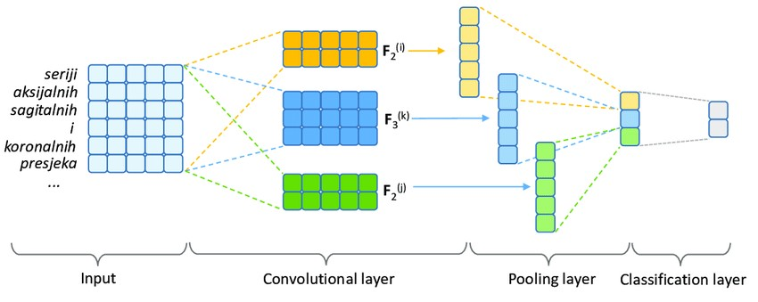
CNN Architecture

Slide 9

Model Training
Convolutional neural networks (CNNs) are the foundation of the model architecture used for text classification.
To start, an embedding layer is used to represent words densely.
The word embeddings undergo filtering by 128 filters with a kernel size of 5 in the Conv1D layer.
Nonlinearity is introduced by activating the Rectified Linear Unit (ReLU).
MaxPooling1D downsamples feature maps while keeping pertinent data.
By extracting essential features, GlobalMaxPooling1D lowers dimensionality.
Softmax activation is used by the Dense layer to perform multi-class classification.
For effective text categorization, this architecture maximizes feature extraction and classification.

Slide 10
Hyper-parameter Details
max_words: Maximum number of words to be used in tokenization. Set to 10,000.
max_seq_length: Maximum length of sequences after padding. Set to 100.
embedding_dim: Dimension of the word embeddings. Set to 100.
Conv1D filters: 128 filters with a kernel size of 5 are used.
MaxPooling1D: Pooling size is set to 2.
GlobalMaxPooling1D: Global max pooling is applied.
optimizer: Adam optimizer is used.
loss function: Sparse categorical cross-entropy loss is used.
batch_size: Batch size for training is set to 32.
epochs: Number of epochs for training is set to 10.

Slide 11
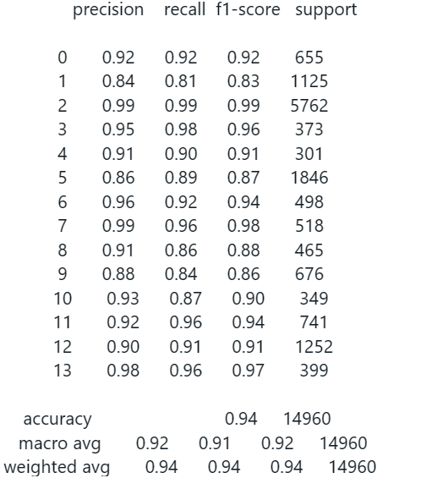
Classification Report

Slide 12
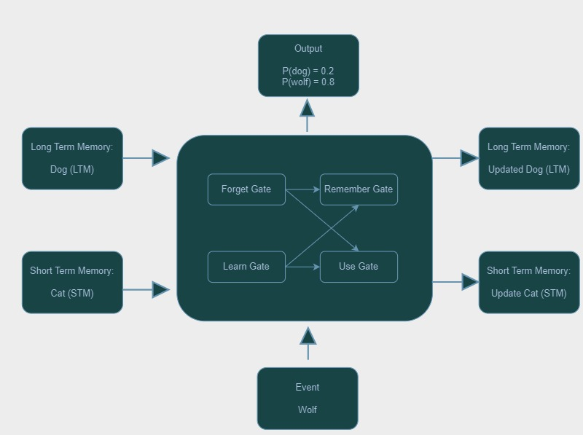
LSTM Architecture

Slide 13
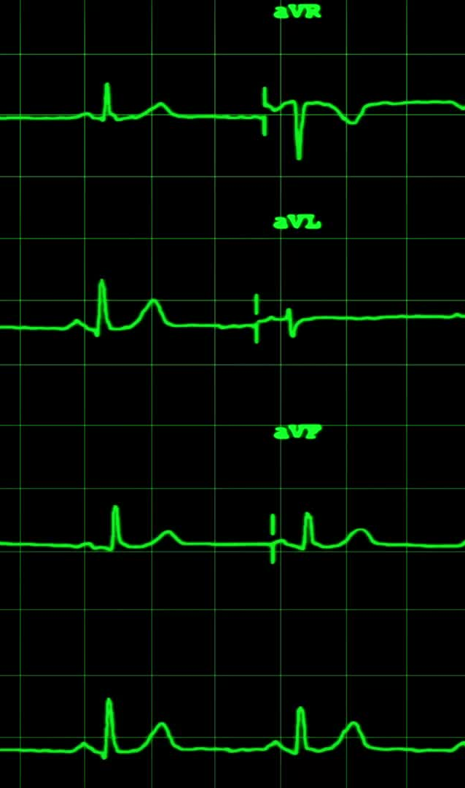
Model Training
Sequences were padded or trimmed to a maximum length of 100.
The LSTM model included an embedding layer, a spatial dropout layer, a single LSTM layer with 128 units, and a dense layer with softmax activation.
Adam optimizer and sparse categorical cross-entropy loss were used.
Training occurred over ten epochs with a batch size of 32.
Performance assessment included measures like loss, accuracy, recall, and F1 scores.
Classification report was generated using scikit-learn's function.
The trained model was saved for future use.
New text was preprocessed and padded using the same tokenizer.
The model predicted the class label for new text, mapped back to the original dataset's labels.

Slide 14
Hyper-parameter Details
max_words: Maximum number of words to be used in tokenization. Set to 10,000.
max_seq_length: Maximum length of sequences after padding. Set to 100.
embedding_dim: Dimension of the word embeddings. Set to 100.
SpatialDropout1D: Dropout rate of 0.2 is applied after the embedding layer.
LSTM units: 128 LSTM units are used.
optimizer: Adam optimizer is used.
loss function: Sparse categorical cross-entropy loss is used.
batch_size: Batch size for training is set to 32.
epochs: Number of epochs for training is set to 10.

Slide 15
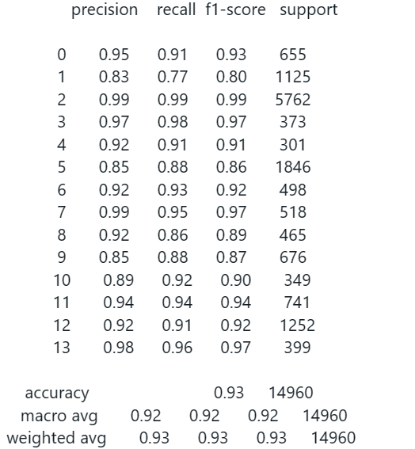
Classification Report

Slide 16
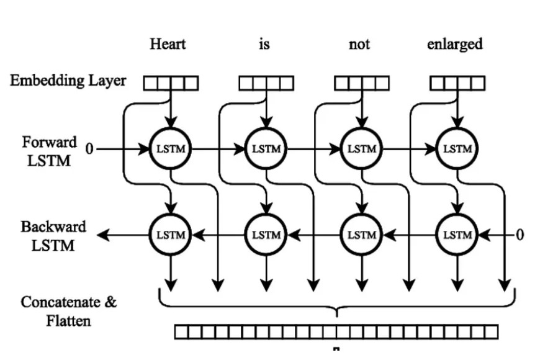
BiLSTM Architecture

Slide 17

Model Training
Implemented Bidirectional Long Short-Term Memory (BiLSTM) architecture.
Preprocessed input text through tokenization and padding.
Limited vocabulary size to 10,000 words and sequence length to 100 tokens.
Used a word embedding layer of dimension 100.
Added Spatial Dropout layer (dropout rate: 0.2) for overfitting prevention.
Core model included a Bidirectional LSTM layer (128 units).
Employed Adam optimizer, batch size of 32, and trained over 10 epochs.
Evaluated model performance with sparse categorical cross-entropy loss and accuracy metrics.
Generated classification reports using scikit-learn's classification-report function.

Slide 18
Hyper-parameter Details
max_words: Maximum number of words to be used in tokenization. Set to 10,000.
max_seq_length: Maximum length of sequences after padding. Set to 100.
embedding_dim: Dimension of the word embeddings. Set to 100.
SpatialDropout1D: Dropout rate of 0.2 is applied.
Bidirectional LSTM units: 128 LSTM units are used in both forward and backward directions.
optimizer: Adam optimizer is used.
loss function: Sparse categorical cross-entropy loss is used.
batch_size: Batch size for training is set to 32.
epochs: Number of epochs for training is set to 10.

Slide 19
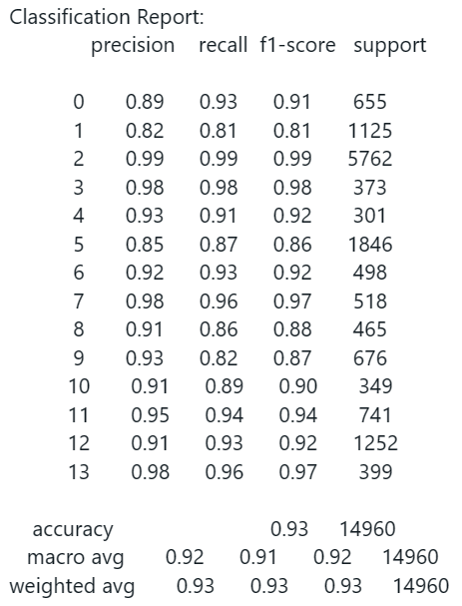
Classification Report

Slide 20
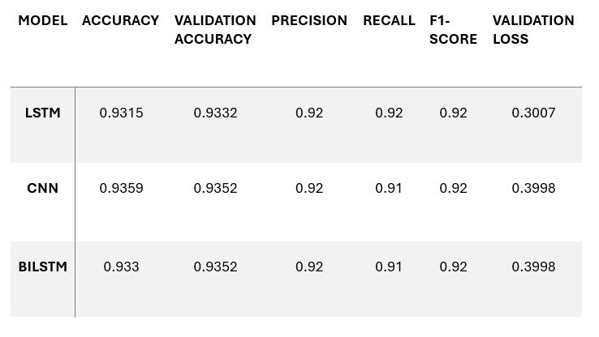
Results and Observations
Common Error Patterns: Across all models, classes 1, 5, and 11 show consistent misclassifications, showing intrinsic difficulties in identifying these classes.
Performance discrepancies: While overall accuracies are good, some classes have lesser precision and recall,
indicating areas for targeted improvement.
Model Consistency: Despite variations in architecture (LSTM, CNN, BiLSTM), the error patterns are consistent,
implying undeclassification and overall model performance.

Slide 21
Conclusion
The CNN, BiLSTM, and LSTM models perform well on classification tasks.
All three models show a consistent improvement.
CNN model achieves higher accuracy and F1-score than LSTM and BiLSTM.
The models' recall and precision vary somewhat from one another.
Overall performance stays consistent, demonstrating dependability and adaptability.
Deep learning architectures, such as CNN, BiLSTM, and LSTM, work well on challenging categorization problems.
Improving model performance over time requires constant optimization and improvement.

Slide 22

Thank You

