Slide 1


DARI-Mark: Deep Learning for Robust Image Watermarking
Presented by Yimeng Zhao, Chengyou Wang, Xiao Zhou, Zhiliang Qin.
by PAVAN ARAVAPALLI

Slide 2
DARI-Mark Framework Overview
End-to-End Framework
Four Components
DARI-Mark is an end-to-end network for robust image watermarking.
Attention Network
Watermark Embedding Network
It balances imperceptibility and robustness.
Attack Layer
Watermark Extraction Network

Slide 3




Attention Network
Imperceptibility
Robustness
CBAM-Derived
Embeds watermarks in non-significant regions, improving imperceptibility.
Focuses on watermark features, suppressing noise for better robustness.
Based on CBAM, inferring attention across channel and spatial dimensions.

Slide 4
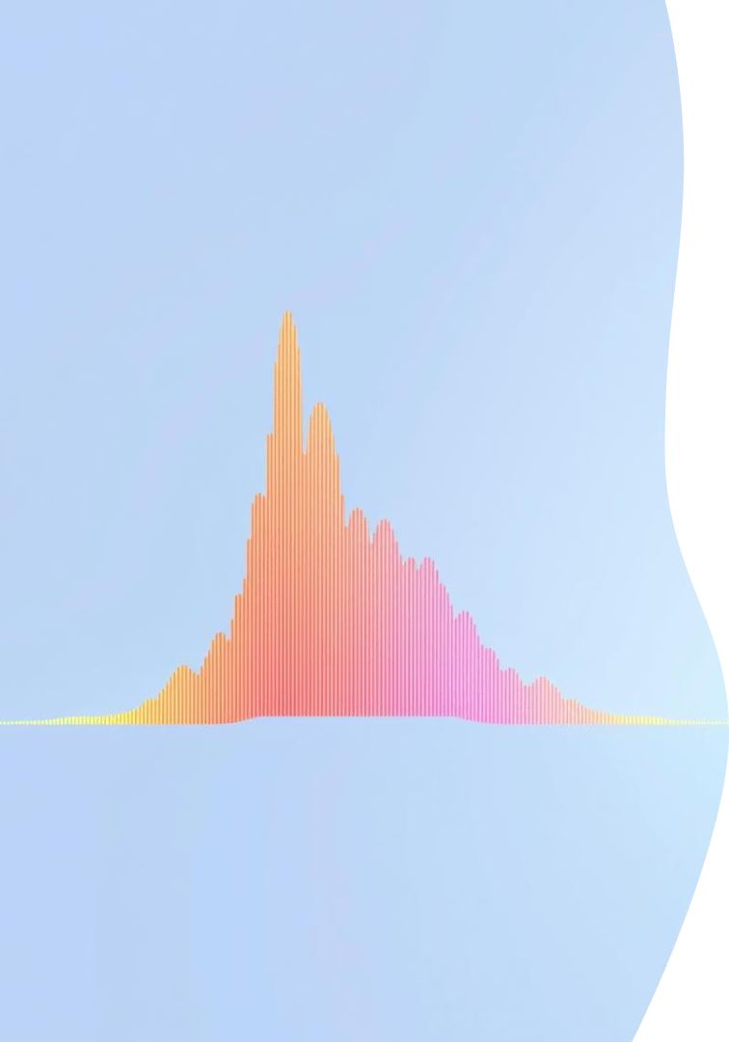
Watermark Embedding Network
DCT Layer
Convolutional Layers
Performs Discrete Cosine Transform on the attention feature map.
Uses 1x1 and 2x2 Conv layers to embed watermark data.
Includes batch normalization and ReLU activation.
Aligns with HVS for better imperceptibility.
Residual Structures
2x2 layers use residual structures with shortcut connections.
Prevents gradient issues in deep networks.

Slide 5




Watermark Embedding Output
Inverse DCT (IDCT)
Transforms embedded information from frequency to spatial domain.
Embedding Strength Factor (α)
Multiplies IDCT output by α to control embedding strength.
Higher α enhances robustness; set to 1.0 for training.
Final 3x3 Conv Layer
Produces the final watermarked image, same dimensions as original.

Slide 6





Attack Layer
JPEG Compression
Salt-and-Pepper Noise
Gaussian Noise
Simulates common image compression (Q=50).
Adds random noise (density s=0.04).
Introduces random noise (std dev σ=0.1).
Sharpening
Applies sharpening (radius RS=10).
The attack layer simulates common distortions to enhance robustness during end-to-end training. Attack probabilities are randomized for generalization.

Slide 7

Watermark Extraction Network
Initial 3x3 Conv
Transforms attacked image from 1 to 64 channels.
Attention Network
Re-utilized to focus on watermark features and suppress noise.
DCT Layer
Performs DCT to return features to frequency domain.
Extraction Conv Layers
Similar to embedding, with residual structures for stability.

Slide 8
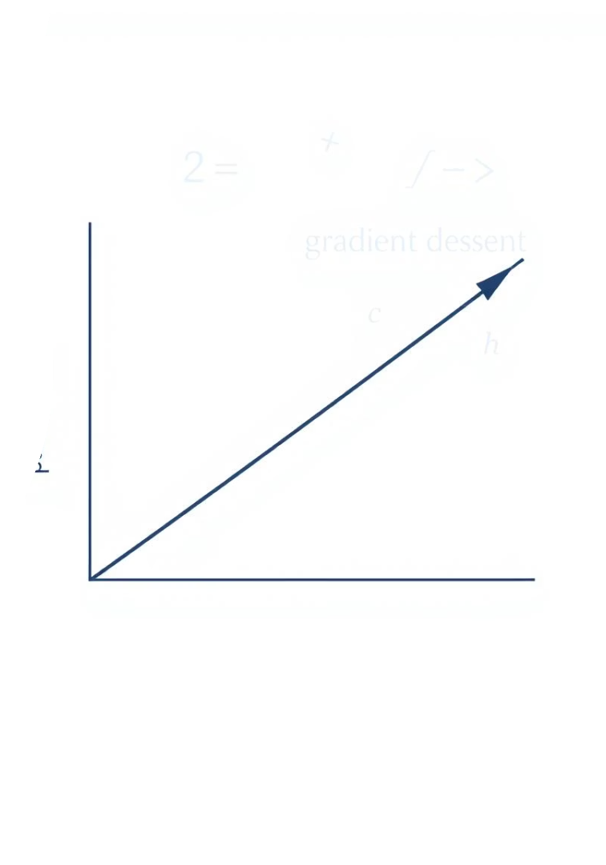
Training Details & Loss Functions
100
Epochs
10,000 iterations, batch size 32.
0.0001
Learning Rate
SGD optimizer with 0.98 momentum.
0.5
Lambda (λ)
Balances embedding and extraction loss.
35dB+
PSNR
Ensures normal viewing quality.
All four networks are trained end-to-end. Overall loss combines SSIM for imperceptibility and BCE for extraction accuracy. Datasets include BOSSbase, CIFAR 10, and Granada.

