Slide 1
TrustMark: Universal Watermarking for Arbitrary Resolution Images
Summary of the research paper by Tu Bui, Shruti Agarwal, and John Collomosse
Prepared by: A.Pavan Kumar

Slide 2
Core Contributions
Novel Architecture: Frequency-aware GAN model designed for imperceptible yet robust watermark embedding.
Resolution Scaling: Generalizes watermarking to images of arbitrary sizes using a residual mapping approach.
TrustMark-RM: Enables effective watermark removal and re-watermarking, supporting workflow flexibility.
State-of-the-Art Performance: Demonstrates best in class results in terms of image quality preservation and watermark robustness.

Slide 3
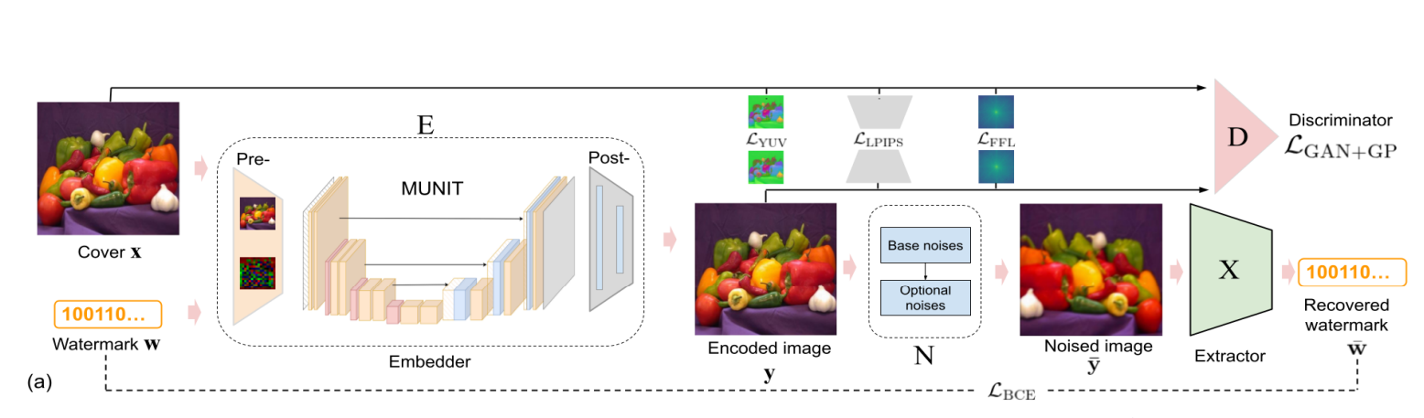
Watermarking Network Architecture
TrustMark model includes three modules:
• Embedder (E): Fuses watermark with image features
• Noise Module (N): Simulates real-world transformations
• Extractor (X): Recovers watermark bits from perturbed image

Slide 4
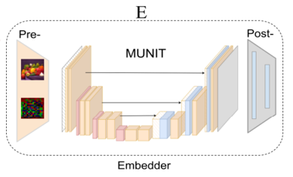
Embedder Module
Embedder encodes a watermark into the host image such that it is imperceptible to the human eye, while ensuring reliable recovery.
The Embedder consists of three stages:
Preprocessing Module: Input image is passed through d 3×3 filters
MUNIT-based Core: Deep encoder-decoder style architecture (no normalization layers)
Postprocessing Module: Uses 1×1 convolutions to reduce dimensions, converts features back to RGB space, uses SiLU and tanh activations
Mathematical Description:
Input: Image x ∈ ℝ^{256×256×3}, watermark w ∈ {0,1}^l
Architecture: Modified MUNIT-based design
Output: y = E(x, w) — visually identical watermarked image

Slide 5
Extractor & Noise Module
The extractor employs a ResNet50 backbone followed by a sigmoid to predict watermark bits from transformed images. The noise module applies differentiable augmentations simulating real-world distortions to watermarked images. Geometric modifications include cropping, resizing, and flipping, while photometric changes cover JPEG compression, blur, color shifts, and noise addition. This enables the extractor to learn to recover watermark bits reliably under various degradation scenarios.

Slide 6
Loss Functions
The training optimizes a total loss function combining quality and recovery losses: 𝓛_total = α·𝓛_quality + 𝓛_recovery.
Quality loss includes multiple components—YUV color space fidelity, perceptual similarity (LPIPS), frequency domain imperceptibility (FFL), and adversarial GAN loss encouraging natural image appearance. Recovery loss enforces accurate watermark bit prediction. This multi-faceted loss ensures the watermarked images remain visually intact while embedding recoverable watermarks robustly.
𝓛_quality = β_YUV · 𝓛_YUV + β_LPIPS · 𝓛_LPIPS + β_FFL · 𝓛_FFL + β_GAN · 𝓛_GAN
• YUV, LPIPS: Preserve visual and perceptual quality
• FFL: Enforces imperceptibility in frequency domain
• GAN: Encourages natural-looking outputs

Slide 7
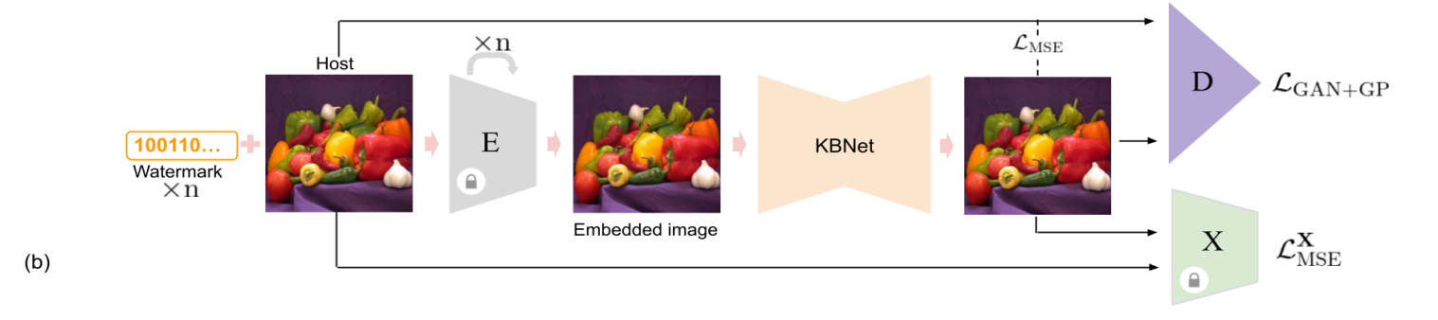
TrustMark-RM: Removal Network
The watermark removal network, TrustMark-RM, is built on the KBNet architecture featuring attention and denoising modules to cleanly remove watermarks. Its training losses include decoder consistency loss that aims to fool the extractor network, mean squared error to minimize pixel difference between original and cleaned images, and adversarial loss to maintain realistic textures after removal. This framework supports subsequent re-watermarking workflows.

Slide 8
Resolution Scaling
Though trained on fixed 256×256 inputs, TrustMark supports arbitrary resolution watermarking at inference time using residual-based scaling. The method interpolates the residual difference between embedded and original downscaled image applied to the original resolution input:
y = clamp(x + interpolate(E(x̄, w) - x̄), -1, 1).
This technique preserves watermark quality across different image sizes without re-training, making it practical for diverse real-world applications.

Slide 9
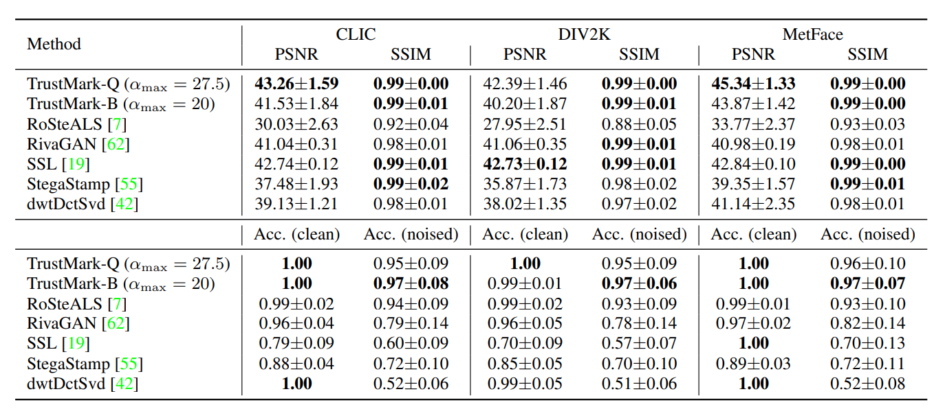
Results Summary
TrustMark was extensively evaluated on datasets including CLIC, DIV2K, and MetFace. Key metrics such as PSNR, SSIM, and bit accuracy show consistent outperformance against baseline methods. It demonstrates resilience to JPEG compression, additive noise, resizing, and adversarial attacks like I-FGSM. Additionally, TrustMark-RM proves effective in removing and enabling reapplication of watermarks, maintaining system versatility and security assurance.

