Slide 1






Multi-Model Social Media Hate Speech and Cyberbullying Detection
1. Aatman Patel 2. Darsh Shah 3. Hemil Shah 4. Pavan Pandya 5. Samruddha Deshmukh

Slide 2
Table of Contents
Introduction
Significance
Work Plan Breakdown
Project Features
Data Collection and Extraction
Data Preprocessing
Exploratory Data Analysis
Multi-Model Approaches
Feature Engineering
Evaluation and results
Conclusion

Slide 3
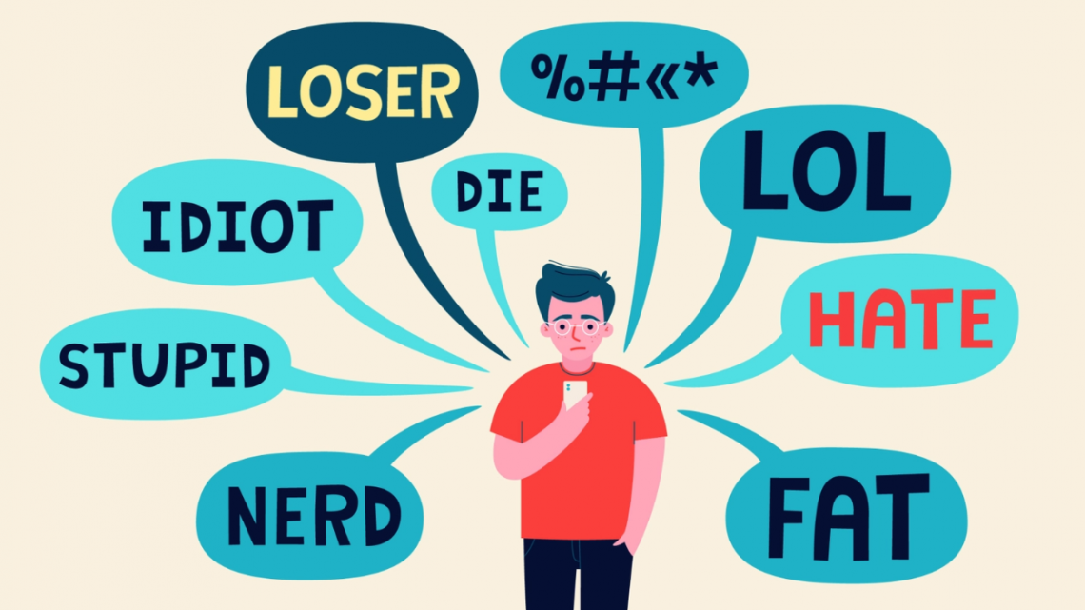
Introduction
Hate speech and cyberbullying on social media platforms like Twitter can normalize prejudice and cause psychological harm
Our project aims to address this critical issue by developing a multi-model system to accurately detect online hate speech and cyberbullying
Focuses specifically on textual content on Twitter
.

Slide 4

Significance
Addressing Growing Concerns
Impact on Mental Well-being
Impact on Mental Well-being
Technical Advancements
Social Responsibility
Contributing to Positive Online Culture
Real-world Impact
This Photo by Unknown author is licensed under CC BY-NC.

Slide 5
Work Plan Breakdown
Data Load
Data Preprocessing
Exploratory Data Analysis
Model Building
Evaluation
Interpretation of Results

Slide 6

Project Features
Dataset: Twitter Hate Speech Detection dataset and Cyberbullying Datasets from Kaggle containing over 500,000 comments (tweets, comments from various social media sites)labeled as offensive or not.
Data Cleaning: Because the size of the data was very immense and imbalanced before preprocessing we cleaned, extracted and merged the data a bit and made it down to around 200,000 tweets and comments from 500,000.
This Photo by Unknown author is licensed under CC BY.

Slide 7
Project Features
Data Preprocessing: Lowercasing, removal of URLs/handles/hashtags/punctuation, spelling correction, lemmatization
Models: SVM, Naive Bayes, Decision Trees, Logistic Regression
Features: N-grams, TF-IDF vectors, word embeddings like word2vec and GloVe, user metadata
Evaluation Metrics: Accuracy, Precision, Recall, F1-Score, ROC AUC, Confusion Matrix

Slide 8
Data Collection and Extraction
Collected over 500,000 tweets and comments from Kaggle datasets annotated as offensive or not based on criteria like directing hatred against a protected group.
Dataset comprised of 10 different datasets like Twitter Hate Speech and Cyberbullying detections.
After collecting and analyzing the datasets, found some differences and imbalance in ratio of classes between datasets.

Slide 9
Data Collection and Extraction
Extracted required columns, dropped some positive comments' rows randomly and renamed the feature names.
Finally Merged all the datasets into one final dataset, ready for the next step of Data Preprocessing.
Will investigate collecting additional Twitter data through API if needed to improve model generalization

Slide 10
Data Preprocessing
Data Cleaning:
Convert to lowercase: Normalize text by converting all characters to lowercase.
Remove URLs: Eliminate web links from the text data.
Remove user mentions: Exclude mentions of other users or handles in the text.
Remove special characters, numbers, and punctuation: Cleanse the text by removing non-alphabetic characters, digits, and punctuation marks.
Replace multiple white spaces with a single space: Ensure consistent spacing by replacing consecutive white spaces with a single space.
Tokenizing:
Removal of stop words: Enhance analysis by eliminating common words (stop words) that do not contribute significantly to the overall meaning.
Stemming: Simplify words to their root form for more effective analysis.
Lemmatization: Reduce words to their base or dictionary form, improving text normalization and analysis.

Slide 11
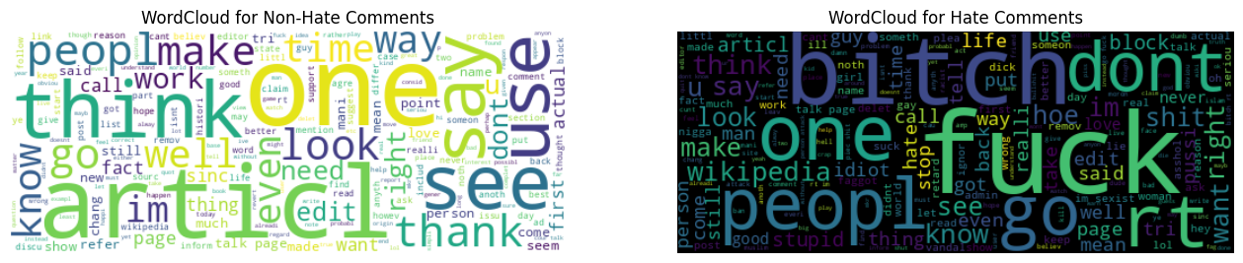
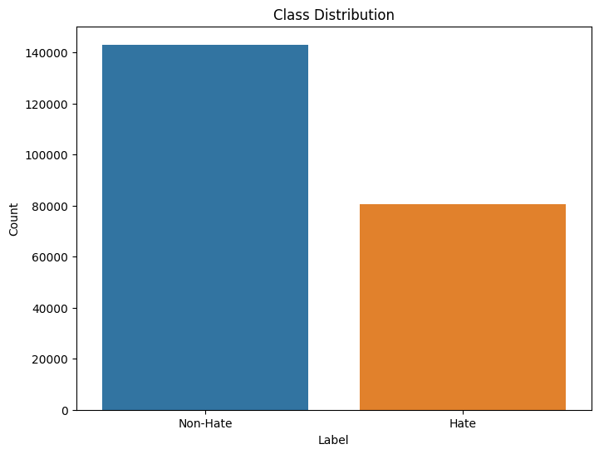
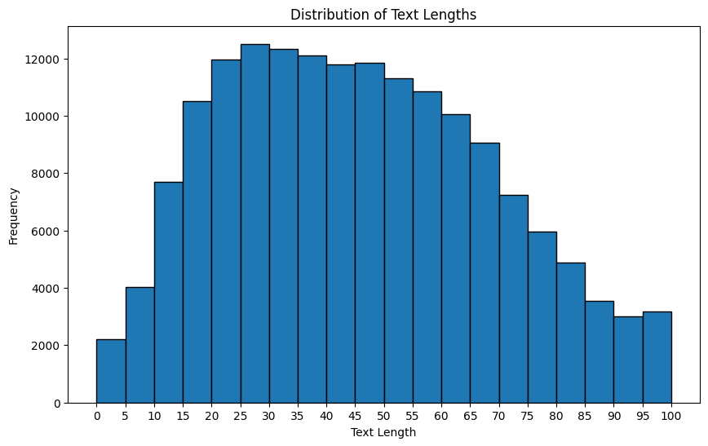
Exploratory Data Analysis

Slide 12
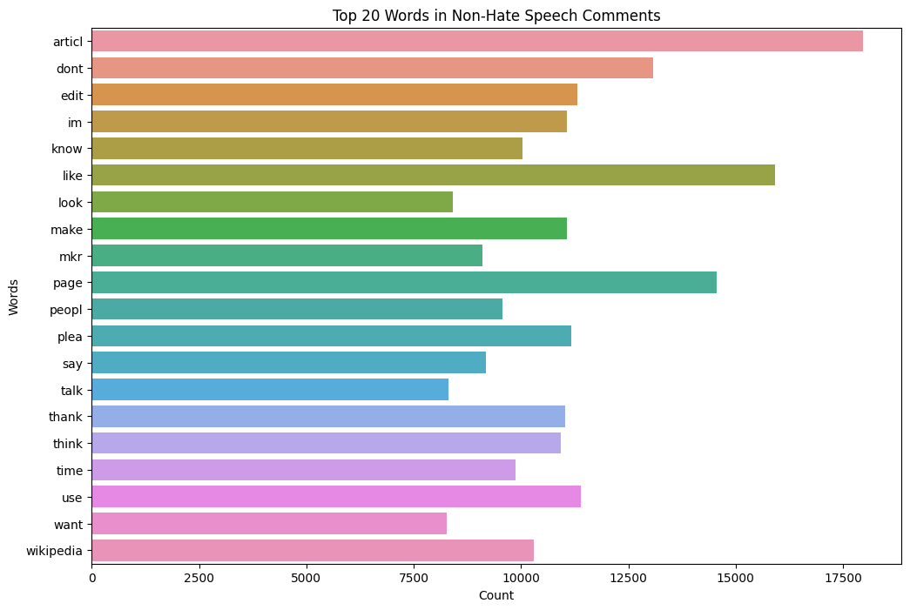
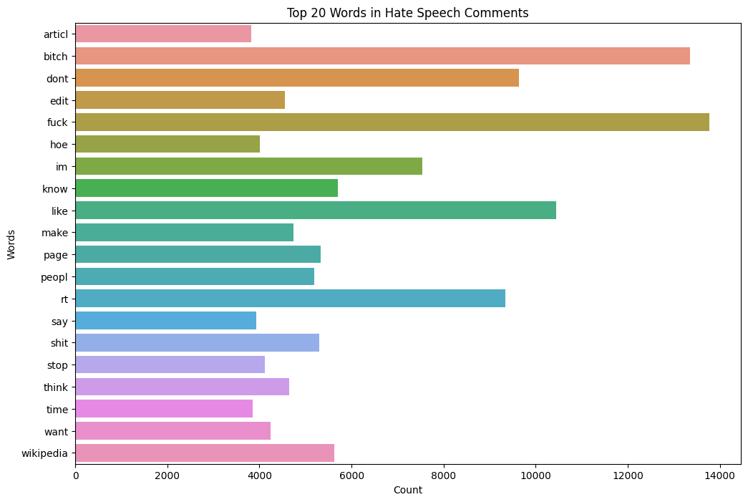
Exploratory Data Analysis

Slide 13
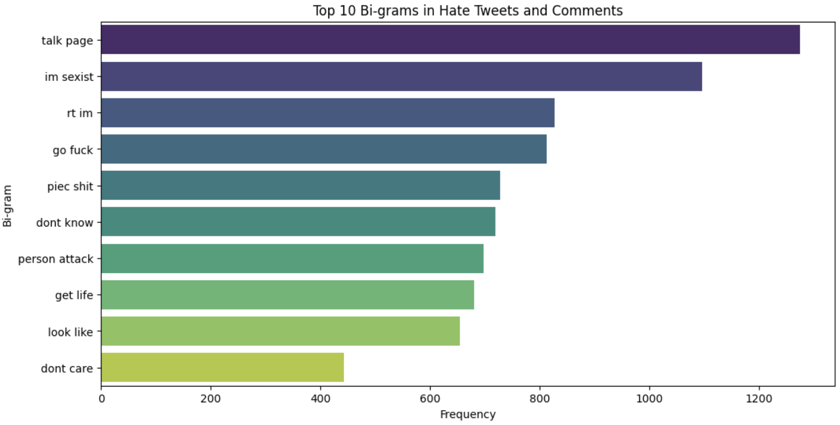
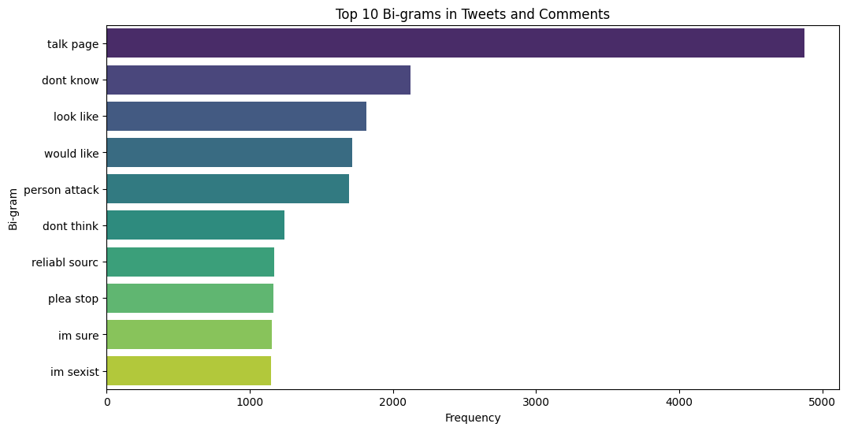
Exploratory Data Analysis

Slide 14
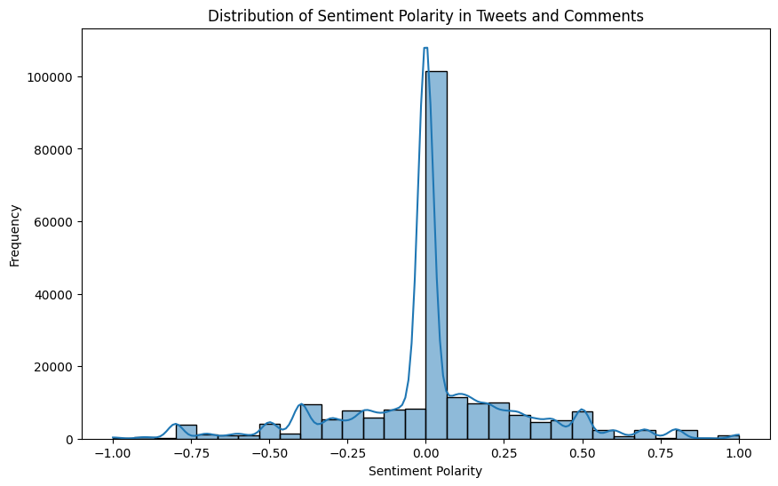
Exploratory Data Analysis

Slide 15
Multi-Model Approaches
Apply
Applied SVM, Naive Bayes and Logistic Regression models to compare performance
Use
Used vectorizer, TF-IDF, for hyperparameter tuning to optimize each model
Identify
Identified most effective model architecture: - Logistic Regression

Slide 16
Multi-Model Approaches
Model training is a technique used to extract topics from large corpus of text.
Topic modelling is used to identify the main theme present in hate speech and cyberbullying comments.
Data is split into two parts: Train, test.
The data preparation function is used to prepare data using TensorFlow.
TensorFlow creates a copy of the input dataset and extracts the target feature from it.
The data is then shuffled to avoid bias.
DS.batch() prefetches the data to optimize data loading.
English Google News 7B corpus is used for text embedding techniques
TensorFlow Keras sequential model is used for the model. INPROGRESS

Slide 17
Feature Engineering
Feature engineering is a critical step to enhance model understanding and performance.
Experimented with different features representation of comments, such as:
TF-IDF vectorization:
Sentiment analysis using TextBlob, the sentiment polarity scores are added as features
Doc2Vec to embed the processed tweets into vectors and combines these vectors with TF-IDF features and sentiment polarity scores.

Slide 18
Evaluation & Results
Evaluated the models on all the labeled test of Logistic Regression, Support Vector Machines(SVM) and Naïve Bayes Models set using:-
1. Accuracy with precision, Recall and F1-Measure.
2. ROC AUC :- Receiver Operating Characteristic Area Under the Curve
3. Confusion Matrix

Slide 19
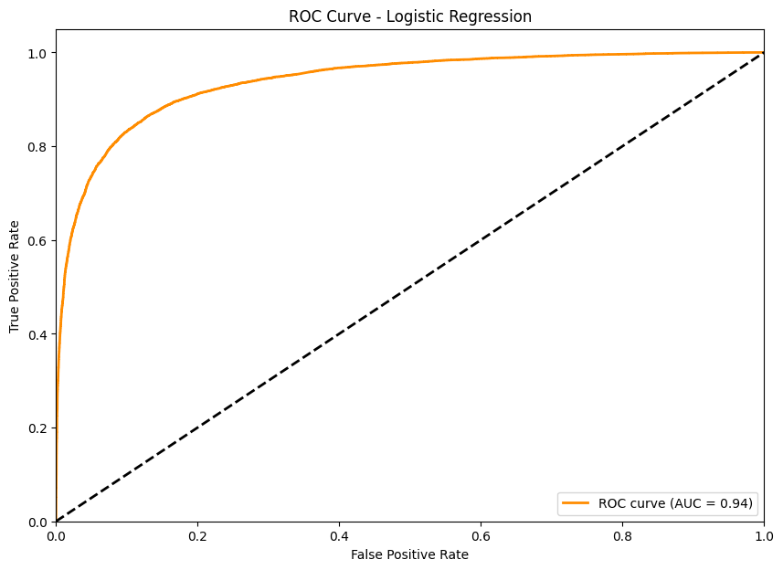
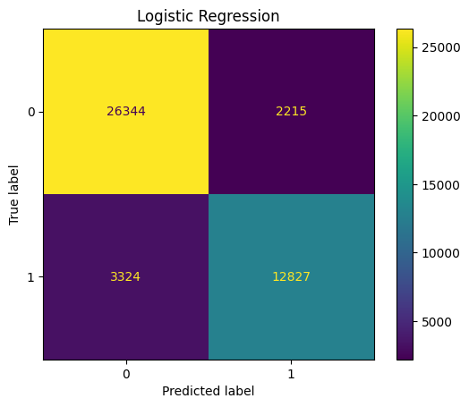
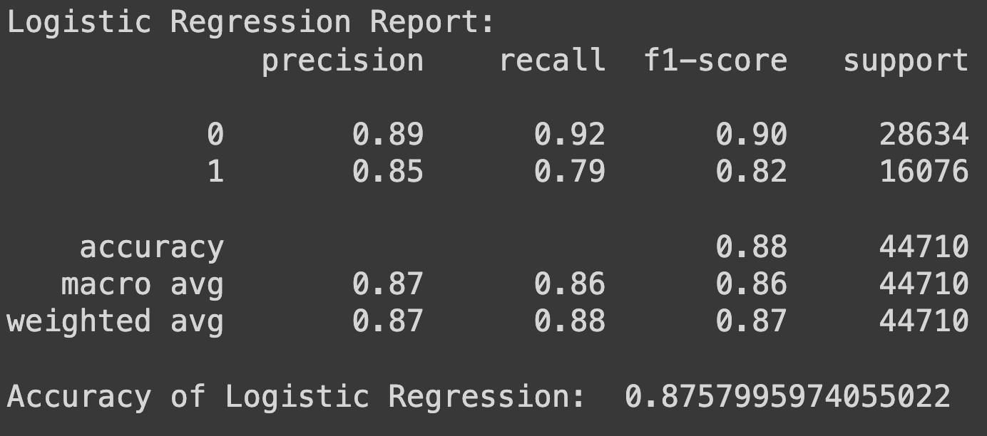
Logistic Regression Model Results

Slide 20
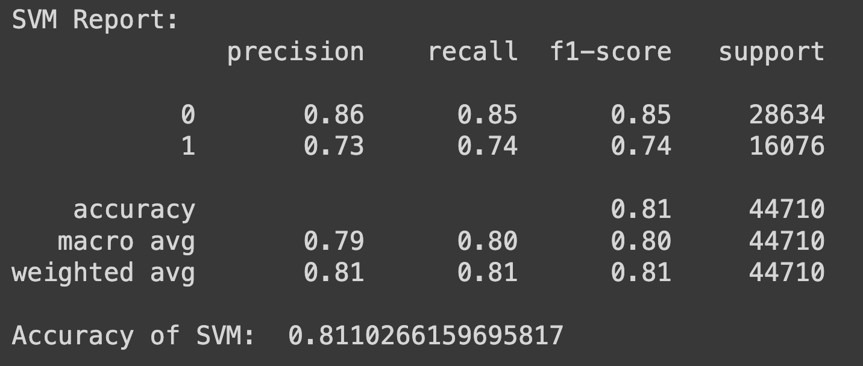
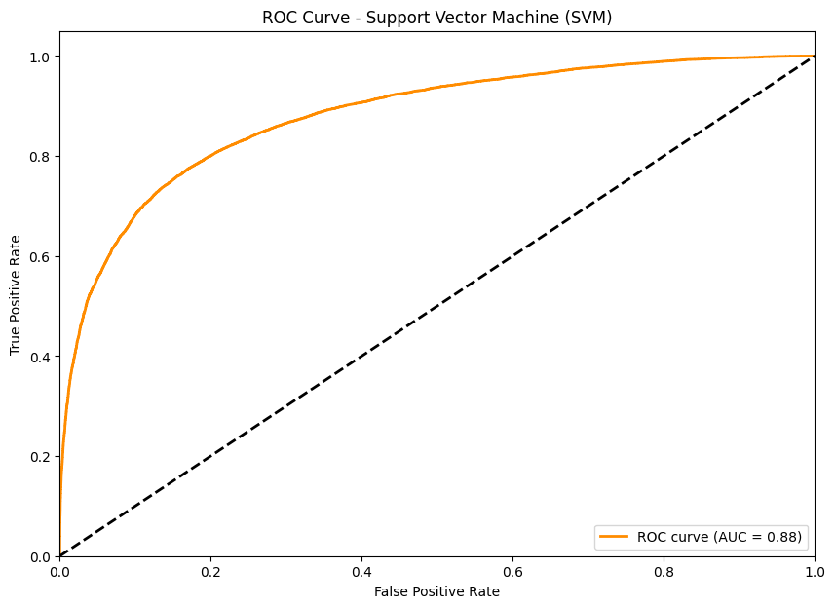

Support Vector Machine(SVM) Model Results

Slide 21
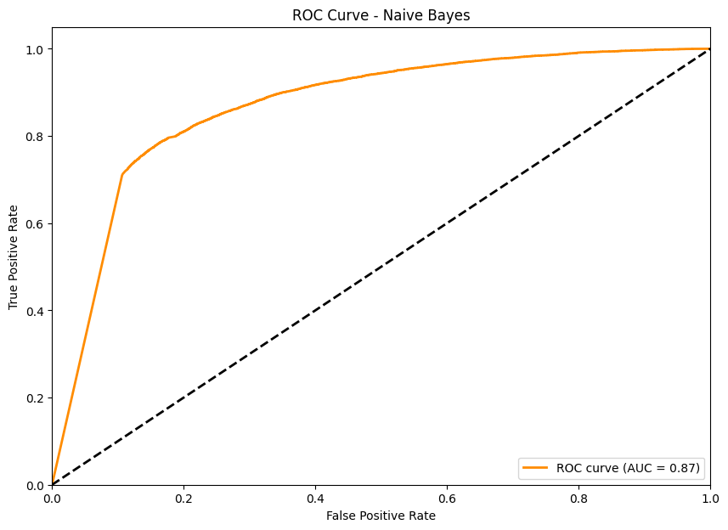
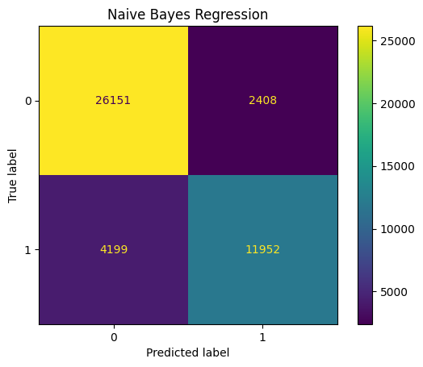
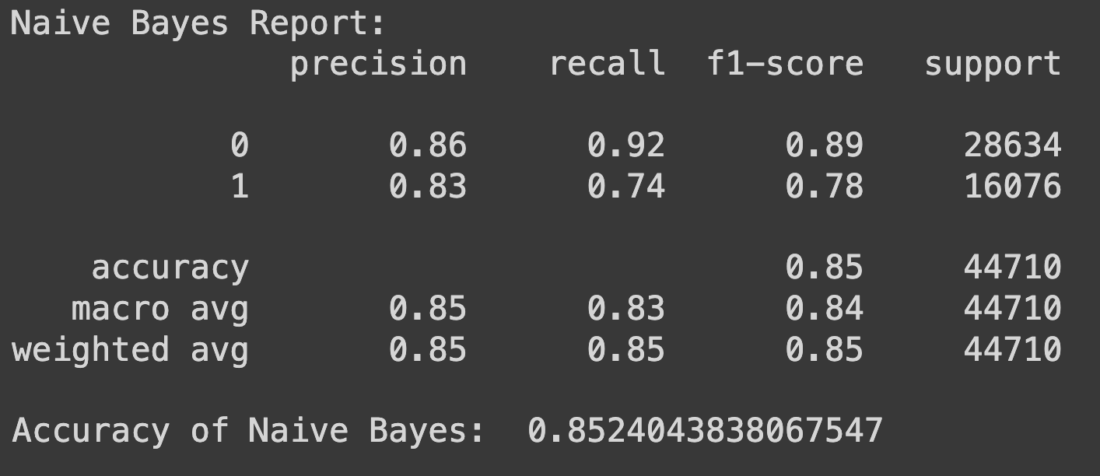
Naïve Bayes Model Results

Slide 22
Conclusion
Evaluate models on labeled test set using accuracy, ROC AUC, confusion matrix, other metrics
Perform error analysis - what tweets are hardest to classify and why?
Report comparative results, propose enhancements & future work
SAMRUDDHA

