Slide 1
Lending Club Case Study
Group Members: Pavan Srivathsa R Roopesh Kumar

Slide 2
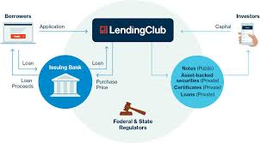
Business Understanding
Working for Lending club which specialises in lending various types of loans to customers.
Two types of risks are associated with
If the applicant is likely to repay the loan i.e a profit for the company
If the applicant is not likely to repay the loan i.e is financial loss to the company.
The aim is to identify patterns which indicate if a person is likely to default, which may be used for taking actions such as denying the loan, reducing the amount of loan, lending (to risky applicants) at a higher interest rate, etc.

Slide 3
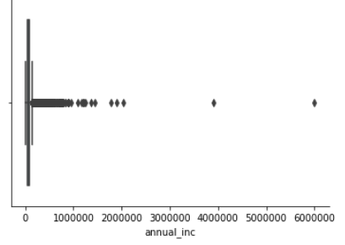
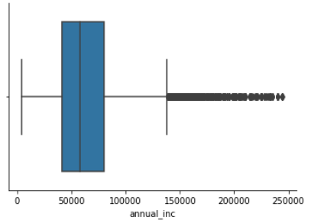
Data Cleaning
We have dropped the columns that have 100% missing values.
We have also dropped the columns that are having missing values >30%
We are left with 37 columns for analysis.
Outliers are also removed.

Slide 4
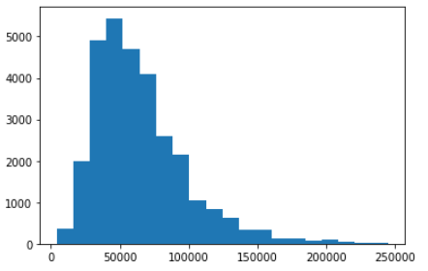
Univariate Analysis
Analysis of each column individually.
Analysis of Annual Income It is noticed that most of the customers are from the 50,000 Rs.
Annual income Range

Slide 5
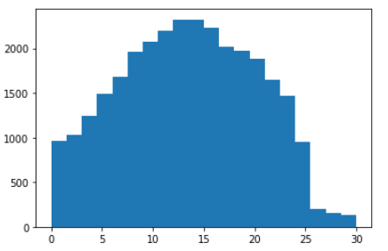
Analysis of debt to income ratio
Most of the customers are from the range 10-20

Slide 6
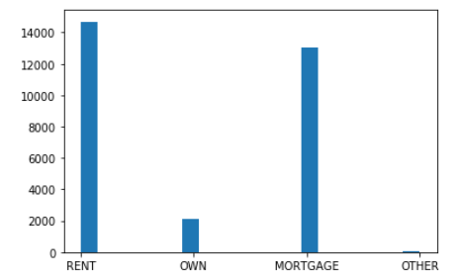
Analysis of Home Ownership
Most of the customers who apply for loans either have rented homes
and mortgaged homes

Slide 7
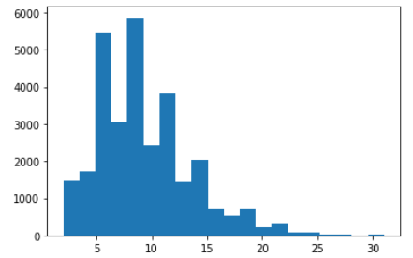
Analysis of Open_accounts
It is observed that most customers have 10 open accounts

Slide 8
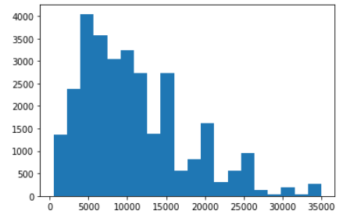
Analysis of Loan_amount
Most of the customers have loans in 5,000 Rs. Range

Slide 9
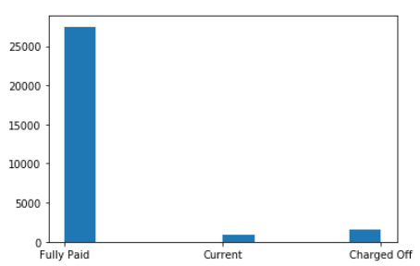
Analysis of Loan Status
Some of the customers have been charged off

Slide 10
Segmented univariate Analysis
The broad agenda of “Segmented Univariate Analysis” is as follows:
Basis of segmentation
Comparison of averages
Comparison of other metrics

Slide 11
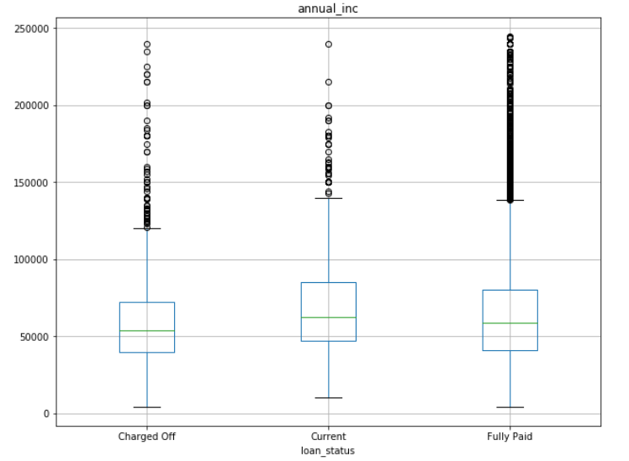
The annual incomes vs loan status.
There is not much variation in the meadian of

Slide 12
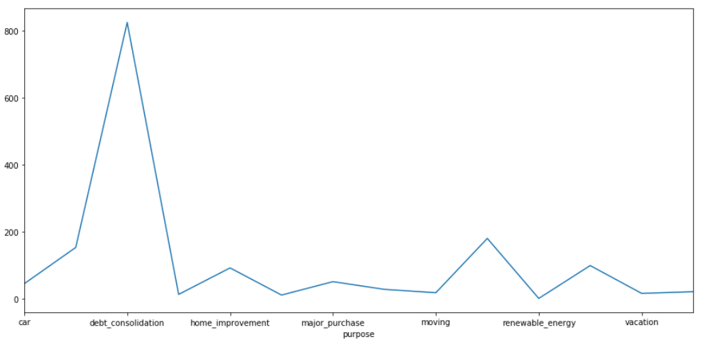
According to this graph we notice that customers who have debt consolidation are
More likely to default on their debt

Slide 13
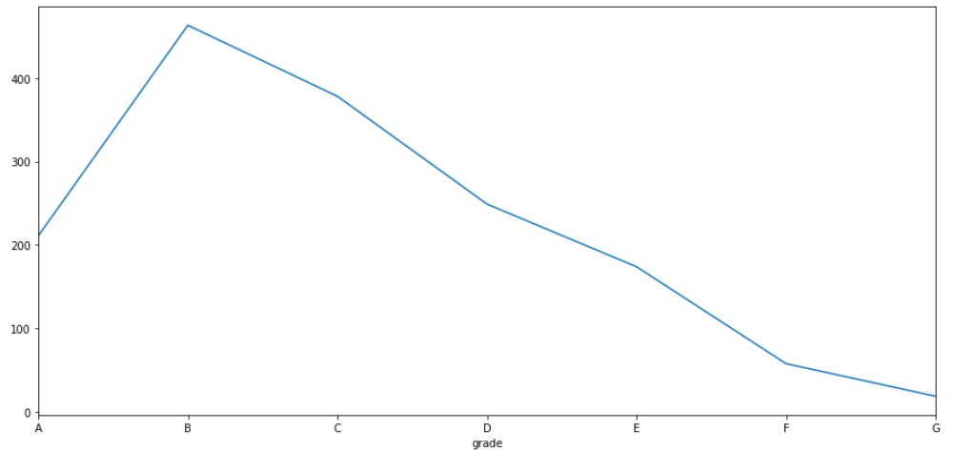
It is Observed that the customers with high graded loans default
on their loans more

Slide 14
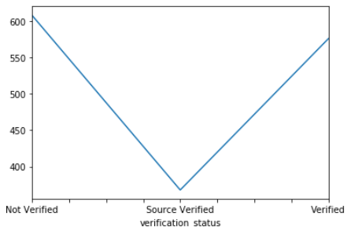
It is observed that customers who have source verified status are least likely
To dafault on their loans

Slide 15
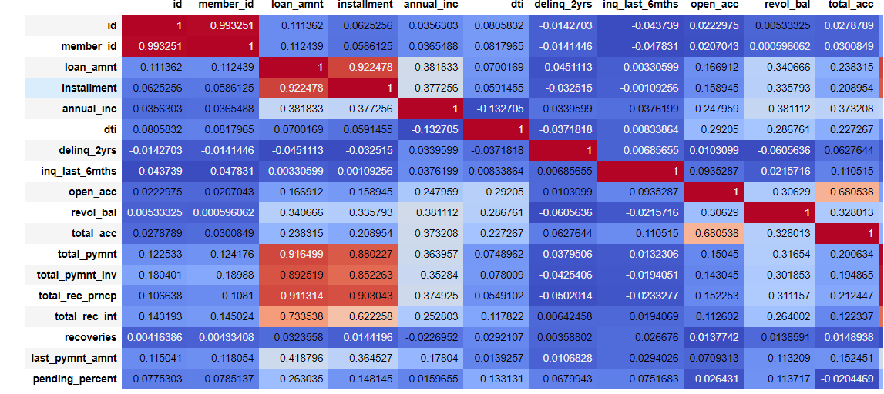
Bi-variate Analysis
We have plotted the correlation matrix

Slide 16
These are the insights we have got after the observing the trends in the
Correlation matrix
It is oberseved that open_acc and dti are positively correlated¶
it is observed that revolving balance and load amount are positively correlated
it is observed that total account and dti are positively correlated

Slide 17
Conclusion
Based on how the various attributes like dti , pending_percent(derived column)
We observe the various trends and the customers who most likely are the default
On their loans and are going to cause financial loss the lending club.
Thank You.

