Slide 1


Employee Management System

Slide 2
About me:
NAME :Pavan Teja Vinukollu
EDUCATION: B.TECH (IT)
PROFILE:
LINKEDIN :
https://www.linkedin.com/in/pavan-teja-vinukollu-a2452a272/

Slide 3
OBJECTIVE OF THE PROJECT :
To manage employee information such as personal details, job departments, qualifications, and contact information efficiently.
To manage salary and bonus details and calculate payroll accurately for employees.
To track employee leaves and maintain proper records of leave dates and reasons.
To generate useful reports and insights about employees, qualifications, salaries, bonuses, leaves, and payroll using SQL queries.

Slide 4
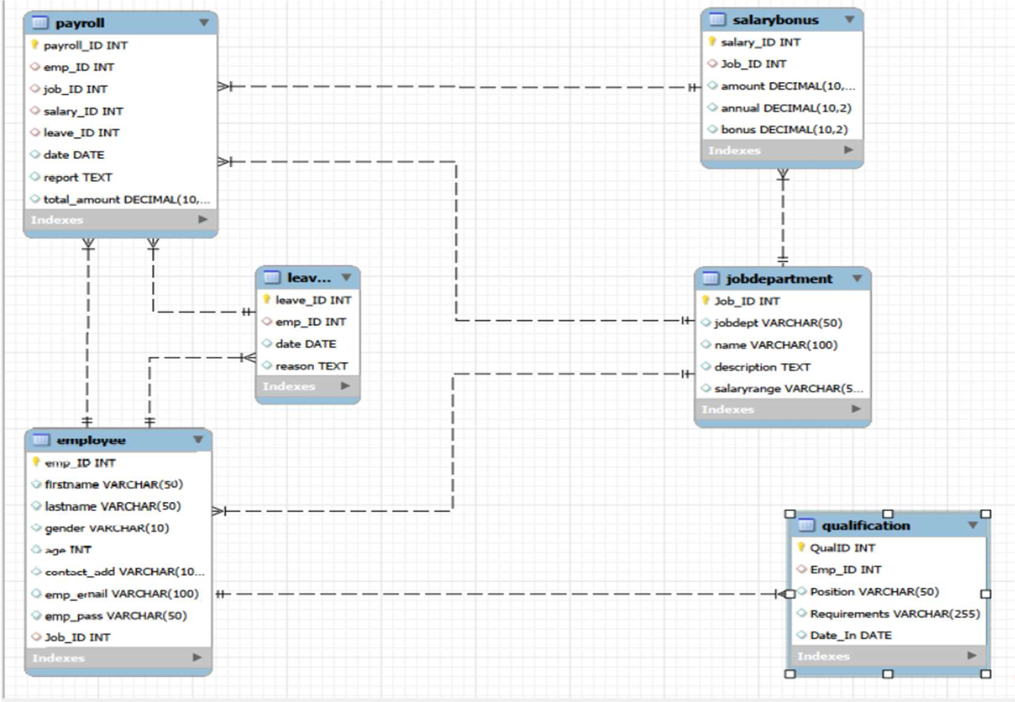
ER Diagram:

Slide 5
ER DIAGRAM HIGHLIGHTS
The ER diagram represents the Employee Payroll Management System.
Employee is the central entity containing employee details.
JobDepartment stores job roles, departments, and job descriptions.
SalaryBonus maintains salary, annual pay, and bonus information.
Qualification records the qualifications of each employee.
Leaves stores employee leave dates and reasons.
Payroll connects employee, job, salary, and leave information.
Primary and foreign keys establish relationships and maintain data integrity.

Slide 6
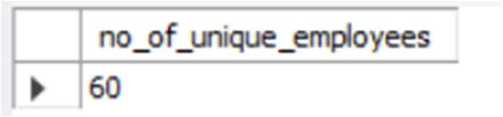
1. Employee Insights
Question 1: How many unique employees are currently in the system?
SQL QUERY :
OUT PUT :
INSIGHT:
Counts the total number of unique employees currently.

Slide 7
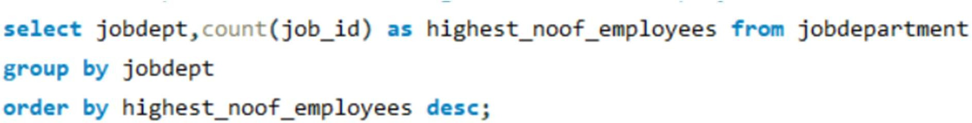
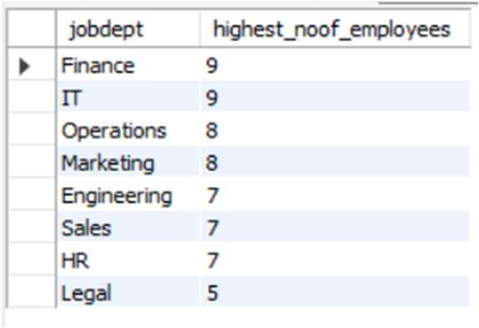
QUESTION 2.
Which departments have the highest number of employees ?
SQL QUERY :
OUT PUT :
INSIGHT:
Identifies departments with the largest employee workforce.

Slide 8
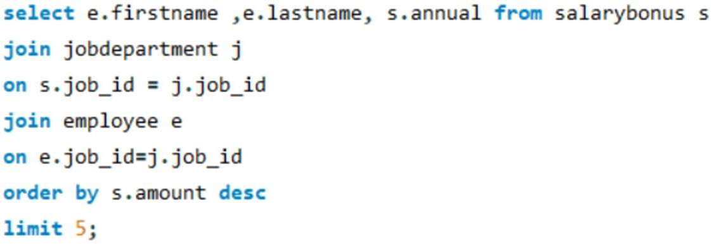
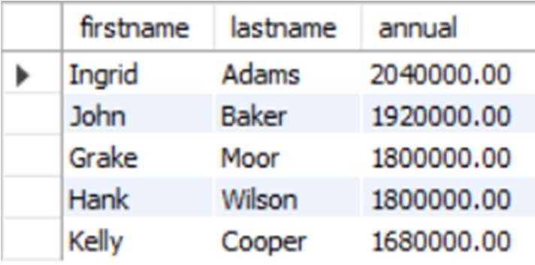
Question 3.
Who are the top 5 highest-paid employees?
SQL QUERY :
OUT PUT :
Insight:
Identifies the top 5 highest-paid employees based on salary amount.

Slide 9
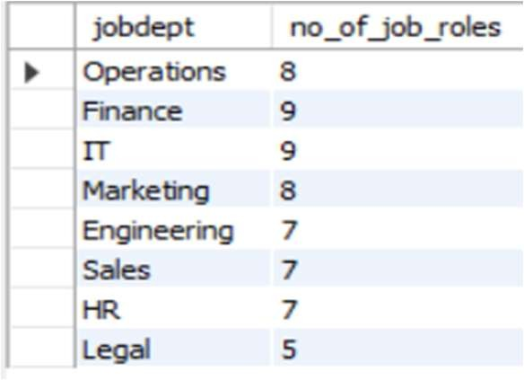
2. Job Role and Department Analysis Question 4.
How many different job roles exist in each department?
SQL QUERY :
OUT PUT :
Insight:
Identifies the number of distinct job roles available within each department.

Slide 10
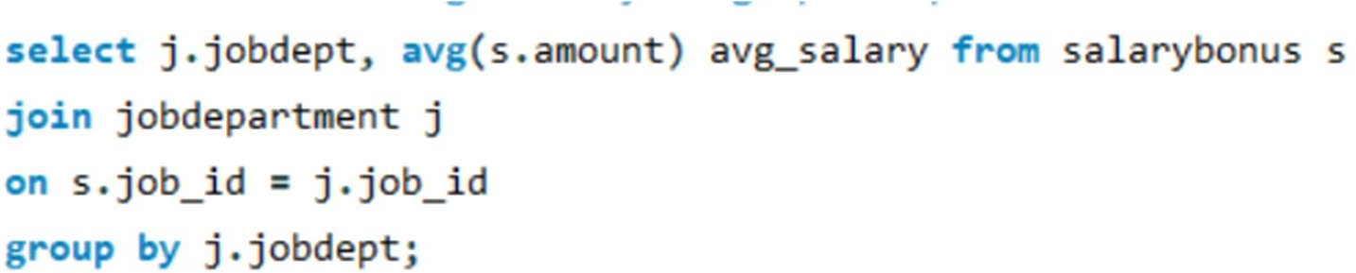
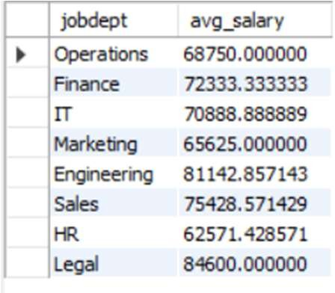
Question 5. What is the average salary range per department?
SQL QUERY :
OUT PUT :
Insight: Calculates the average salary value for each department, helping compare typical salary levels across departments..

Slide 11
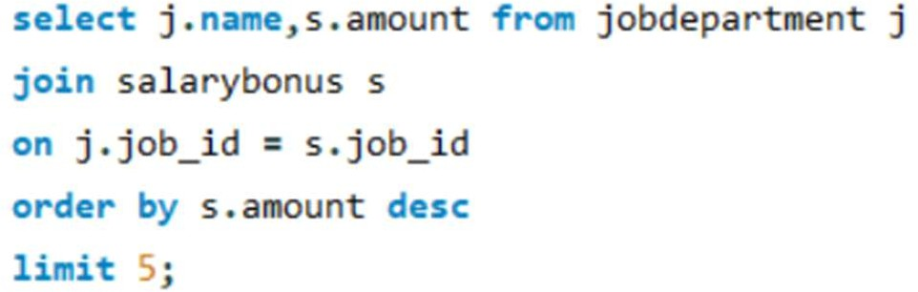
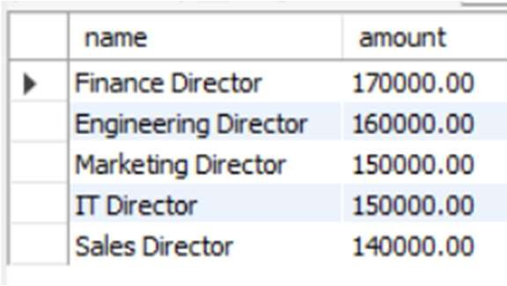
Question 6. Which job roles offer the highest salary?
SQL QUERY :
OUT PUT :
Insight:
Identifies job roles offering the highest salaries, enabling comparison of the most lucrative positions.

Slide 12
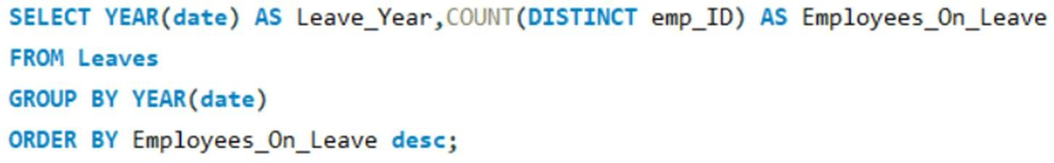

3. Leave and Absence Patterns
Question 7. Which year had the most employees taking leaves? SQL QUERY :
OUT PUT :
Insight: Identifies the year with the highest number of employees taking leave, helping analyze annual leave trends.

Slide 13
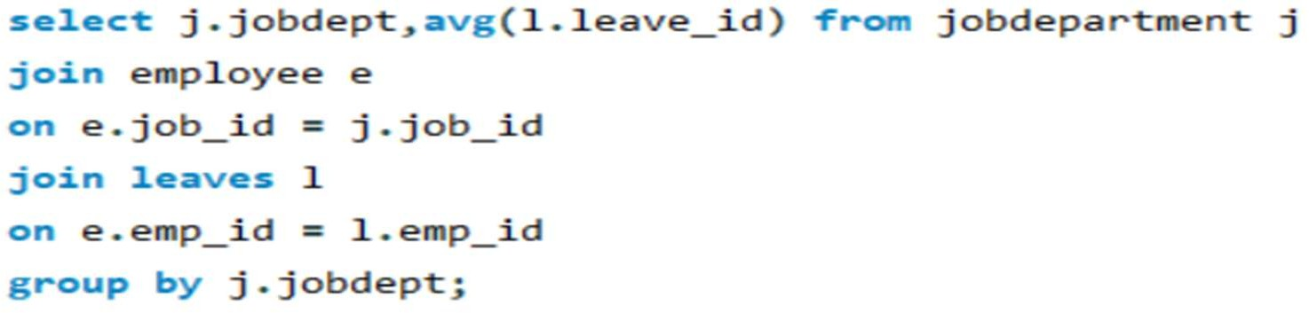
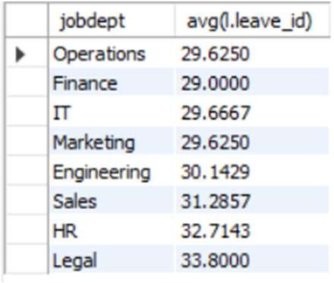
Question 8.
What is the average number of leave days taken by its employees per department?
SQL QUERY :
OUT PUT :
Insight:
Measures the average leave days taken by employees in each department, helping compare leave patterns across departments.

Slide 14
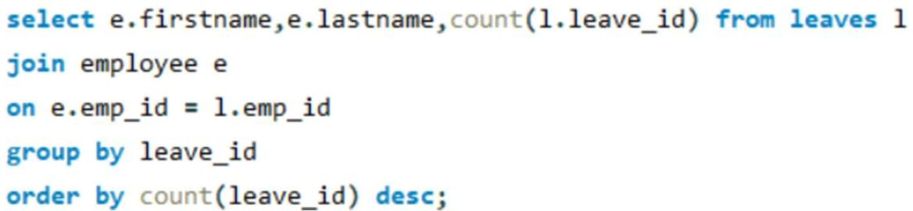
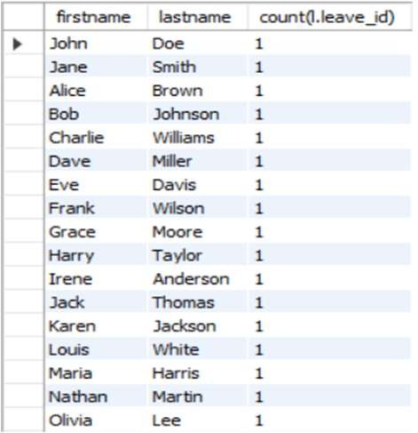
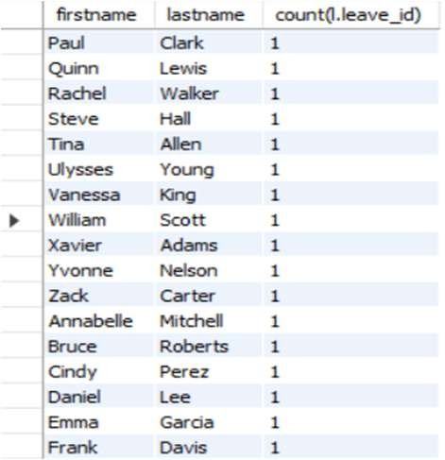
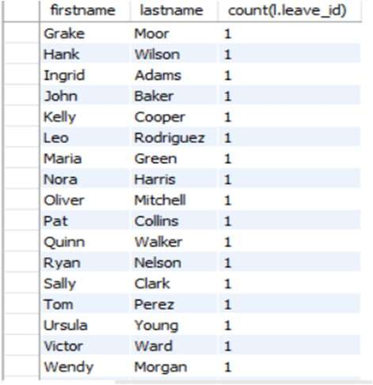
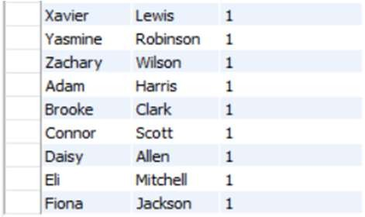
Question 9.
Which employees have taken the most leaves?
SQL QUERY :
OUT PUT :
Insight:
Identifies employees with the highest number of leave records, highlighting frequent leave takers.

Slide 15
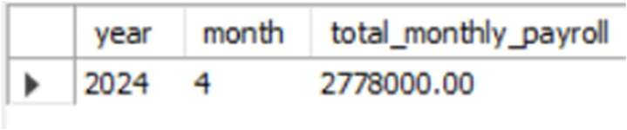
5. PAYROLL AND COMPENSATION ANALYSIS
Question 10.
What is the total monthly payroll processed? SQL QUERY :
OUT PUT :
Insight:
Calculates the total payroll processed each month, helping monitor salary expenses and monthly payroll trends.

Slide 16
FINAL BUSINESS INSIGHTS
The system provides a clear overview of employee distribution across departments and job roles.
Salary analysis identifies high-paying job roles and top-paid employees.
Qualification data highlights employees and positions requiring greater professional expertise.
Leave analysis helps identify frequent leave patterns and departmental leave trends.
Payroll analysis tracks monthly salary expenses and overall payroll processing.
These insights support better workforce planning, salary management, and decision-making.

Slide 17
CHALLENGES :
Managing relationships between multiple tables while maintaining data integrity.
Handling employee salary, bonus, leave, and payroll data accurately.
Writing complex SQL queries to generate meaningful business insights.
Avoiding duplicate records and ensuring accurate calculations in reports.

Slide 18
CONCLUSION:
The Employee Payroll Management System successfully organizes employee, department, qualification, salary, leave, and payroll information in a structured database.
SQL queries help analyze employee performance, salary distribution, leave patterns, bonuses, and monthly payroll, providing useful business insights.
Overall, the project demonstrates how database management and SQL can improve data accuracy, reporting, workforce planning, and effective decision-making.

Slide 19

THANK YOU

