Slide 1

Cyberbullying Detection Across Social Media Platforms: A Two-Tier Hate Speech Detection System Using SVM and BERT with Confidence-Based Routing
Presented By Batch-C5
V.Sai Pavan- 22481A12H4 N.Teja - 23485A1216
Y.Nitya Sri- 22481A12I9 T.P. Santhosh -234851A1220
Under Guidance Of:
Mrs. A. Koteswaramma, M.Tech(Ph.D).
Assistant Professor
Department of Information Technology
SESHADRI RAO GUDLAVALLERU ENGINEERING COLLEGE
(An Autonomous Institute with Permanent Affiliation to JNTUK, Kakinada)
Seshadri Rao Knowledge Village, Gudlavalleru – 521356, Krishna District

Slide 2
CONTENTS
Abstract
Introduction
Objectives
Existing System
Proposed System
System Requirements
Design and Methodology Diagrams
Results
Conclusion

Slide 3
Abstract
Cyberbullying and hate speech on social media pose serious risks to user safety and mental health, demanding more advanced detection methods than traditional keyword-based or rule-driven systems. This project presents a comprehensive framework that integrates machine learning, natural language processing, and deep learning—particularly transformer-based models like BERT(Bidirectional Encoder Representations from Transformers)—to automatically identify harmful content in tweets with improved contextual understanding. To overcome challenges such as informal language, sarcasm, imbalanced datasets, and limited labeled data, the system employs data augmentation and active learning strategies. It further extends detection capabilities through multilingual support, sentiment and emotion analysis, and user behavior modeling to capture patterns of repeated harassment. Emphasizing transparency and ethical considerations, the approach ensures interpretability and accountability, resulting in a scalable, adaptive, and reliable solution that fosters safer online communities.

Slide 4
Introduction
With the rapid growth of social media platforms, cyberbullying and hate speech have become pressing issues, threatening users’ mental health and online safety. Traditional detection systems are often keyword-based or rule-driven, which makes them less effective in handling informal language, sarcasm, or evolving abusive patterns. This project proposes using Machine Learning (ML) and Natural Language Processing (NLP) to automatically detect cyberbullying in real time. Ensemble models such as Random Forest and advanced deep learning architectures, including transformer-based models like BERT, are applied to capture the context and intent behind harmful posts. To improve robustness, techniques like data augmentation and active learning address challenges such as data imbalance and limited labeled datasets. The system is further extended to support multilingual detection, sentiment and emotion analysis, and user behavior modeling. By integrating explainable AI, the framework ensures transparency and trust, while a proposed real-time deployment on social media platforms and browser extensions enables proactive intervention. Together, these methods create a scalable, adaptive, and trustworthy solution for building safer online communities.

Slide 5
Objectives
To develop an automated system for detecting cyberbullying and hate speech in social media posts, with a primary focus on tweets.
To compare the performance of traditional supervised machine learning classifiers with ensemble methods for cyberbullying detection.
To explore deep learning and transformer-based models (e.g., BERT) for improved contextual understanding and detection accuracy.
To address key challenges such as informal language, sarcasm, data imbalance, and scarcity of high-quality labeled datasets using advanced techniques like data augmentation and active learning.
To extend detection capabilities to multilingual text, sentiment and emotion analysis, and user behavior modeling for identifying repeated harassment patterns.
To design a real-time detection framework that can be integrated into social media platforms and browser extensions for proactive intervention.

Slide 6
Existing System
Traditional hate speech and bullying detection relied on manual moderation or simple keyword filters.
Some studies used linear classifiers like Gaussian Naive Bayes, Logistic Regression, Decision Tree with moderate results but lacked scalability and context understanding.
Limited use of ensemble models and social/network features in earlier systems.

Slide 7
Proposed System
The proposed system leverages advanced Machine Learning (ML), Natural Language Processing (NLP), and Deep Learning techniques to detect cyberbullying and hate speech more effectively than traditional methods. Instead of relying on simple keyword filters or linear models, the system applies:
SVM (Support Vector Machines) for higher accuracy and scalability.
Deep Learning and Transformer-based architectures (e.g., BERT) to capture semantic meaning, sarcasm, and contextual relationships in text.
Data augmentation to address data imbalance and enhance model robustness.
Multilingual support for handling diverse user communities.
Sentiment and emotion analysis combined with user behavior modeling to detect repeated harassment patterns.
Real-time detection framework integrated with social media platforms or browser extensions for proactive intervention.

Slide 8
System Requirements
Hardware: Processor (i5 or higher), 8GB+ RAM, GPU (for DL), storage.
Software: Python, TensorFlow/PyTorch, scikit-learn, NLP libraries (NLTK, spaCy, Transformers).
Development Tools: Jupyter Notebook, PyCharm/VS Code, APIs for data collection (Twitter API)

Slide 9
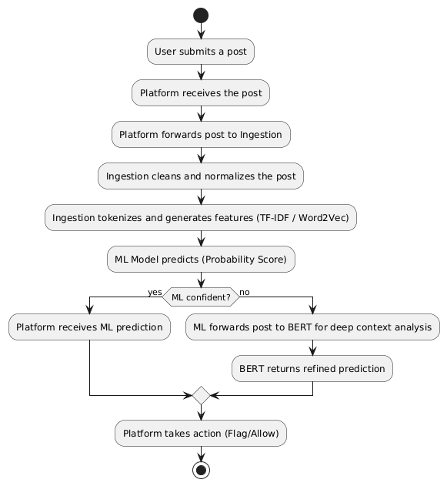
Design and Methodology Diagrams
System Work Flow:

Slide 10
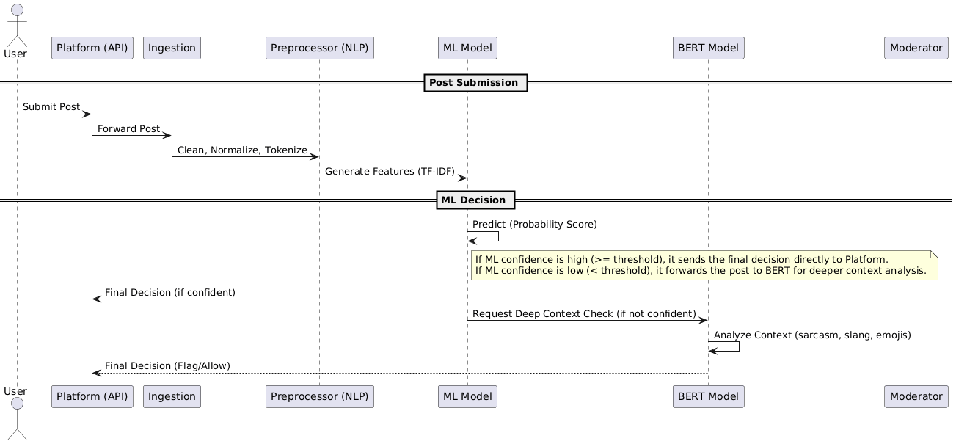
Sequence Diagram

Slide 11
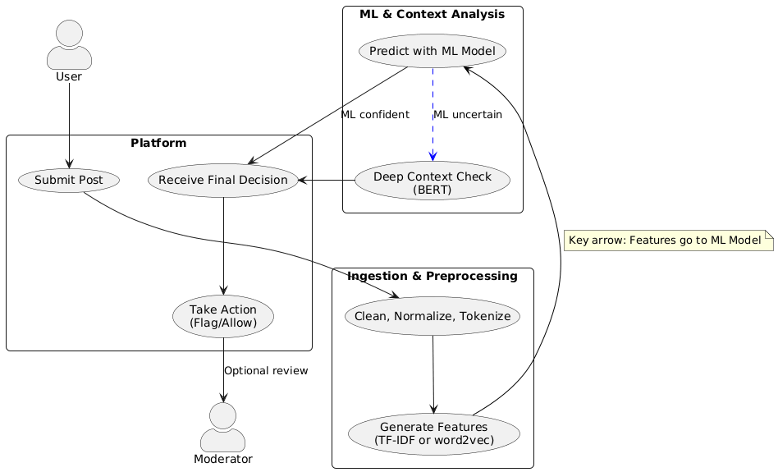
Use Case Diagram

Slide 12
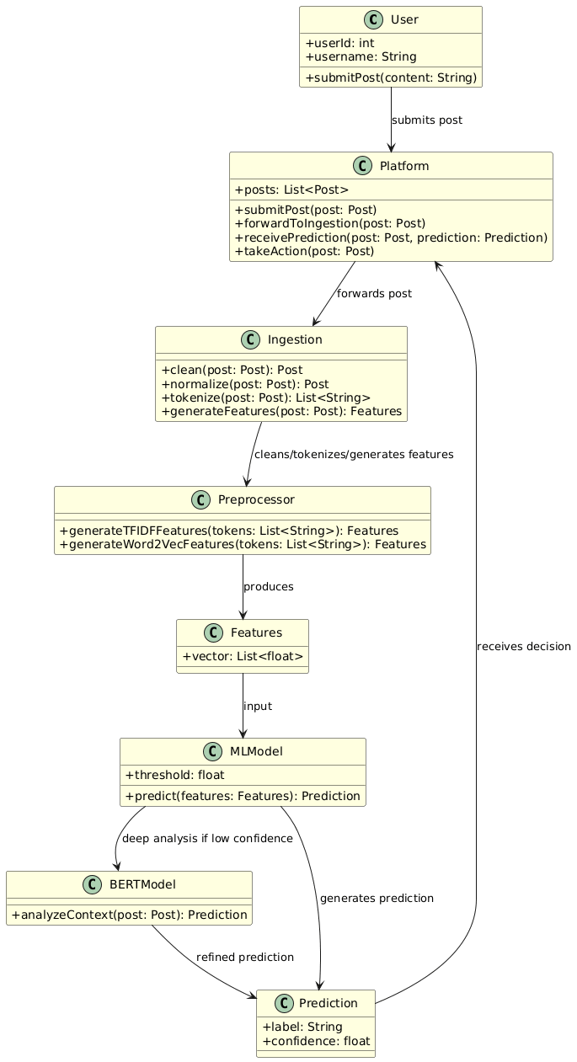
Class Diagram

Slide 13
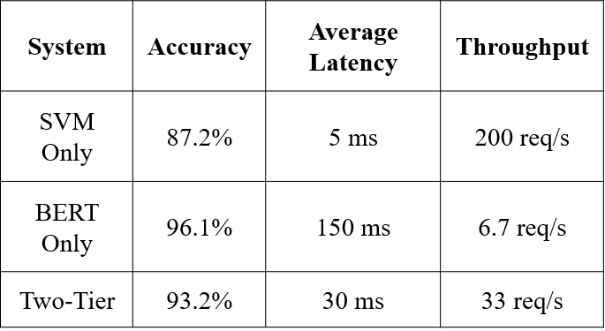
Results
The proposed two-tier hate speech detection system achieved 93.2% accuracy while maintaining moderate latency of 30 ms and a throughput of 33 requests per second.
Compared with single-model baselines, the SVM-only system delivered the fastest response at 5 ms with 200 requests per second but lower accuracy of 87.2%, while the BERT-only system achieved the highest accuracy of 96.1% at the cost of much higher latency of 150 ms and low throughput of 6.7 requests per second

Slide 14
conclusion
Proposed a confidence-aware two-tier hate speech detection system that combines an SVM classifier with a BERT model to balance high accuracy and low inference latency for real-time moderation.
Used a confidence-based routing strategy in which clear inputs are handled by the lightweight SVM, while uncertain inputs are forwarded to BERT for deeper contextual analysis.
Achieved performance close to a BERT-only system while significantly reducing latency and improving throughput, making the framework suitable for large-scale real-time deployment.
Showed that most inputs can be classified reliably by the fast first tier, while selective escalation improves detection of ambiguous and minority-class hate speech, providing a practical and scalable production-ready solution.

Slide 15
Thank You

