Slide 1



project1@hr
View in Power BI
Last data refresh:
2/1/2024 11:36:53 AM UTC
Downloaded at:
3/10/2024 3:51:06 AM UTC

Slide 2
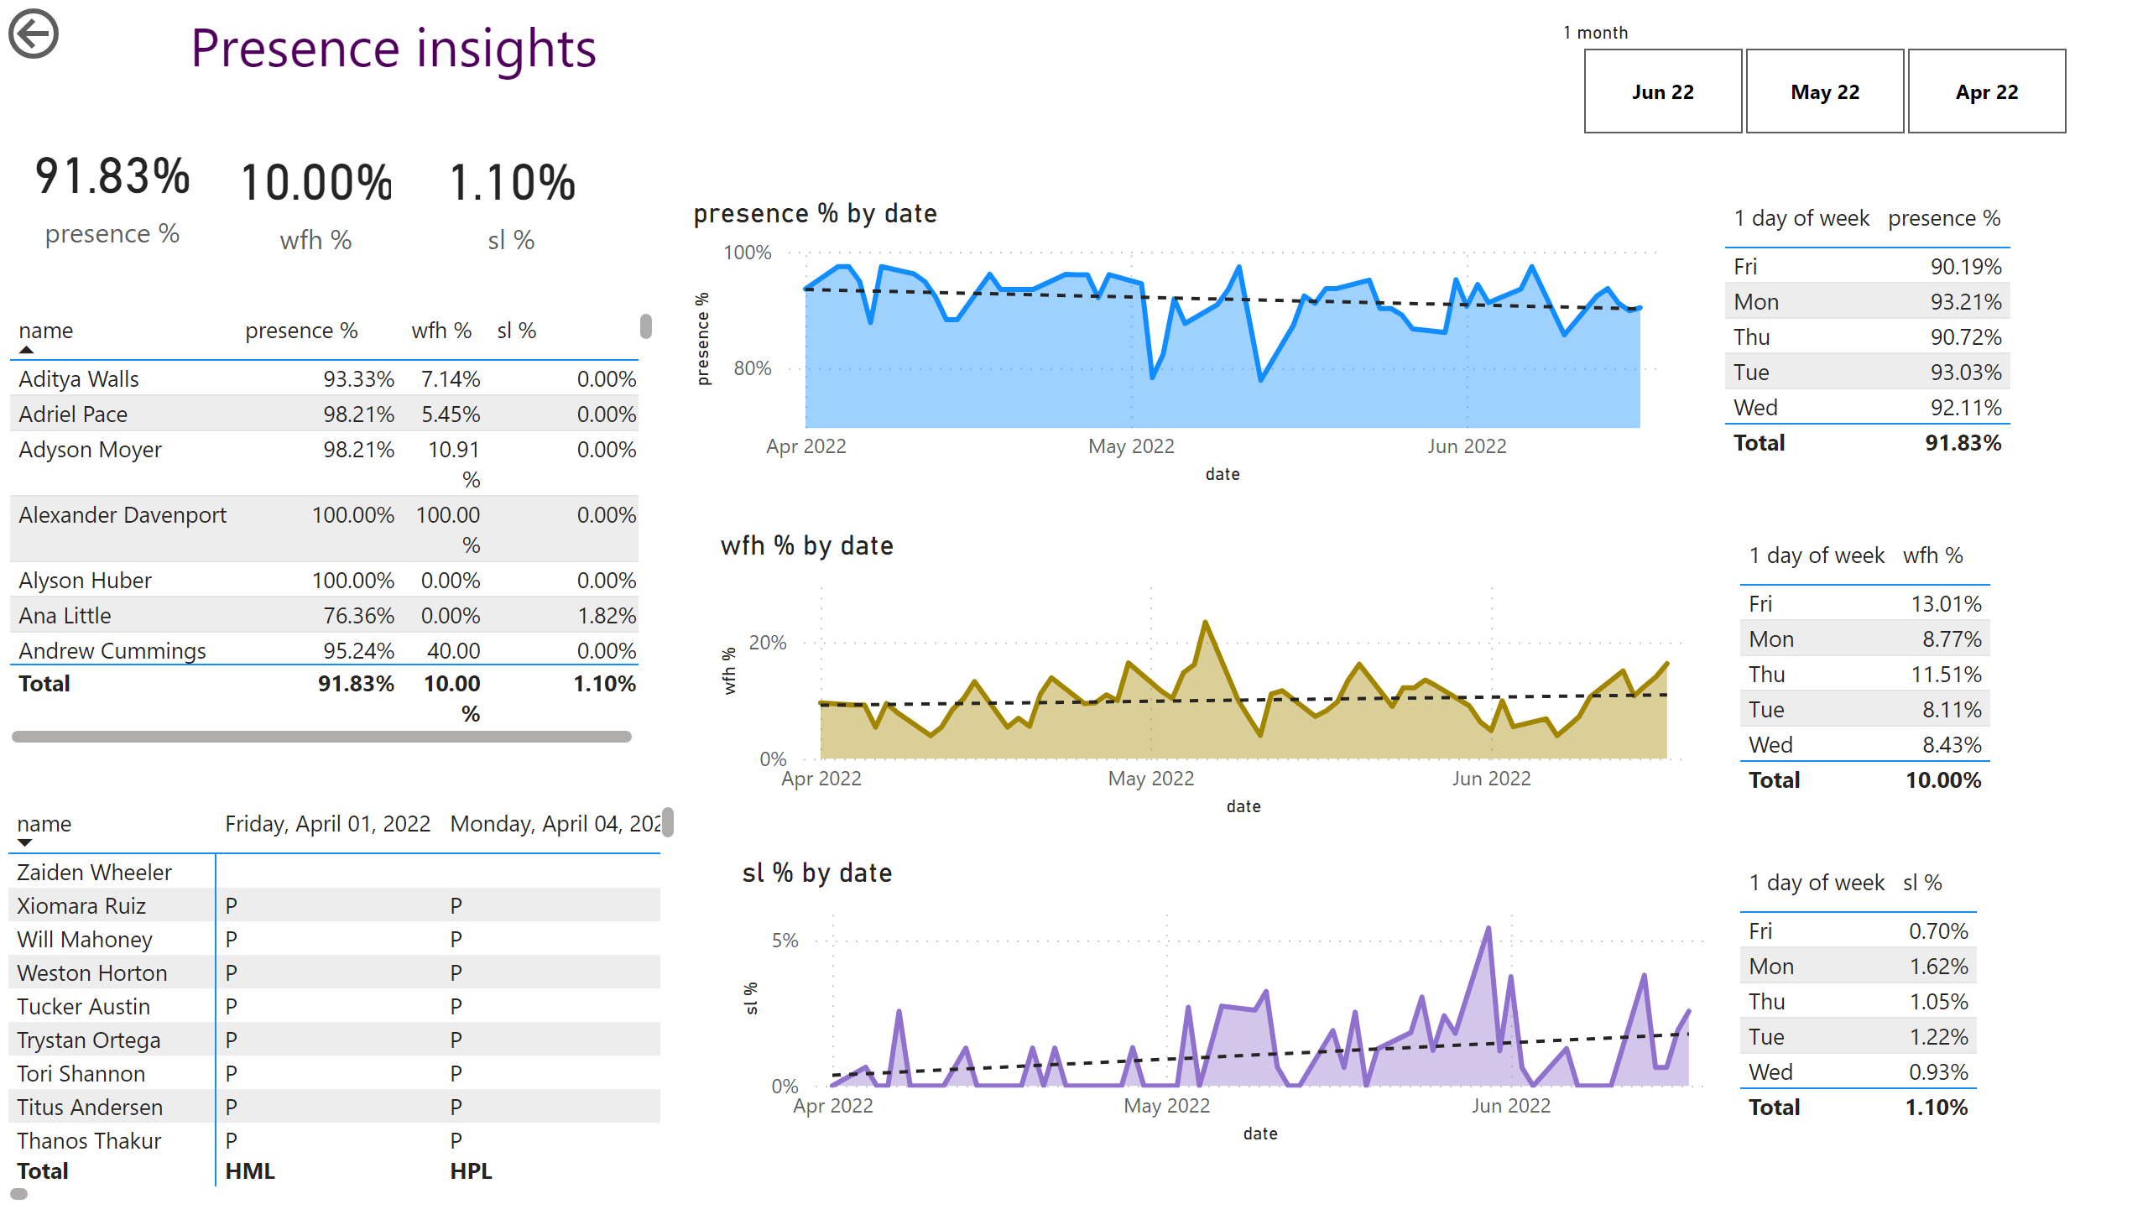
Page 1
Notes:
tableEx
No alt text provided
tableEx
No alt text provided
tableEx
No alt text provided
areaChart
No alt text provided
areaChart
No alt text provided
areaChart
No alt text provided
actionButton
No alt text provided
pivotTable
No alt text provided
textbox
No alt text provided
card
No alt text provided
card
No alt text provided
card
No alt text provided
tableEx
No alt text provided
slicer
No alt text provided

