Slide 1
Gen AI

Slide 2
Rule-Based Systems
Definition: Hand-crafted rules (e.g., regex) for text processing.
Purpose: Early Chatbots, text filtering.
Example: Filtering "urgent" emails in IT support.
Code: if re.search(r"urgent", text): print("Priority")
Relevance: Historical context, replaced by neural models.

Slide 3
Context-Free Grammars
Definition: Formal grammars for syntactic structure.
Purpose: Sentence parsing, early NLP systems.
Example: Parsing "The cat runs" for grammar rules.
Relevance: Foundational, now niche.

Slide 4
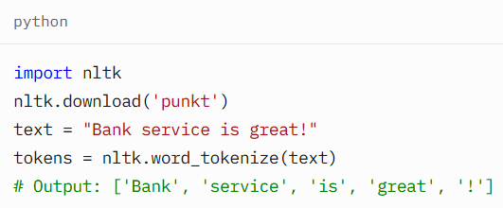
Tokenization
Definition: Splitting text into tokens (words, subwords).
Types: Word-based, character-based, subword (later in transformers).
Example: Tokenizing "Bank service is great!" for BFSI sentiment analysis.

Slide 5
Stemming
Definition: Reducing words to root (e.g., "running" → "run").
Purpose: Normalize text for search.
Example: "Cancers" to "cancer" in healthcare search.
Code: PorterStemmer().stem("running")
# Output: run
Relevance: Basic preprocessing, less used.

Slide 6
Lemmatization
Definition: Converting to dictionary form (e.g., "better" → "good").
Purpose: Accurate normalization.
Example: "Ran" to "run" in IT logs.
Code: WordNetLemmatizer().lemmatize("better", pos="a") # Output: good
Relevance: Preprocessing, less critical.

Slide 7
Stop Words
Definition: Removing common words (e.g., "the", "is").
Purpose: Reduce noise.
Example: Filtering "the" from BFSI reviews.
Code: stopwords.words('english')
Relevance: Basic, less relevant for modern NLP.

Slide 8
N-grams
Definition: Sequences of n words (e.g., bigrams: "bank service").
Purpose: Capture local context.
Example: "Good service" in BFSI reviews.
Code: nltk.ngrams(word_tokenize(text), 2)
Relevance: Early context tool, now less used.

Slide 9
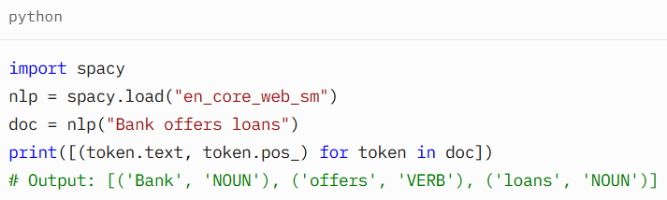
Part-of-Speech (POS) Tagging
Definition: Assigning grammatical tags (e.g., noun, verb).
Purpose: Understand sentence structure.
Example: Tagging "Bank/NOUN offers/VERB loans/NOUN" in BFSI.

Slide 10
Dependency Parsing
Definition: Analyzing syntactic relationships.
Purpose: Build sentence structure trees.
Example: Parsing "Bank offers loans" for subject-verb-object.
Code: spacy.displacy.render(doc) (visualizes tree)
Relevance: Useful, less critical for Gen AI.

Slide 11
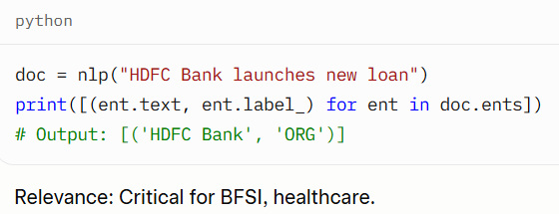
Named Entity Recognition (NER)
Definition: Identifying entities (e.g., person, organization).
Purpose: Extract key information.
Example: Extracting "HDFC Bank" from BFSI reports.

Slide 12
Word Sense Disambiguation (WSD)
Definition: Resolving ambiguous word meanings (e.g., "bank").
Purpose: Improve semantic understanding.
Example: "Bank" as financial in BFSI.
Relevance: Niche, handled by modern models.

Slide 13
Bag of Words (BoW)
Definition: Sparse vector of word frequencies.
Purpose: Simple text representation.
Example: Classifying BFSI reviews.
Code: CountVectorizer().fit_transform([text])
Relevance: Basic, replaced by embeddings.

Slide 14
TF-IDF
Definition: Weighing words by frequency and rarity.
Purpose: Improved BoW for ranking.
Example: Ranking BFSI complaints by terms.
Code: TfidfVectorizer().fit_transform([text])
Relevance: Foundational, less used.

Slide 15
Latent Semantic Analysis (LSA)
Definition: Matrix factorization for semantics.
Purpose: Topic modeling, search.
Example: Grouping healthcare reports.
Code: TruncatedSVD(n_components=2).fit_transform(matrix)
Relevance: Early method, outdated.

Slide 16
Latent Dirichlet Allocation (LDA)
Definition: Probabilistic topic modeling.
Purpose: Extract document topics.
Example: Themes in IT support tickets.
Code: gensim.models.LdaModel(corpus, num_topics=2)
Relevance: Niche, less relevant.

Slide 17
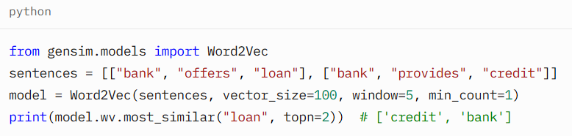
Neural Word Embeddings
Word2Vec
Definition: Neural embeddings for semantic similarity.
Types: CBOW, Skip-gram.
Example: Synonyms for "loan" in BFSI.

Slide 18
GloVe
Definition: Matrix factorization-based embeddings.
Purpose: Global word co-occurrence.
Example: Similarity in healthcare terms.
Code: Load pre-trained GloVe vectors.
Relevance: Alternative to Word2Vec.

Slide 19
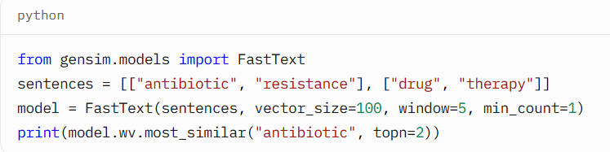
FastText
Definition: Subword embeddings for rare words.
Purpose: Handle out-of-vocabulary words.
Example: Embedding "antibiotic" in healthcare.

Slide 20
Sequential Neural Models
Character-Level Models
Definition: RNNs/CNNs for character-level text.
Purpose: Spelling correction, classification.
Example: Correcting typos in IT logs.
Code: Simple RNN for character sequences.
Relevance: Niche, less used.

Slide 21
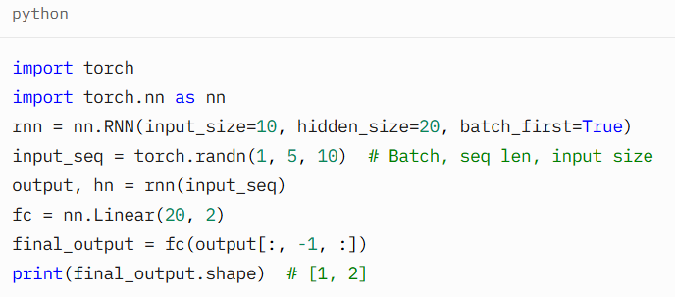
Recurrent Neural Networks (RNNs)
Definition: Process sequential data with hidden state.
Components: Hidden state, backpropagation through time.
Example: Sentiment analysis of BFSI reviews.

Slide 22
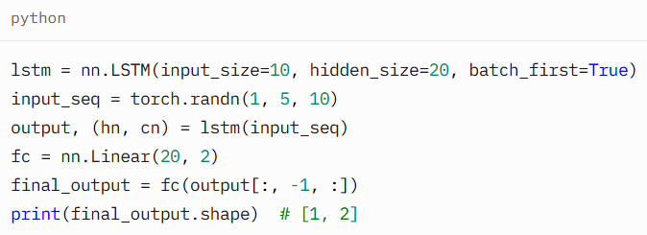
Long Short-Term Memory (LSTM)
Definition: RNN variant for long dependencies.
Components: Memory cell, gates.
Example: Text generation for IT support.

Slide 23
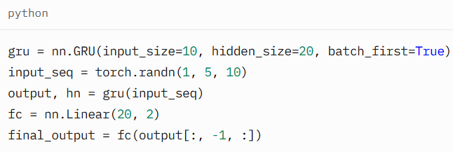
Gated Recurrent Unit (GRU)
Definition: Simplified LSTM with update/reset gates.
Purpose: Faster modeling.
Example: Similar to LSTM.

Slide 24
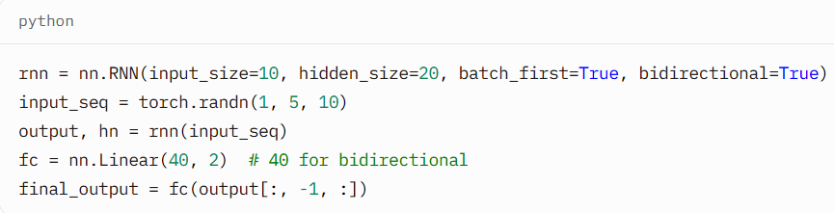
Bidirectional RNNs
Definition: Process sequences both directions.
Purpose: Contextual understanding.
Example: NER in healthcare.

Slide 25
Components
Tokens
Parameters
Embedding Layer
Transformer Architecture
Positional Encoding

Slide 26
Popular Tokenization Techniques
Byte Pair Encoding (BPE)
Used by: GPT-2, GPT-3, GPT-4 (variant of BPE)
How it works:
Starts with individual characters.
Iteratively merges the most frequent pair of tokens (bigrams) into one token.
Builds a vocabulary of subwords.
Example:
yaml
CopyEdit
Text: "lower" Initial tokens: [l, o, w, e, r] After merges: [low, er]
Pros:
Handles rare words well by breaking them into known subwords.
Efficient and compact vocabulary.
Embeddings: One vector per BPE token.

Slide 27
WordPiece
Used by: BERT
How it works:
Similar to BPE, but uses a likelihood-based criterion for merging.
Splits unknown words into known subwords or characters with ## prefix.
Example:
arduino
CopyEdit
"unhappiness" → [un, ##happi, ##ness]
Pros:
Good for understanding word morphology.
Prevents OOV (out-of-vocabulary) issues.
Embeddings: One vector per subword, including prefixes like ##.

Slide 28
SentencePiece
Used by: T5, ALBERT, XLNet
How it works:
Learns subword units without needing pre-tokenized input.
Treats input as a raw byte stream, allowing it to work with any language.
Can use BPE or Unigram Language Model internally.
Example:
scss
CopyEdit
"Hello world" → ['▁Hello', '▁world'] (▁ indicates space)
Pros:
Handles multilingual data better.
Robust to whitespace and punctuation variation.

Slide 29
Attention Mechanisms and Transformers
Attention Mechanisms - The Spotlight of A
Objective: Understand how attention powers transformers.
What is Attention?: Like a spotlight, it focuses on important words in a sentence for better context (e.g., “loan” in “Bank offers loan”).
Types:
Additive: Adds weights to score importance (older, less common).
Multiplicative: Uses dot products for efficiency.
Scaled Dot-Product: Balances large vectors (used in transformers).

Slide 30
How It Works:
Queries (Q), Keys (K), Values (V) compute weights.
Formula: Attention(Q, K, V) = softmax(QK^T / sqrt(d_k))V.
Example: In “HDFC Bank offers loan,” “loan” gets high weight for sentiment.
Use Case: BFSI (sentiment analysis), Healthcare (Q&A), IT (log analysis).
Visual: Attention heatmap for “HDFC Bank offers loan.”

Slide 31
Transformer Architecture - The LLM Backbone
What is a Transformer?: A neural network using attention to process text, replacing slow RNNs with parallel speed.
Components:
Encoder: Reads input (e.g., BFSI contract).
Decoder: Generates output (e.g., IT support response).
Attention: Links words for context.
Feed-Forward: Adds reasoning layers.
Positional Encoding: Tracks word order.
Use Case: BFSI (contract translation), Healthcare (report summarization), IT (chatbots).
Visual: Encoder-decoder diagram; trace “Bank offers loan” flow.

Slide 32
Self-Attention & Multi-Head Attention - Deep Dive
Self-Attention:
Each word “looks” at all words (e.g., “Bank” attends to “loan”).
Computes weights to focus on relevant words.
Example: In “Patient has diabetes,” “diabetes” links to “has.”
Multi-Head Attention:
Runs attention multiple times (e.g., 8 heads) for diverse patterns.
Captures relationships (e.g., “Bank” to “loan” and “offers”).
Use Case: BFSI (sentiment), Healthcare (diagnostics), IT (log triage).
Visual: Self-attention matrix; multi-head split diagram.

Slide 33
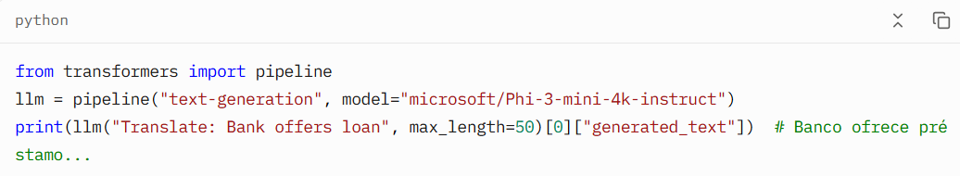
Full Architecture:
Stack encoders/decoders (e.g., 6 layers each).
Add normalization (stabilizes training).
Use positional encoding for sequence order.
Output via softmax for text generation.

Slide 34
Introduction to LLMs
Definition: Scaled transformer models (billions of parameters) for NLP tasks.
Purpose: General-purpose language understanding and generation.
Examples: BERT, GPT, T5, Mistral, DistilBERT.
Use Cases:
BFSI: Chatbots for customer support.
Healthcare: Q&A for medical queries.
IT: Automated log analysis.
Relevance: Power modern Gen AI and Agentic AI.

Slide 35
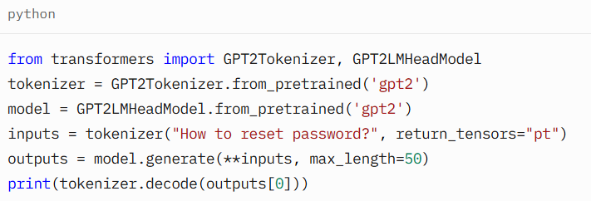
LLM Architecture
Base: Transformers (encoder, decoder, or both).
Components: Multi-head attention, FFNs, positional encoding, normalization.
Scaling: 100M–175B parameters (e.g., GPT-3: 175B).
Training: Pre-training on massive text (e.g., Wikipedia, Common Crawl), fine-tuning for tasks.
Example: GPT-2 generating IT support responses.

Slide 36
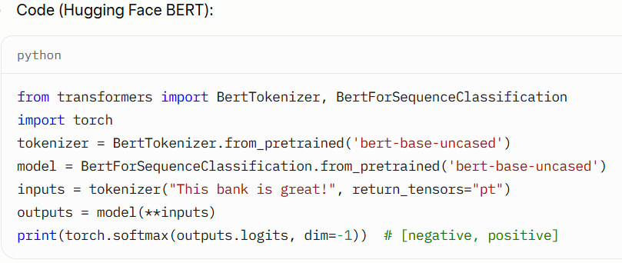
LLM Variants - BERT and DistilBERT
BERT: Bidirectional, Masked Language Modeling (MLM), classification tasks.
DistilBERT: Smaller, faster BERT (40% fewer parameters, 60% faster).
Example: Sentiment analysis of “This bank is great!” (BFSI).

Slide 37
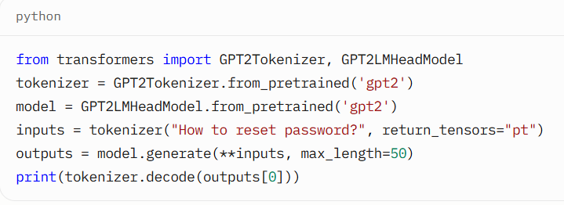
LLM Variants - GPT and Mistral
GPT: Decoder-only, autoregressive, text generation.
Mistral: Efficient decoder-only (e.g., Mixtral 8x7B), open-source.
Example: Generating IT support responses.

Slide 38
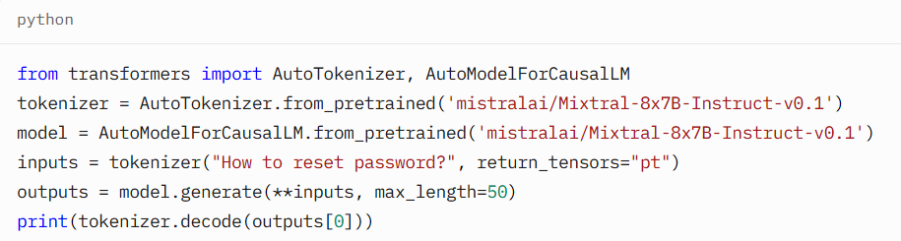

Slide 39
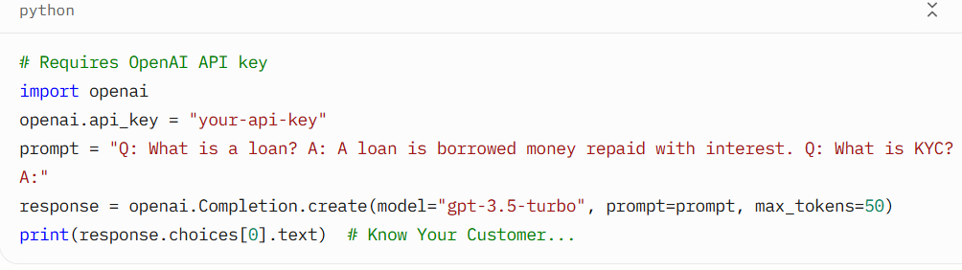
Prompt Engineering
Definition: Crafting prompts to optimize LLM performance for tasks.
Types: Zero-shot, few-shot, chain-of-thought (CoT).
Purpose: Improve accuracy, reduce training needs.
Example: BFSI query “What’s KYC?” with few-shot prompt.

Slide 40
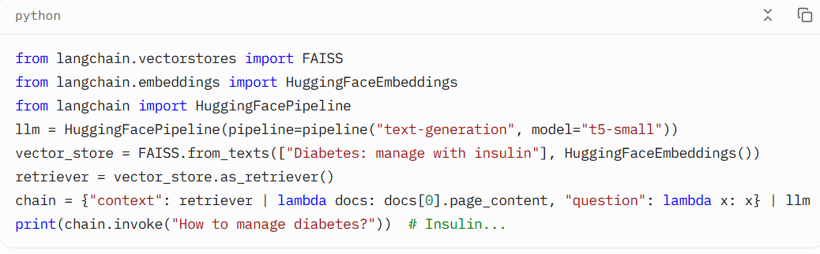
Retrieval-Augmented Generation (RAG)
Definition: Combines LLMs with external data retrieval for accurate responses.
Workflow: Index documents → Embed → Store → Retrieve → Generate.
Benefits: Uses private data, reduces hallucination.
Example: Healthcare Q&A on diabetes management.

Slide 41
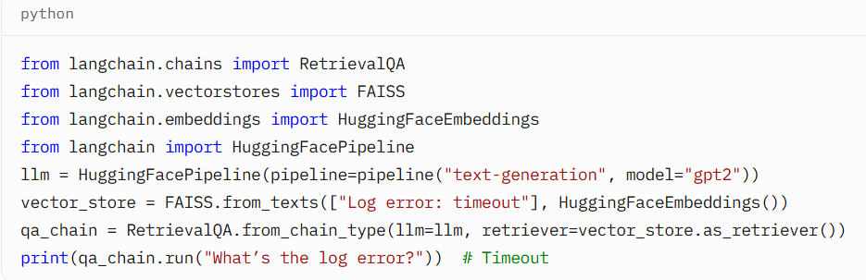
LangChain
Definition: Framework for LLM-powered apps with data, tools, memory.
Modules: LLMs, chains, retrievers, memory, document loaders, tools.
Example: IT log analysis chatbot.

Slide 42
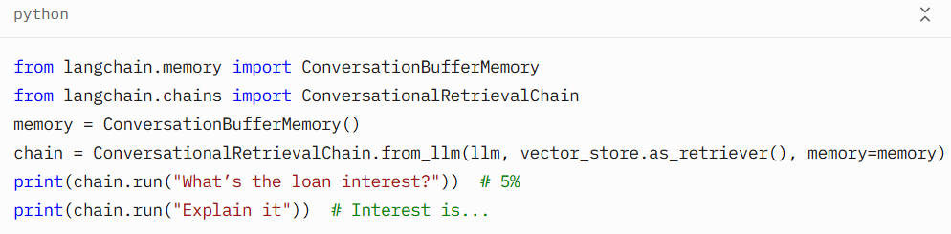
LangChain Modules in Depth
LLMs: Interface with OpenAI, Hugging Face.
Chains: Workflows (e.g., RetrievalQA, ConversationalRetrievalChain).
Retrievers: Fetch data from vector stores (FAISS, Chroma).
Memory: Store context (ConversationBufferMemory).
Document Loaders: Ingest PDFs, web pages.
Tools: Call APIs, databases.
Example: BFSI contract Q&A with memory.

Slide 43
Lexical vs. Semantic Search
Aspect | Lexical Search | Semantic Search
Based on | Keywords (exact match) | Meaning/context (embeddings)
Example query | AI training course | Learn how machines think like humans
Missed matches | Misses synonyms or rephrasings | Captures related concepts
Tool | TF-IDF, BM25 | Transformers (e.g., BERT, Sentence-

Slide 44
How Does Semantic Search Work?
Step-by-step:
Tokenization: Input text is tokenized (as discussed earlier).
Embedding: The entire query or document is passed through a transformer model (like BERT, Sentence-BERT, OpenAI embeddings).
Vector Output: The model outputs a dense vector (e.g., 384 or 768 dimensions) that represents the semantic meaning.
Vector Similarity: Compare vectors using cosine similarity or dot product to find the most similar ones.

Slide 45
Model | Dim | Description
Sentence-BERT | 384–1024 | Optimized BERT for sentence-level embeddings
OpenAI Embeddings | 1536 | Used in GPT-3.5/4 APIs for semantic search
Cohere | 768+ | API-based semantic embeddings
GTE (Google) | 768 | Efficient transformer for search tasks
Instructor XL | 1024 | Instruction-tuned model that improves embeddings
Common Embedding Models for Semantic Search

Slide 46
Scenario | Action
🔸 Chat-only | LLM answers directly using its trained weights
🔸 Chat with RAG | First vector store is queried, then LLM is invoked
🔸 Hybrid | If vector search fails or low score, fallback to LLM
🔸 Chat with memory | Past interactions are stored as vector embeddings or tokens
When Does LLM Search vs Vector Store?

Slide 47
Vector DB | Description
FAISS | Local, fast, supports cosine/L2 distance
Pinecone | Cloud, scalable, persistent
Weaviate | Open source, with GraphQL and schema support
ChromaDB | Lightweight, used in LangChain/LLM prototypes
Using Vector DBs

