Slide 1
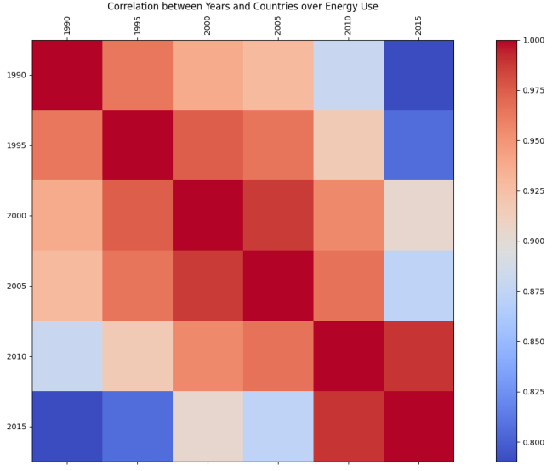
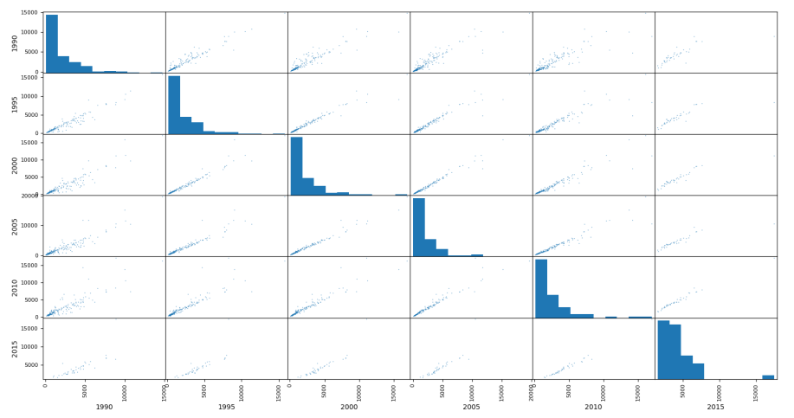
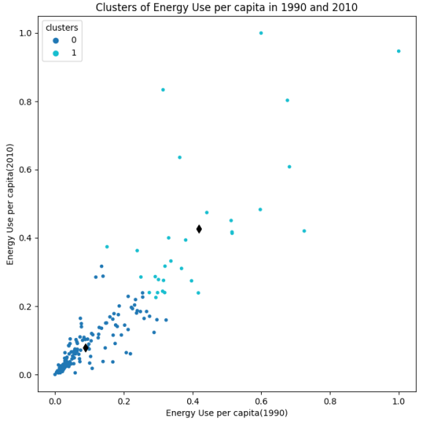
Energy Use By Various Countries
Student Name: Pavan Gade
Student ID: 22089513
Introduction
A proportion of energy consumption is indicator of economic potential of countries and also conveys the environmental status. The main objective of this study is to conduct analysis over the use of energy in European countries and also finds out its relationship with environment.
Correlation Between Countries and Years
Analyzing the correlation between energy consumption and years for European countries involves studying the trends and patterns in energy usage over time. This analysis often considers various factors such as economic growth, technological advancements, and changes in energy policies. Some European countries have experienced a decoupling of economic growth from energy consumption. This means that their economies have grown without a proportional increase in energy use, often due to improved energy efficiency and the adoption of cleaner technologies. The same has been revealed in this visualization of correlation between countries and years.
Clusters of Energy Use per capita
Creating clusters based on energy use per capita from 1990 to 2015 for European countries involves grouping countries with similar patterns of energy consumption over this period. This type of analysis can reveal trends, similarities, and differences in how countries have evolved in terms of energy use. K-Means clustering is a commonly used method, but hierarchical clustering or other algorithms may also be appropriate depending on the nature of your data. The number of clusters, and the interpretation of clusters depend on your specific goals and the characteristics of the data. Additionally, consider any contextual information, such as changes in energy policies or economic conditions, when interpreting the results.
Conclusion
It has been learned from these visual outcomes that energy consumption is highly diversified across the various countries in European continent. It showed some places with higher consumption and few places with lower consumption of energy.
GitHub Source: https://github.com/Pavan0325/Applied-Data-Science-1-Assignment-3.git

