Slide 1

SKILL NO:6
Operating System Design
@KL University, 2020

Slide 2
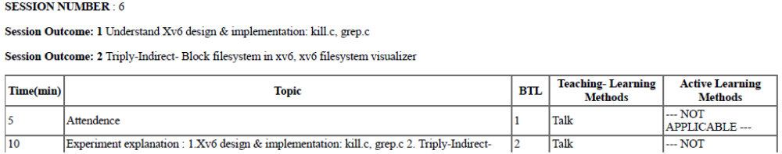
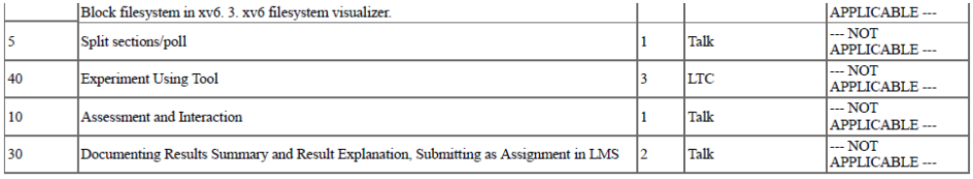

Slide 3
Kill
Kill command in Linux/UNIX is a built-in command which is used to terminate processes manually.
Kill command sends a signal to a process ,which terminates the process.
If the user doesn’t specify any signal which is to be sent along with kill command, then default TERM signal is sent that terminates the process.
Kill –l to display all the available signals
$kill pid --→kills the process with the specified pid

Slide 4
What is grep?
2
A text manipulation program
Used to find pattern in files or text
global regular expression print (: g/RE/p) / general regular expression parser (grep)
Other text manipulation commands – cut, tr, awk, sed
grep family - grep, egrep, and fgrep
Type man grep to find list of options
General syntax of grep command
grep [-options] pattern [filename]
Examples:
$ grep pattern filename
$ grep pattern file1file2
$ grep -idesktop /etc/services
$ grep [yf]/etc/group
$ grep –vi tcp /etc/services
2/16/2014

Slide 5
grep and exit status
4
If the pattern is found, grep returns an exit status of 0, indicating success
if grep cannot find the pattern, it returns 1 as its exit status
if the file cannot be found, grep returns an exit status of 2
Note: Other UNIX utilities such as sed and awk do not use the exit status to indicate the success or failure of locating a pattern; they report failure only if there is a syntax error in a command
2/16/2014

Slide 6
options
Option | Description
-b | Display the block number at the beginning of each line.
-c | Display the number of matched lines.
-h | Display the matched lines, but do not display the filenames.
-i | Ignore case sensitivity.
-l | Display the filenames, but do not display the matched lines.
-n | Display the matched lines and their line numbers.
-s | Silent mode.
-v | Display all lines that do NOT match.
-w | Match whole word
-o | Displays only the matched string
^ | Displays the lines which start with the given string/pattern
$ | Displays the lines which end with the given string or pattern

Slide 8
XV6 File System
Understanding the Current XV6 File System
Understanding the Doubly Indirect Block File System
Understanding the Triply Indirect Block File System

Slide 9
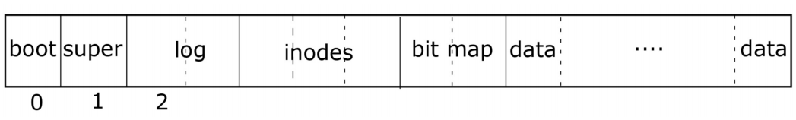
XV6 Files System
The purpose of a file system is to organize and store data
File systems typically support sharing of data among users and applications, as well as persistence so that data is still available after a reboot.
boot block super block inode list data blocks
layout of File System

Slide 10
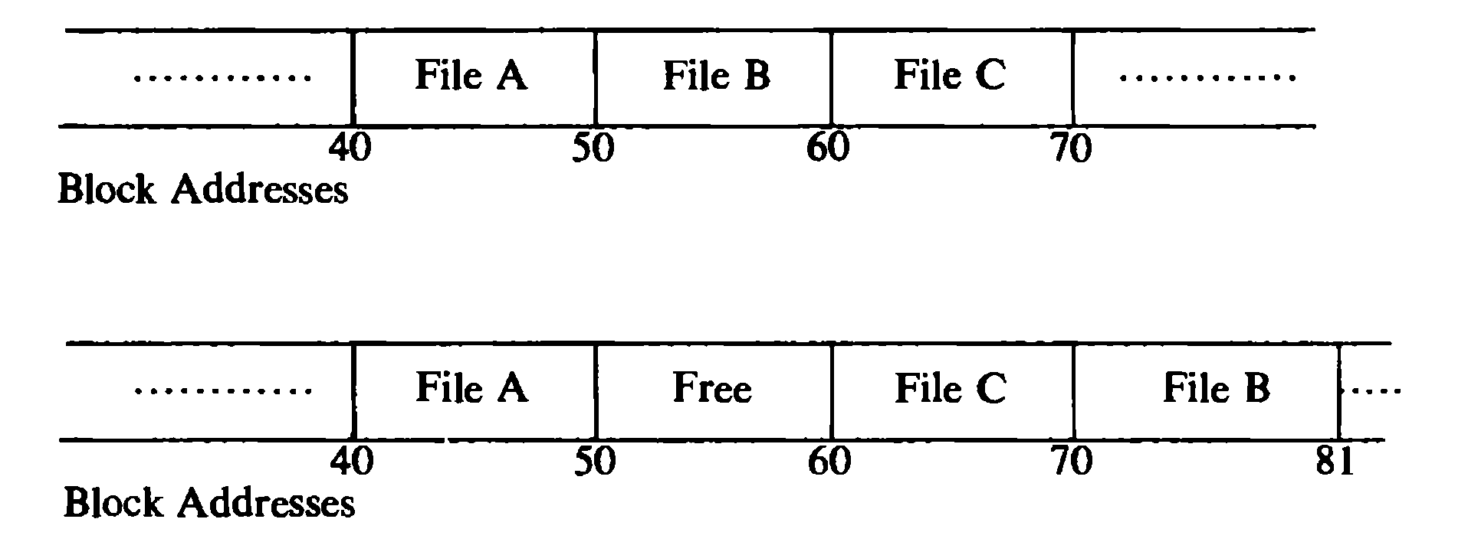
Structure of a Regular File
The Inode contains the table of contents to locate a file’s data on disk.
If file is stored on the contiguous section of the disk, then Inode will contain
Not suitable for simple expansion and contraction of files in the file system.
Disk Block Number | Address on Disk
Start Block Address | File Size

Slide 11
Structure of a Regular File
The kernel allocates file space one block at a time and allows the data in a file to be spread throughout the file system.
The inode table contains
If block size =1k and file size =10 k then Inode table of content will have 10 entries . Similarly for 100k size, 100 entries in inode.
Disk Block Number | Address on disk

Slide 12
Structure of a Regular File
Inode
Data Blocks
To keep the inode structure simple yet allow larger files , the table of contents of the disk block conforms to figure shown.
The blocks marked direct contain the number of disk block that contain real data.
The blocks marked single indirect refers to a block that contains a list of direct block numbers.
To access the data via the indirect block, the kernel must read the indirect block, find
the appropriate direct block entry, and then read the direct block to find the data
direct0
direct1
Direct2
direct3
direct4
direct5
direct6
direct7
direct8
Direct9
single indirect
double indirect
triple indirect

Slide 13
Structure of a Regular File
Suppose System V UNIX
Assume that a logical Disk block on the file system holds 1K bytes and that a block number is addressable by a 32 bit integer, then a block can hold up to 256 block numbers
10 direct blocks with 1K bytes each=10K bytes
1 indirect block with 256 direct blocks= 1K*256=256K bytes
1 double indirect block with 256 indirect blocks=256K*256=64M bytes
1 triple indirect block with 256 double indirect blocks=64M*256=16G bytes

Slide 14
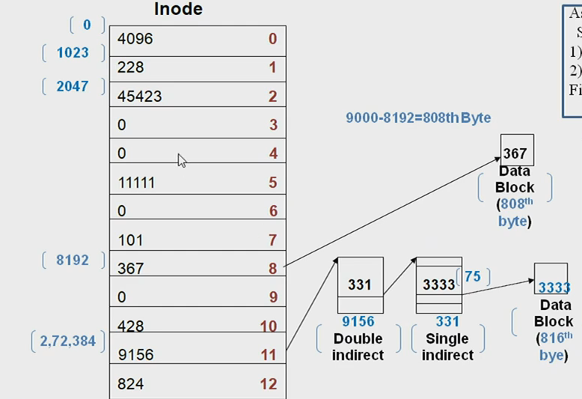
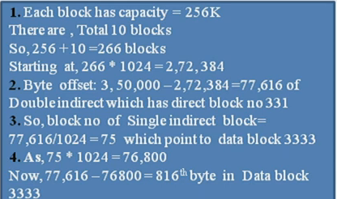
Block layout of a Sample file and its inode
Assume that a disk block contains 1024 bytes.
1. Process wants to access byte offset 9000
2. process wants to access byte offset 3,50,000
Find how process access

Slide 15
XV6 File System
Current implementation limit files to 70 KB
Disk Sectors/blocks
0
1
2
…
140
512 bytes
We want it to be able to map more then 140 sectors/data blocks.
71 680 bytes

Slide 16
XV6 File System
This limit is based in the current implementation of direct and indirect references you can use in the inode
We can modify xv6 to be able to map bigger files by adding a double indirect or triply indirect reference in its inode.
xv6 file system is similar to Unix Fast File System (FFS) or (UFS).

Slide 17




XV6 File System
data
inode
metadata
data
.
.
.
data
data
Saved as data blocks of 512 bytes. (each data block is a disk sector)
some_file.some_extesion

Slide 18






Existing XV6 File System
data
In xv6 the first table can holds 128
data
blocks. (Block size/pointer size)
.
.
inode
metadata
data
•
•
•
data
.
.
In xv6 you can have 12 direct pointers
.
data
Direct pointers
.
single indirect

Slide 19
XV6 File System
data
data
.
.
inode
metadata
data
•
•
•
data
.
.
.
data
Direct pointers
.
single indirect
The task is to to add a double indirect block

Slide 20






xv6 File System
data
data
.
.
inode
metadata
data
•
•
•
data
.
.
.
data
Direct pointers
.
•
•
•
•
single indirect double indirect
Each pointer will point to a table of single indirect pointers

Slide 21



xv6 File System
data
data
.
.
inode
metadata
data
•
•
•
data
.
.
.
data
.
Direct pointers
•
•
•
•
.
•
•
•
•
single indirect double indirect
And each pointer from this table table to actual physical blocks

Slide 22

xv6 File System
data
data
.
.
inode
metadata
data
•
•
•
data
.
.
.
data
.
Direct pointers
•
•
•
•
.
•
•
•
•
data
.
.
single indirect double indirect
data
And each pointer from this table table to actual physical blocks

Slide 23





xv6 File System
data
data
.
.
inode
metadata
data
•
•
•
data
.
.
.
data
.
Direct pointers
•
•
•
•
•
•
•
•
.
•
•
•
•
data
.
.
single indirect double indirect triple indirect
data
•
•
•
•
data
•
•
•
•
.
data

Slide 24
xv6 File System
data
data
.
.
inode
metadata
data
•
•
•
data
.
.
.
data
.
Direct pointers
•
•
•
•
.
•
•
•
•
data
.
.
single indirect
data
Skilling-6
goal
double indirect
It will allow us to map files up to 8.5 MB

Slide 25
xv6 File System
Important xv6 files for this Skilling are:
  fs.h – defines the number of direct blocks
  fs.c – bmap()
  file.h – inode struct

Slide 26
Existing XV6 File System
bmap() function code
static uint
bmap(struct inode *ip, uint bn)
{
uint addr, *a;
struct buf *bp;
if(bn < NDIRECT){// 0-11 direct references
if((addr = ip->addrs[bn]) == 0)// is block empty
ip->addrs[bn] = addr = balloc(ip->dev);// creating new block
return addr;
}
bn - = NDIRECT;
if(bn < NINDIRECT){//12-139 indirect references
// Load indirect block, allocating if necessary.
if((addr = ip->addrs[NDIRECT]) == 0)
ip->addrs[NDIRECT] = addr = balloc(ip->dev);
bp = bread(ip->dev, addr);
a = (uint*)bp->data;
if((addr = a[bn]) == 0){
a[bn] = addr = balloc(ip->dev);
log_write(bp);
}
brelse(bp);
return addr;
}
panic("bmap: out of range");
}

Slide 27
Existing XV6 File System
Fs.h
#define ROOTINO 1 // root i-number
#define BSIZE 512 // block size
// Disk layout:
// [ boot block | super block | log | inode blocks |
// free bit map | data blocks]
//
// mkfs computes the super block and builds an initial file system. The
// super block describes the disk layout:
struct superblock {
uint size; // Size of file system image (blocks)
uint nblocks; // Number of data blocks
uint ninodes; // Number of inodes.
uint nlog; // Number of log blocks
uint logstart; // Block number of first log block
uint inodestart; // Block number of first inode block
uint bmapstart; // Block number of first free map block
};
#define NDIRECT 12
#define NINDIRECT (BSIZE / sizeof(uint))// 512/4=128
#define MAXFILE (NDIRECT + NINDIRECT)// 12+128=140 sectors
// On-disk inode structure
struct dinode {
short type; // File type
short major; // Major device number (T_DEV only)
short minor; // Minor device number (T_DEV only)
short nlink; // Number of links to inode in file system
uint size; // Size of file (bytes)
uint addrs[NDIRECT+1]; // Data block addresses
};

Slide 28
Existing XV6 File System
short type; // copy of disk inode
short major;
short minor;
short nlink;
uint size;
}; uint addrs[NDIRECT+1];
// table mapping major device number to
// device functions
struct devsw {
int (*read)(struct inode*, char*, int);
int (*write)(struct inode*, char*, int);
};
extern struct devsw devsw[];
#define CONSOLE 1
File.h
struct file {
enum { FD_NONE, FD_PIPE, FD_INODE } type;
int ref; // reference count
char readable;
char writable;
struct pipe *pipe;
struct inode *ip;
uint off;
};
// in-memory copy of an inode
struct inode {
uint dev; // Device number
uint inum; // Inode number
int ref; // Reference count
struct sleeplock lock; // protects everything below here
int valid; // inode has been read from disk?

Slide 29
Doubly Indirect File System in XV6
Bmap() Function Code in fs.c
static uint
bmap(struct inode *ip, uint bn){
uint addr, *a;
struct buf *bp;
if(bn < NDIRECT){// 0-11direct references
if((addr = ip->addrs[bn]) == 0)
ip->addrs[bn] = addr = balloc(ip->dev);
return addr; }
bn -= NDIRECT;
//doubly indirect fs
if(bn < (NINDIRECT*NINDIRECT)){ // 128*128
// Load indirect block, allocating if necessary.
if((addr = ip->addrs[NDIRECT]) == 0)
ip->addrs[NDIRECT] = addr = balloc(ip->dev);
bp = bread(ip->dev, addr);
a = (uint*)bp->data;
if((addr = a[bn/(NINDIRECT)]) == 0){
a[(bn/NINDIRECT)] = addr = balloc(ip->dev);
log_write(bp);
}
brelse(bp);
bp = bread(ip->dev, addr);
a = (uint*)bp->data;
//load doubly indirect block, allocating if necessary
if((addr = a[bn%(NINDIRECT)]) == 0){
a[(bn%NINDIRECT)] = addr = balloc(ip->dev);
log_write(bp);
}
brelse(bp);
return addr;
}
panic("bmap: out of range");
}// 12+128*128=16396

Slide 30
Doubly Indirect File System in XV6
Fs.h
#define ROOTINO 1 // root i-number
#define BSIZE 512 // block size
// File system super block
struct superblock {
uint size; // Size of file system image (blocks)
uint nblocks; // Number of data blocks
uint ninodes; // Number of inodes.
uint nlog; // Number of log blocks};
#define NDIRECT 12
#define NINDIRECT (BSIZE / sizeof(uint))// 512/4=128
#define MAXFILE (NDIRECT + (NINDIRECT*NINDIRECT)) // 12 + (128*128)
// On-disk inode structure
struct dinode {
short type; // File type
short major; // Major device number (T_DEV only)
short minor; // Minor device number (T_DEV only)
short nlink; // Number of links to inode in file system
uint size; // Size of file (bytes)
uint addrs[NDIRECT+1]; // Data block addresses// No change
};

Slide 31
Doubly Indirect File System in XV6
File.h
struct file {
enum { FD_NONE, FD_PIPE, FD_INODE } type;
int ref; // reference count
char readable;
char writable;
struct pipe *pipe;
struct inode *ip;
uint off;
};
// in-memory copy of an inode
struct inode {
uint dev; // Device number
uint inum; // Inode number
int ref; // Reference count
int flags; // I_BUSY, I_VALID
short type; // copy of disk inode
short major;
short minor;
short nlink;
uint size;
uint addrs[NDIRECT+1];// no changes
};
#define I_BUSY 0x1
#define I_VALID 0x2
// table mapping major device number to
// device functions
struct devsw {
int (*read)(struct inode*, char*, int);
int (*write)(struct inode*, char*, int);
};
struct devsw devsw[];
#define CONSOLE 1

Slide 32
Triply Indirect File System in XV6
Bmap() function code in fs.c //Line no 356
**Single Indirect
static uint
bmap(struct inode *ip, uint bn)
{
uint addr, *a;
struct buf *bp;
if(bn < NDIRECT){
if((addr = ip->addrs[bn]) == 0)
ip->addrs[bn] = addr = balloc(ip->dev);
return addr;
}
bn -= NDIRECT;
//single indirect
if(bn < NINDIRECT){
// Load indirect block, allocating if necessary.
if((addr = ip->addrs[NDIRECT]) == 0)
ip->addrs[NDIRECT] = addr = balloc(ip->dev);
bp = bread(ip->dev, addr);
a = (uint*)bp->data;
if((addr = a[bn]) == 0){
a[bn] = addr = balloc(ip->dev);
log_write(bp);
}
brelse(bp);
return addr;
}

Slide 33
Triply Indirect File System in XV6
//double indirect
if( bn < NINDIRECT*NINDIRECT){
// Load indirect block, allocating if necessary.
if((addr = ip->addrs[NDIRECT+1]) == 0)
ip->addrs[NDIRECT+1] = addr = balloc(ip->dev);
bp = bread(ip->dev, addr);
a = (uint*)bp->data;
if((addr = a[bn/(NINDIRECT)]) == 0){
a[(bn/NINDIRECT)] = addr = balloc(ip->dev);
log_write(bp);
}
brelse(bp);
bp = bread(ip->dev, addr);
a = (uint*)bp->data;
//load doubly indirect block, allocating if necessary
if((addr = a[bn%(NINDIRECT)]) == 0){
a[(bn%NINDIRECT)] = addr = balloc(ip->dev);
log_write(bp);
}
brelse(bp);
return addr;
}

Slide 34
Triply Indirect File System in XV6
//triple indirect
if(bn < NINDIRECT*NINDIRECT*NINDIRECT){
// Load indirect block, allocating if necessary.
if((addr = ip->addrs[NDIRECT+2]) == 0)
ip->addrs[NDIRECT+2] = addr = balloc(ip->dev);
bp = bread(ip->dev, addr);
a = (uint*)bp->data;
//first indirect layer
if((addr = a[bn/(NINDIRECT*NINDIRECT)]) ==0){
a[bn/(NINDIRECT*NINDIRECT)] = addr = balloc(ip->dev);
log_write(bp);
}
brelse(bp);
bn = bn%(NINDIRECT*NINDIRECT);
//2nd indirect layer
bp = bread(ip->dev, addr);
a = (uint*)bp->data;
if((addr = a[bn/(NINDIRECT)]) == 0){
a[(bn/NINDIRECT)] = addr = balloc(ip->dev);
log_write(bp);
}
brelse(bp);
//3rd indirect layer
bp = bread(ip->dev, addr);
a = (uint*)bp->data;
//load doubly indirect block, allocating if necessary
if((addr = a[bn%(NINDIRECT)]) == 0){
a[(bn%NINDIRECT)] = addr = balloc(ip->dev);
log_write(bp);
}
brelse(bp);
return addr;
}

Slide 35
Triply Indirect File System in XV6
Fs.h
// Block 0 is unused.
// Block 1 is super block.
// Blocks 2 through sb.ninodes/IPB hold inodes.
// Then free bitmap blocks holding sb.size bits.
// Then sb.nblocks data blocks.
// Then sb.nlog log blocks.
#define ROOTINO 1 // root i-number
#define BSIZE 512 // block size
File system super block
struct superblock {
uint size; // Size of file system image (blocks)
uint nblocks; // Number of data blocks
uint ninodes; // Number of inodes.
uint nlog; // Number of log blocks
};
#define NDIRECT 10
#define NINDIRECT (BSIZE / sizeof(uint))
#define MAXFILE (NDIRECT + NINDIRECT*NINDIRECT*NINDIRECT) //10 + 128^3 = 2097964 blocks
// On-disk inode structure
struct dinode {
short type; // File type
short major; // Major device number (T_DEV only)
short minor; // Minor device number (T_DEV only)
short nlink; // Number of links to inode in file system
uint size; // Size of file (bytes)
uint addrs[NDIRECT+3]; // Data block addresses, last three are single indirect, double indirect, triple indirect
};

Slide 36
Triply Indirect File System in XV6
File.h
struct file {
enum { FD_NONE, FD_PIPE, FD_INODE } type;
int ref; // reference count
char readable;
char writable;
struct pipe *pipe;
struct inode *ip;
uint off;
};
// in-memory copy of an inode
struct inode {
uint dev; // Device number
uint inum; // Inode number
int ref; // Reference count
int flags; // I_BUSY, I_VALID
short type; // copy of disk inode
short major;
short minor;
short nlink;
uint size;
uint addrs[NDIRECT+3];
};
#define I_BUSY 0x1
#define I_VALID 0x2
// table mapping major device number to
// device functions
struct devsw {
int (*read)(struct inode*, char*, int);
int (*write)(struct inode*, char*, int);
};
extern struct devsw devsw[];
#define CONSOLE 1

Slide 37




XV6 File System
In the bmap() from the fs.c file
bmap(struct inode *ip, uint bn) uint addr, *a;
struct buf *bp;
inode
metadata
0
1
2
…
140
.
Direct pointers
.
if(bn < NDIRECT){
if((addr = ip->addrs[bn]) == 0)
ip->addrs[bn] = addr = balloc(ip->dev); return addr;
}
…
single indirect double indirect

Slide 38
XV6 File System
In the bmap() from the fs.c file
bmap(struct inode *ip, uint bn) uint addr, *a;
struct buf *bp;
inode
metadata
0
1
2
…
140
.
Direct pointers
.
if(bn < NDIRECT){
if((addr = ip->addrs[bn]) == 0)
ip->addrs[bn] = addr = balloc(ip->dev); return addr;
}
…
single indirect double indirect

Slide 39
XV6 File System
In the bmap() from the fs.c file
bmap(struct inode *ip, uint bn) uint addr, *a;
inode
metadata
0
1
2
…
140
.
Direct pointers
Is the pointer empty?
.
struct buf *bp;
if(bn < NDIRECT){
if((addr = ip->addrs[bn]) == 0)
ip->addrs[bn] = addr = balloc(ip->dev); return addr;
}
…
single indirect double indirect

Slide 40
XV6 File System
In the bmap() from the fs.c file
bmap(struct inode *ip, uint bn) uint addr, *a;
struct buf *bp;
inode
metadata
0
1
2
…
140
If it is empty create a new block
.
Direct pointers
.
if(bn < NDIRECT){
if((addr = ip->addrs[bn]) == 0)
ip->addrs[bn] = addr = balloc(ip->dev);
return addr;
}
…
single indirect double indirect

Slide 41
xv6 File System
In the bmap() from the fs.c file
bmap(struct inode *ip, uint bn) uint addr, *a;
struct buf *bp;
inode
metadata
0
1
2
…
140
.
Direct pointers
.
if(bn < NDIRECT){
…
single indirect double indirect
11

Slide 42
XV6 File System
In the bmap() from the fs.c file
bmap(struct inode *ip, uint bn) uint addr, *a;
struct buf *bp;
inode
metadata
0
1
2
…
140
.
Direct pointers
.
if(bn < NDIRECT){
…
bn -= NDIRECT;
if(bn < NDINDIRECT){
single indirect double indirect
11

Slide 43
XV6 File System
In the bmap() from the fs.c file
bmap(struct inode *ip, uint bn) uint addr, *a;
struct buf *bp;
inode
metadata
0
1
2
…
140
.
Direct pointers
.
if(bn < NDIRECT){
…
bn -= NDIRECT;
if(bn < NDINDIRECT){
12
single indirect double indirect

Slide 44




XV6 File System
In the bmap() from the fs.c file
bmap(struct inode *ip, uint bn) uint addr, *a;
struct buf *bp;
Only holds 128
inode
metadata
0
1
2
…
140
•
•
•
.
Direct pointers
.
12
if(bn < NDIRECT){
…
single indirect double indirect
bn -= NDIRECT;
if(bn < NDINDIRECT){
We map 12 - 139
to 0 - 127

Slide 45
XV6 File System
In the bmap() from the fs.c file
// Load indirect block, allocating if necessary.
Only holds 128
inode
metadata
0
1
2
…
140
if((addr = ip->addrs[NDIRECT+1]) == 0)
ip->addrs[NDIRECT+1] = addr = balloc(ip->dev);
bp = bread(ip->dev, addr);
a = (uint*)bp->data;
.
single indirect double indirect
•
•
•
Direct pointers
if((addr = a[bn]) == 0){
a[bn] = addr = balloc(ip->dev); log_write(bp);
}

Slide 46
XV6 File System
In the bmap() from the fs.c file
// Load indirect block, allocating if necessary.
Only holds 128
inode
metadata
0
1
2
…
140
if((addr = ip->addrs[NDIRECT+1]) == 0)
ip->addrs[NDIRECT+1] = addr = balloc(ip->dev);
bp = bread(ip->dev, addr);
a = (uint*)bp->data;
.
single indirect double indirect
•
•
•
Direct pointers
if((addr = a[bn]) == 0){
a[bn] = addr = balloc(ip->dev); log_write(bp);
}

Slide 47
xv6 File System
In the bmap() from the fs.c file
// Load indirect block, allocating if necessary.
Only holds 128
inode
metadata
0
1
2
…
140
if((addr = ip->addrs[NDIRECT+1]) == 0)
ip->addrs[NDIRECT+1] = addr = balloc(ip->dev);
bp = bread(ip->dev, addr);
a = (uint*)bp->data;
.
single indirect double indirect
•
•
•
Direct pointers
if((addr = a[bn]) == 0){
a[bn] = addr = balloc(ip->dev); log_write(bp);
}

Slide 48
XV6 File System
In the bmap() from the fs.c file
// Load indirect block, allocating if necessary.
Only holds 128
inode
metadata
0
1
2
…
140
if((addr = ip->addrs[NDIRECT+1]) == 0)
ip->addrs[NDIRECT+1] = addr = balloc(ip->dev);
bp = bread(ip->dev, addr);
a = (uint*)bp->data;
.
single indirect double indirect
•
•
•
Direct pointers
if((addr = a[bn]) == 0){
a[bn] = addr = balloc(ip->dev); log_write(bp);
}

Slide 49
xv6 File System
In the bmap() from the fs.c file
// Load indirect block, allocating if necessary.
Only holds 128
inode
metadata
0
1
2
…
140
if((addr = ip->addrs[NDIRECT+1]) == 0)
ip->addrs[NDIRECT+1] = addr = balloc(ip->dev);
bp = bread(ip->dev, addr);
a = (uint*)bp->data;
.
single indirect double indirect
•
•
•
Direct pointers
if((addr = a[bn]) == 0){
a[bn] = addr = balloc(ip->dev); log_write(bp);
}

Slide 50
XV6 File System
In the bmap() from the fs.c file
// Load indirect block, allocating if necessary.
Only holds 128
inode
metadata
0
•
•
•
if((addr = ip->addrs[NDIRECT+1]) == 0)
ip->addrs[NDIRECT+1] = addr = balloc(ip->dev);
bp = bread(ip->dev, addr);
a = (uint*)bp->data;
.
single indirect double indirect
1
Direct pointers
2
…
140
if((addr = a[bn]) == 0){
a[bn] = addr = balloc(ip->dev); log_write(bp);
}
We are checking if the block from the table we just read is empty

Slide 51
XV6 File System
In the bmap() from the fs.c file
// Load indirect block, allocating if necessary.
Only holds 128
inode
metadata
0
1
2
…
140
…
if((addr = a[bn]) == 0){
a[bn] = addr = balloc(ip->dev);
log_write(bp);
}
brelse(bp);
return addr;
•
•
•
.
Direct pointers
.
single indirect double indirect

Slide 52



