Slide 1
FINAL PROJECT PROPOSAL
Online News Popularity

Slide 2
Group 1 members
Amisha Shukla
Dave Shivhare
Niharika B
Pavan Vamsi Tadikonda
Sonal Seth

Slide 3
CONTENTS OF THIS PRESENTATION
Executive summary
Data description
Interesting findings
Models used
Managerial Recommendations

Slide 4

Aim of the Project
The aim here is to maximize the article outreach. Our model shall analyze what elements determine the popularity of a news article which can be later used by the news agencies.

Slide 5
—Geoffrey Moore, author and consultant.
“Without analytics, companies are blind and deaf, wandering out onto the web like deer on a freeway..”

Slide 6
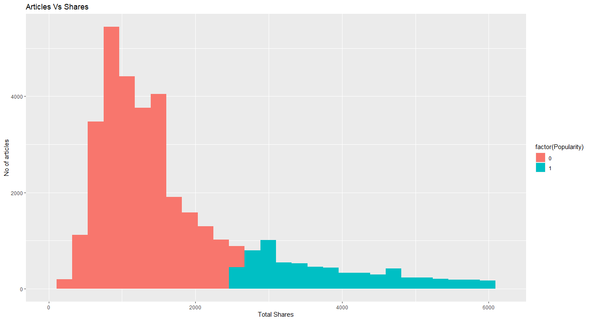
INTERESTING FINDINGS: I
As we can see, most of the articles do not reach the popularity benchmark.

Slide 7
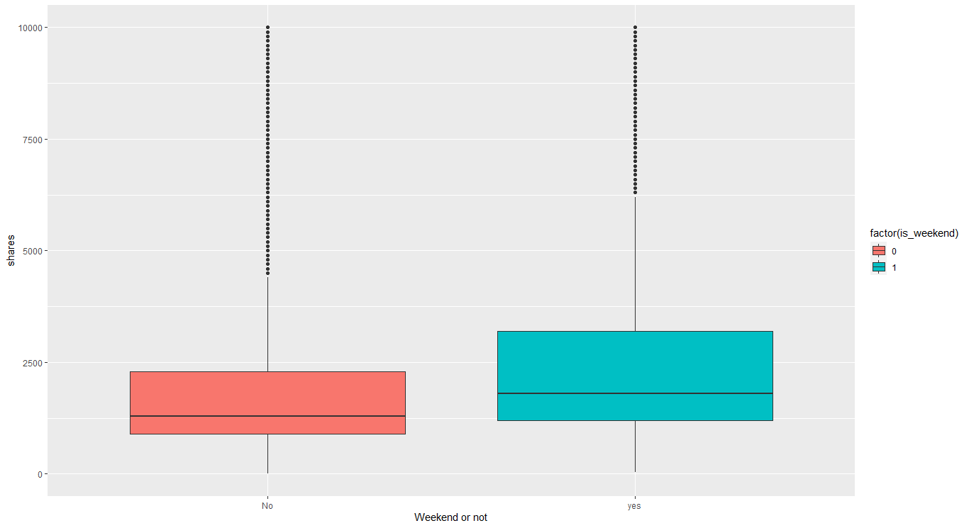
II: POPULARITY AS A FUNCTION OF TIME
Articles written in the weekend are generally more popular

Slide 8
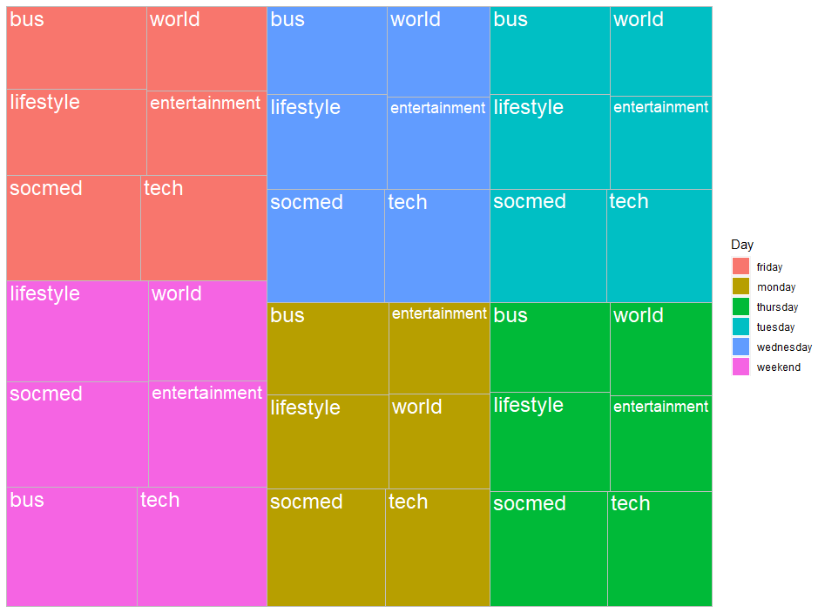
III: Popularity as a function of channel type and time
No specific channel type is more popular during the weekdays than in the weekends.

Slide 9
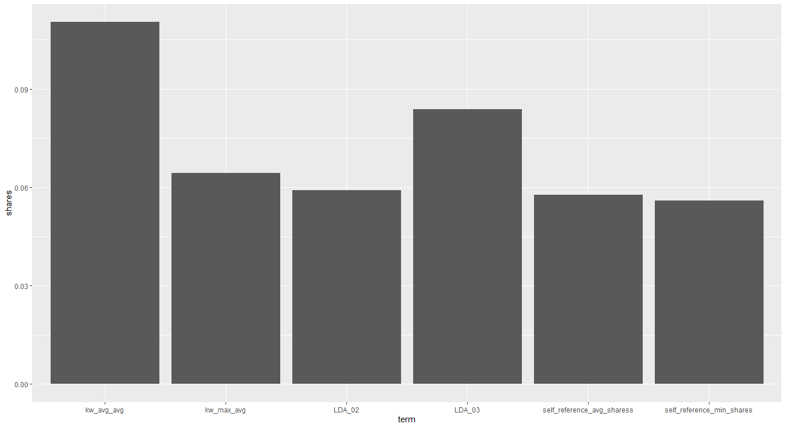
IV: CORRELATION WITH THE NUMBER OF SHARES
There is no one variable which has very high correlation with the shares. Hence, we cannot reduce the number of features in the data much at all.
Too many variables will translate to greater cost of data collection and model deployment. Hence, we cut down the number of variables using the AKAIKE information criterion.

Slide 10
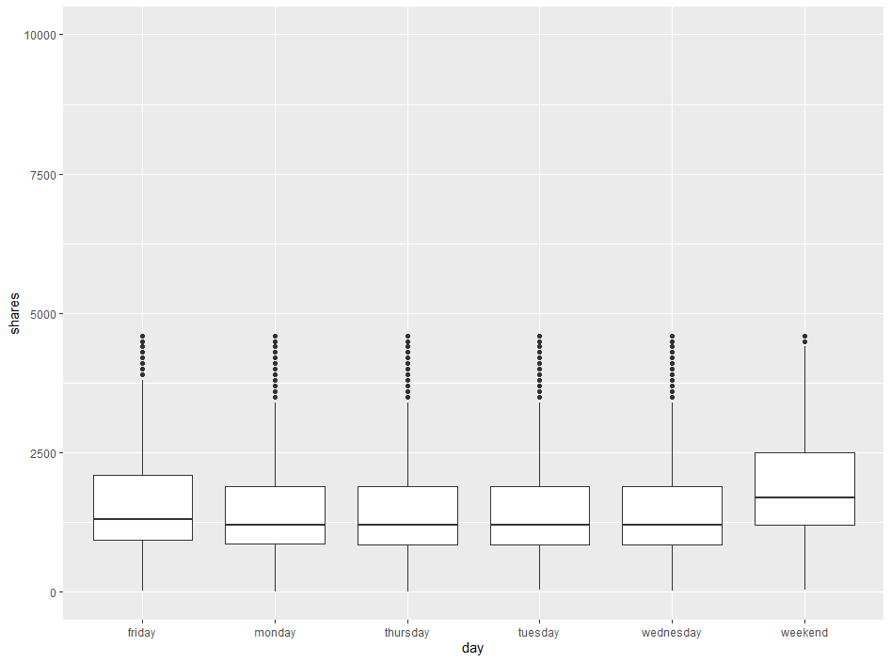
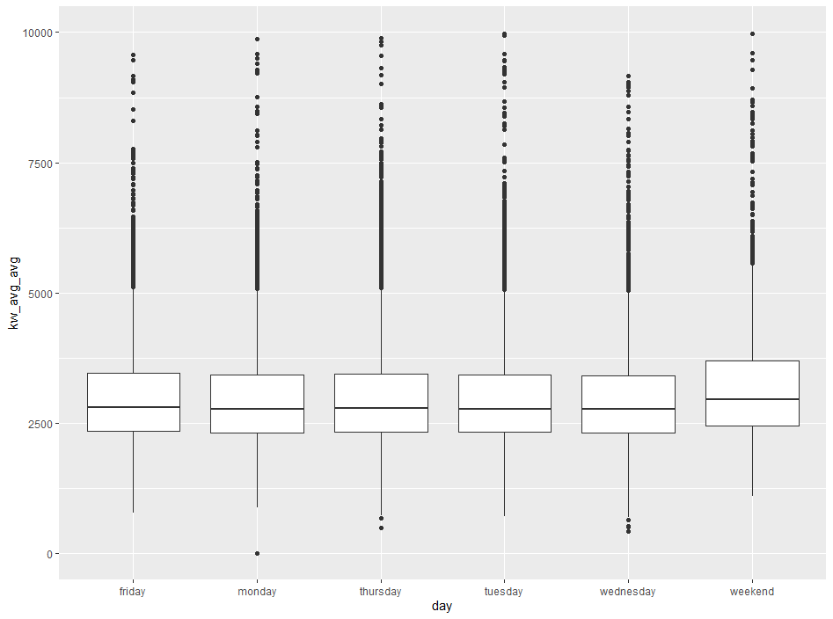
V: CERTAIN VARIABLES FOLLOW THE NUMBER OF SHARES EACHDAY
KW_AVG_AVG follows the same trend as the shares over the week
Both the variables point to the weekend.

Slide 11
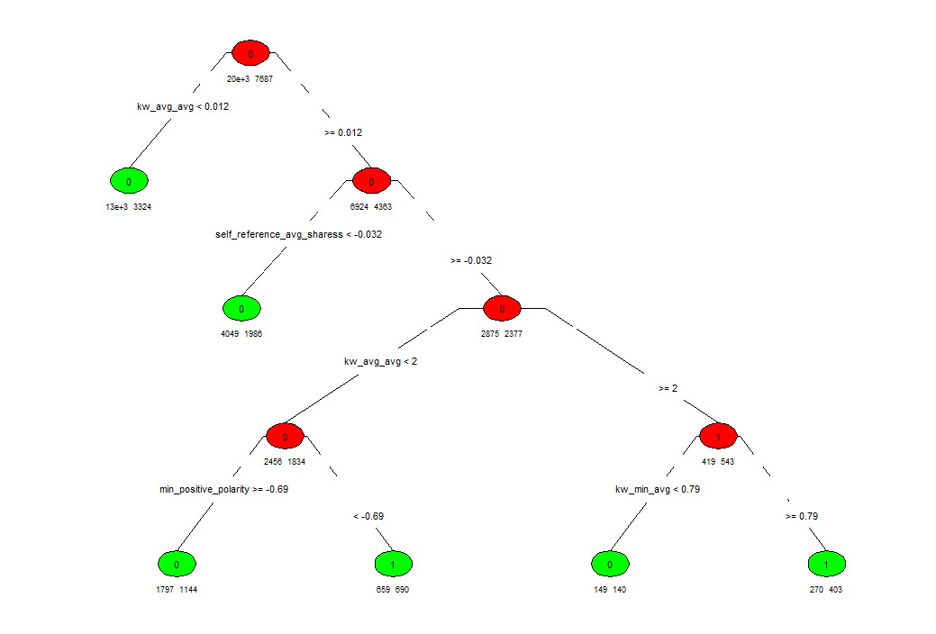
MODELS USED I: DECISION TREE
UNPRUNED TREE
THE MODEL SCORES HIGH IN SPECIFICITY (95%)
Which comes in line with the expectation that a false positive is far more costly than a false negative

Slide 12
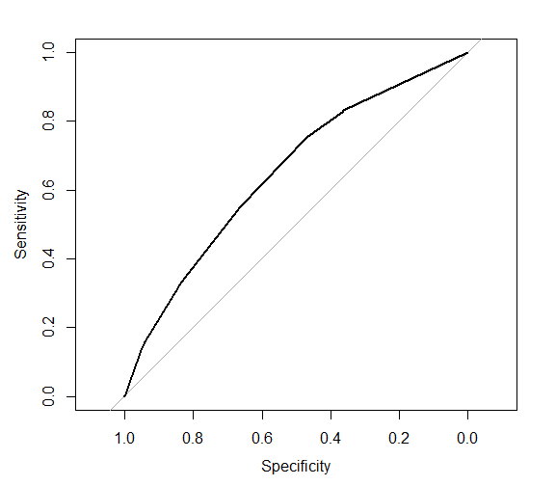
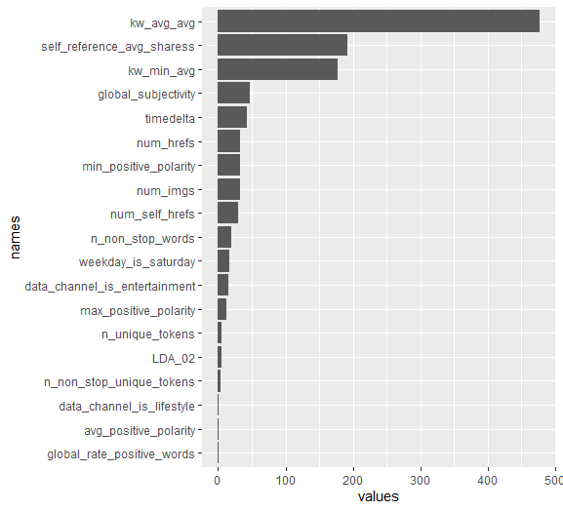
MODELS USED I: DECISION TREE
ROC Curve: The auc score is 0.65
The variable importance plot
The variable importance plot re-iterates the trend shown previously about the keywords features. The average number of keywords used is the most important factor in the model

Slide 13
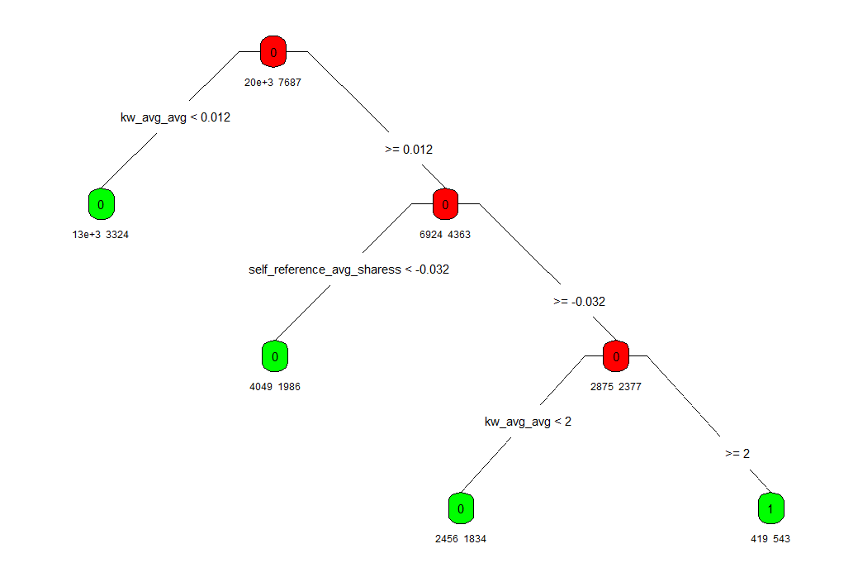
MODELS USED II: DECISION TREE
PRUNED TREE
THE MODEL SCORES ABOUT THE SAME IN SPECIFICITY (96%).
Overall accuracy is 72.1% down from 72.6%. Hence, the pruned and unpruned trees are the same

Slide 14
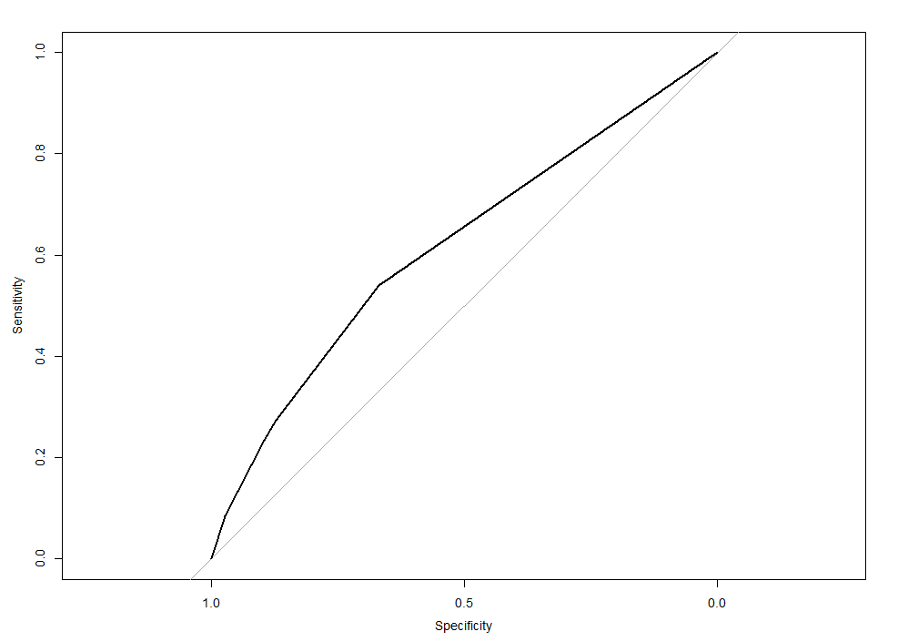
MODELS USED I: DECISION TREE
ROC Curve: The auc score is 0.65
The variable importance plot
The variable importance plot of the smaller tree. The smaller tree highlights the same trend as the bigger one but uses fewer features.

Slide 15
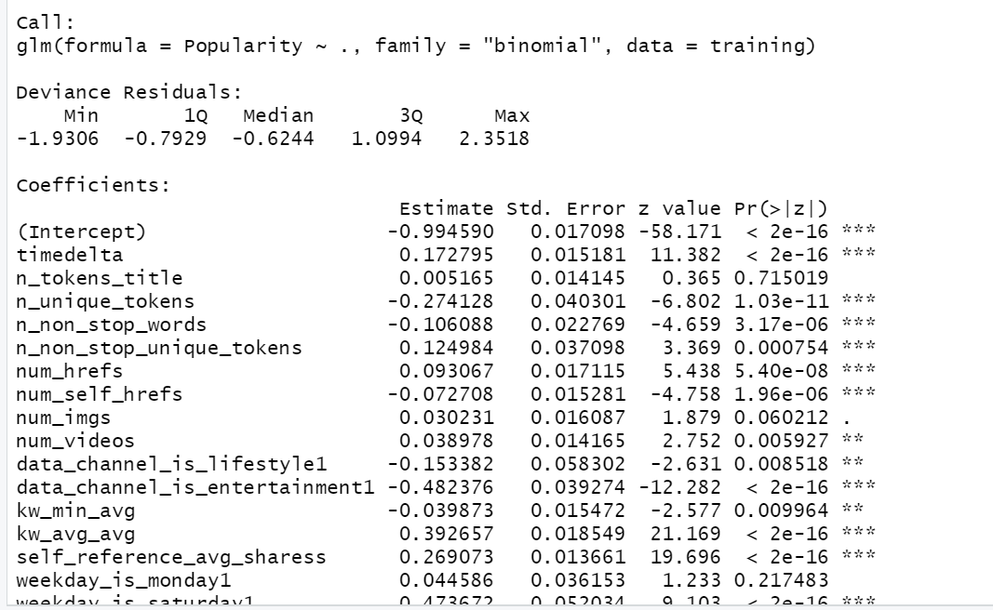
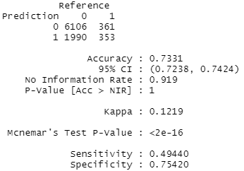
MODELS USED II: LOGISTIC MODEL
THE SPECIFICITY VALUES WERE:

Slide 16
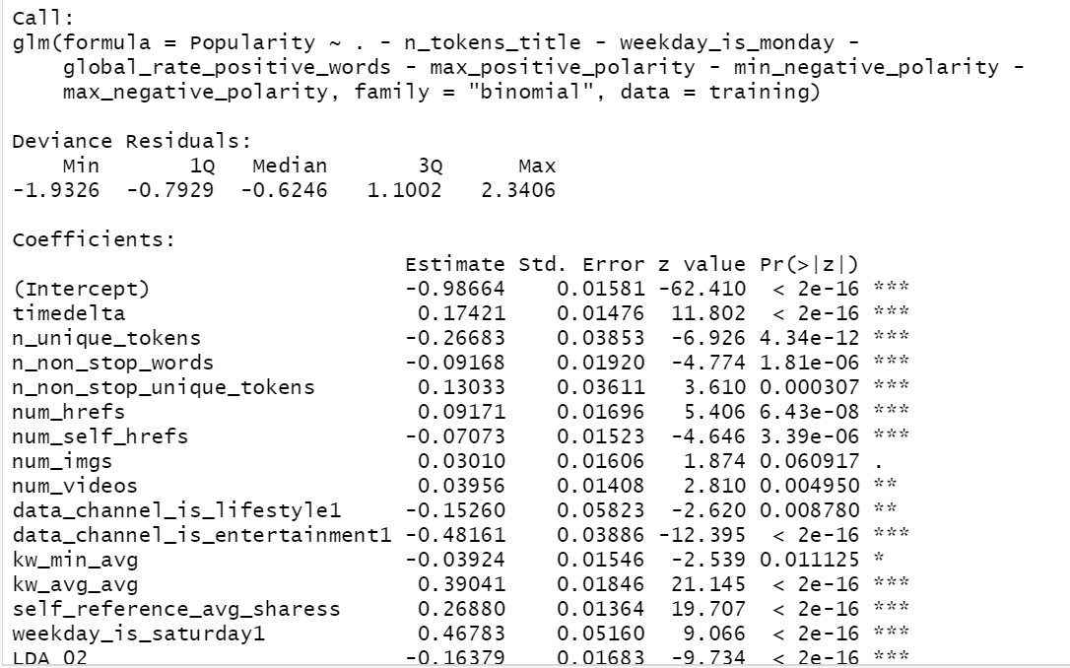
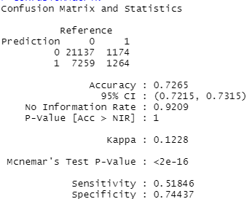
MODELS USED II: LOGISTIC MODEL
After removing variables that are not significant enough, we obtained the following model

Slide 17
RECOMMENDED MODEL
We recommend the decision tree model as it has higher specificity and reduces the number of False positives.
A false negative would require the media house to review the article again before publishing. This would increase the costs yet is far less costly than losing the customer base due to unpopular articles.

Slide 18
Managerial Recommendations
Try to publish weak articles during the weekend
Try to use as many relevant keywords as possible. However, LDA_00 (Closeness to the topic) is also important and too many frivolous keywords will backfire
Use discretion as this model is designed to reduce the specificity

Slide 19
Thank you

