Slide 1

CAPSTONE PROJECT HACKATHON
PAVAN KUMAR
4706 BATCH_116

Slide 2
CONTENTS
OBJECTIVE
PROBLEM STATEMENT
01
SOLUTION REQUIREMENT
MODEL DEVELOPMENT
02
MODEL DEPLOYMENT
CONCLUSION
03

Slide 3
OBJECTIVE
The Main objective of solving this Machine Learning (ML) problem is to Develop a predictive Model which customers are likely to churn so that they can take proactive measures to retain them.
Deploying a Model where it allows the model to be used in real-world applications.

Slide 4
PROBLEM STATEMENT
Predicting Customer Churn in a Telecom Company:
A telecom company is facing a high customer churn rate and wants to reduce it. Customer churn refers to the process where a customer stops doing business with a company. In the telecom industry, customer churn is a major problem as acquiring new customers is more expensive than retaining existing customers. The company wants to use machine learning to predict which customers are likely to churn so that they can take proactive measures to retain them.
The data set includes information about:
1. Demographic info about customers – gender, age range, and if they have partners and dependents
2. Services that each customer has signed up for – phone, multiple lines, internet, online security, online backup, device protection, tech support, and streaming TV and movies

Slide 5
3.Customer account information – how long they’ve been a customer, contract, payment method, paperless billing, monthly charges, and total charges
4. Customers who left within the last month – the column is called Churn
CONTRACT
PAPERLESS BILLING
PAYMENT METHOD
MONTHLY CHARGES
TOTAL CHARGES
03
CHURN
04
CUSTOMER ID
GENDER
SENIOR CITIZEN
PARTNER
DEPENDENTS
01
PHONE SERVICE
MULTIPLE LINES
INTERNET SERVICE
ONLINE SECURITY
ONLINE BACKUP
DEVICE PROTECTION
TECH SUPPORT
STREAMING TV
STREAMING MOVIES
02

Slide 6
SOLUTION REQUIREMENT
ML problem statement - Business Case
Data Preprocessing
Data Exploration
Visualization
Models
Validation and Parameter Tuning
Model Deployment

Slide 7
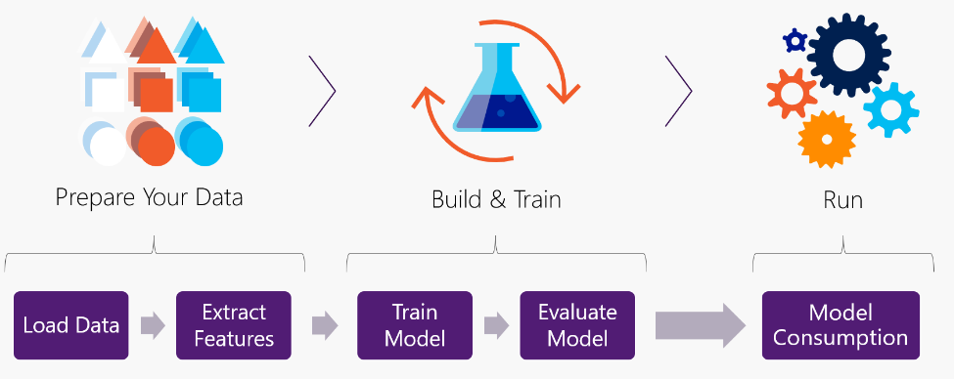
MODEL DEVELOPMENT

Slide 8
Solving a machine learning problem involves a series of steps that must be followed to ensure success. Below is a step-by-step guide on how to solve a machine learning problem:
Step 1: Define the problem
Define the problem we are trying to solve. What is the objective of machine learning model? What are the inputs and outputs? Is it a classification or regression problem – Here our Machine Learning Problem is a Classification Problem.
Step 2: Collect the data
Collecting the data for our problem. The data should be relevant and sufficient to address the problem. The data should be collected in a way that ensures it is unbiased and represents the real-world scenario.
Step 3: Data Preprocessing
It refers to the set of techniques and procedures applied to raw data to transform it into a format that is suitable for further analysis or modeling. It involves a series of steps that are applied to data to clean, transform, and enrich it in order to extract meaningful insights and knowledge. The following are some of the steps involved in data preprocessing:

Slide 9
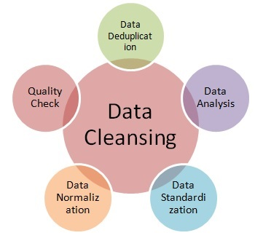
Data Cleaning: This involves handling missing or erroneous data, outliers, and duplicates. Techniques such as imputation, removing outliers, and removing duplicates may be used.
Feature Selection: This involves identifying the most important features in the dataset and removing irrelevant or redundant features. Feature selection techniques may include statistical methods such as correlation analysis, or machine learning algorithms such as decision trees or random forests.
Feature Scaling: This involves scaling or normalizing the features to ensure that they are on the same scale. Scaling can improve the performance of some machine learning algorithms such as SVMs.

Slide 10
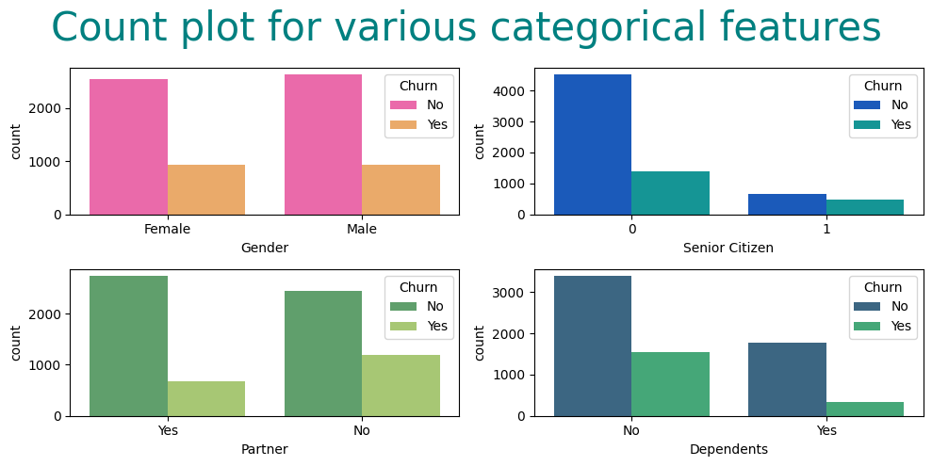
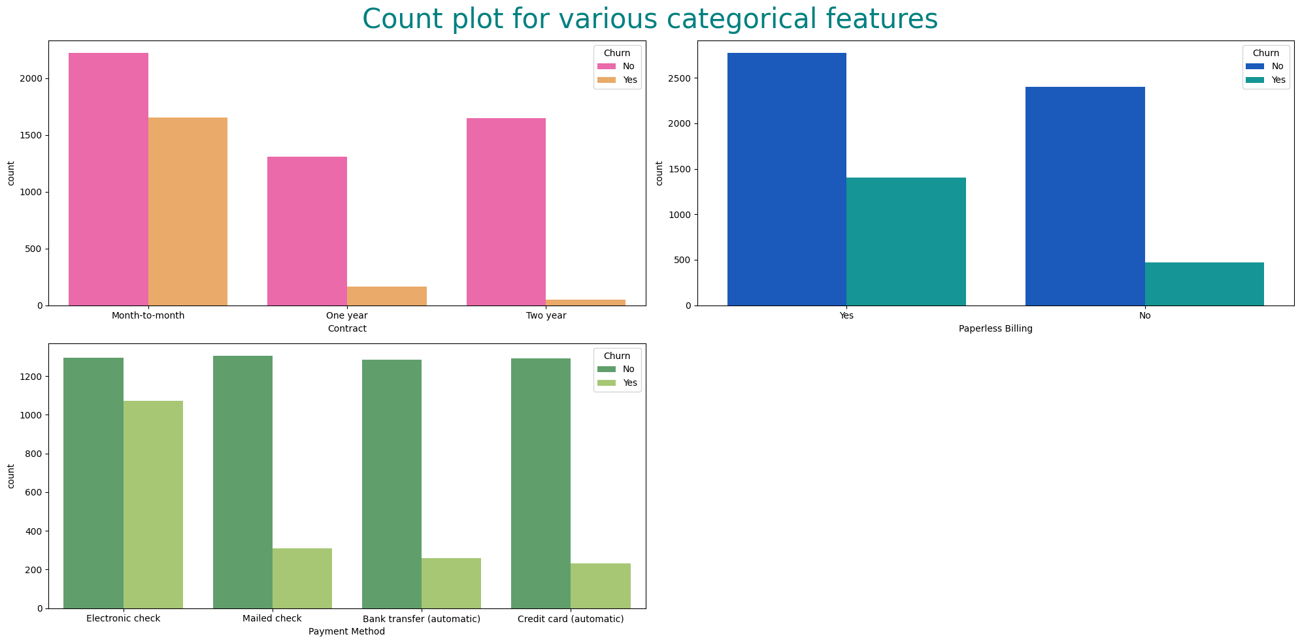
4. Data visualization : Data visualization is the process of representing data in a visual format, such as graphs, charts, and maps, to facilitate understanding and communication. It involves using graphical elements like bars, lines, and dots to present data in an easy-to-understand manner. The goal of data visualization is to make complex data more accessible, understandable, and actionable.

Slide 11
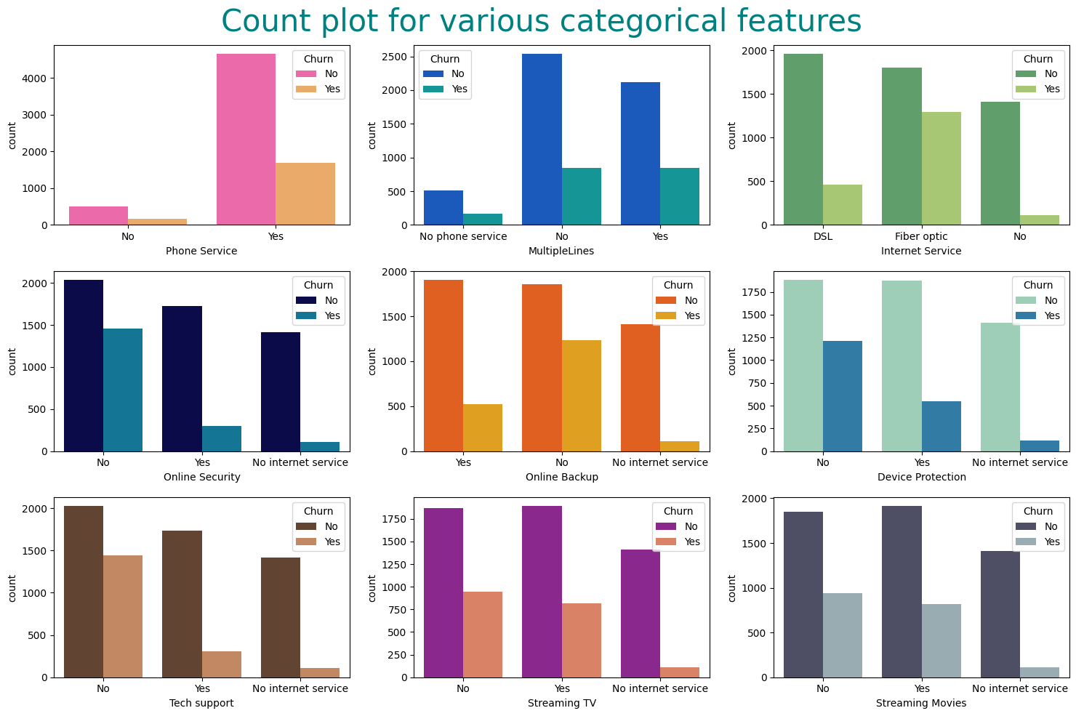

Slide 12
5. Data Transformation: This involves transforming the data to make it more suitable for modeling. Common techniques include one-hot encoding, label encoding, and feature scaling.
6. Data Splitting: This involves splitting the dataset into training, validation, and testing sets. The training set is used to train the model, the validation set is used to tune the hyperparameters of the model, and the testing set is used to evaluate the performance of the final model.
Step 5: Select the algorithm :
In our Model I tried with so many Classification Algorithm and they are as below:
Logistic Regression: A popular algorithm for binary classification problems that predicts the probability of an event occurring.
Decision Tree: A simple yet effective algorithm that can handle both binary and multi-class classification problems. It works by recursively splitting the data into smaller subsets based on the values of the input features.
Naive Bayes: A probabilistic algorithm that is based on the Bayes' theorem. It is fast and efficient, and works well in text classification problems.

Slide 13
4. Random Forest: An ensemble learning algorithm that combines multiple decision trees to improve accuracy and reduce overfitting.
5. Support Vector Machines (SVM): A powerful algorithm that is effective in both linear and non-linear classification problems. It works by finding the best hyperplane that separates the data into different classes.
6. K-Nearest Neighbors (KNN): An instance-based learning algorithm that classifies new data points based on the classes of their k-nearest neighbors.
7. XG Boost (eXtreme Gradient Boosting) : is a variant of Gradient Boosting that was developed to improve performance and scalability. It includes several optimization techniques such as parallel processing, tree pruning, and cache awareness, which can significantly speed up training and improve predictive accuracy.

Slide 14
Step 4: Evaluating the Model:
Evaluate the performance of the trained machine learning model on the validation set. Use appropriate metrics to determine how well the model is performing.
Step 5: Tuning Hyperparameters:
Adjust the hyperparameters of the machine learning model to improve its performance on the validation set. There are several methods for hyperparameter tuning, including grid search, random search, and Bayesian optimization.
1.Grid search involves exhaustively searching a predefined range of values for each hyperparameter. This method can be computationally expensive for a large number of hyperparameters or a wide range of values.
2. Random search involves randomly sampling values from a predefined range of values for each hyperparameter. This method is less computationally expensive than grid search and can be effective for high-dimensional search spaces

Slide 15
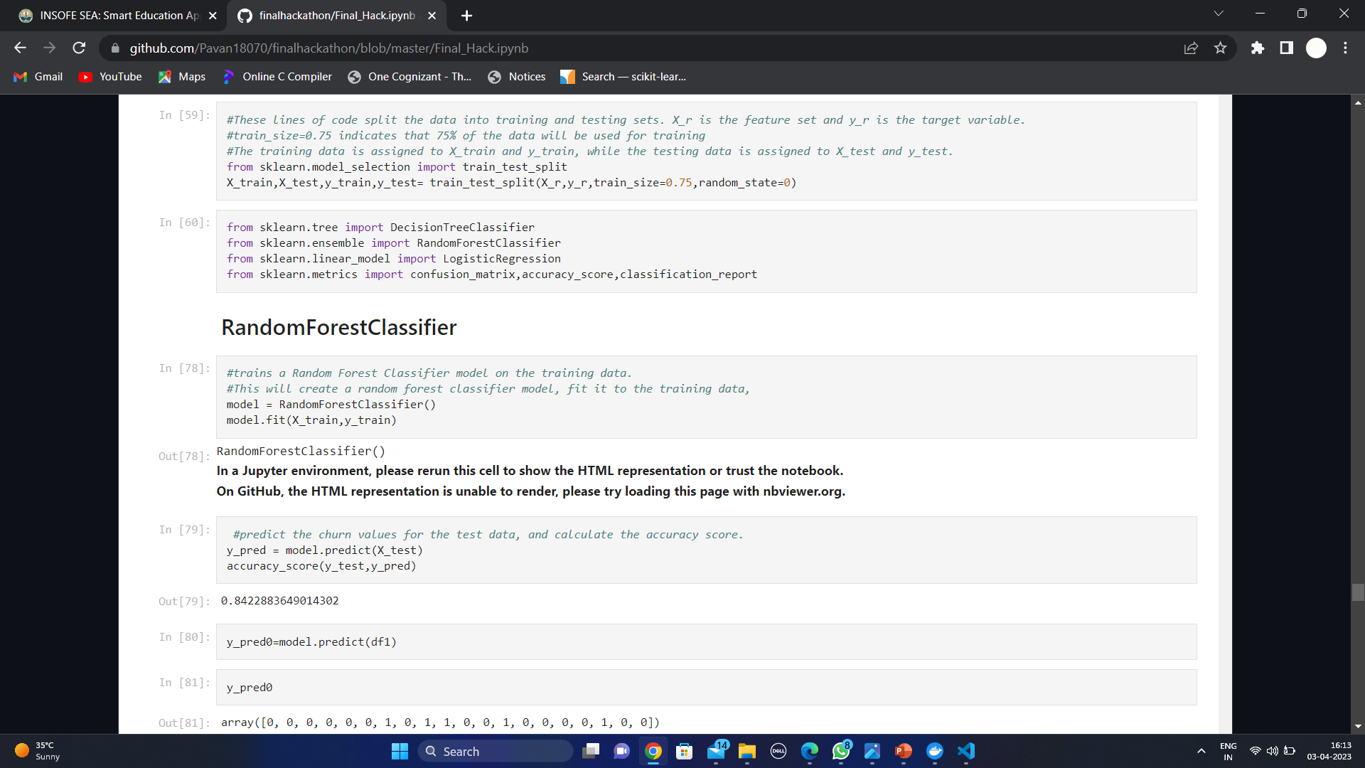

Slide 16
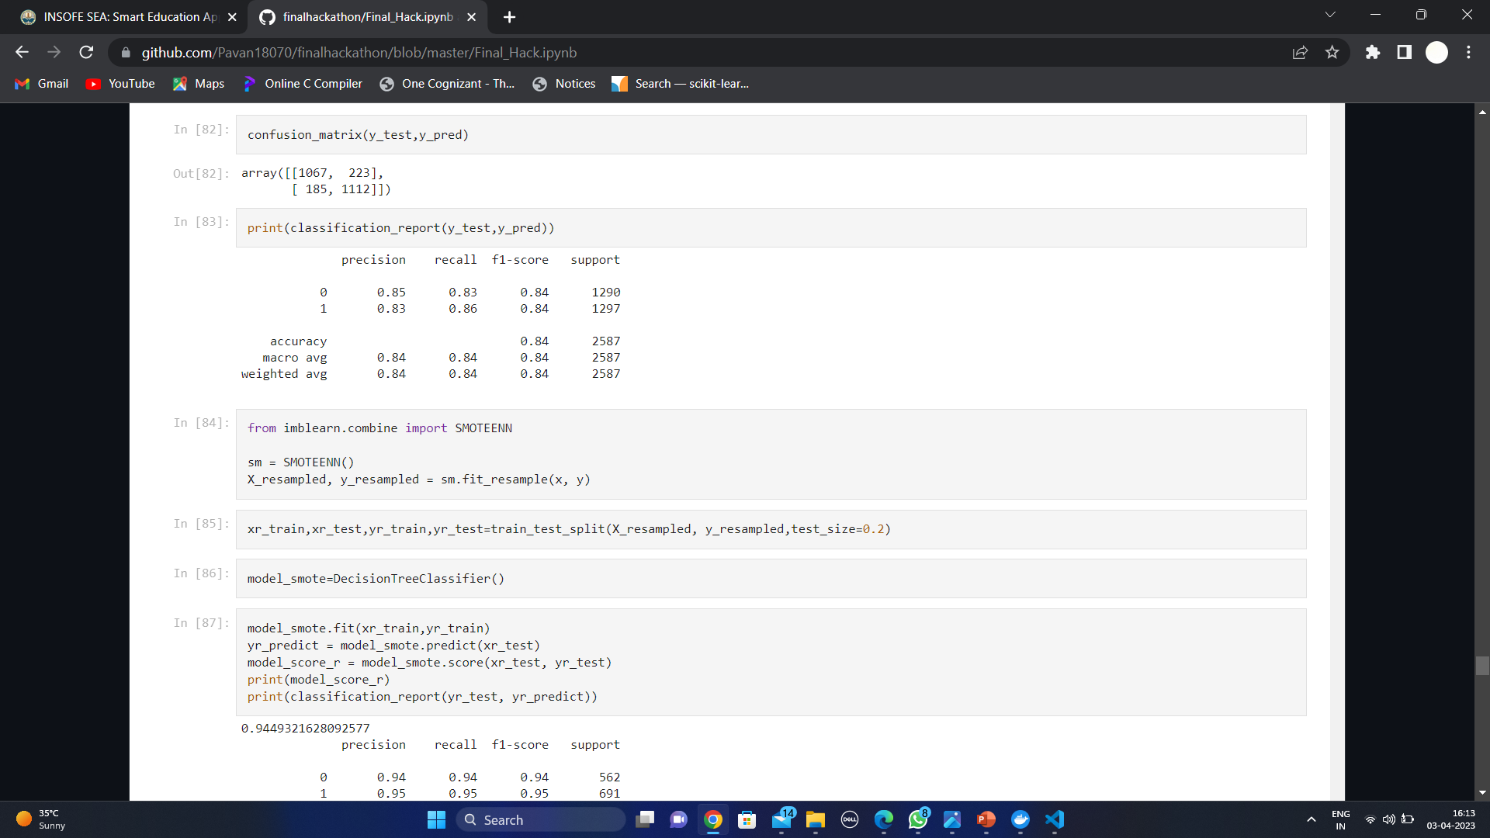
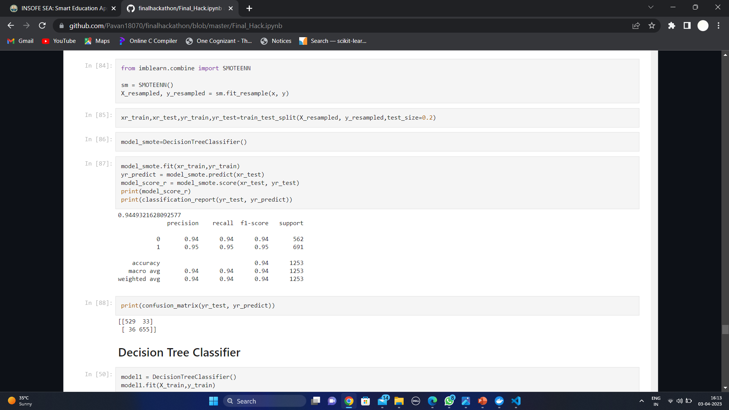

Slide 17
Step 6: Testing the Model:
Once the model has been trained and tuned, test it on the testing set to evaluate its final performance. This step is critical to ensure that the model can generalize well to new data.
Random Forest classifier :
Before SMOTENN
Accuracy:84.22
After SMOTEEN
Accuracy:94.49
Decision Tree Classifier :
Before SMOTENN
Accuracy:78.27
After SMOTEEN
Accuracy:93.45

Slide 18
Results of Other Algorithm
LR: 80.2499 (0.012202)
KNN: 75.1945 (0.013929)
RF: 79.1706 (0.014849)
NB: 75.1668 (0.010033)
SVM: 79.7956 (0.010049)
X G boost: 78.4751 (0.018192)

Slide 19
Confusion matrix classification Reports of
Random forest classifier(Before SMOTENN)
Decision Tree (Before SMOTENN)
 | precision | recall | f1-score | support
0 | 0.85 | 0.83 | 0.84 | 1290
1 | 0.83 | 0.86 | 0.84 | 1297
Accuracy |  |  | 0.84 | 2587
macro avg | 0.84 | 0.84 | 0.84 | 2587
weighted avg | 0.84 | 0.84 | 0.84 | 2587
 | precision | recall | f1-score | support
0 | 0.79 | 0.77 | 0.78 | 1290
1 | 0.78 | 0.79 | 0.79 | 1297
Accuracy |  |  | 0.78 | 2587
macro avg | 0.78 | 0.78 | 0.78 | 2587
weighted avg | 0.78 | 0.78 | 0.78 | 2587

Slide 20
Confusion matrix classification Reports of
Random forest classifier(After SMOTENN)
Decision Tree (After SMOTENN)
 | precision | recall | f1-score | support
0 | 0.94 | 0.94 | 0.94 | 562
1 | 0.95 | 0.95 | 0.95 | 691
Accuracy |  |  | 0.94 | 1253
macro avg | 0.94 | 0.94 | 0.94 | 1253
weighted avg | 0.94 | 0.94 | 0.94 | 1253
 | precision | recall | f1-score | support
0 | 0.92 | 0.93 | 0.92 | 535
1 | 0.94 | 0.94 | 0.94 | 718
Accuracy |  |  | 0.93 | 1253
macro avg | 0.93 | 0.93 | 0.93 | 1253
weighted avg | 0.93 | 0.93 | 0.93 | 1253

Slide 21
MODEL DEPLOYMENT
Deploying a model is crucial as it allows the model to be used in real-world applications. Without deployment, the model remains limited to the development environment and cannot be integrated into production systems or used to make predictions on new data.
Deployment of a model refers to the process of making a trained machine learning model available for use in a production environment. It involves taking the model from the development phase and integrating it into a larger software application, where it can be accessed and used by end-users.
The deployment process typically involves tasks such as packaging the model, selecting an appropriate deployment environment, integrating the model into the larger application, and monitoring its performance.

Slide 22
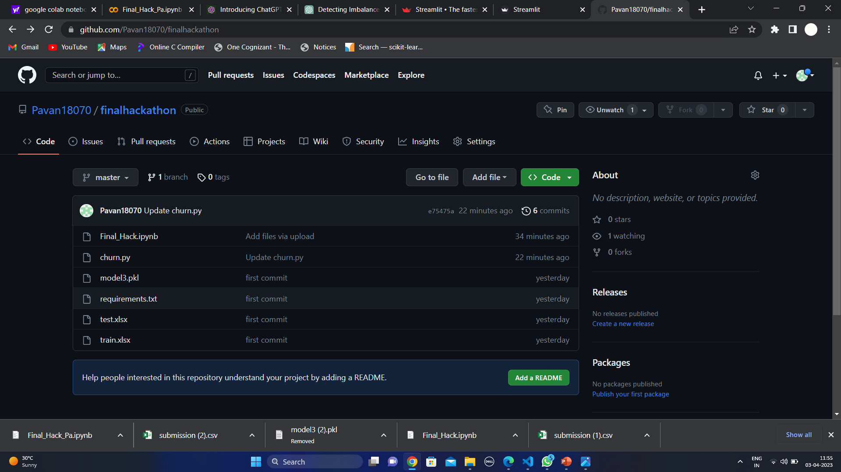
REQUIREMENTS FOR DEPLOYMENT

Slide 23
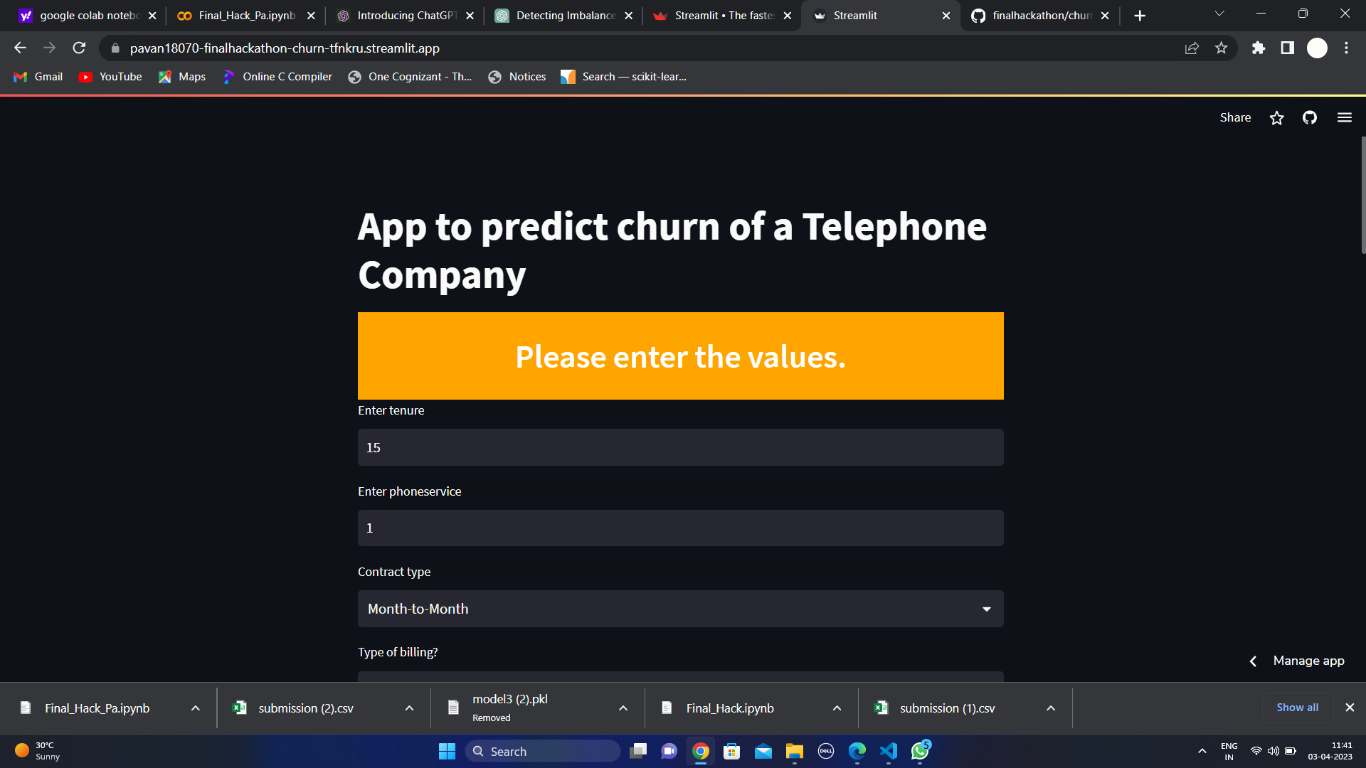
Home screen of Deployed App using Stream Lit

Slide 24
CONCLUSION
The churn of a customer can be reduced by making a new yearly contract, be proactive with customers.
The company can use this model to identify at-risk customers and implement targeted retention strategies. Additionally, the company can use feature importance metrics to identify which factors are most strongly associated with customer churn and make changes to their business practices accordingly. I got good results for Random Forest algorithm, Random Forest is a powerful and popular machine learning algorithm that belongs to the family of ensemble methods.

Slide 25
THANK YOU
PAVAN KUMAR

