Slide 1
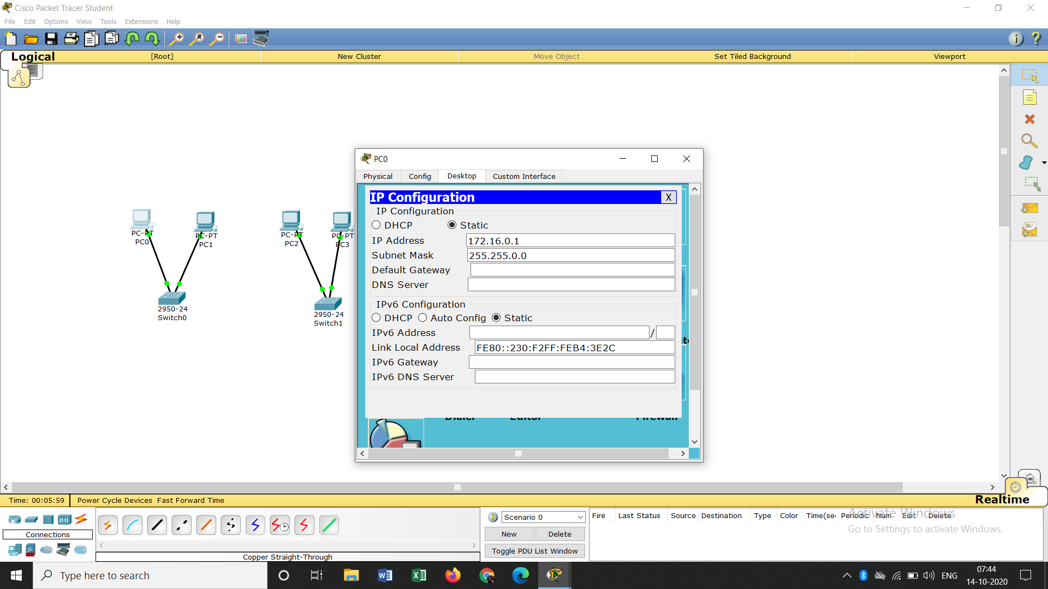

Ip and subnetmask
Adssigning the ip addresses to the end devices

Slide 2
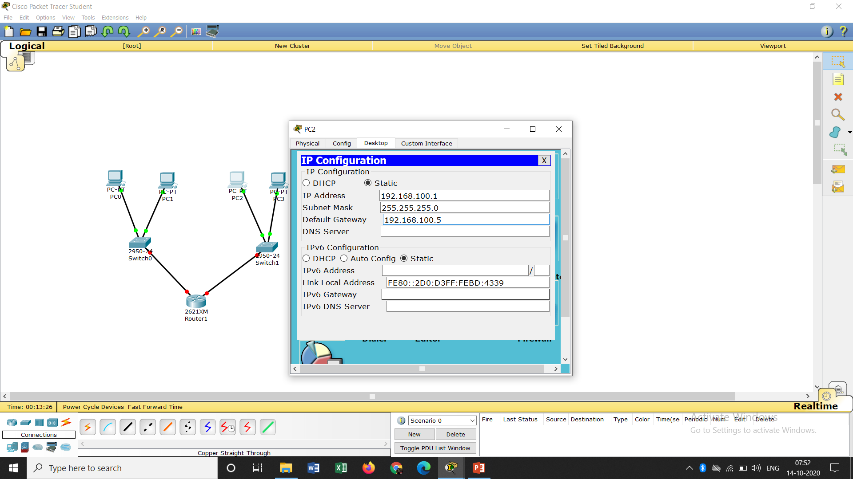
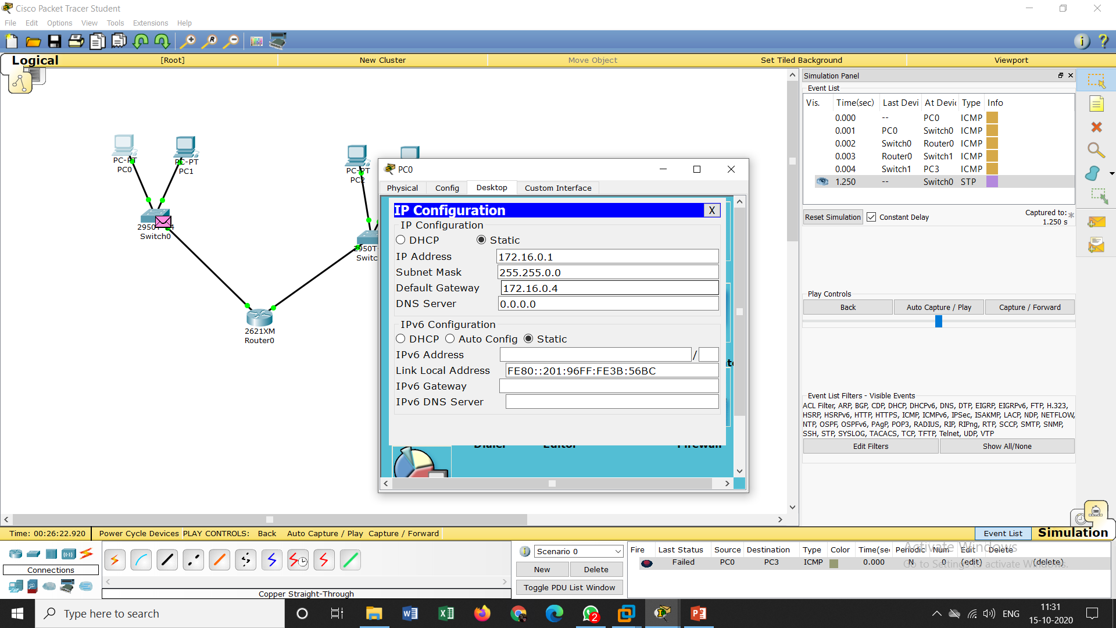
gateway
Assigning the default gateway to the
End devices

Slide 3
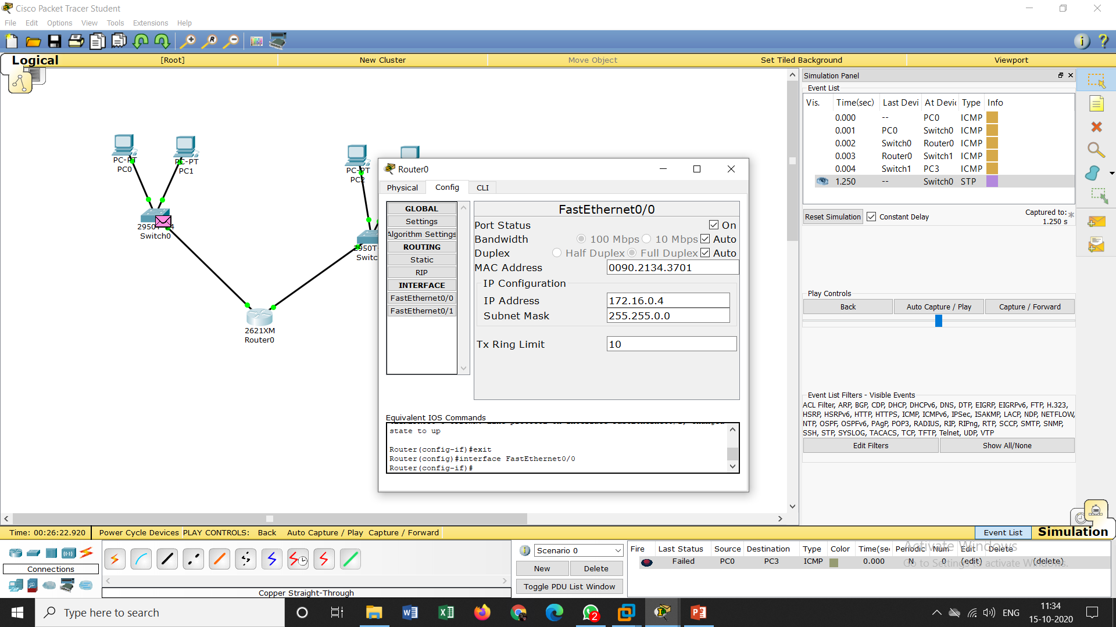
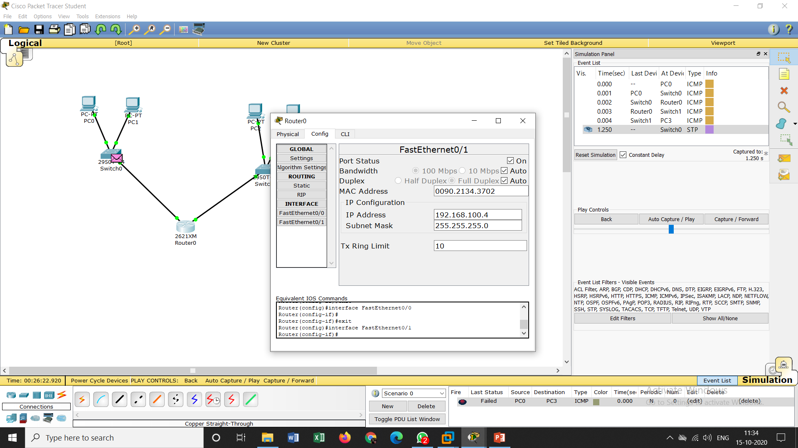
Assigning the ip to a router for fast Ethernet 0 and 1

Slide 4
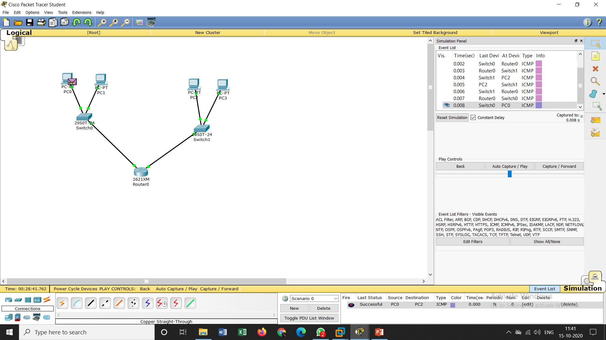
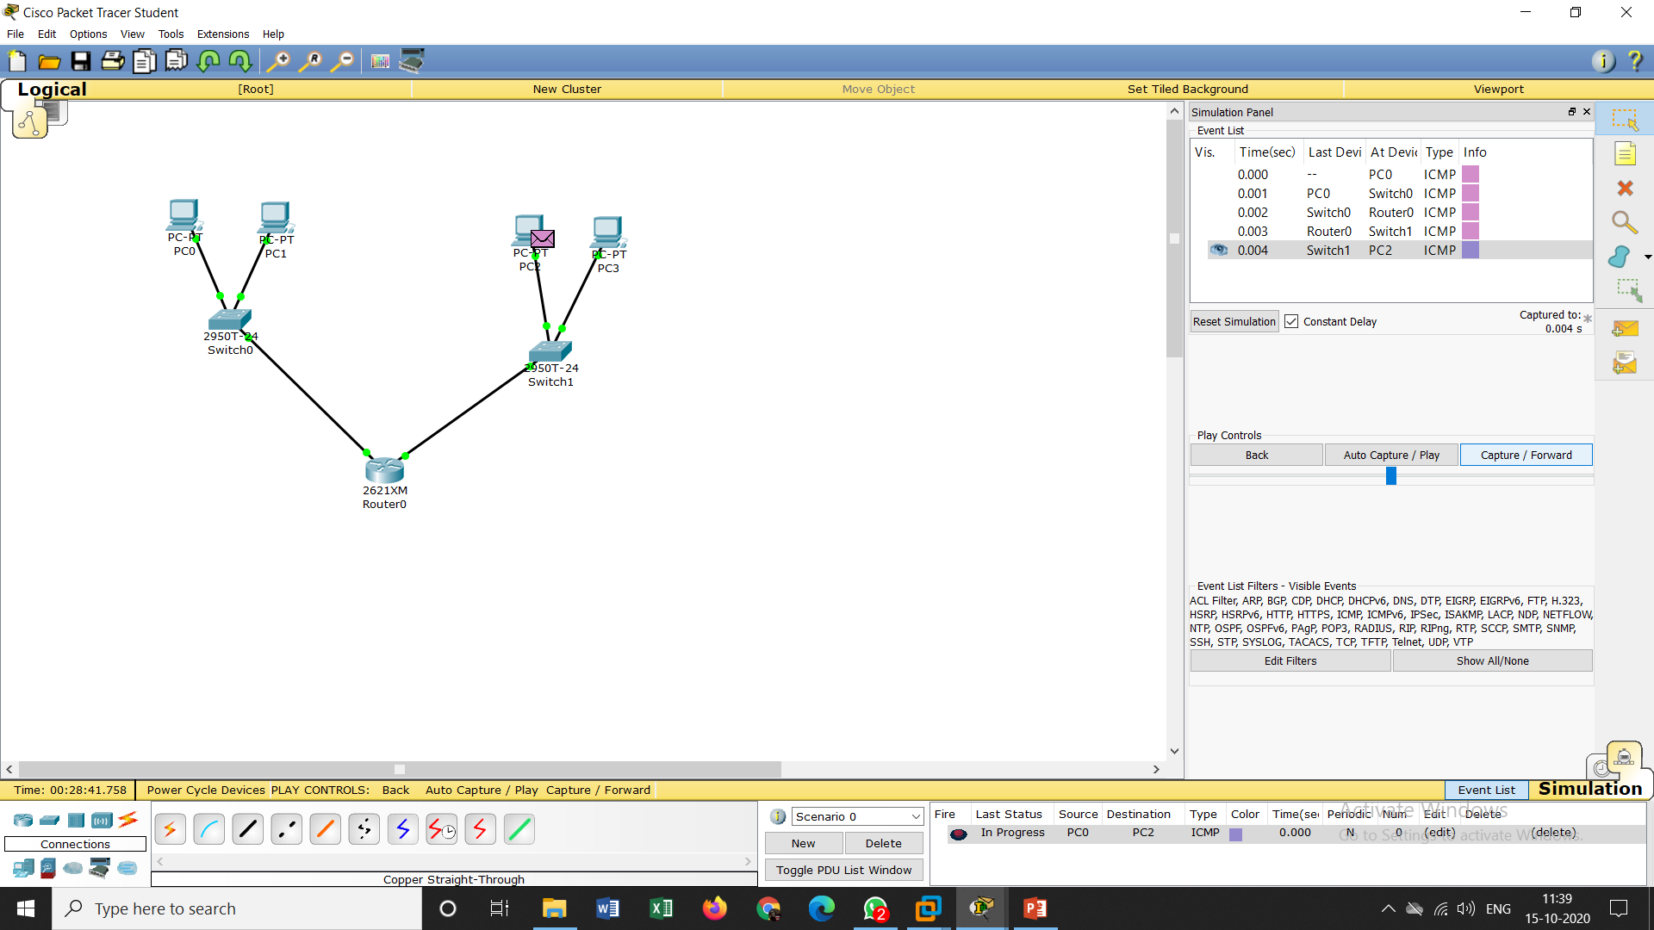
Sending the packet from pc0 to pc2

Slide 5

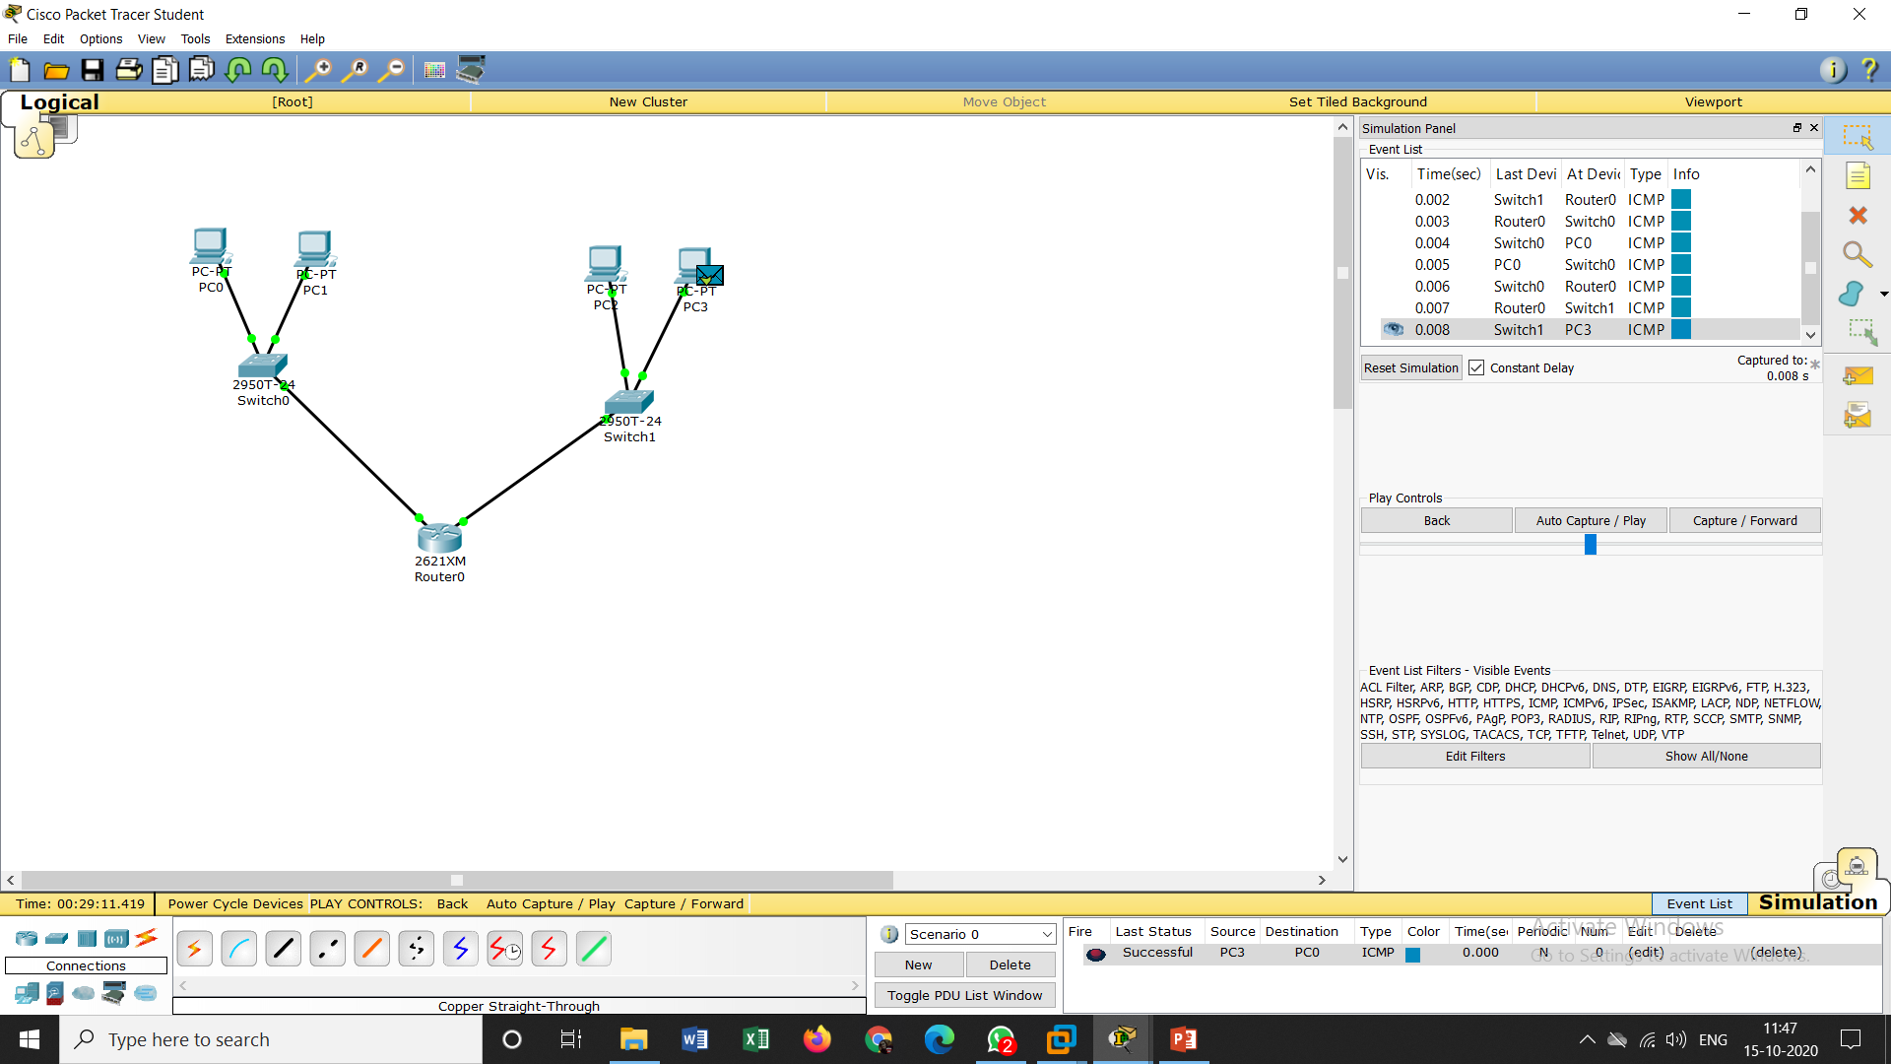
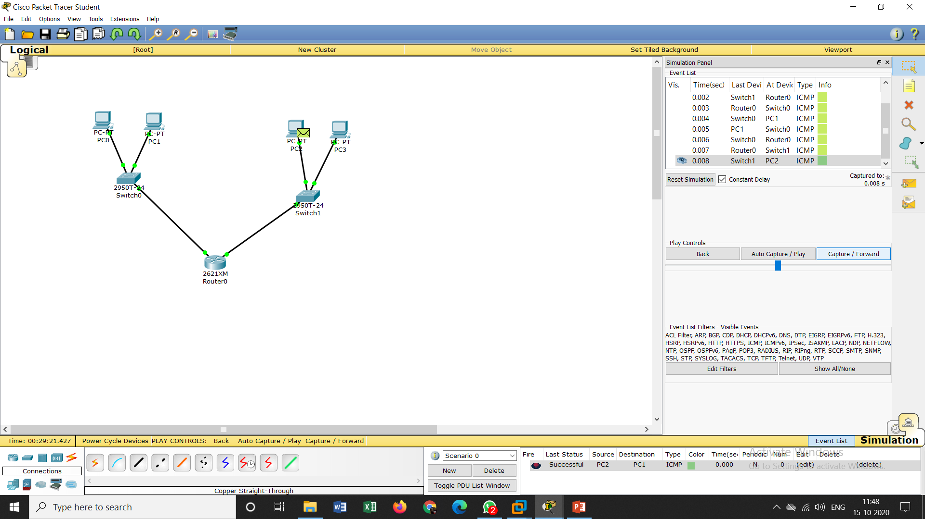
fig-1 :from pc2 to pc1 fig-2: from pc3 to pc0 fig -3:from pc2 to pc1 ending from all the end devices to every device

Slide 6
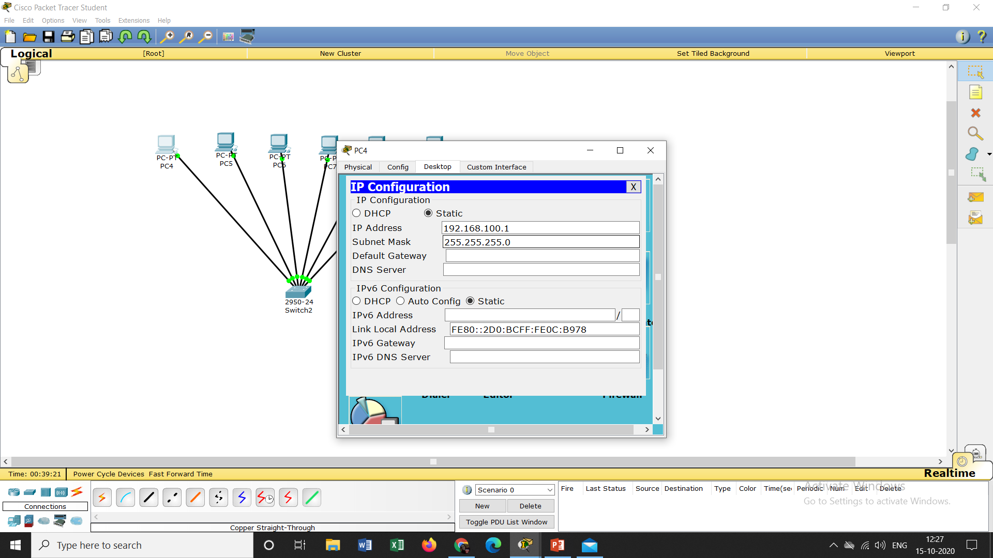
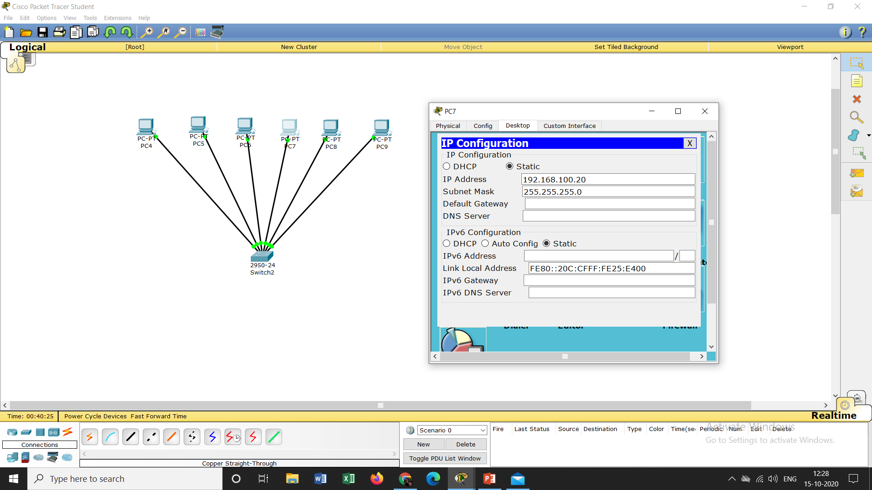
Task 2:Assigning the random ip address to the end devices

Slide 7
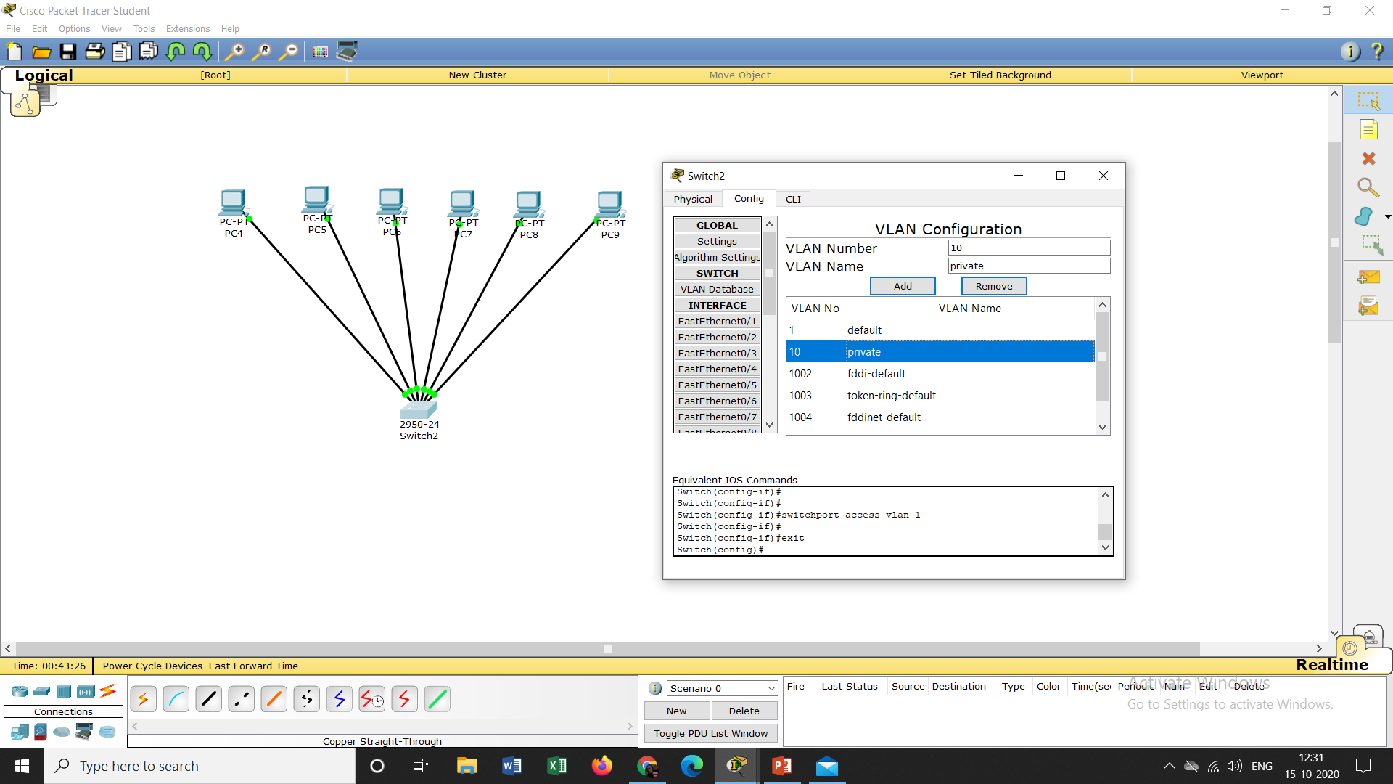
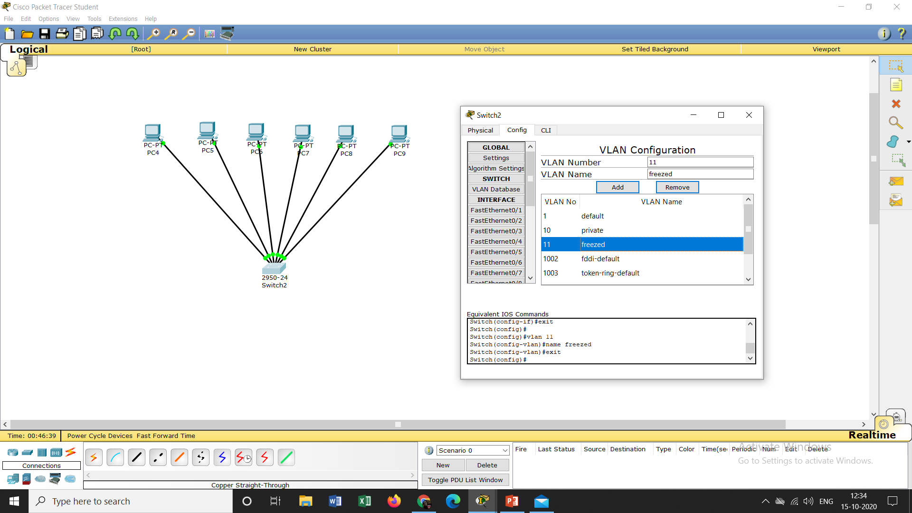
Creating a vlan number 10 name private vlan number12 name freezed

Slide 8
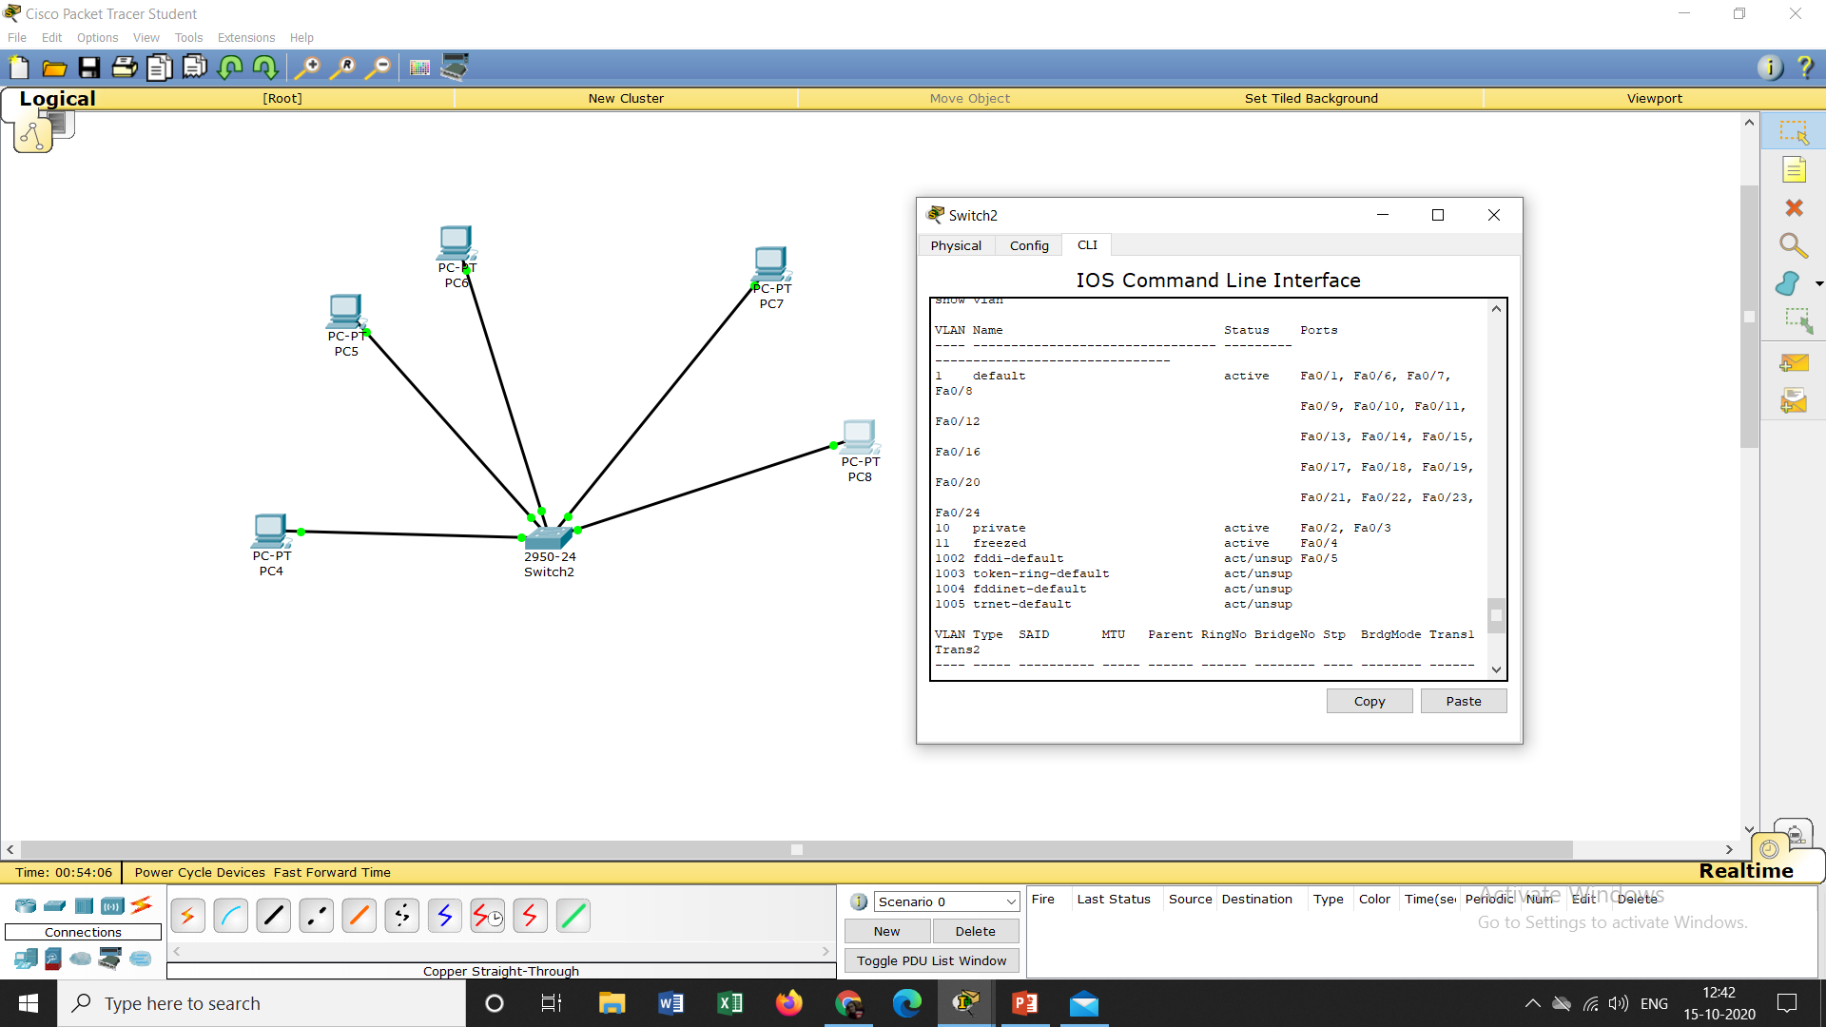
Here pc4(fa0/1)is connected to default vlan 1, pc5(fa0/2),pc6(fa0/3) iss connected to private vlan 10, pc7(fao/4) to freezed vlan 11 and pc8(fa0/5) is connected to vlan 1002 fddi-default

Slide 9
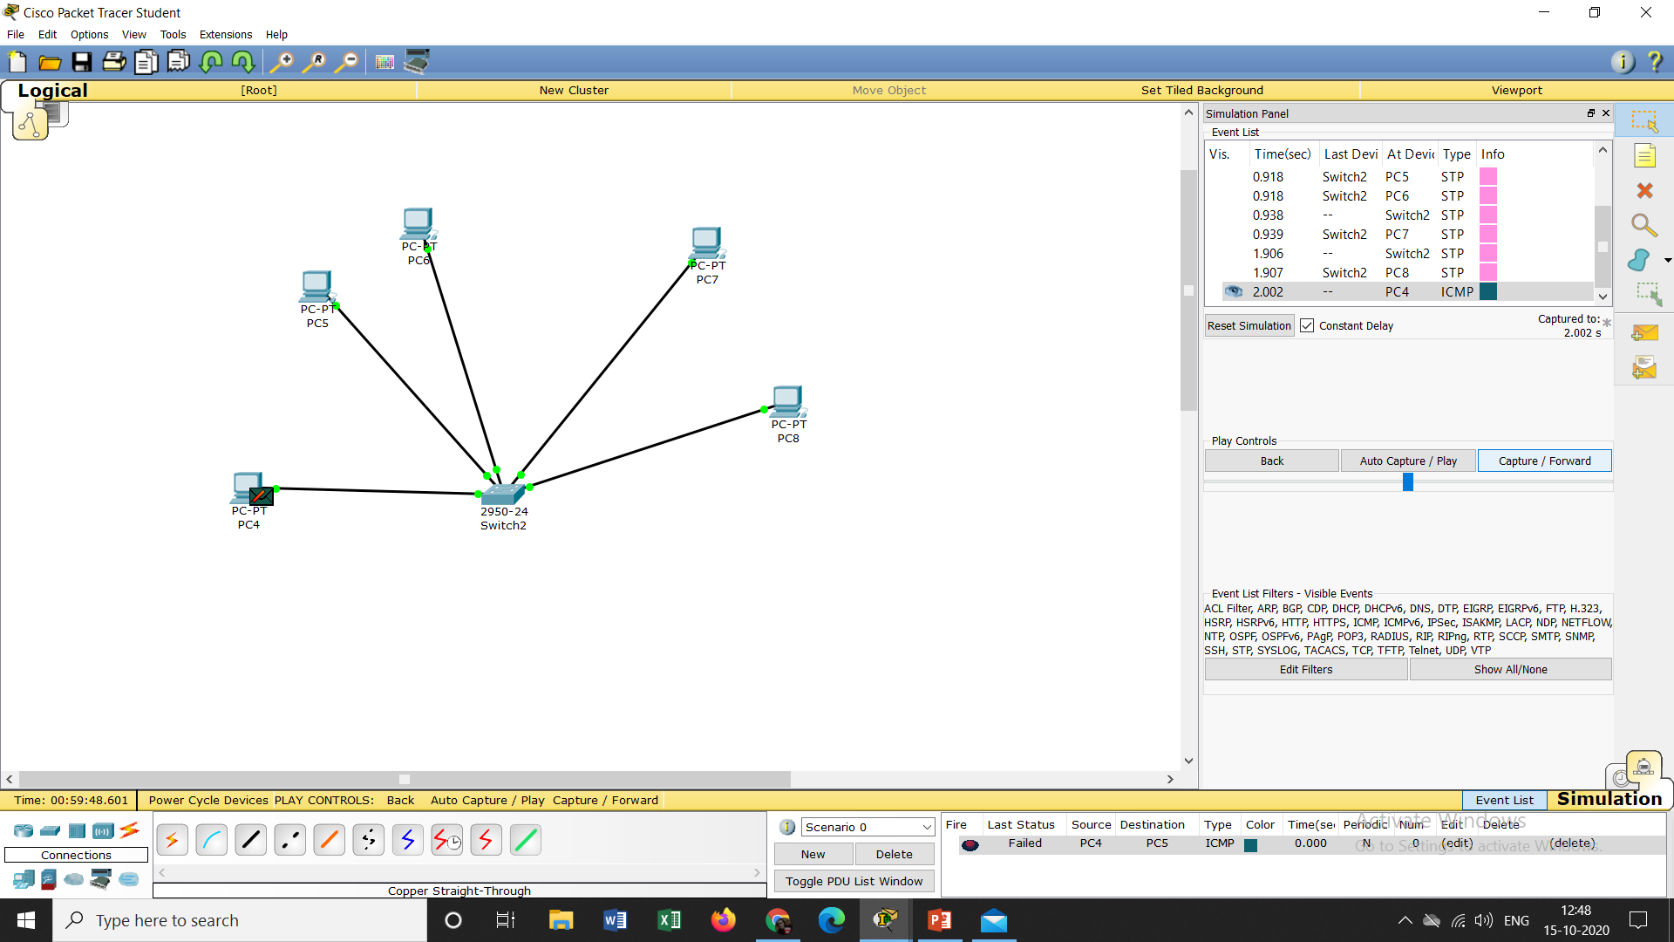
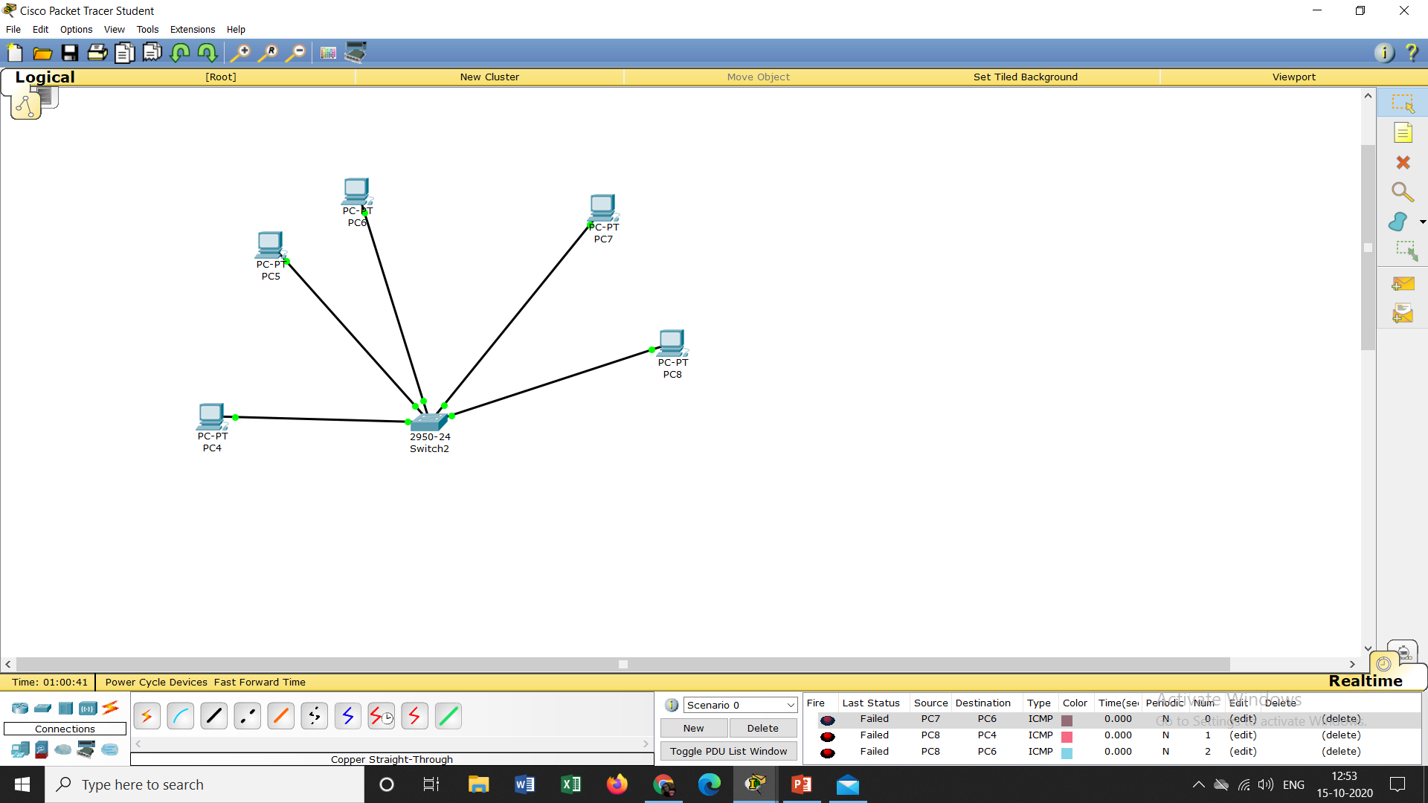
Only pc5 and pc6 can communicate each other ,Pc4 cannot communicate with any other system because it is connected in separate vlan,pc7 and pc8 both are connected to different vlans so they cannot communicate

