Slide 1
Day Opening Constraint Backup
Opening Summary
Line type: HDT
Mapped report rows: 1217
Hold orders: 14
Skip vehicles: 1
Charts
Hold by model: 1624 (BUS) = 7
Hold by model: 1924 (BUS) = 1
Hold by model: 2823R = 1
Hold by model: 2826R = 2
Hold by model: 3526R = 3
Skip by model: 2826C = 1
Hold by type: Bus = 8
Hold by type: Truck = 6
Skip by type: Bus = 0
Skip by type: Truck = 1

Slide 2
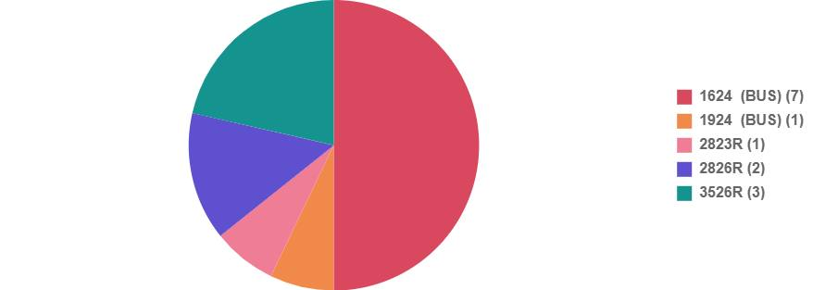
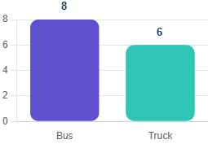
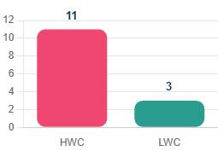
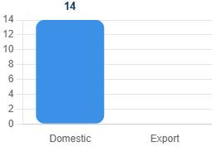
Hold PI Chart & Further Stratifications

Slide 3

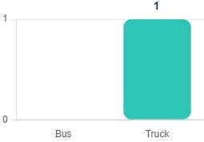
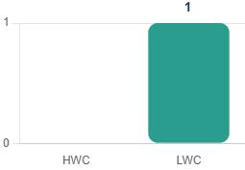
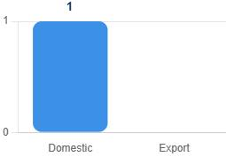
Skip PI Chart & Further Stratifications

Slide 4
Shortage Impact Analysis
Shortage Impact Analysis
A4003220479 A part: First shortage 2026-05-15 at 8:50 AM; sequence 11, 12, 13, 14, 15, 16, 17, 18, 19, 20, 21, 22, 23, 40, 43; models 3532CM
2026-05-15: Day plan 15, Shortage qty 15
2026-05-16: Day plan 0, Shortage qty 0
2026-05-18: Day plan 0, Shortage qty 0

