Slide 1
Day Opening Constraint Backup
Opening Summary
Line type: HDT
Mapped report rows: 1248
Hold orders: 24
Skip vehicles: 3
Charts
Hold by model: 1624 (BUS) = 5
Hold by model: 1924 (BUS) = 4
Hold by model: 2823R = 1
Hold by model: 2826R = 6
Hold by model: 3526R = 4
Hold by model: 5532TS = 4
Skip by model: 3532CM = 1
Skip by model: 4032T = 1
Skip by model: 5532TS = 1
Hold by type: Bus = 9

Slide 2
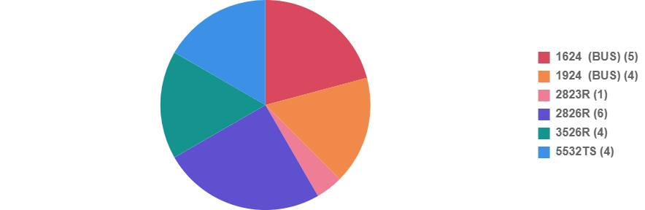
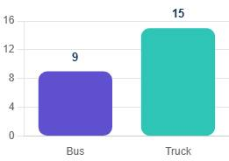
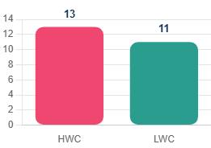
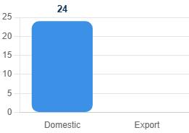
Hold PI Chart & Further Stratifications

Slide 3
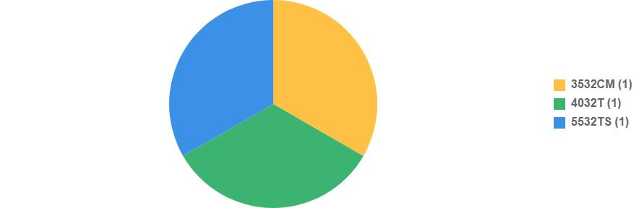
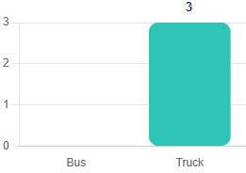
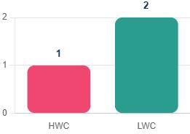
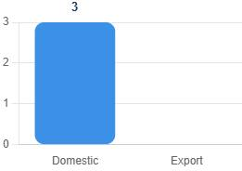
Skip PI Chart & Further Stratifications

Slide 4
Shortage Impact Analysis
Shortage Impact Analysis
A4003220479 SWIVELLING LEVER FRT LH / FA1: First shortage 2026-05-05; scheduled impact 7:10 AM; point-of-fit impact 8:40 AM at station 100; sequence 1, 21, 28, 69; models 3532CM
2026-05-05: Day plan 4, Shortage qty 4
2026-05-06: Day plan 1, Shortage qty 1
2026-05-07: Day plan 0, Shortage qty 0
2026-05-08: Day plan 0, Shortage qty 0

