Slide 1
SmartParkX
APPLICATION DOMAIN: Machine Learning
BATCH-No : IN-A04
Guide: Ms. Y. Srilatha
REGISTER NUMBERS | NAME OF STUDENTS | NO OF MEETINGS WITH GUIDE
19L31A0504 | K. CHAKRADHAR | 10
19L31A0546 | E. YATHESWAR | 10
19L31A0583 | S. TRISULE KUMAR REDDY | 10
20L35A0502 | PAVAN KALYAN MAHANTY | 10

Slide 2
Abstract
As urban populations continue to grow, finding a parking space can be a challenge for drivers. To address this problem, SmartParkX is an innovative parking system that leverages advanced technology to improve the parking experience for drivers. With features such as vehicle registration Number scanning, parking space allocation, and payment processing, SmartParkX is intended to speed up parking and lessen the time and effort needed to place a car. In this SmartParkX, we have proposed a Smart Parking System based on Machine learning techniques to answer the real time management of parking and uncertainties. The proposed solution utilizes Machine Learning models, Cloud Database, API’s, Messaging, Payments and physical systems. Development of a graphical user interface for an end-user is a major challenge as it requires smooth monitoring, control and security of the parking system. Moreover, it needs to establish effortless coordination with an end-user. The proposed system is successful in smartly addressing the challenges such as indicating status of parking slot well in advance to end-user, use of reserved and unreserved parking slots, unauthorized parking, real time analysis of free and occupied slots etc.

Slide 3
Existing System
In a conventional parking system, the driver needs to manually search for an available parking spot, which can often be time-consuming and frustrating.
There has to be human intervention also, to perform the following tasks like: 1. To open/close the barricade.
2. To collect the parking charges and issue a bill.
3. To show the available parking slots .
Overall, conventional parking systems are relatively inefficient and can be a source of frustration for both drivers and parking lot operators. This has led to the development of more advanced parking systems, such as automated parking systems and smart parking systems.

Slide 4
Proposed System
The system employs an Automatic Number Plate Recognition (ANPR) module to read the vehicle's license plate as it approaches the parking lot during the Entry Phase. This eliminates the need for manual ticketing or verification and ensures a smooth and hassle-free entry process. Additionally, the system utilizes the YOLO object detection algorithm to identify the type of vehicle as a 2-wheeler or 4-wheeler.
This information is used to allocate the appropriate parking slot and calculate the parking fee. The Space Counter algorithm is then used to allocate an available parking slot based on the type of vehicle. This algorithm helps to manage the parking lot efficiently and ensures that the available slots are allocated to the vehicles correctly based on their type. The system examines the vehicle's license plate once more with the ANPR module during the Exit Phase to determine whether it is already in the database.
If the vehicle is found, the system retrieves the check-in date and time and the type of vehicle from the database. The system then calculates the parking fee based on the fixed rates for 2-wheelers and 4-wheelers and displays it on a QR code. We also display other details such as the vehicle number, slot allocated, phone number, check-in date, check-in time, check-out date, check-out time, and the total amount to be paid.

Slide 5
Modules
SmartParkX is based on the following modules..
1. ANPR (Automatic Number Plate Recognition): Vehicle number plates are recognized automatically using module. In order to extract the number plate's alphanumeric characters, the ANPR module takes a picture of the number plate and
uses character identification and image processing algorithms to process it.
2. YOLO (You Only Look Once): We use this module with Non-Maximum Suppression (NMS) for Identification of vehicles as 2-wheeler or 4-wheeler. It generates several bounding boxes and related confidence values for each object it detects, including vehicles.
3. Active Contour: Active contours are primarily used in image processing to create closed contours for regions and designate smooth shapes in images. It is primarily used to spot asymmetrical patterns in pictures.

Slide 6
System Requirements
Software Requirements
Software’s to be installed : VS Code, Dbeaver
Programming Language : Python
Framework : Flask
Libraries: NumPy, Pandas, Matplotlib, Scikit Learn, EasyOCR, Pillow, Pypng, PyQRCode, Twilio, Mysql Connector or Python
Hardware Requirements
Processor: Multi Core Processor
RAM: 8GB (Minimum)
Hard Disk: 3GB (Minimum)

Slide 7
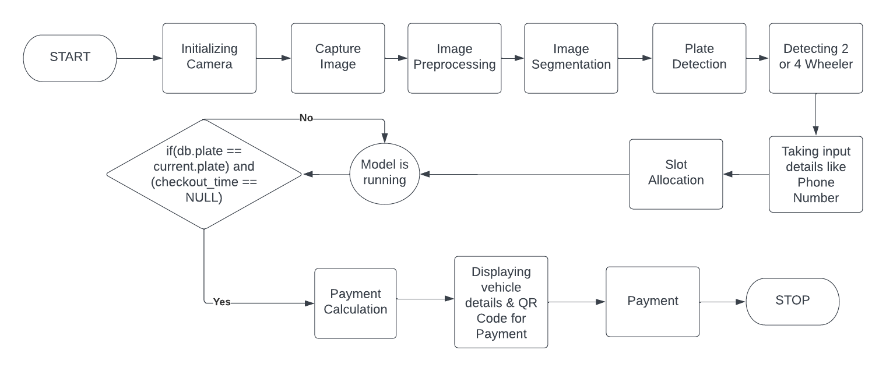
Methodology/Algorithm(s)
.

Slide 8
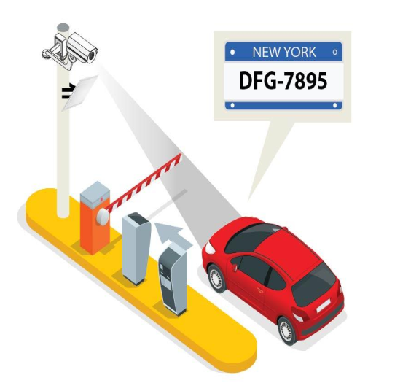
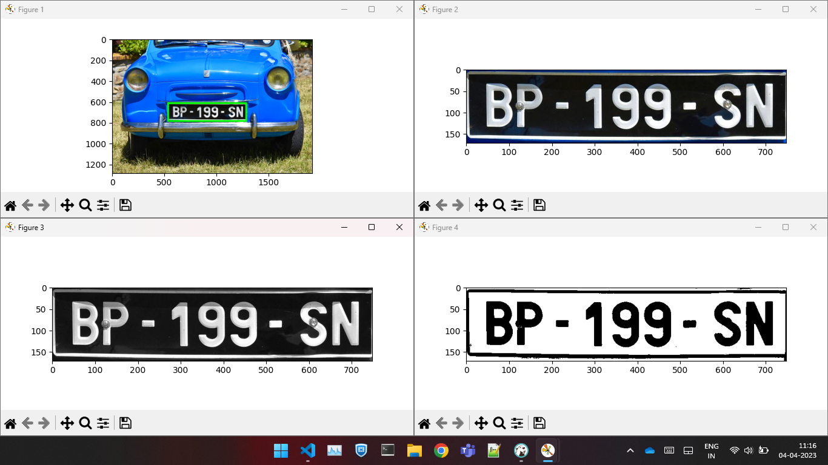
Results
Stage -1:

Slide 9
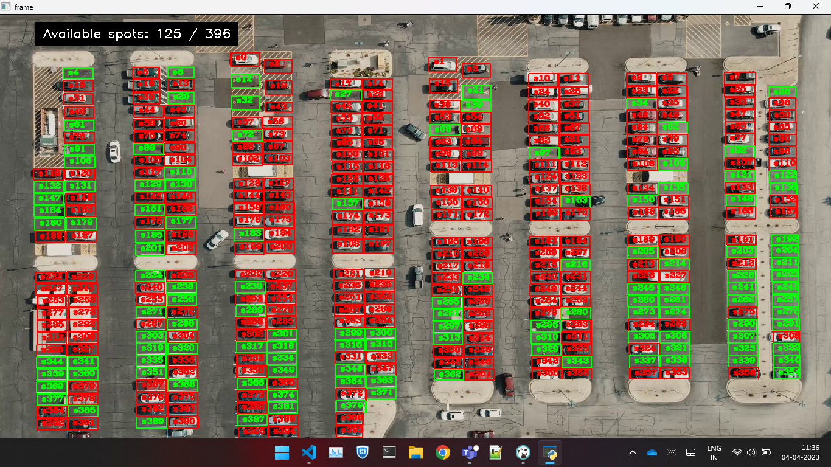
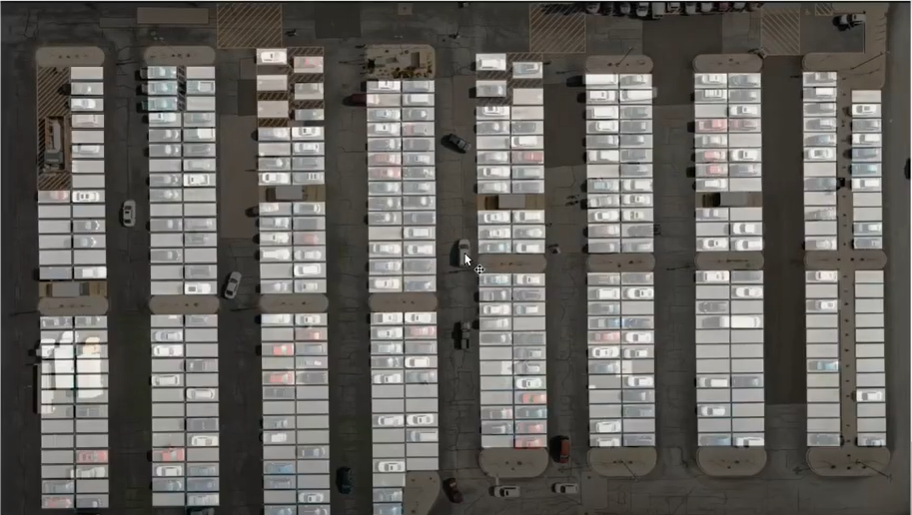
Stage - 2:

Slide 10
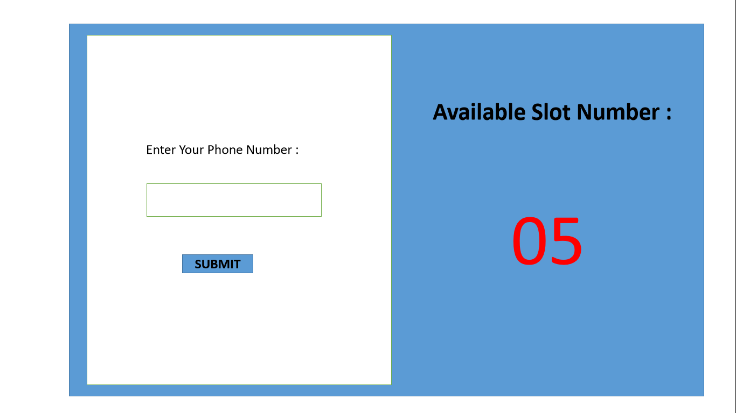
Stage - 3:

Slide 11
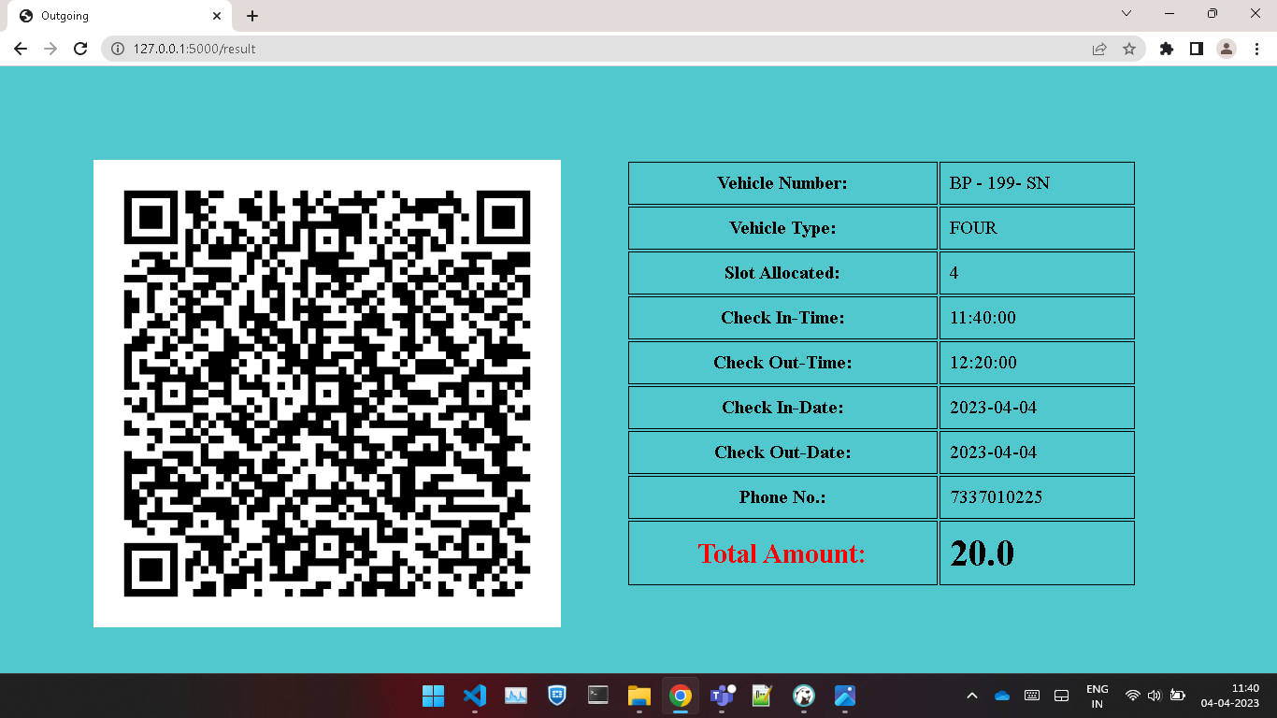
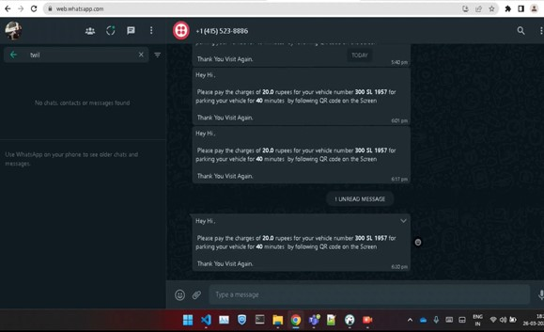
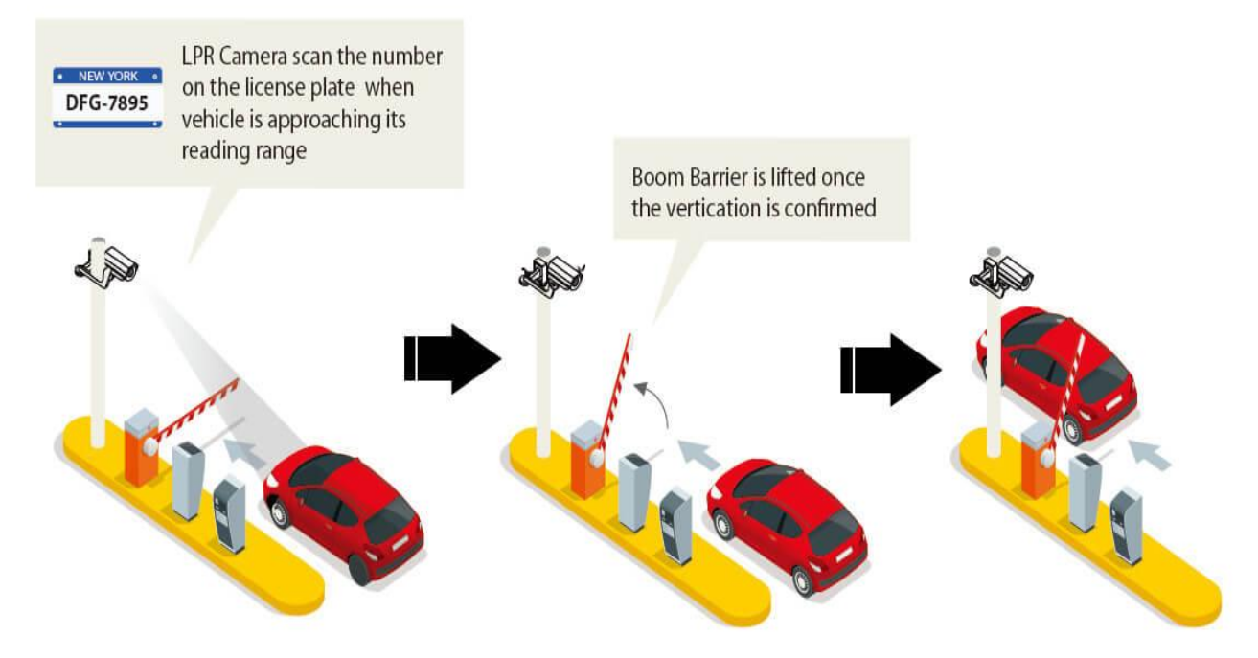
Stage - 4:

Slide 12
Time Line
Stages | Time required
1. Problem identification and definition | 1 Week
2. Collection of the related articles and requirements | 1 Week
3. Contact guide and industrial people for designing | 2 Weeks
4. Building a model for proposed work | 2 Weeks
5. Implementation, Testing, Results and Analysis | 3 Weeks
6. Thesis, preparation and submission. | 1 Week
DEPARTMENT OF CSE

Slide 13
References
[1] S.Suraj, N.K.Sridhar, J.J.Jijesh, Shivashankar. "Automatic Parking Gateway using Character
Recognition", 2018 3rd IEEE International Conference on Recent Trends in Electronics, Information
& Communication Technology(RTEICT), 2018. [Publication].
[2] Kartikeya Jain, Tanupriya Choudhury, Nirbhay Kashyap, "Smart vehicle identification system
using OCR", 2017 3rd International Conference on Computational Intelligence & Communication
Technology (CICT), 2017, [Publication].
[3] Automatic Number Plate Recognition System (ANPR): A Survey. [Online]. Available:
https://www.researchgate.net/publication/236888959_Automatic_Number_Plate_Recognition_System_ANPR_A_Survey
[4] Open Data Science, ‘Overview of the YOLO Object Detection Algorithm’. [Online]. Available:
https://medium.com/@ODSC/overview-of-theyolo-object-detection-algorithm-7b52a745d3e0yoloyolov2-28b1b93e2088

