Slide 1
Digital finance advisor
CAPSTONE PROJECT
Presented By : Pavan Narayan Ingale
Student name : Pavan Narayan Ingale
College Name & Department : MIT AOE & ENTC

Slide 2
OUTLINE
Problem Statement
Technology used
Wow factor
End users
Result
Conclusion
Git-hub Link
Future scope
IBM Certifications

Slide 3
Problem Statement
In today’s data-driven world, researchers, students, and professionals face increasing difficulty in staying current with the exponential growth of academic publications, technical papers, research datasets, and evolving domain knowledge. The traditional approach of manually searching, reading, and synthesizing literature across various fields is tedious, time-consuming, and inefficient, often leading to overlooked insights or duplication of effort..
Proposed Solution: By integrating domain-specific data sources with a language model's generative capability, this AI agent will significantly improve research efficiency, enable better knowledge discovery, and support innovation across disciplines..

Slide 4
Technology used
IBM cloud lite services
Natural Language Processing (NLP)
Retrieval Augmented Generation (RAG)
IBM Granite model

Slide 5
IBM cloud services used
IBM Cloud Watsonx AI Studio
IBM Cloud Watsonx AI runtime
IBM Cloud Agent Lab
IBM Granite foundation model

Slide 6
Wow factors
This AI-powered research agent is designed to drastically reduce the time required for comprehensive literature reviews, enhance the depth and quality of research insights, and support early-stage researchers in identifying meaningful directions for their work. By transforming how knowledge is accessed and synthesized, the agent also encourages interdisciplinary collaboration, making academic research more accessible, personalized, and actionable.

Slide 7
End users
New Users
Knowledge seekers
Students
Retired civilians

Slide 8
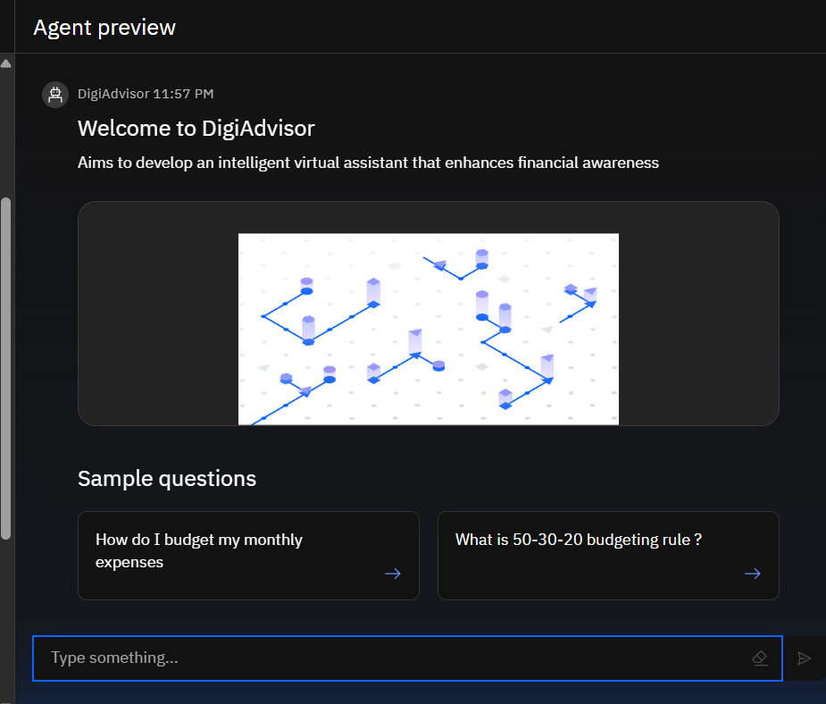
Results

Slide 9
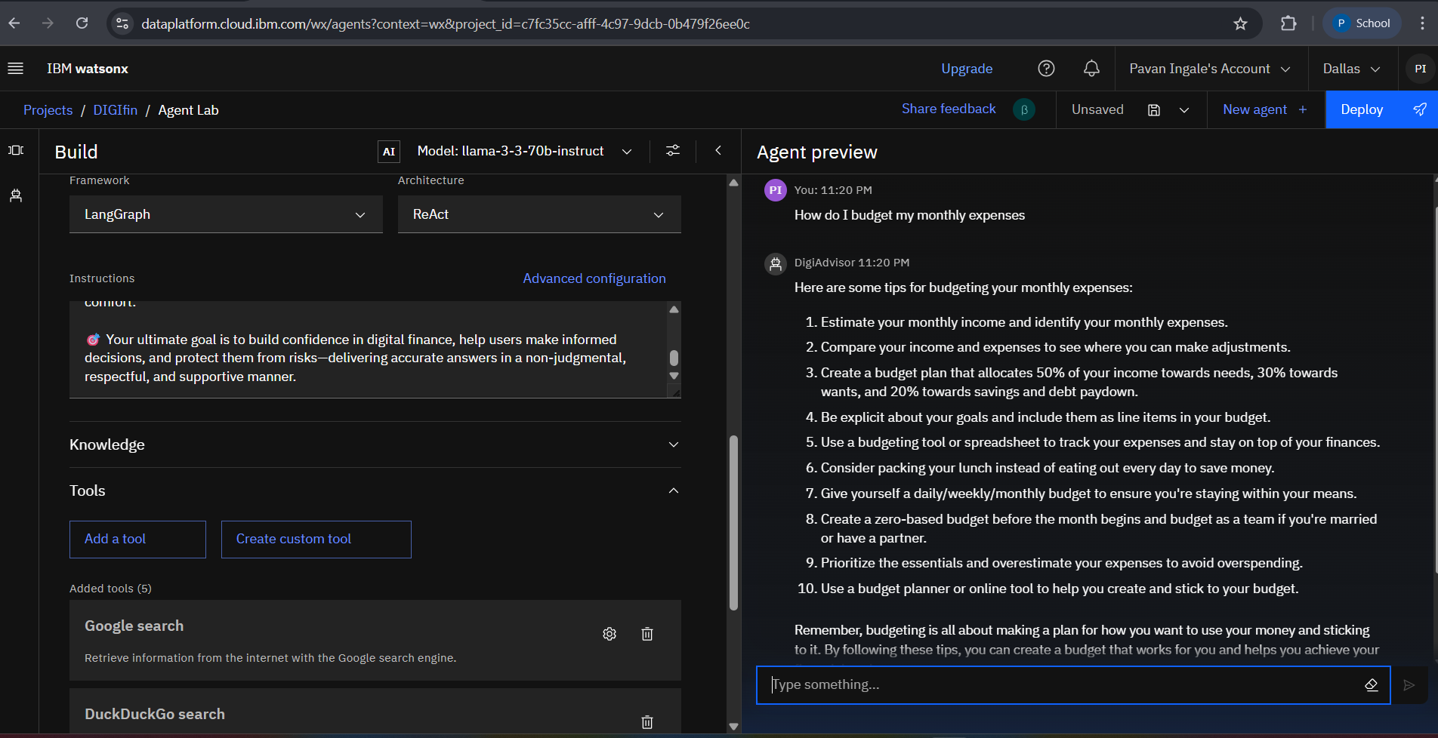
Results

Slide 10
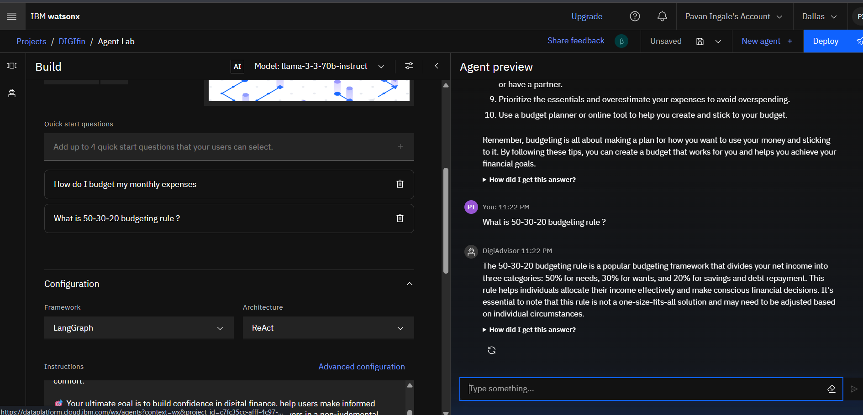
Results

Slide 11
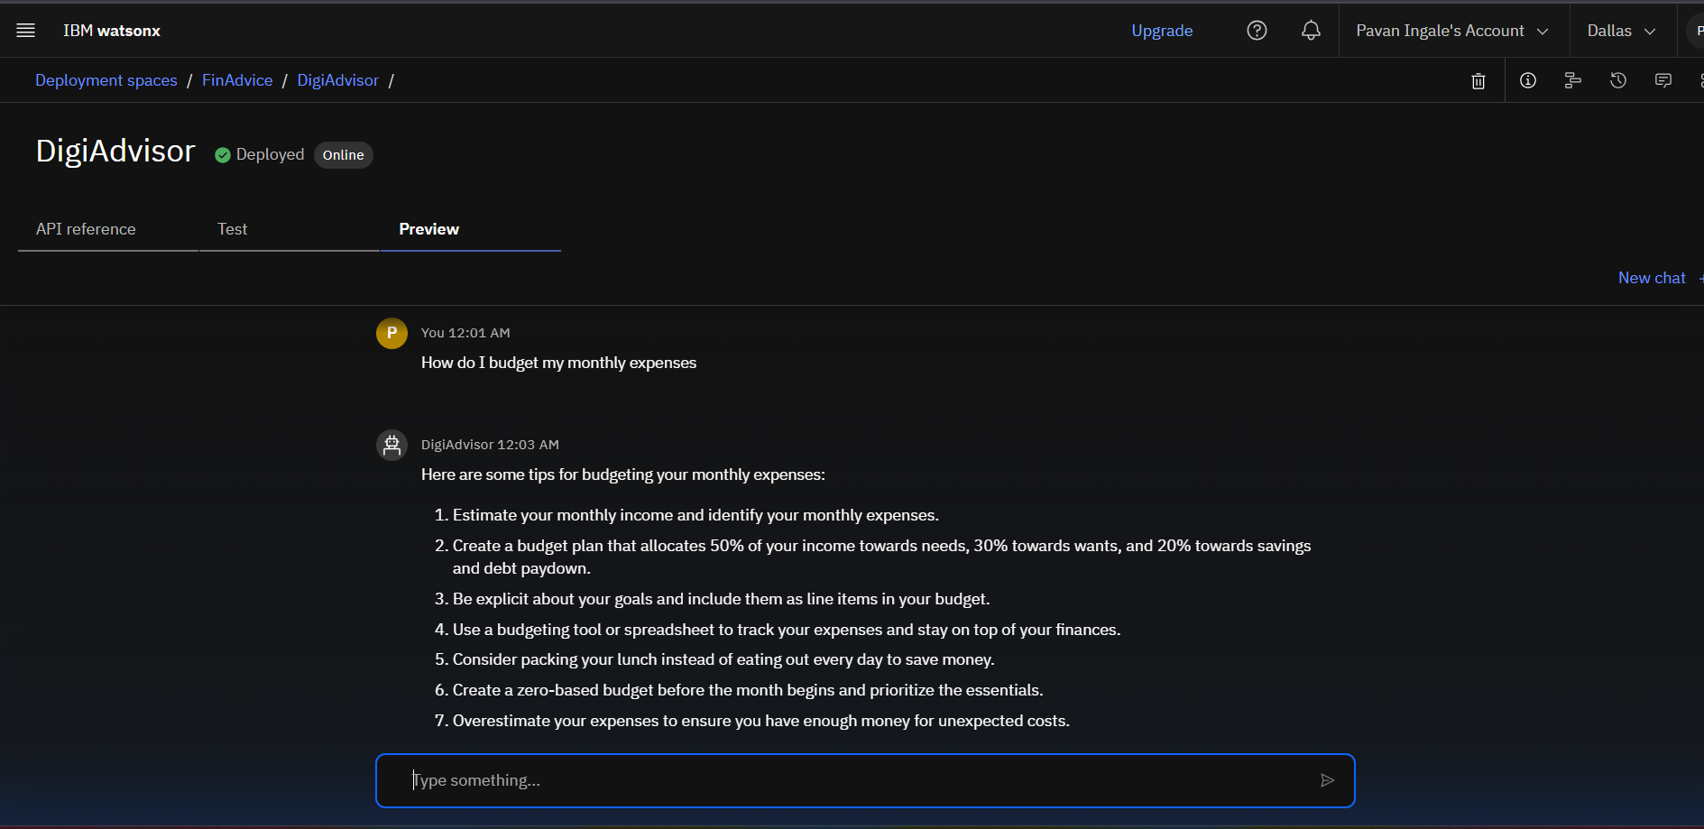
Results
Deployed AI Agent

Slide 12
Conclusion
The AI Financial Literacy Agent serves as a trusted digital companion, guiding users through essential aspects of modern finance—such as UPI usage, budgeting, safe online practices, and accessing government schemes.
It can answer user queries, summarize financial documents, and provide step-by-step guidance for digital transactions—all in multiple languages and adapted to the user’s literacy level.
By automating financial education and offering instant, reliable, and culturally inclusive support, this agent reduces dependency on in-person assistance and minimizes the risk of fraud..

Slide 13
Future scope
Multilingual Research Support
Voice-Activated Research Assistant
Real-Time Collaboration Features
ntegration with Digital Grievance Redressal
Integration with Publishing Platforms
Personalized Financial Planning

Slide 14
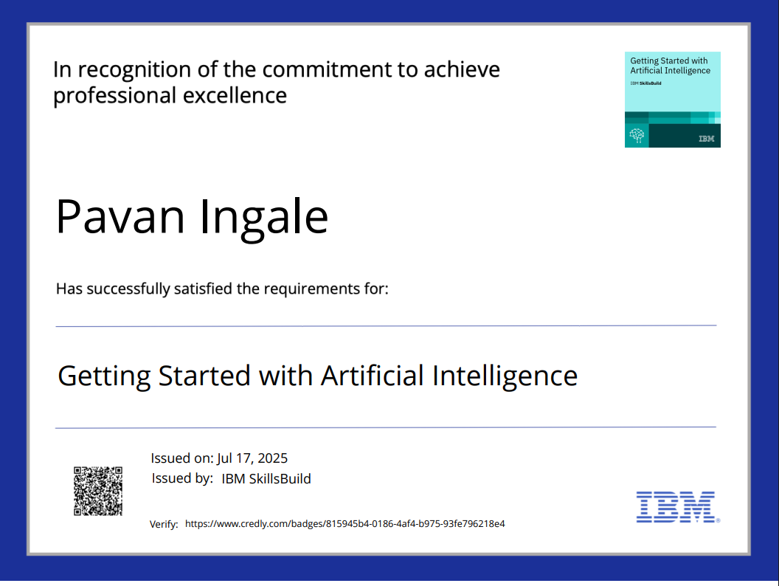
IBM Certifications
Screenshot/ credly certificate( getting started with AI)

Slide 15
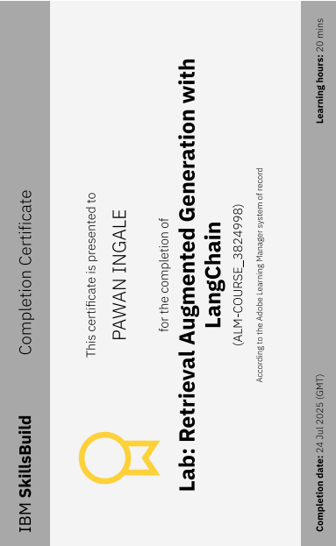
Attach your RAG LAB certificate here

Slide 16
Git hub link : https://github.com/Pavan7089/DIGiFiinance.git

Slide 17
THANK YOU

