Slide 1
What is Bootstrap?
Bootstrap is an open-source CSS framework developed by the team at Twitter.
It is a combination of HTML, CSS, and Javascript code designed to help build user interface components.
Bootstrap was also programmed to support both HTML5 and CSS3.
Also it is called Front-end-framework.
Bootstrap is a free collection of tools for creating a websites and web applications.
It contains HTML and CSS-based design templates for Typography, forms, buttons, navigation and other interface components, as well as optional JavaScript extensions.

Slide 2
Bootstrap Files
Bootstrap can be added down to three main files:
bootstrap.css - a CSS framework
bootstrap.js - a JavaScript/jQuery framework
Additionally, Bootstrap requires jQuery to function. jQuery is an extremely popular and widely used JavaScript library, that both simplifies and adds cross browser compatibility to JavaScript.

Slide 3
Advantages of Bootstrap
Easy to use: Anybody with just basic knowledge of HTML and CSS can start using Bootstrap
Responsive features: Bootstrap's responsive CSS adjusts to phones, tablets, and desktops
Mobile-first approach: In Bootstrap, mobile-first styles are part of the core framework
Browser compatibility: Bootstrap is compatible with all modern browsers (Chrome, Firefox, Internet Explorer 10+, Edge, Safari, and Opera)

Slide 4

Containers
Bootstrap requires a containing element to wrap site contents.
There are two container classes to choose from:
The .container class provides a responsive fixed width container
The .container-fluid class provides a full width container, spanning the entire width of the viewport

Slide 5
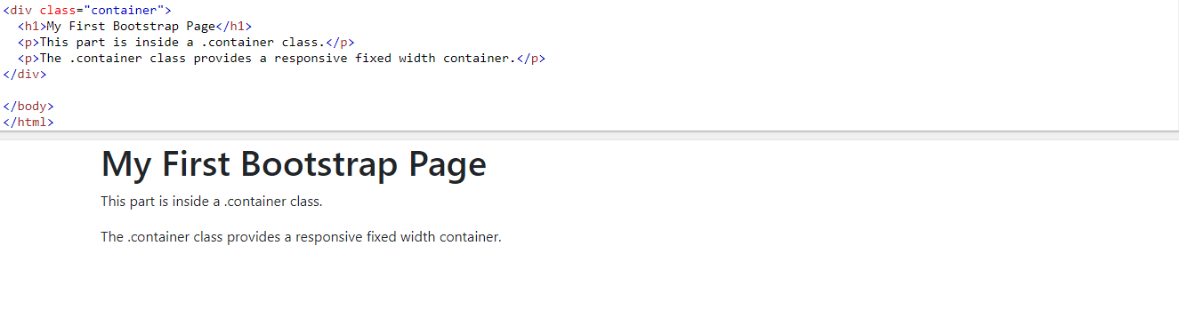
Example of Containers

Slide 6
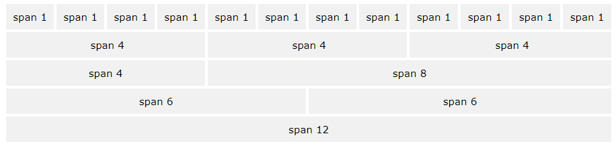
Bootstrap Grid System
Bootstrap's grid system allows up to 12 columns across the page.

Slide 7
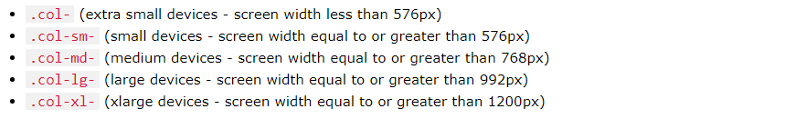
Grid Classes
The Bootstrap grid system has five classes:

Slide 8
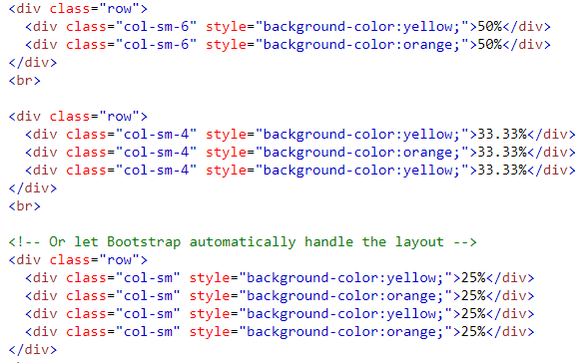
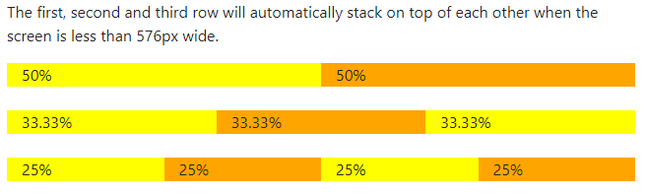
Grid System

Slide 9
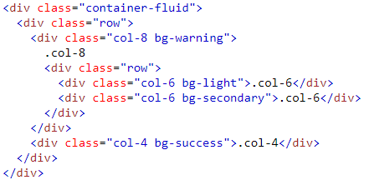
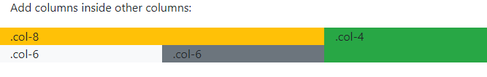
Nested Columns
The following example shows how to create a two column layout, with another two columns inside one of the columns

Slide 10
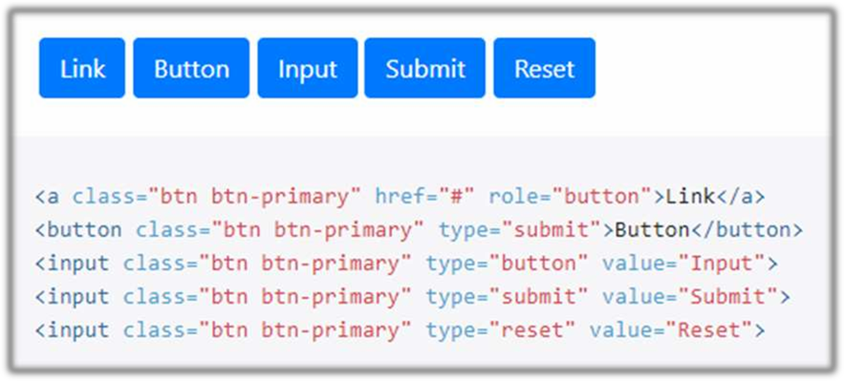
Button tags

Slide 11
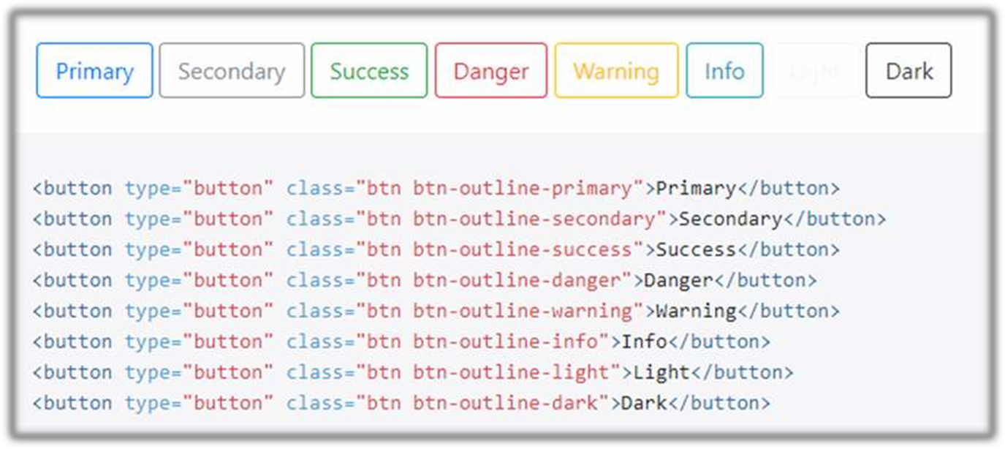
Outline buttons

Slide 12
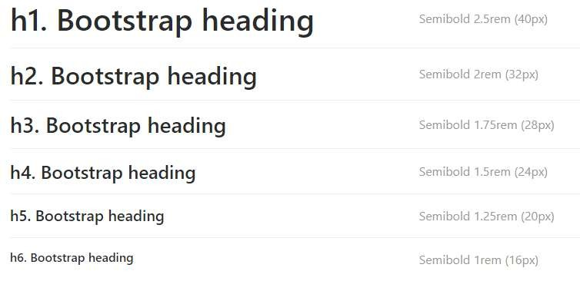
Headings
In order to create heading in bootstrap we can use h1-h6 tags as an class name to create headings is as follows

Slide 13
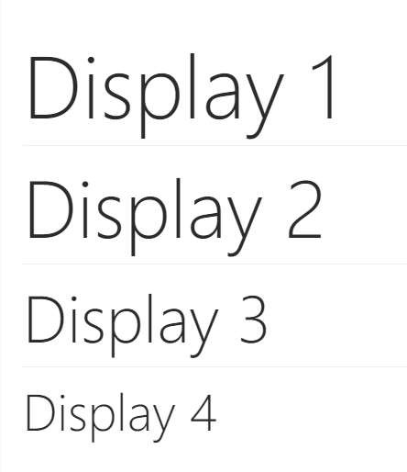
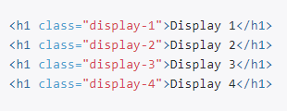
Display
Whenever we need more style headings then instead of using h1-h6 classes we can used h1-h6 classes we can use dipslay1-display6 classes as show below

Slide 14
Text Related Class
Class=“text-muted”
When we apply class=“text-muted” then on what ever text we apply the above class will be greyed out.
i.e the color of the text will become grey.
Example:
<p>Welcome To<span class=“text-muted” Bootstrap Class</span></p>
Class=“lead”
When ever we need to change the look of the paragraph we can use the lead class
Example:
<p class=“lead”>Some text here</p>

Slide 15
Cards
A card is a flexible and extensible content container.
It includes options for headers and footers, a wide variety of content,
contextual background colors, and powerful display options.
Card titles are used by adding .card-title
Card subtitles used by adding .card-subtitle
.card-img-top places an image to the top of the card
Mix and match multiple content types to create the card you need, or throw everything in there.
an optional header and/or footer within a card an be added.

Slide 16
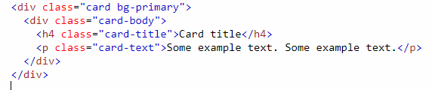
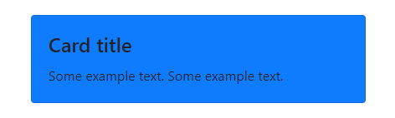
Example

Slide 17
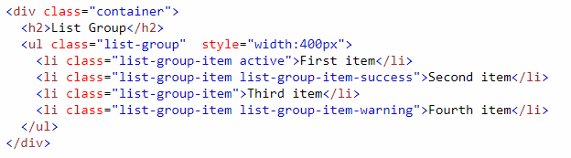
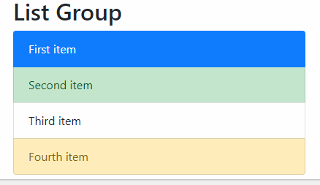
Bootstrap List Groups
To create a basic list group, use an <ul> element with class .list-group, and <li> elements with class .list-group-item:

Slide 18
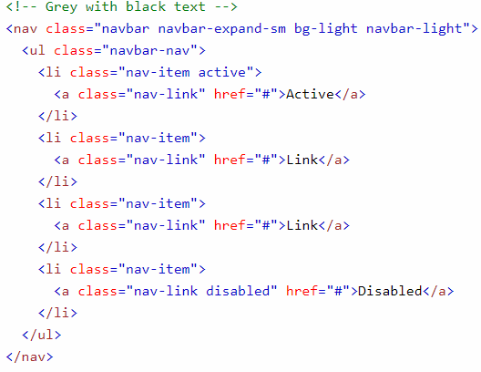
Navigation Bars
A navigation bar is a navigation header that is placed at the top of the page:

Slide 19
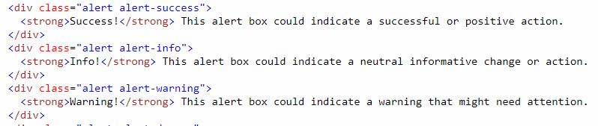
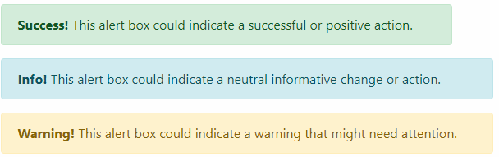
Bootstrap Alerts
Alerts are created with the .alert class, followed by one of the contextual classes .alert-success, .alert-info, .alert-warning, .alert-danger, .alert-primary, .alert-secondary, .alert-light or .alert-dark:

Slide 20
Bootstrap Images
.img-thumbnail class shapes the image to a thumbnail (bordered)
.rounded-circle class shapes the image to a circle
.rounded class adds rounded corners to an image
Aligning Images
Float an image to the right with the .float-start class or to the left with .float-end
Centered Image
Center an image by adding the utility classes.mx-auto and.d-block

Slide 21
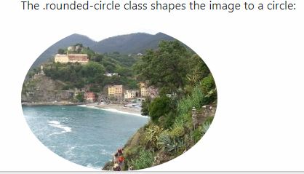
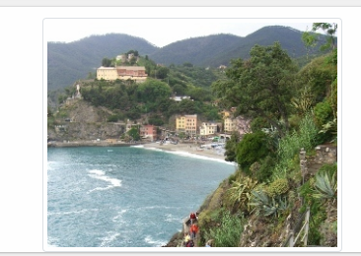
Cont..

Slide 22
Bootstrap Forms
Form controls automatically receive some global styling with Bootstrap
All textual <input>, <textarea>, and <select> elements with class .form-control have a width of 100%
Bootstrap provides two types of form layouts
Stacked (full-width) form
Add a wrapper element with .form-group, around each form control, to ensure proper margins and create Stacked (full-width) form
Inline form
Add class .form-inline to the <form> element to all of the elements are inline and left-aligned

Slide 23
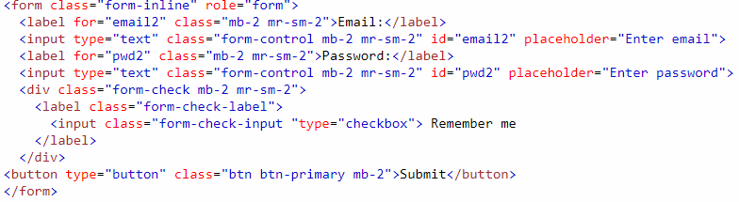
Example of Bootstrap form

Slide 24

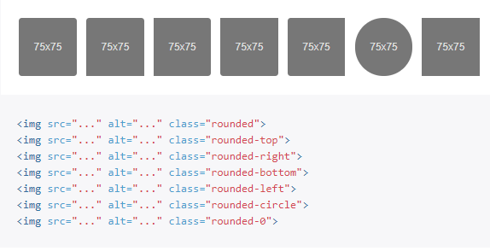
Borders

Slide 25
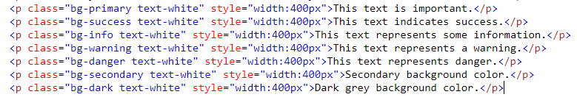
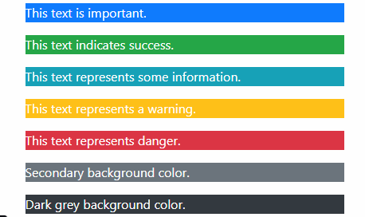
Color
Background Color Classes

Slide 26
Bootstrap Text
Text transform
<p class="text-lowercase">Lowercased text.</p>
<p class="text-uppercase">Uppercased text.</p>
<p class="text-capitalize">Capitalized text.</p>
Font weight and italics
<p class="fw-bold">Bold text.</p>
<p class="fw-bolder">Bolder weight text (relative to the parent element).</p>
<p class="fw-normal">Normal weight text.</p>
<p class="fw-light">Light weight text.</p>
<p class="fw-lighter">Lighter weight text (relative to the parent element).</p>
<p class="fst-italic">Italic text.</p>
<p class="fst-normal">Text with normal font style</p>

Slide 27
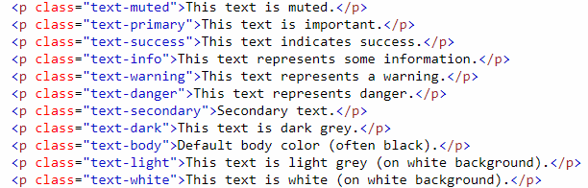
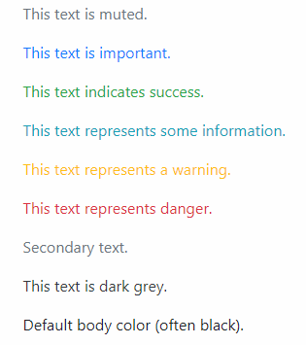
Text Color

Slide 28
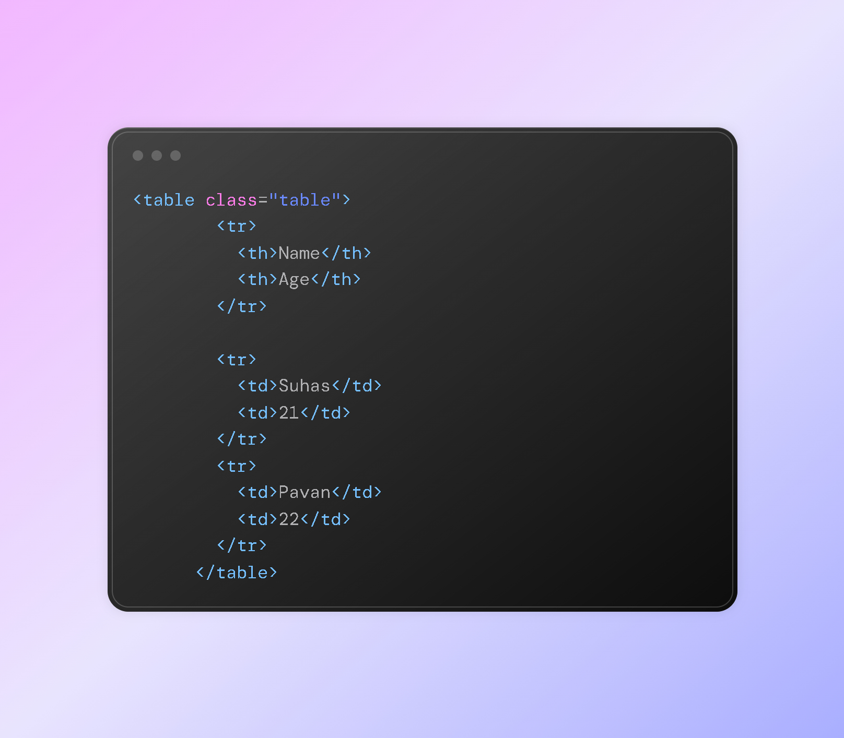
Tables In Bootstrap
.table class will add a basic style gor the table.
it will add simple border after each row.

Slide 29
cont..
.table striped will add the zebra stripe to the table.
table-bordered will add the border on all the sides of the table.
table-hover class will add the hover effect (grey background) on the table.
.table dark will add the dark background to the table.

