Slide 1
H9FECC · Fog and Edge Computing · CA Project
Smart City Pollution Monitor
Fog-enabled AQI analytics with a serverless AWS backend
PRESENTER
FIVE POLLUTANTS
Pavan
PM₂.₅ · PM₁₀ · NO₂ · CO · O₃
MSc in Cloud Computing, NCI

Slide 2
Why this matters
Urban air quality varies block by block — a cloud-only design is both slow and wasteful.
60 %
2 s
0
Reduction in bytes shipped to cloud when AQI is computed at the edge.
Local dashboard update via Server-Sent Events.
Sensor readings dropped under injected DynamoDB throttling.
Moving analytics to the fog layer is the dominant design lever.

Slide 3
Architecture
SENSOR LAYER
FOG NODE
CLOUD LAYER (AWS)
PM₂.₅
Flask ingest
API Gateway
/sensor-data
Lambda: IngestToQueue
PM₁₀
Rolling deque
size=20 per sensor
Amazon SQS
NO₂
AQI compute
EPA breakpoints
Lambda: ProcessQueueToDB
CO
Z-score flag
κ=2.5
Amazon DynamoDB
O₃
Dispatch
S3 dashboard + SSE stream
batched POST

Slide 4
Edge analytics: AQI + Z-score
AQI (US-EPA breakpoint)
Anomaly (rolling Z-score)
I = (I_hi - I_lo) / (C_hi - C_lo)
* (C - C_lo) + I_lo
|x - mu| > k * sigma, k = 2.5
• Rolling deque size W = 20 per sensor.
• μ, σ computed on the fly each tick.
• κ configurable per pollutant — avoids false positives in rush hour.
• Flag attached to payload before cloud dispatch.
• Linear interpolation between concentration breakpoints.
• Category labels: Good → Moderate → Unhealthy → Hazardous.
• Per-sensor breakpoint tables (PM, NO₂, CO, O₃).
• Computed at the fog layer — no cloud round-trip needed.

Slide 5
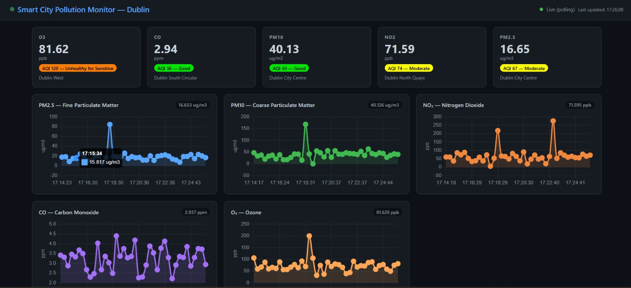
Smart city dashboard
Live AQI by pollutant, category chips, and five Chart.js lines.

Slide 6
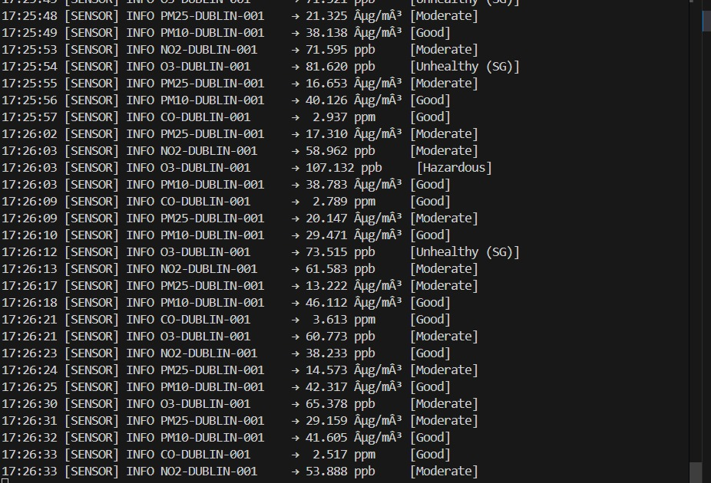
Sensor simulator running
AQI labelling
Each reading tagged Good / Moderate / Unhealthy / Hazardous.
Realistic dynamics
Gaussian noise + rush-hour peaks + rare spikes.
Own cadences
Five threads, five dispatch intervals.

Slide 7
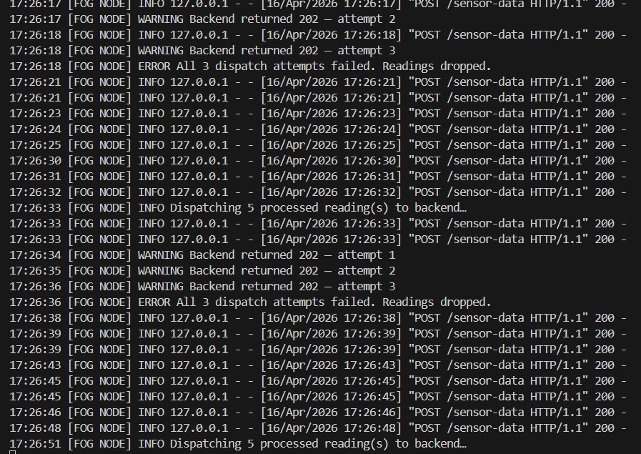
Fog node dispatch + retry
Batches of 5
5 processed readings per dispatch.
Retry semantics
3 retries on 202 / 5xx before dropping.
Back-pressure
Warnings logged when backend is slow.

Slide 8
Scalable serverless backend
Competing consumers
PAY_PER_REQUEST
SQS decouples ingest and storage; Lambda scales with message rate.
DynamoDB auto-scales read/write units; zero idle cost.
SSE over polling
IAM least privilege
Push real-time updates to the dashboard with one line of JS.
Per-Lambda roles: SQS-only, Dynamo-only, read-only.

Slide 9
Results
< 2 s
< 4 s
100 %
$0.28
SSE local latency
Cloud polled latency
delivery via retries
monthly AWS cost
Headline
Edge analytics cut bandwidth and latency; serverless scale-out handles load with zero ops.

Slide 10
Hardest problem → my fix
Challenge
Fix
• Rush-hour peaks looked like anomalies.
• Too low κ → false positives; too high → missed spikes.
• Intermittent backend → retries needed care.
• κ is a per-sensor config setting, not a global constant.
• Fold time-of-day factor into the baseline before Z-score.
• Exponential back-off + 3-try dispatch with structured logs.
• SQS + DynamoDB retry catches the rest.

Slide 11
Thank you.
Questions · live demo
Pavan · H9FECC · NCI MSc Cloud Computing

