Slide 1


KICKSTARTER
AIM OF KICKSTARTER
Kickstarter campaigns make ideas into reality. It’s where creators share new visions for creative work with the communities that will come together to fund them.

Slide 2
WE ARE
No matter what, creators always control how the work comes together—no 100-page grant applications, no donors demanding you modify your message, no last-minute edits from investors. When backers chip in funding and help spread the word, they too become part of these independent works.

Slide 3

MARKET PROBLEM
01
02
Finding invest
Granting permission

Slide 4

OUR SOLUTIONS
Solutions
creators connect directly with their communities, putting power where it belongs.

Slide 5
DATA ANALYSIS
Crowdfunding Excel Dashboard
Crowdfunding PowerBI Dashboard
Crowdfunding SQL Representation

Slide 6
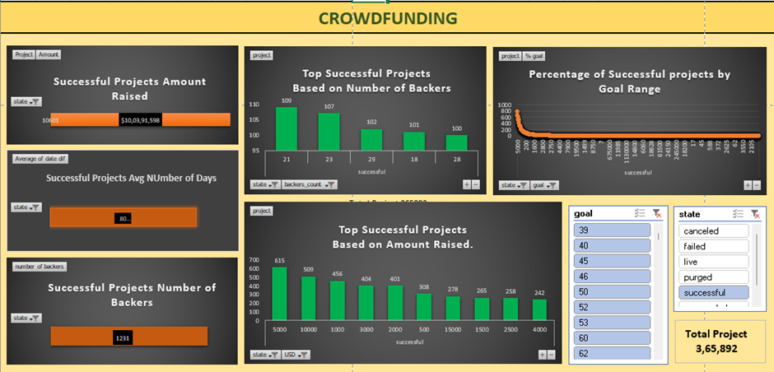
CROWDFUNDING EXCEL DASHBOARD

Slide 7
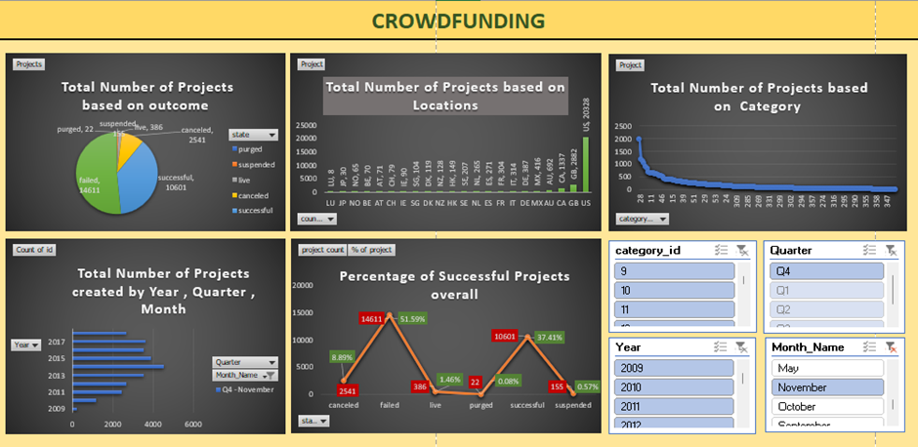
EXCEL DASHBOARD - 2

Slide 8
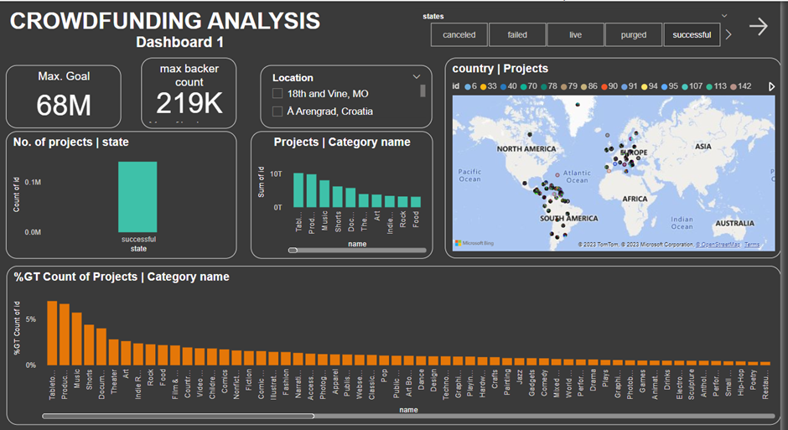
CROWDFUNDING POWERBI DASHBOARD

Slide 9
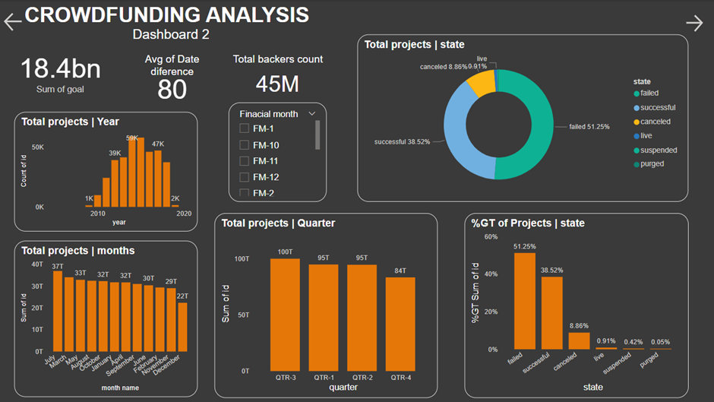

Slide 10
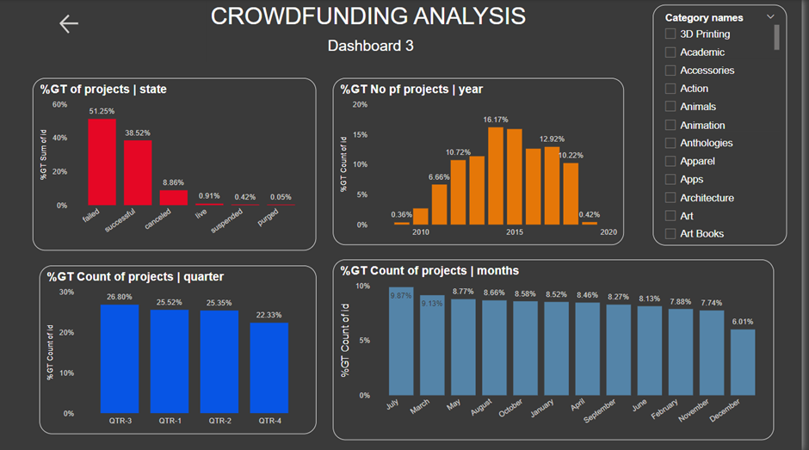

Slide 11
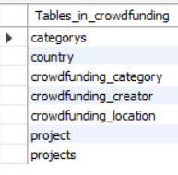
CROWDFUNDING SQL PRESENTATION
Views created:
1)categories
2)projects

Slide 12
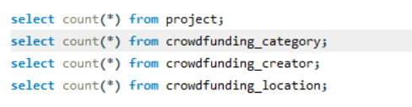
365892
RECORD COUNT IN EACH TABLE
000154
334841
023252

Slide 13


TABLE CONTENT
01
02
03
04

Slide 14
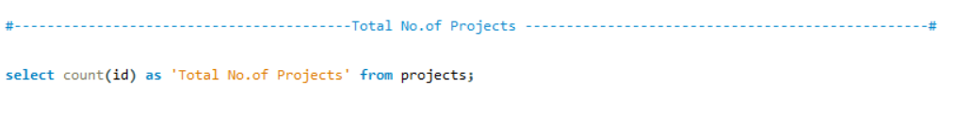
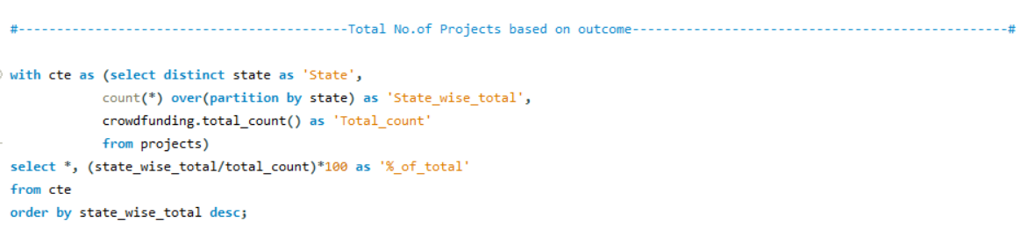
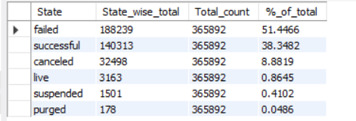
DATA ANALYSIS

Slide 15
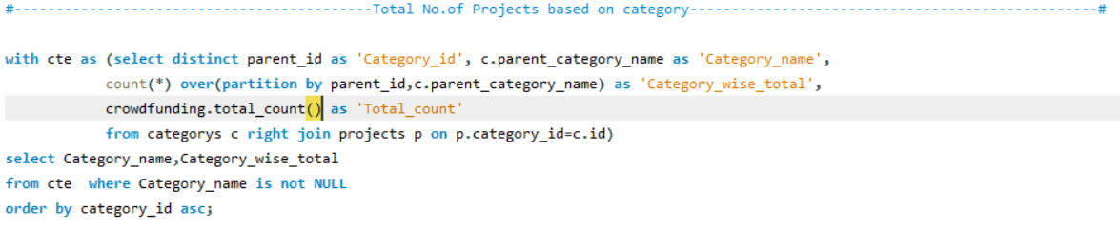
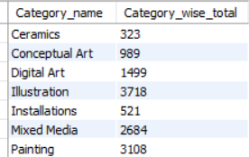
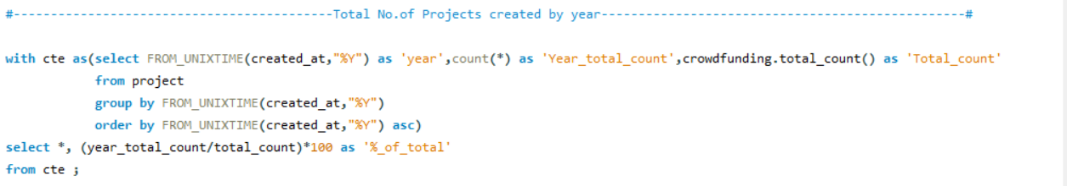
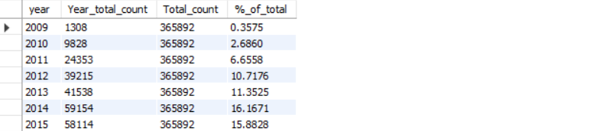

Slide 16
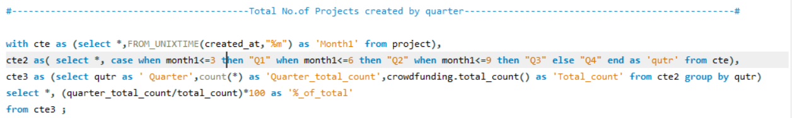
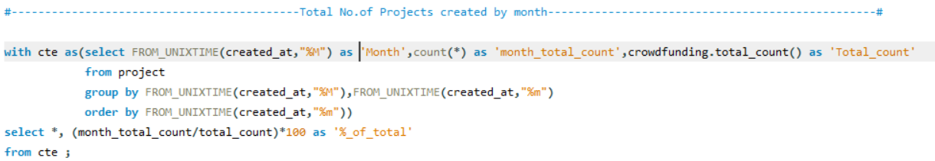
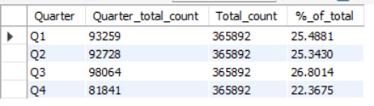
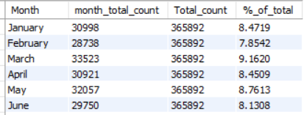

Slide 17
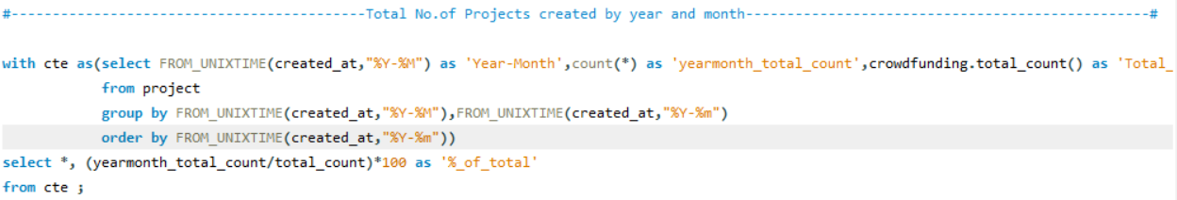
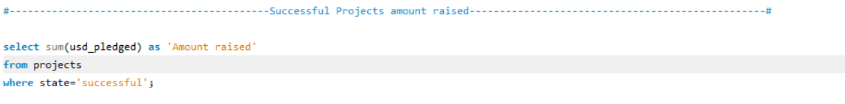
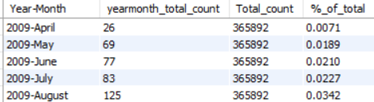


Slide 18
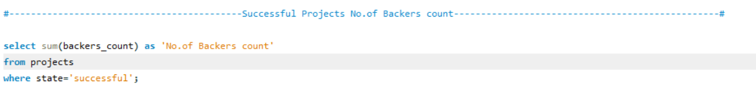
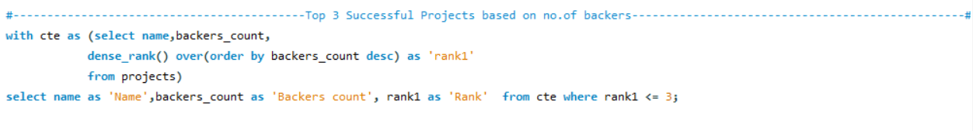
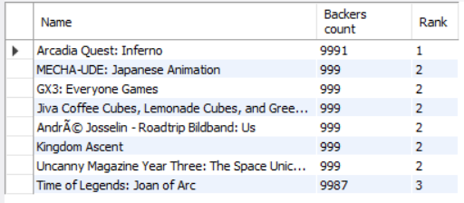


Slide 19
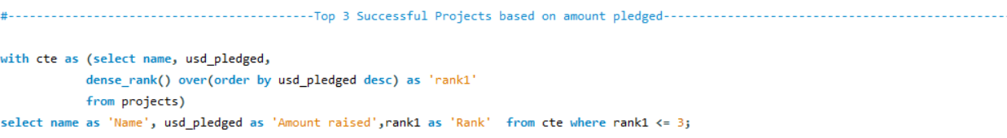
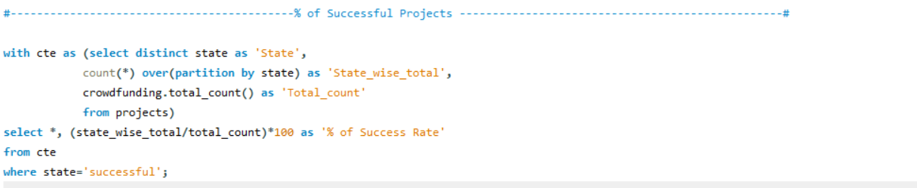
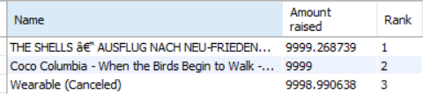


Slide 20
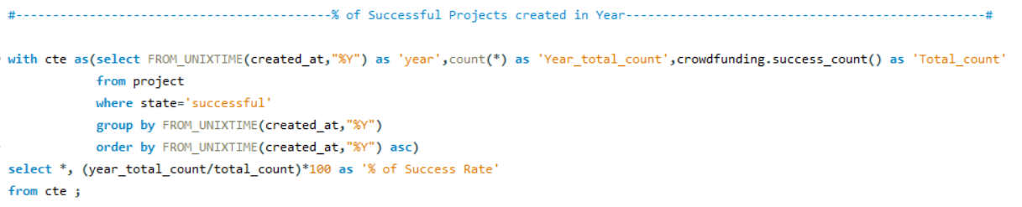
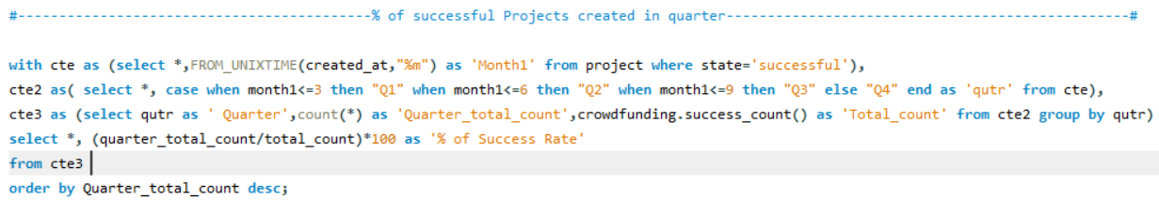
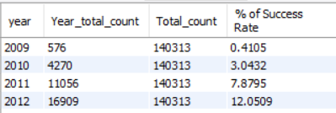
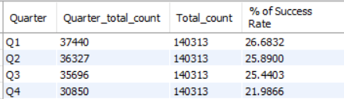

Slide 21
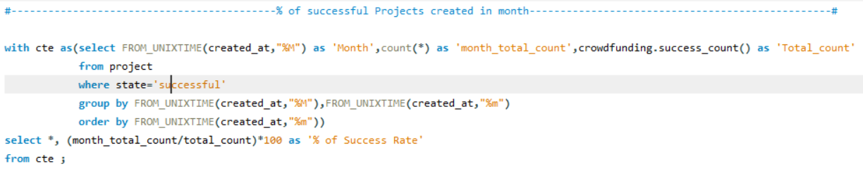
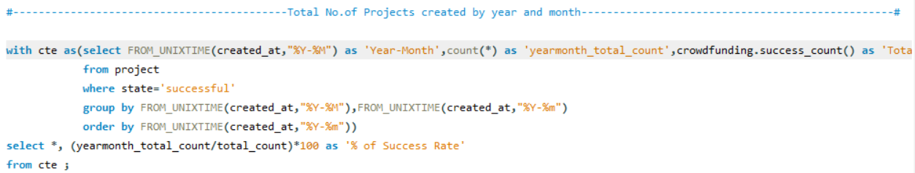
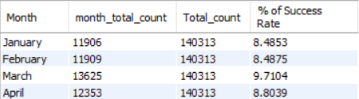
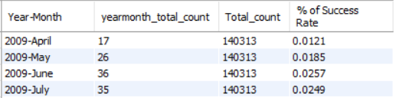

Slide 22
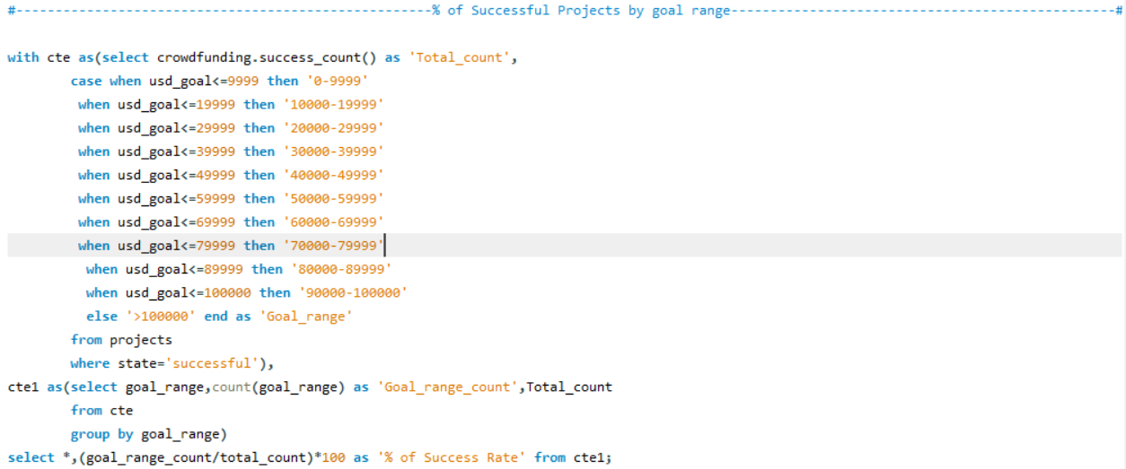
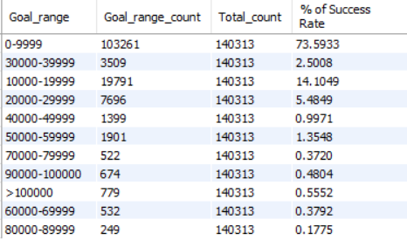
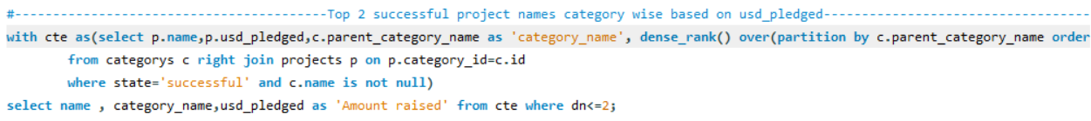

Slide 23

FINDINGS
The total goal amount is $18380 million.
The total backers are 45 million.
The average number of days taken for a successful project is 80 days.
The highest number of backers for a single project is 219k.
The highest goal amount for a single project is $68 million.
The overall successful project rate is 38.35%.

Slide 24

THANK YOU!

