Slide 1

ESTABLISHED 2023 • MIT BENGALURU
RAHAT
A student-led club and media house focused on mental well-being.
MAKING SPACE • Rahat to all.

Slide 2
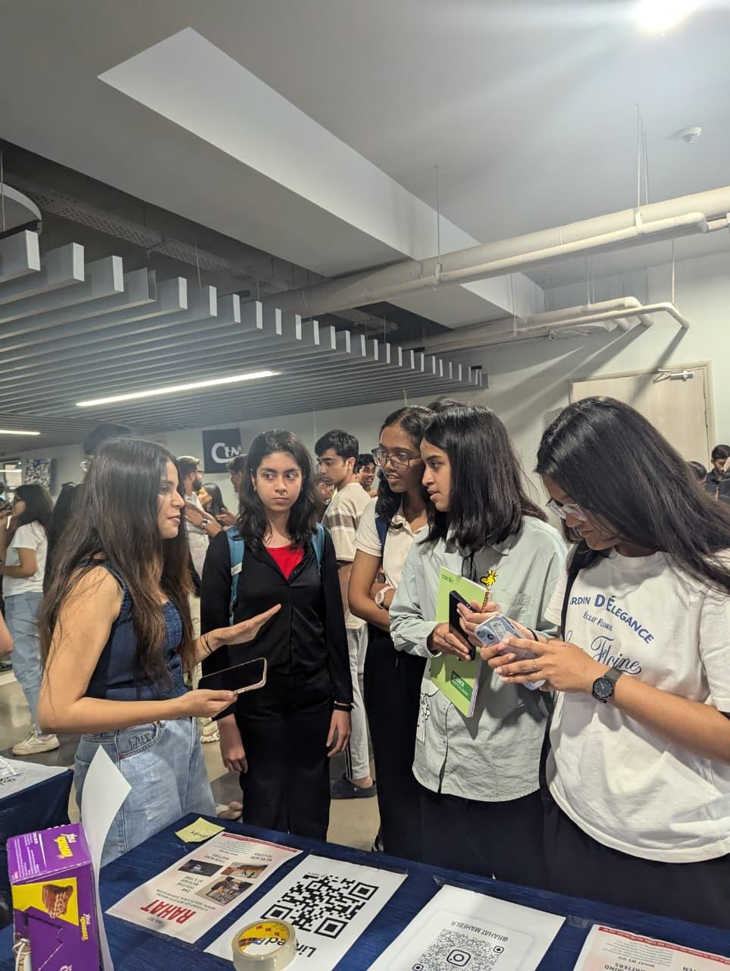
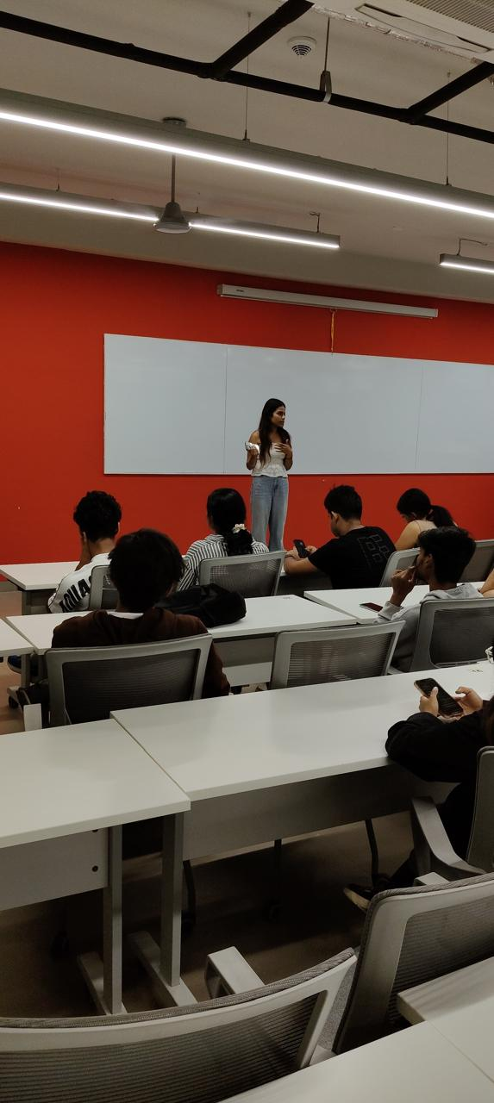
— ACT I — MAKING SPACE
THE PREMISE
What does feeling okay look like?
“Sometimes, it doesn’t look like a formal conversation about mental health.”
Sometimes, it simply looks like finding a space to be.

Slide 3

— ACT II — EVOLUTION OF IDENTITY
FROM WHERE WE STARTED ➔ TO WHERE WE ARE GOING
THEN • THE FOUNDATION (ESTD. 2023)
NOW • THE NEW CHAPTER
➔
EXPANSION
STUDENT WELL-BEING COMMUNITY
STUDENT CLUB & MEDIA HOUSE
“Same purpose. A wider canvas.”
From a student-led mental well-being community to a space for conversations, creativity, connection and stories that matter.

Slide 4
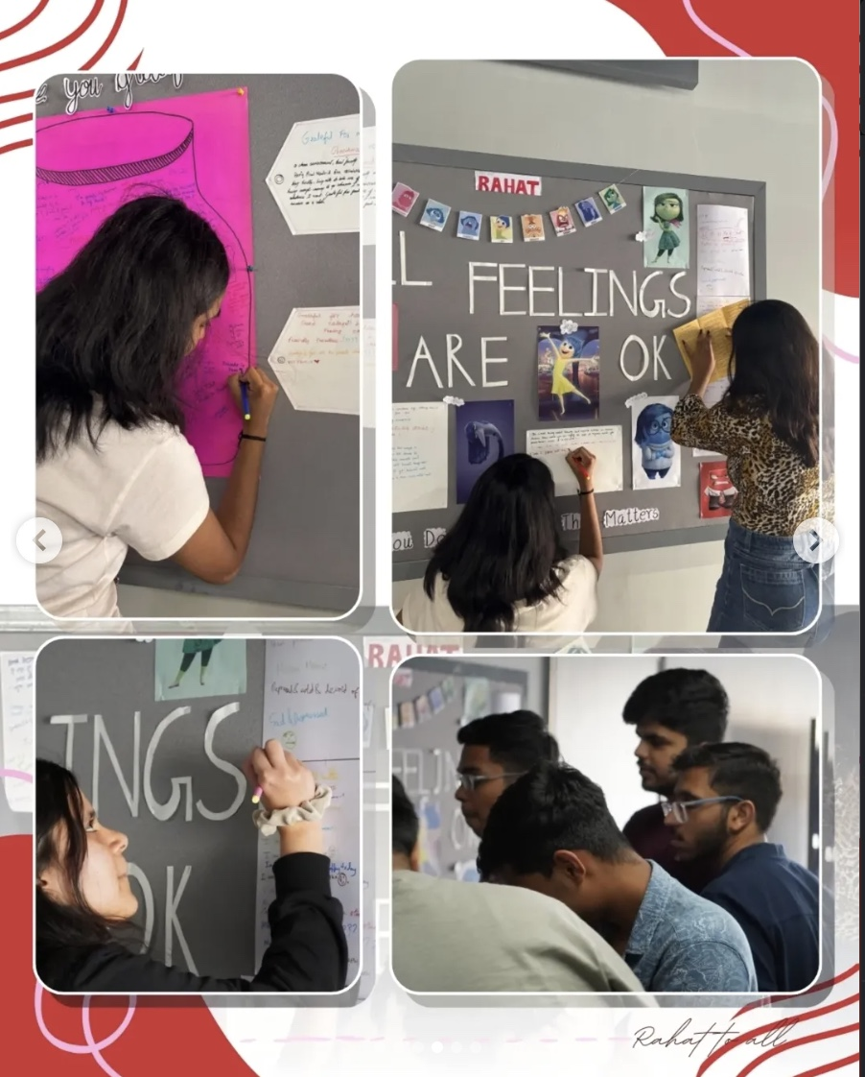
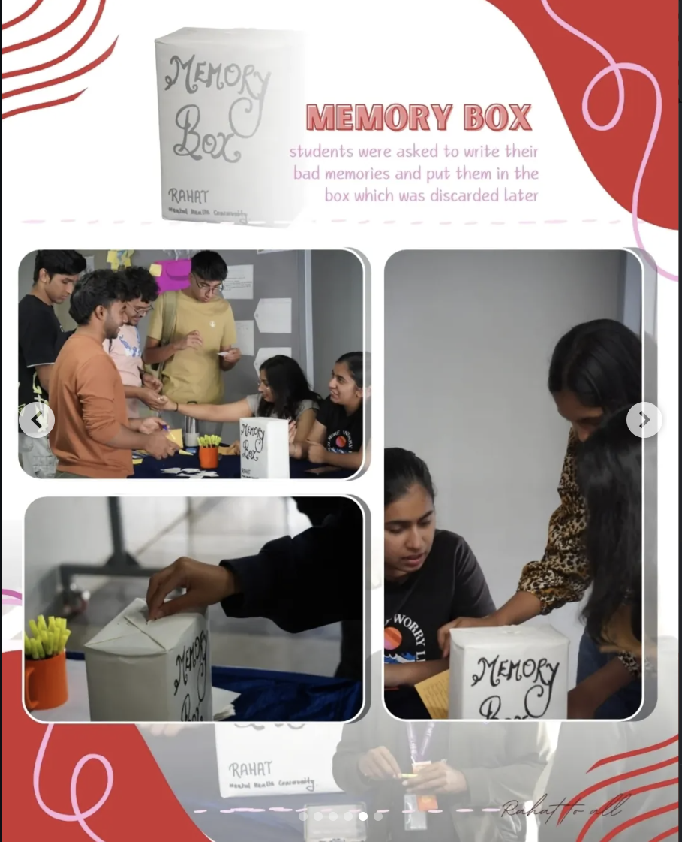
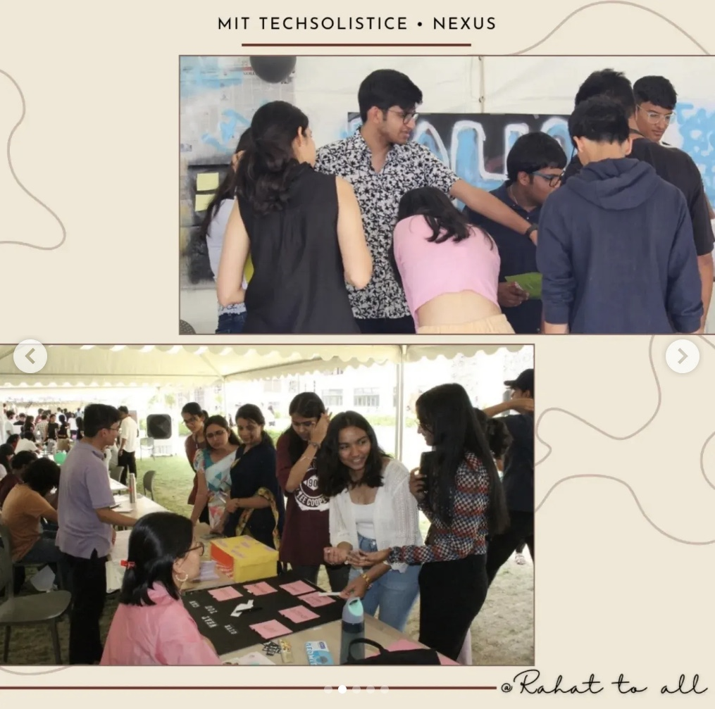
— ACT II — WHAT WE HAVE BUILT
“We started by creating space for expression, creativity and play.”
POLAROIDS & NOTES
FEELINGS BOARD
MEMORY BOX
TREASURE HUNT
COMMUNITY SPACE

Slide 5
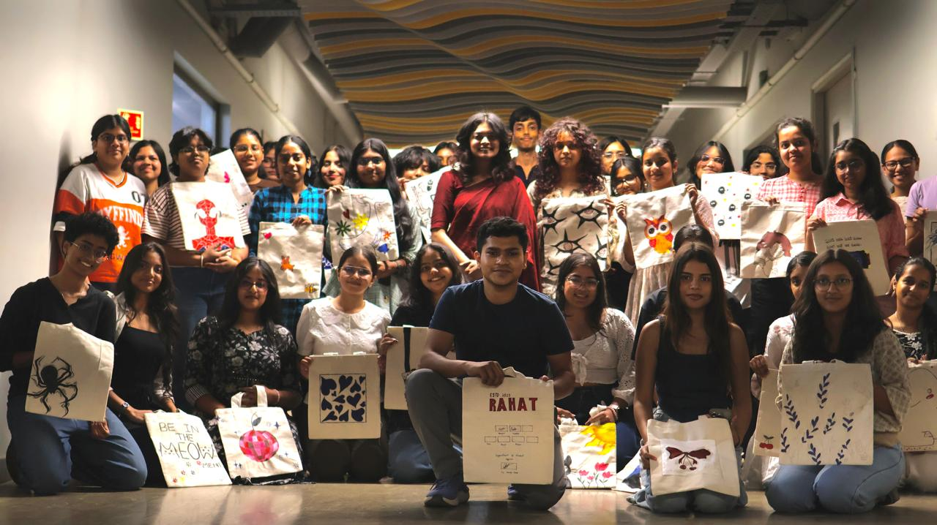
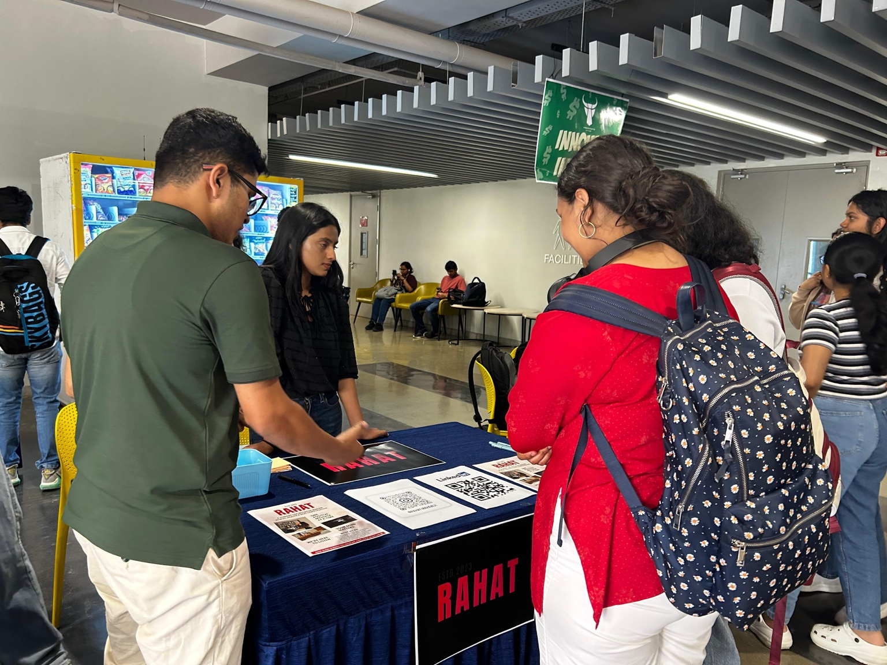
— ACT III — THE HORIZON
WE STARTED BY CREATING SPACE
NOW, WE'RE MAKING THE SPACE BIGGER
01 • RAHAT AS A MEDIA HOUSE
Conversations with people who create social impact.
02 • RAHAT CARNIVAL
A day of games, activities, creativity and connection.
03 • OPEN THEATRE
Movies, conversations and shared experiences under one roof.
04 • CONTINUING THE CORE
Mental well-being remains at the heart of everything we do.

Slide 6
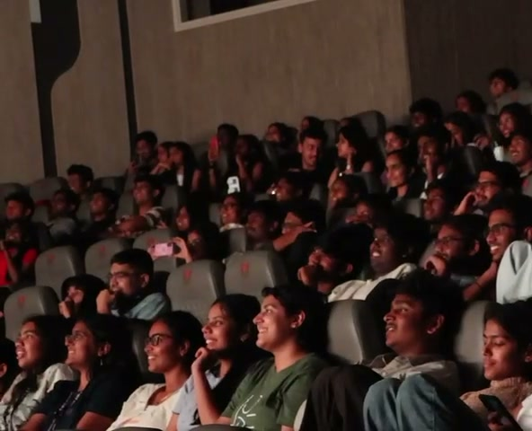
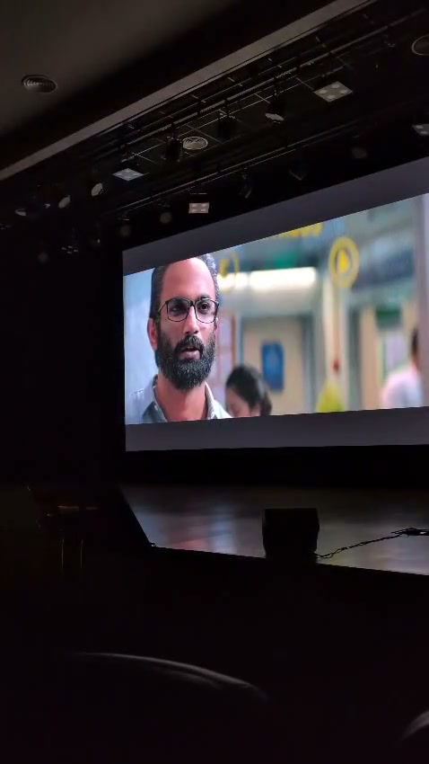
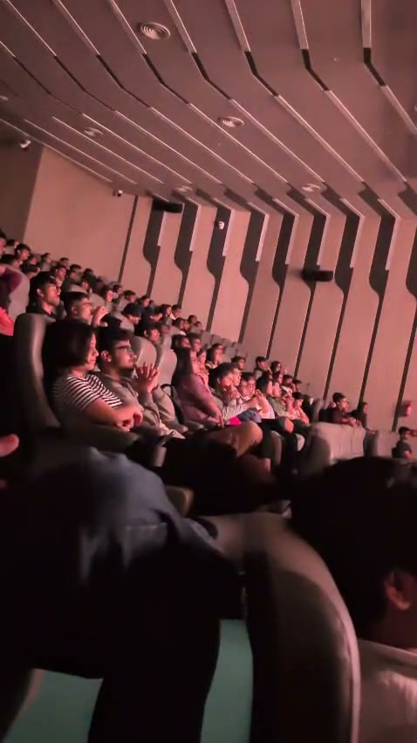
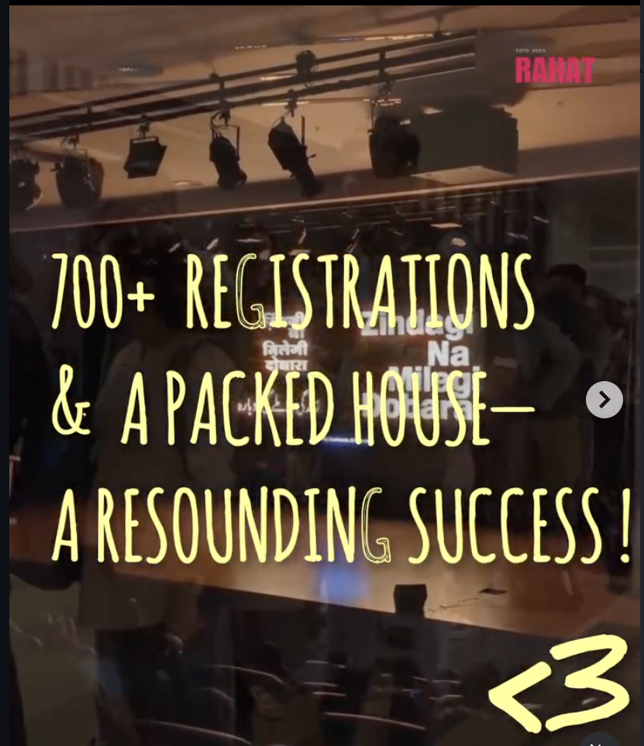
— ACT IV — SCALE & MOMENTUM
700+
REGISTRATIONS
ONE PACKED HOUSE
“A room full of people who showed up, watched, laughed, and shared the moment.”

Slide 7
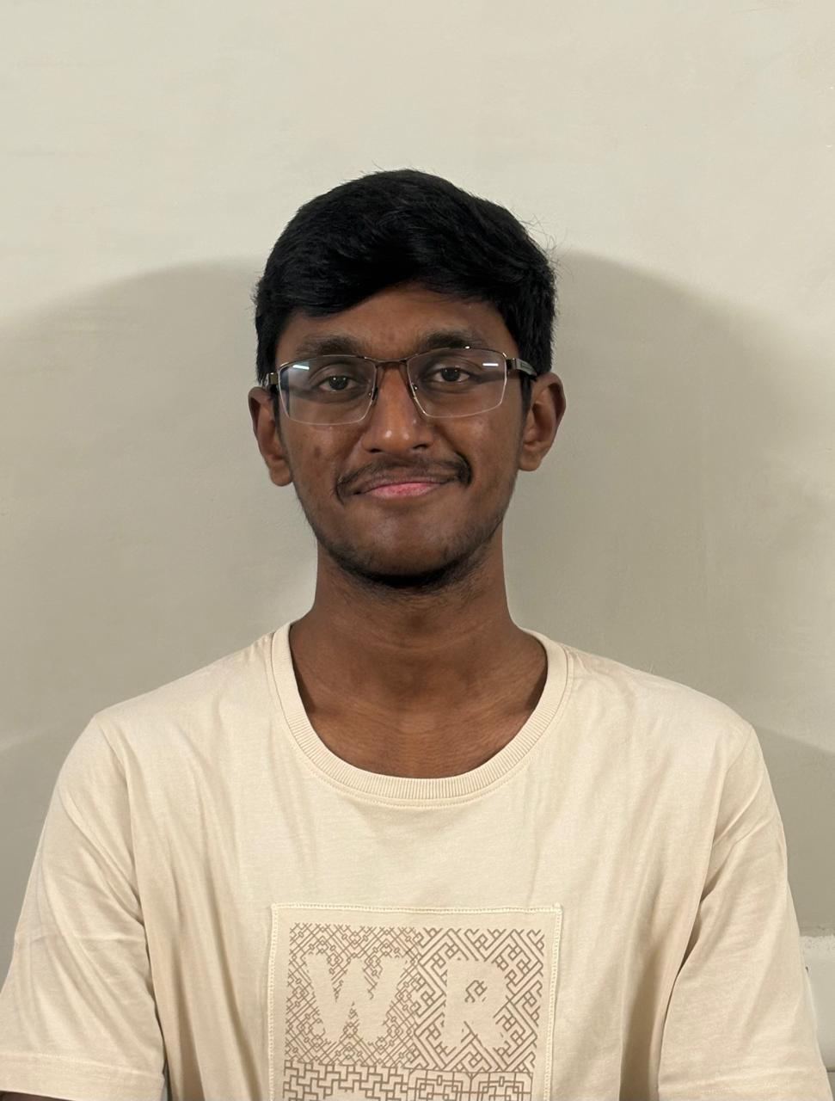
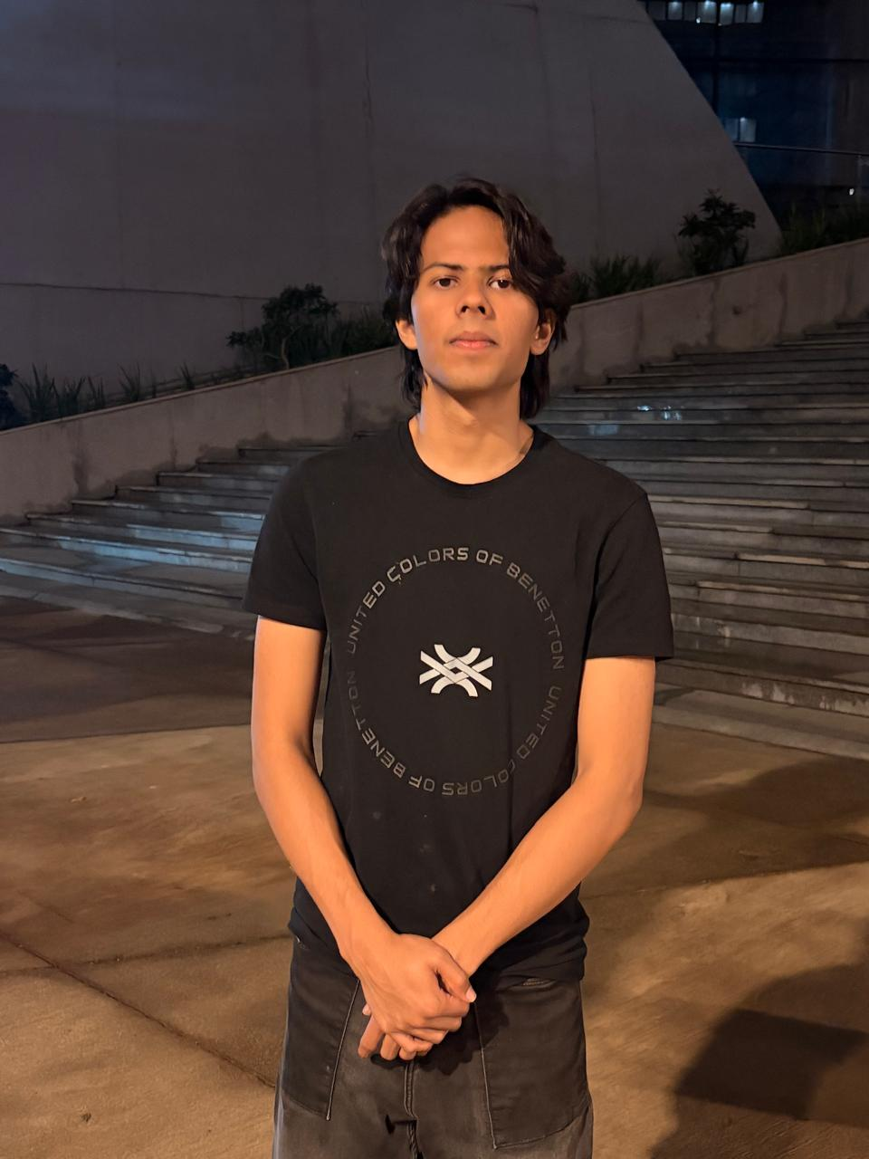
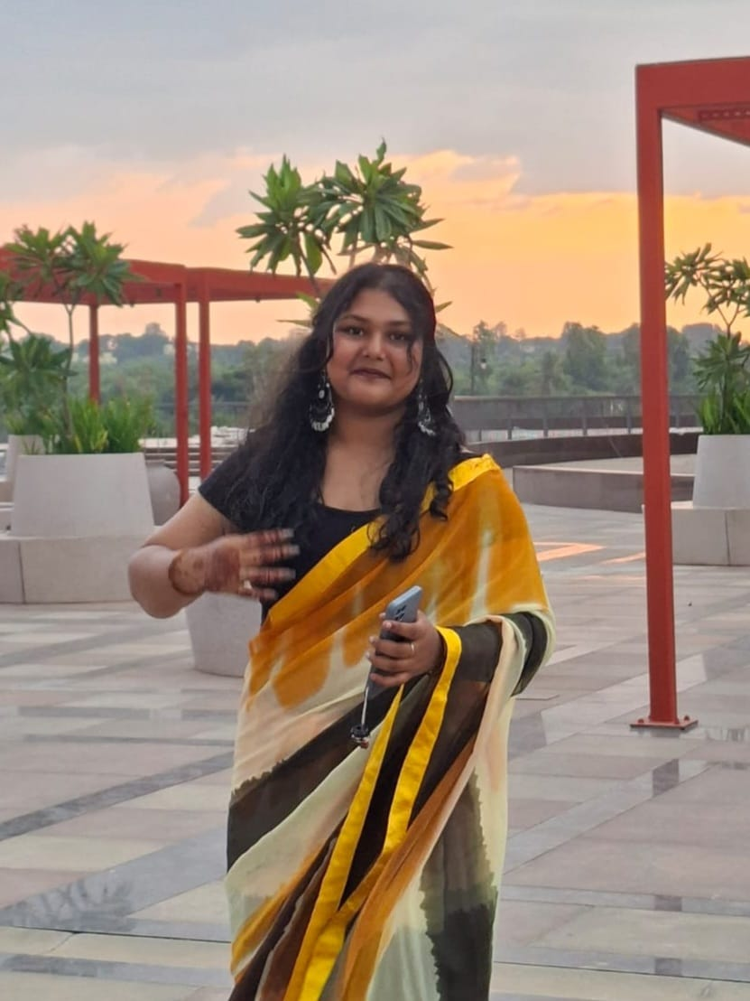
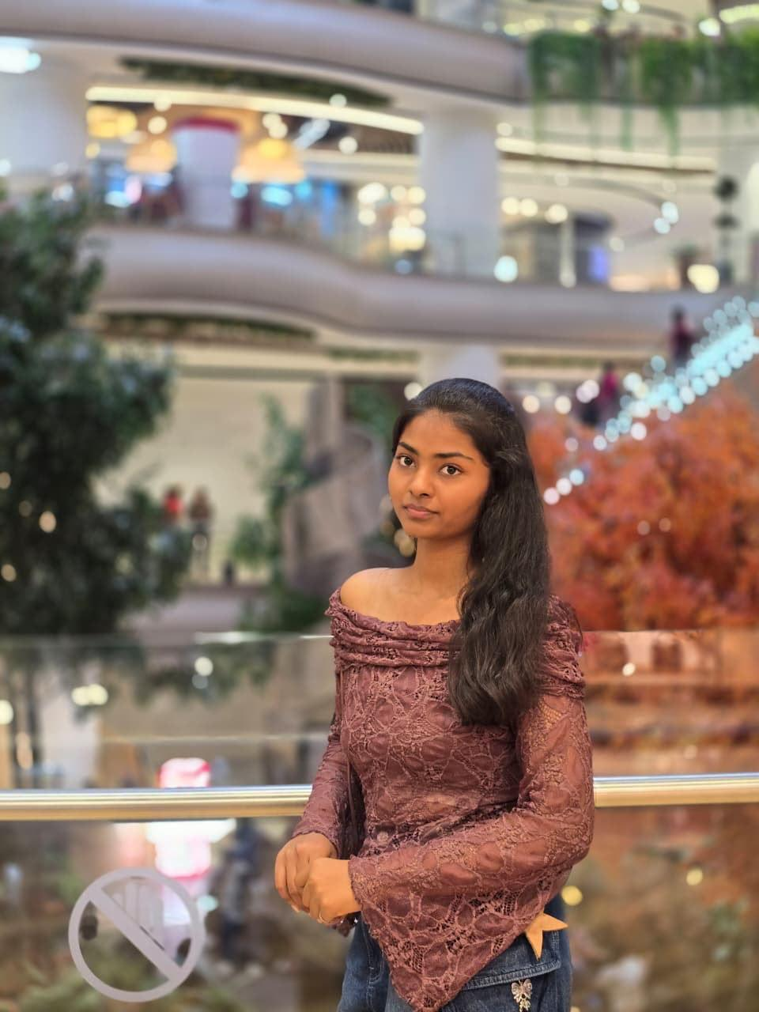
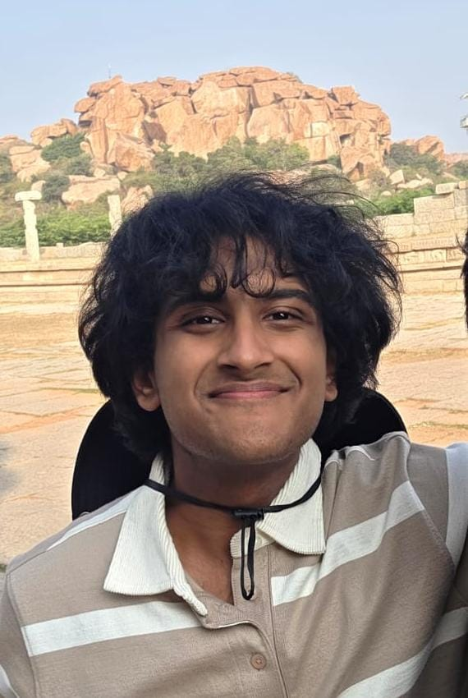
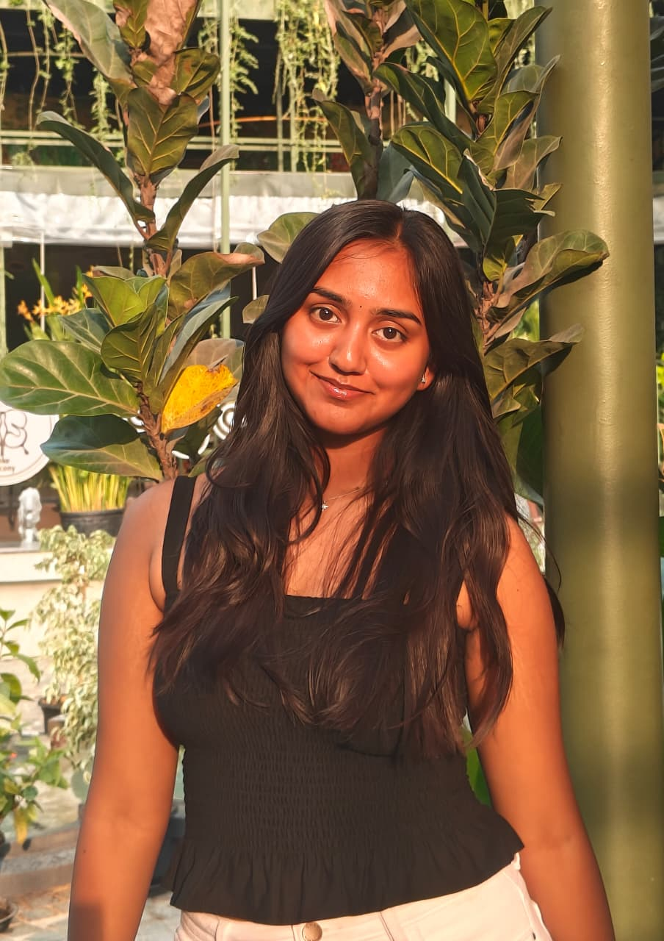
— ACT V — THE LEADERSHIP
THE PEOPLE BEHIND RAHAT
TANVI
PRESIDENT
Executive Leadership & Community Vision
PAVAN
VICE PRESIDENT
TANISH
GENERAL SECRETARY
AKSHITA
CREATIVE LEAD
HAASINI
OPERATIONS LEAD
KESHAV
TREASURER
MANYA
WEB & SOCIAL

Slide 8

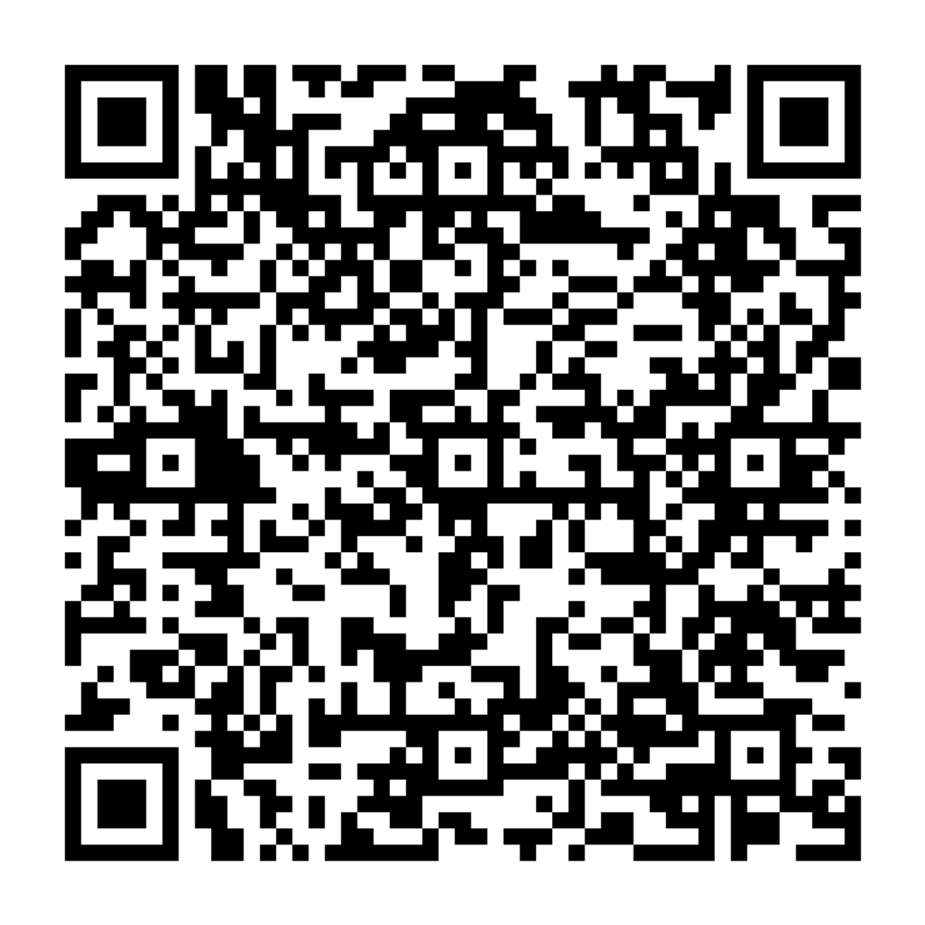
— ACT VI — CONNECT WITH US
BE A PART OF THE CONVERSATION
INSTAGRAM
@rahat.mitb
Follow for stories, event updates, reels & community initiatives
LINKEDIN
Rahat MIT Bengaluru
Connect for collaborations, panels & student leadership networks

Slide 9
“MAKING SPACE”
Rahat to all.
mitbengaluru.rahat@gmail.com • MIT Bengaluru

