Slide 1


EE542 - Internet and Cloud Computing
Prof. Young Cho
Laboratory 10 - Genomics Common Data
Team Laboratory Assignment
Fall 2018
Ekta Trivedi
Vishad Shah
Pavan Athreya Narasimha Murthy

Slide 2

Objective
To integrate and preprocess files related to a particular disease type, and how to use the data obtained from miRNA files
Extract all the file_ids and the corresponding case_ids for future use
Get the meta data for the files and corresponding cases
Generate the miRNA matrix for all the files with labeled normal or tumor
Apply Machine Learning to the above data

Slide 3
Biomarker Data:
A measurable indicator of the severity or presence of some disease state
3 data categories: DNA Methylation, Simple Nucleotide Variation, Transcriptome Profile
Data validation is performed on both data imported into the GDC from existing NCI programs

Slide 4

GDC Data Transfer Tool
Provides a standard client-based mechanism in support of high-performance data downloads and submission
Has a command-line interface supporting both GDC data downloads and submissions
GDC Data Portal’s interface is used to generate a manifest file or obtain UUID(s)
Supports resumption of interrupted downloads

Slide 5
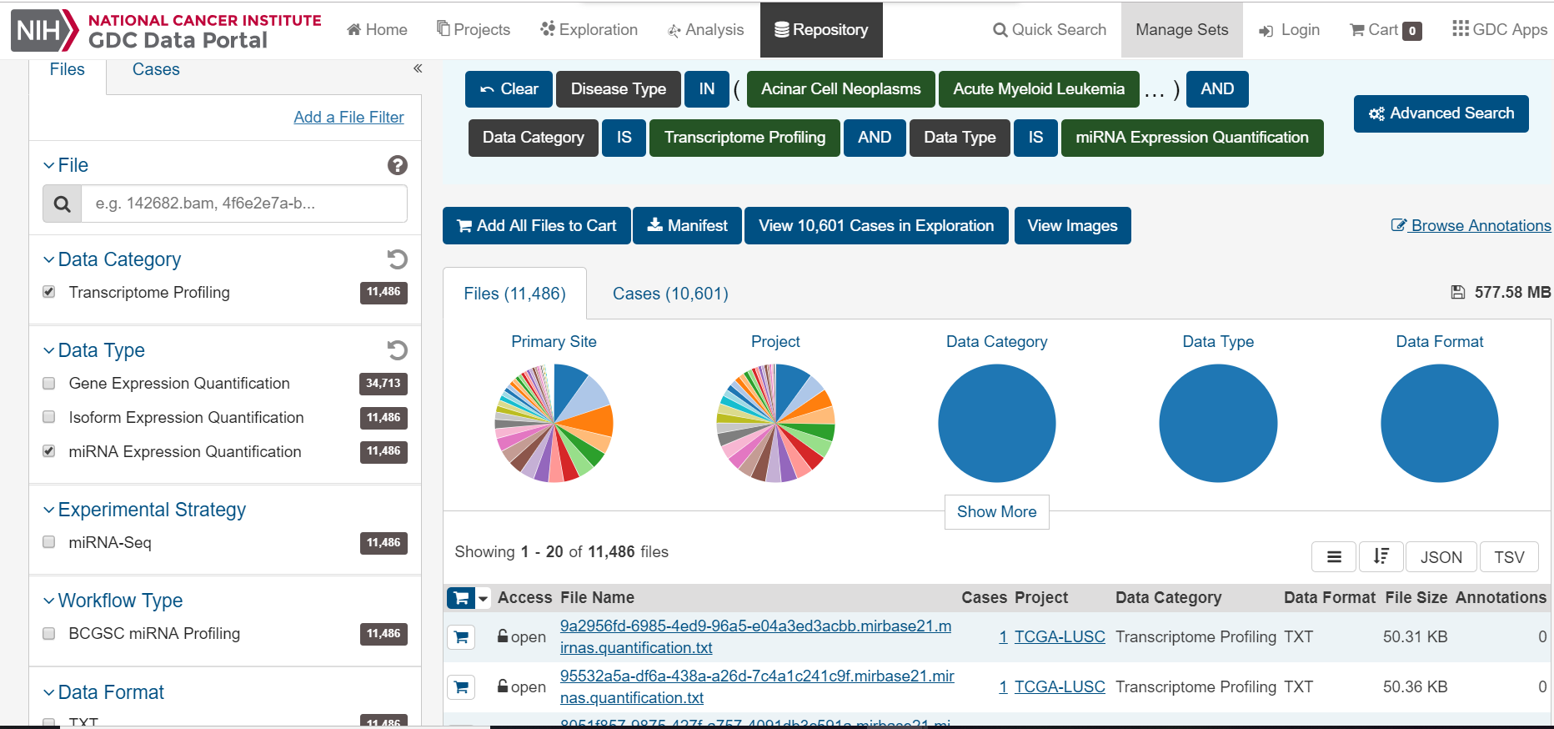
Expression Quantification data
Output of miRNA profiling has 2 separate files mirnas.quantification.txt and isoforms.quantification.txt
Under Disease type, all diseases are selected, while miRNA Seq, miRNA Expression Quantification, Transcriptome Profiling.
11,486 Files and 10,601 cases, few normal cases i.e. without cancer.

Slide 6

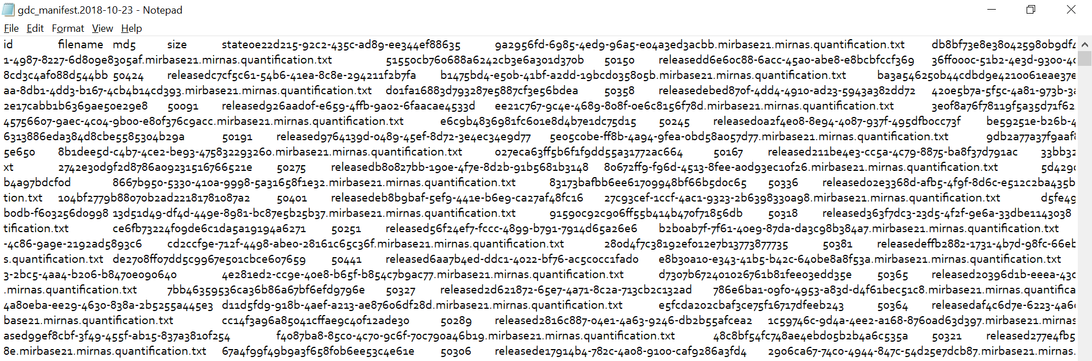
Manifest data
GDC data transfer tool is used to contain id, filename, md5, size, and patient state
The Manifest data is a .txt file downloaded on your local system.
For matching the File Id with its md5 sum, manifest file comes in handy.

Slide 7
Downloading miRNA files
11486 cases for all types of diseases
Download the files with gdc-client tool
Manifest file contains the id, filename, md5, size and patient state
./~/Downloads/gdc-client –m ~/Downloads/gdc_manifest.2018-08-20.txt

Slide 8
Downloading miRNA files
To check the integrity of downloaded files we run check.py
If some files fail download, we run the following command
./gdc-client download fa63ce14-b9b5-4041-9df7-3b86ba9ede16

Slide 9
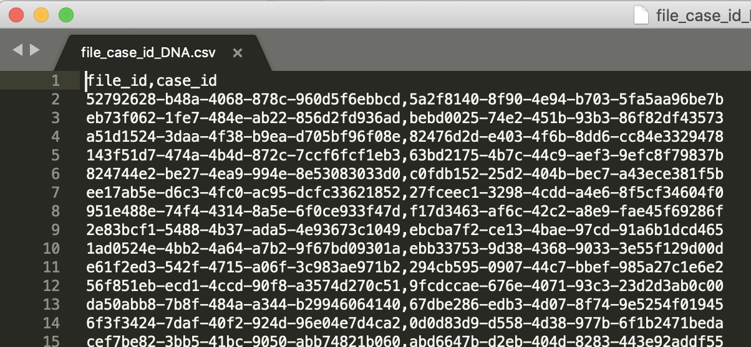
Parsing the file
To extract all the file_ids and the corresponding case_ids for future use
Input file is files.2018-10-18.json
Output file is file_case_id_DNA.csv

Slide 10
Request Metadata
To get the meta data for the files and corresponding cases
Input file is file_case_id_DNA.csv
Output file is files_meta.tsv and cases_meta.tsv
Output File contains 11487 cases data

Slide 11
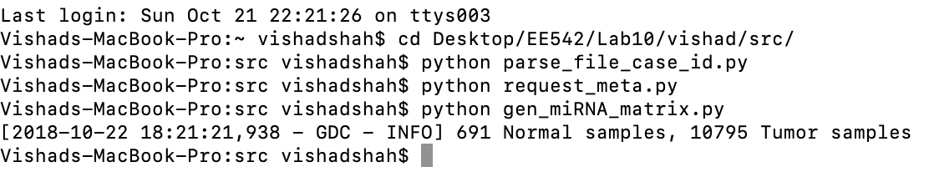
Generate miRNA files
Generate the miRNA matrix for all the files with labeled normal or tumor
miRNA seq that comes from tumor is labeled with 1 to 40 for different types of cancer and normal tissue is labeled with 0.
Found 691 Normal case and 10795 with cancer

Slide 12
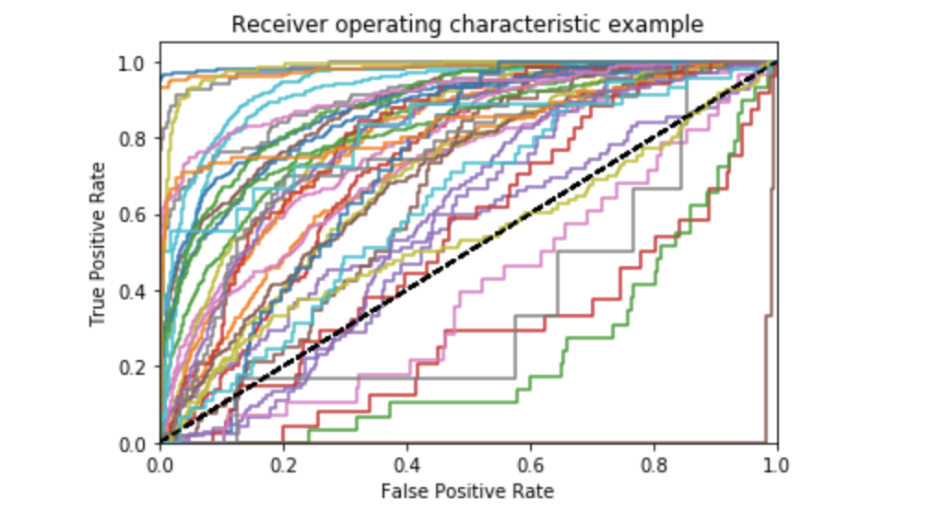
Apply ML to data
Use Machine learning algorithm on the data
Data standardization.
Train and test data split.
Feature selection.
Model hyper-parameters tuning with cross validation
Evaluation: Precision, Sensitivity, Accuracy, F1-score, Specificity
Training accuracy : 0.997695
Testing accuracy : 0.835

Slide 13
Apply ML to data
Scatterplots showing variation per principal component

Slide 14
Github link
https://github.com/PavanAthreya/EE542-Lab10-Pheonix
Link to google drive
https://drive.google.com/open?id=1PKX4eif-onpkGqaOGo4lLmYnRumJq-ec

Slide 15
If you give life to your work,
your work will give you life!

Slide 16


THANK YOU
+1(323)-684 5715
pavan.athreya@usc.edu
https://www.linkedin.com/in/pavanathreya/
+1(213)-421 4922
vishadsh@usc.edu
https://www.linkedin.com/in/vishadshah/
+1(213)-373 0782
etrivedi@usc.edu
https://www.linkedin.com/in/ektatrivedi/

