Slide 1
MICROSERVICES
Author Arun

Slide 2
Agenda
What is monolithic Architecture.
Advantages and Disadvantages of Monolithic Application.
What is Microservices.
Microservices Architectures.
How tow microservices communicate with each other.
Use case Practical Work.

Slide 3
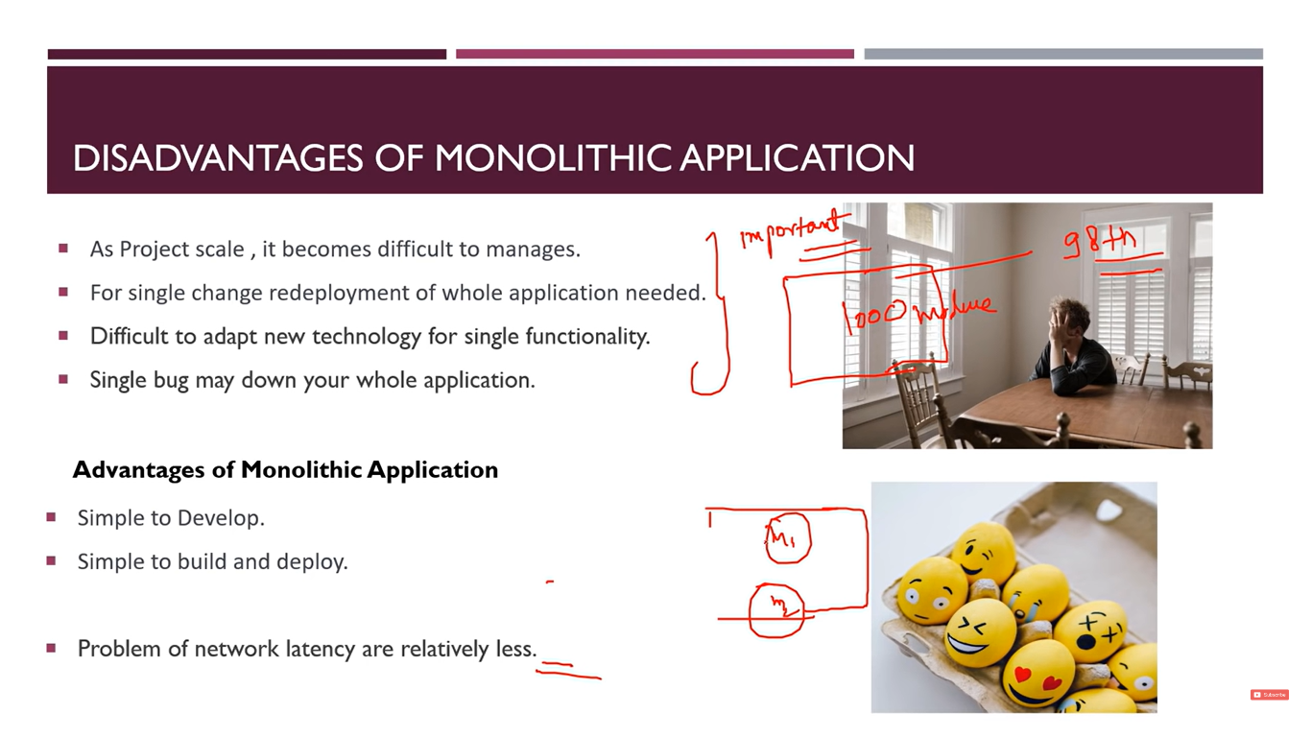
ADV AND DIS OF MONOLITHIC APP

Slide 4
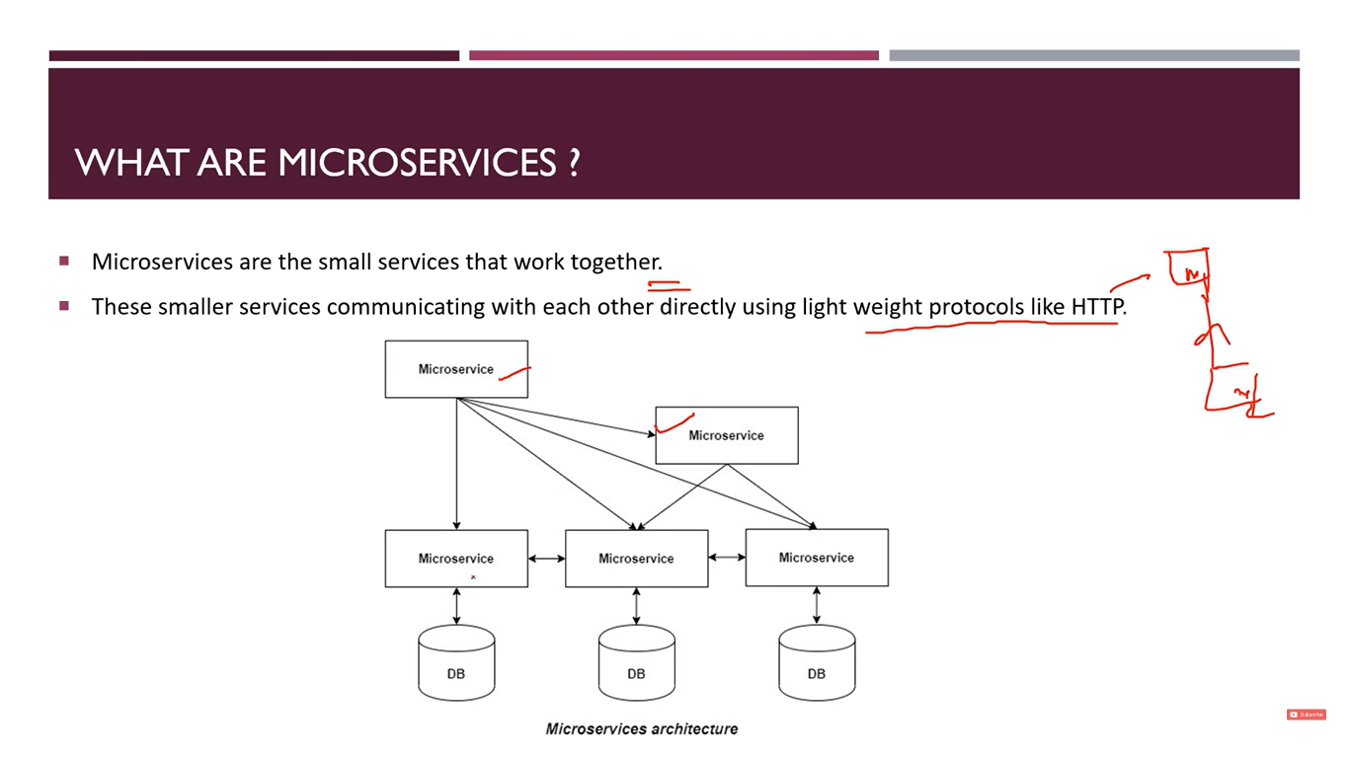
WHAT ARE MICROSERVICES

Slide 5
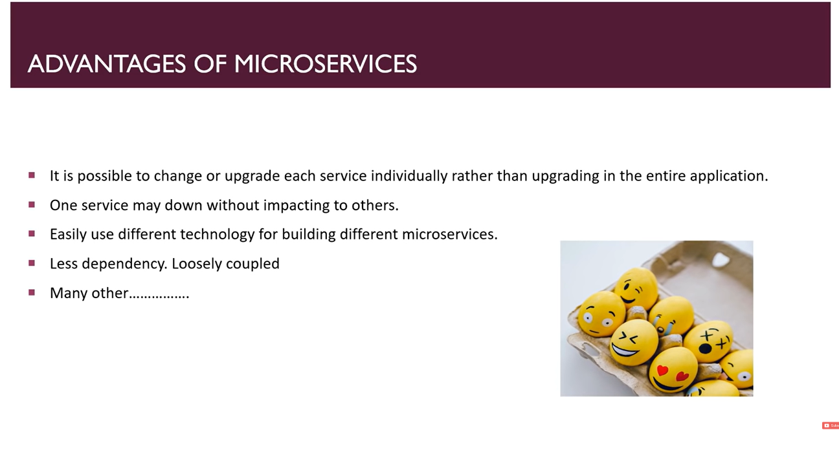
ADVANTAGES OF MICROSERVICES

Slide 6
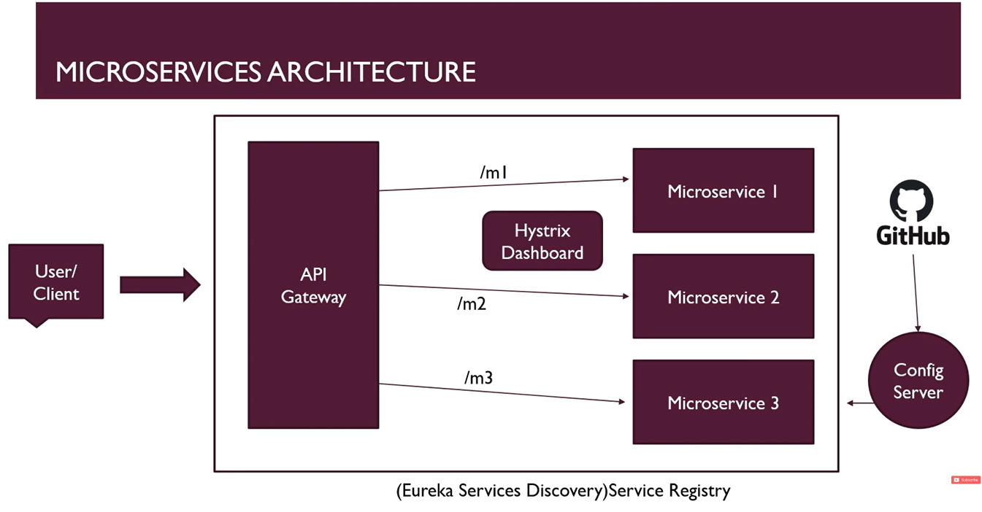
MICRO SERVICES ARCHITECTURE

Slide 7
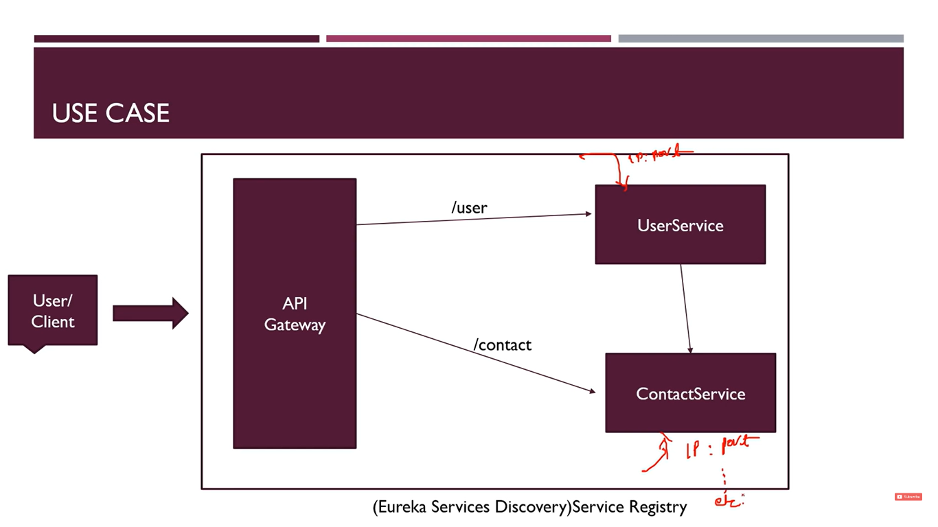

Slide 8
MICRO-SERVICE ARCHTECTURE
EUREK SERVER
API GATE WAY
MICRO SERVICE 1
MICRO SERVICE 2
USER/CLIENT
MICRO SERVICE 3

Slide 9
Micro Services Example
Creation of User Service.
Creation of Contact Service.
Establishing the connection b/w above services.
Configuration of Eureka Server.
Configuration of API gateway.

