Slide 1



AI Agents for Smart Recruitment
AI Brewery
Team members:
Pavan J
Aditya Agarwal
Shreeya.H.M
Ashish Kumar Bhagat

Slide 2




Innovative Solution Overview
Automated Resume Sorting System focuses on automating resume sorting using details from resumes, user profiles (LinkedIn, GitHub, etc.), and extracted key features.
This project focuses on automating the sorting of resumes based on:
- User-provided basic details.
- Profiles such as LinkedIn, GitHub, and LeetCode.
- Extracting key features from resumes (PDFs and photos)
The system assigns a score to evaluate candidates.

Slide 3
Core Technology & Architecture
1. Resume Document: Input is received in PDF or photo format.
2. Document Extractor: Extracts text and key details using OCR and AI models.
3. Feature Extraction: Leverages advanced NLP and LLMs to extract relevant features.
4. Web Crawlers: Scrapes user profiles (LinkedIn, GitHub, LeetCode) for additional data.
5. Database Matching: Compares data with the database of existing employees.
6. Multi-Agent Analysis: Aggregates data from all sources to compute a candidate score.
7. Report Generation: Generates a summary and assigns a percentage score for recruitment.

Slide 4
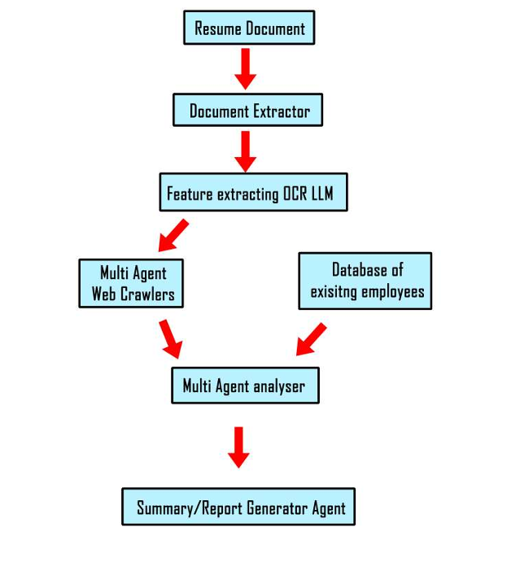
Implementation Strategy
Follow the flowchart representation for input, processing, and output stages:
Resume submission, feature extraction, data comparison, and scoring.

Slide 5
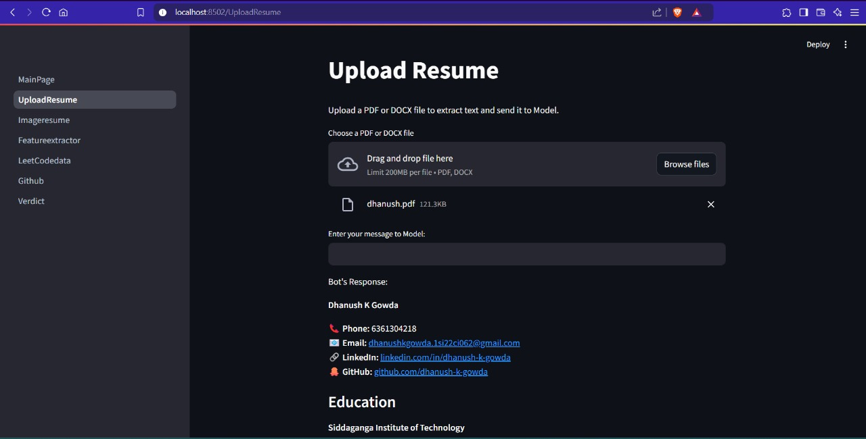
Snippet of Working Prototype

Slide 6
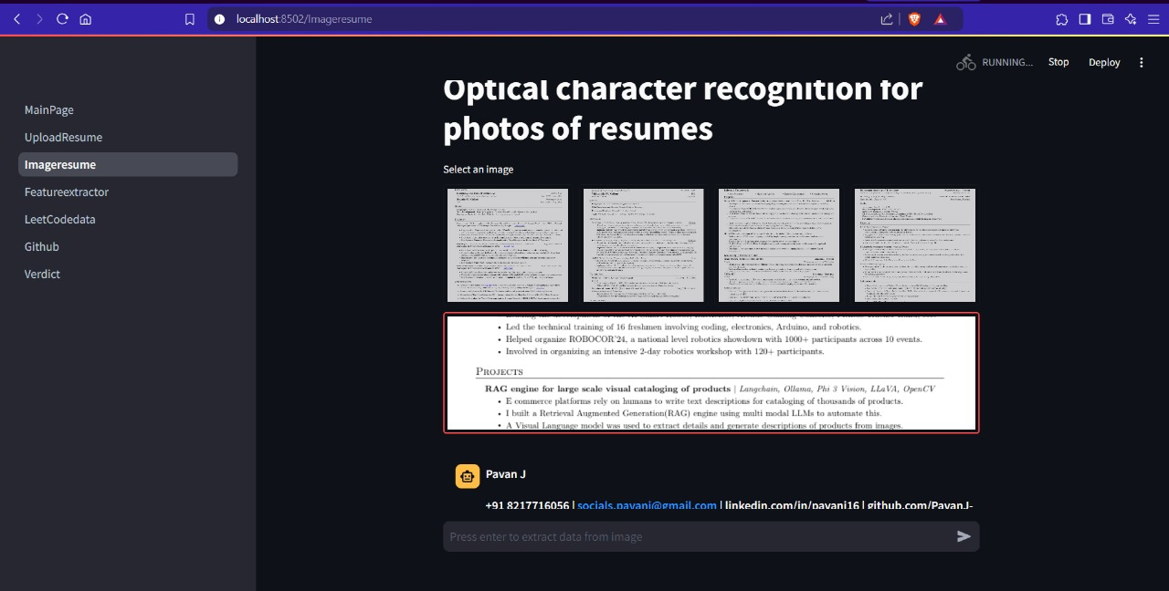

Slide 7
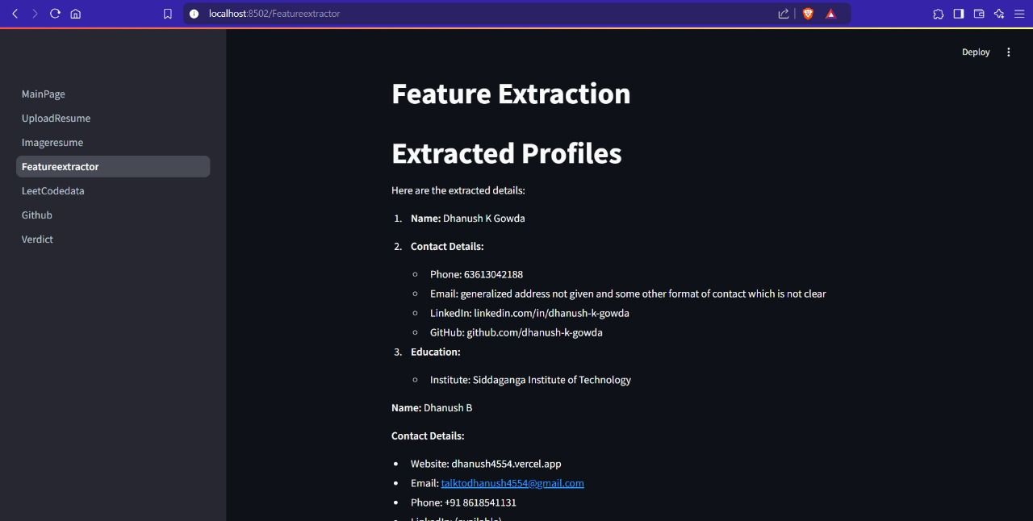

Slide 8
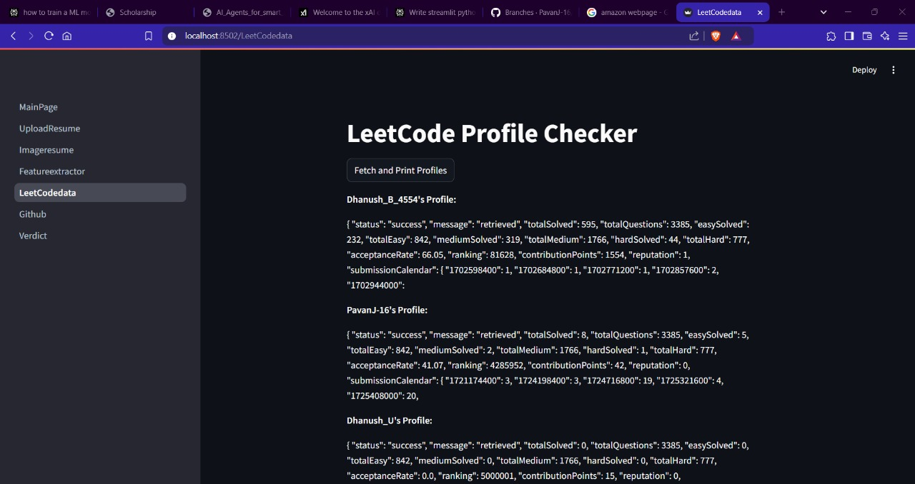

Slide 9
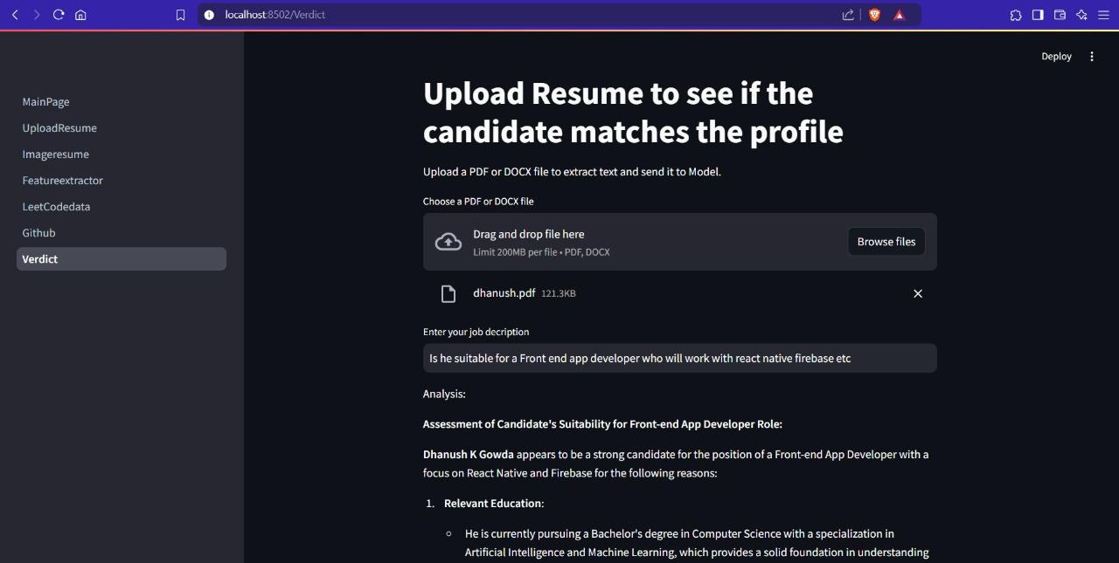

Slide 10
Impact & Value Proposition
1. Increased recruitment efficiency by automating multiple stages.
2. Enhanced decision-making using AI-driven scoring.
3. Integration of diverse data sources for comprehensive evaluation.

Slide 11
Challenges & Future Roadmap
Challenges:
1. Handling diverse resume formats.
2. Ensuring privacy/security during data scraping.
Future Roadmap:
1. Scaling AI models.
2. Expanding integrations to platforms like Behance and Kaggle.
3. User feedback incorporation for improvement.

Slide 12
Conclusion & Next Steps
AI Agents for Smart Recruitment is a transformative approach to talent acquisition. Next steps include refining models, gathering user feedback, and improving scalability.

