Slide 1
IOT based Home Automation Solution
Emertxe IoT Internship
By:
P Pavan Kalyan Reddy
1

Slide 2
Table of contents :
About the Internship
Topics learned in this Internship
What is IoT?
What is embedded system?
C/ C++(OOPs concepts)
About the Project
Implementation of the Project
conclusion

Slide 3
About the Internship:
Emertxe information technology, Bangalore
Duration 4 weeks
Organized, Structured, and Standard
Learning with implementation
Student Support (Moodle LMS)
Free Resources and Tools
Project based learning
Weekly Evaluation of student

Slide 4
Topics to Learn
Learning Part
C/C++ Programming
OOP’s Concepts
IoT Introduction
Embedded System
Workshop
Project Part
Peripherals
Arduino programming
Picsimlab Simulation
Blynk IoT App
Home automation Project
Project Part
Peripherals
Arduino programming
Picsimlab Simulation
Blynk IoT App
Home automation Project

Slide 5
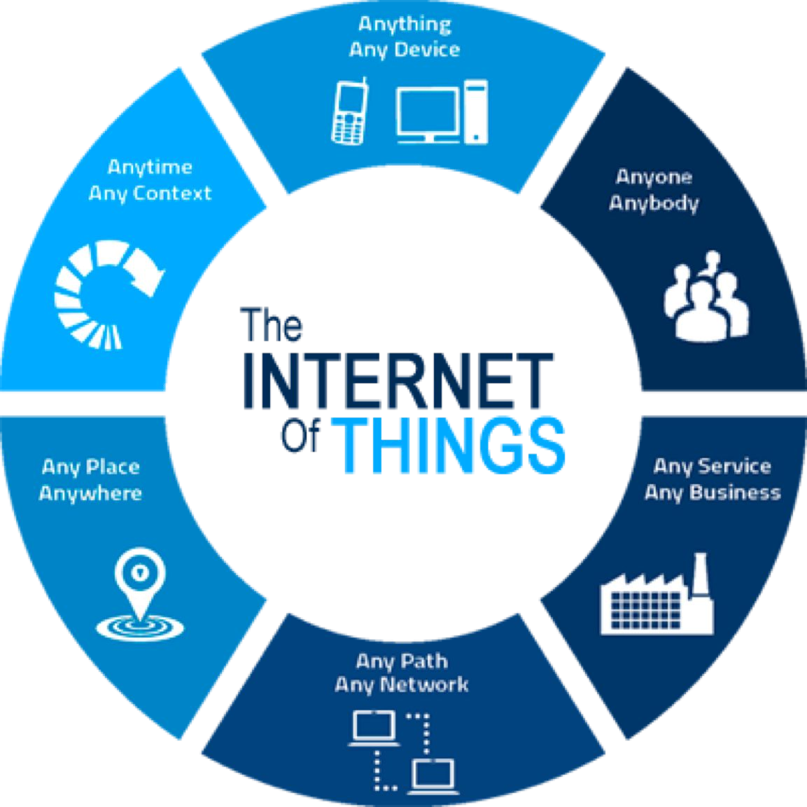
What is IoT ?
IoT — The Internet of Things
Internet : Network Things : Objects
The Combination of objects with the help of network (Internet).
IoT is the network of physical objects
Collection of electronics, software, sensors, and network connectivity, which collect and exchange the data

Slide 6
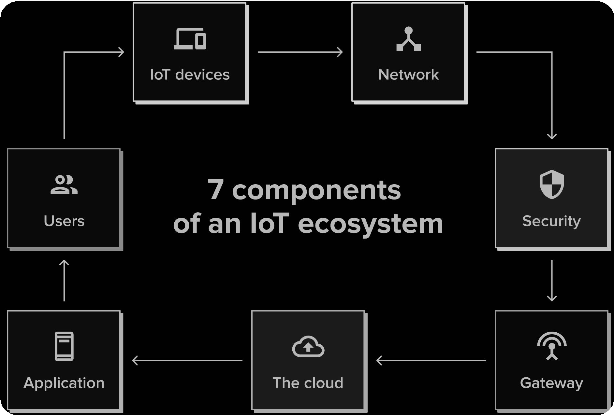
Ecosystem of IoT:
IoT devices
Network
Security
Gateway
The Cloud
Application
Users

Slide 7
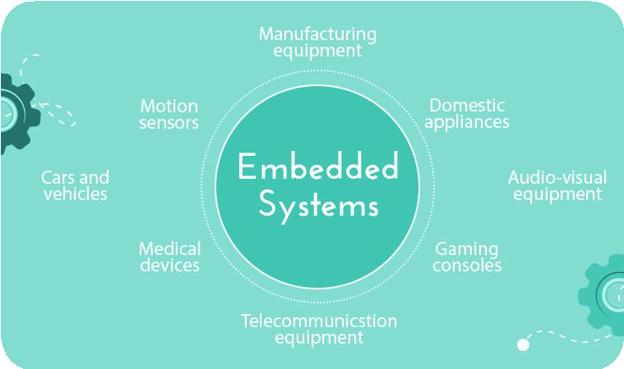
What is Embedded System?
An embedded system is a combination of computer hardware and software designed for a specific function.
An embedded system is a computer system which is the combination of a processor, memory, and input/output peripheral devices.

Slide 8
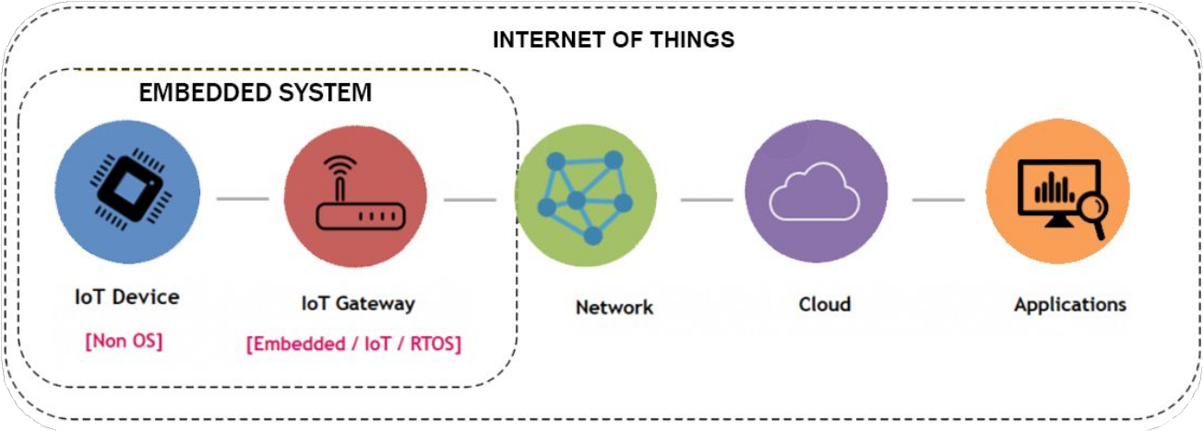
An embedded system and IoT
The difference between an embedded system and the IoT is an embedded system is a subset of IoT

Slide 9

Types of Embedded system:
Self-driving vehicle controls
Aircraft control systems
Medical devices and patient monitoring systems
Digital cameras
Music players
Washing machines
01
Real Time embedded systems
02
Stand alone embedded systems
Home security systems
ATMs (Automated teller machines)
Point of sale systems
03
Networked embedded systems
Cell phones
Laptops
Smartwatches
04
Mobile embedded systems

Slide 10
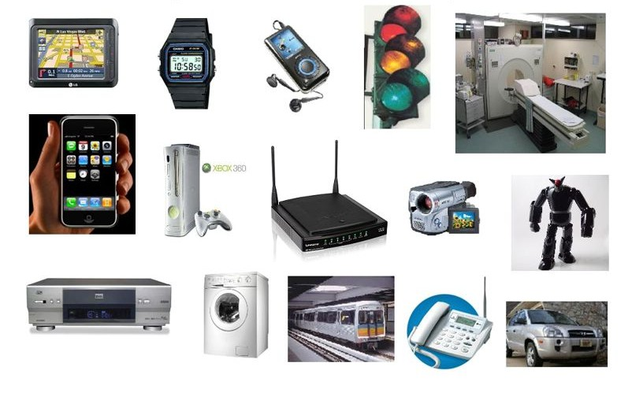
Examples of embedded systems:

Slide 11
C/ C++ Programming
Basics: Intermediate:
Advanced:
Variables
Keywords
Datatypes
Operators
Conditionals
Loops
Arrays
Pointers
Functions
Storage Classes
Files
Preprocessor
C++ Overview
Class and Objects
Abstraction
Inheritance
Encapsulation
Polymorphism

Slide 12
About the project: Home Automation
Requirements:
Garden Lights Control
Temperature control
Heater Control
Threshold Temp. Control
Water Tank control
Inlet and outlet valves control
Display water volume
Displaying the progress and notified on the mobile (Blynk) app and CLCD with automatic actions

Slide 13
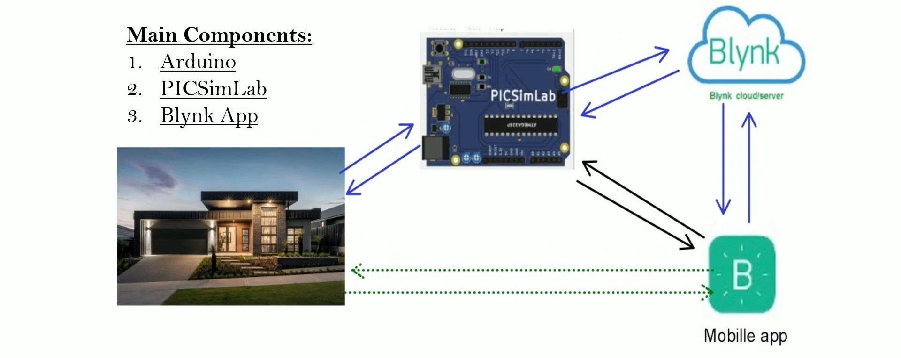
About the Project:
Main Components:
Arduino Uno
PICSimLab
Blynk App

Slide 14
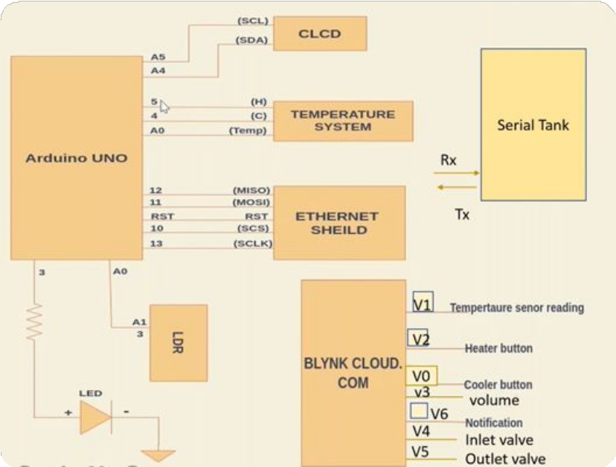
About the Project:
Peripherals:
LED’s
Temperature system
CLCD
LDR
Serial tank (Serial communication)
Ethernet shield

Slide 15
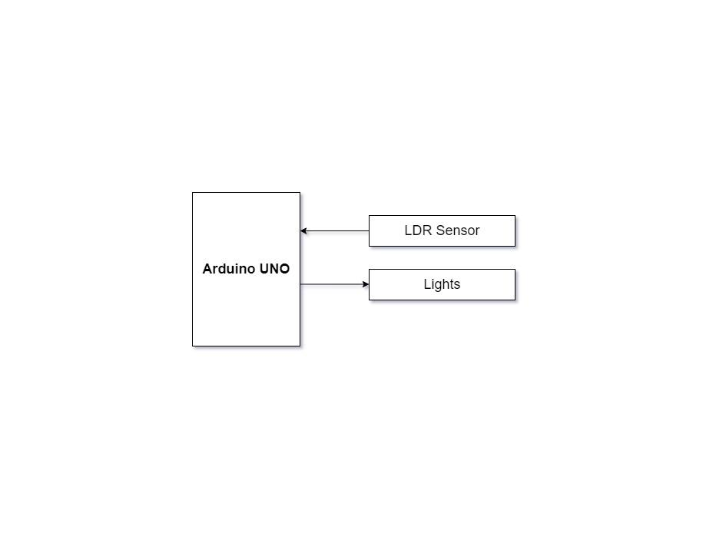
Garden lights control
Read the LDR sensor value, based on the reading from LDR, vary the brightness of the led, which resembles controlling garden lights based on the availability of sunlight.

Slide 16
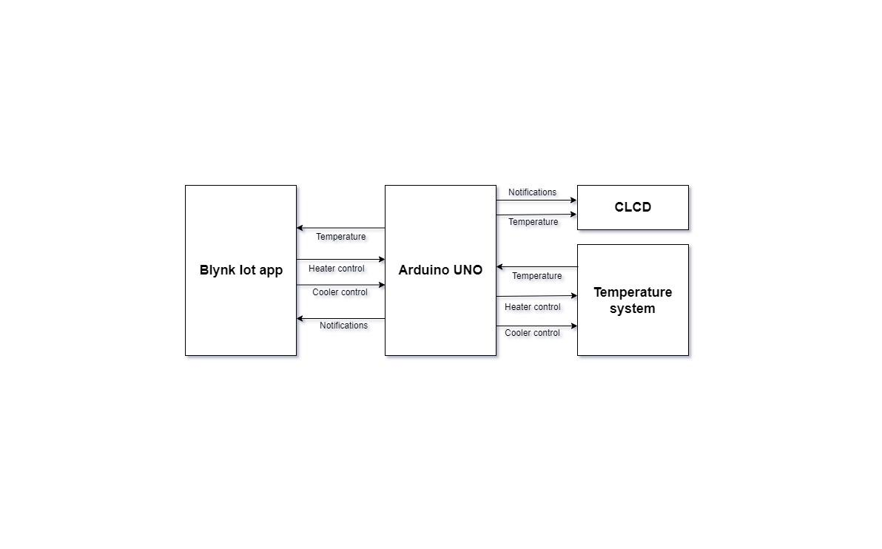
Temperature Control System
The temperature control system consists of a heating resistor, an LM35 temperature sensor, and a cooler. Which resembles the temperature control system at home. Read the temperature from the temperature sensor LM35 and display it on the CLCD. Control the temperature of the system by turning ON/OFF the heater and cooler through the Blynk IOT mobile app .

Slide 17
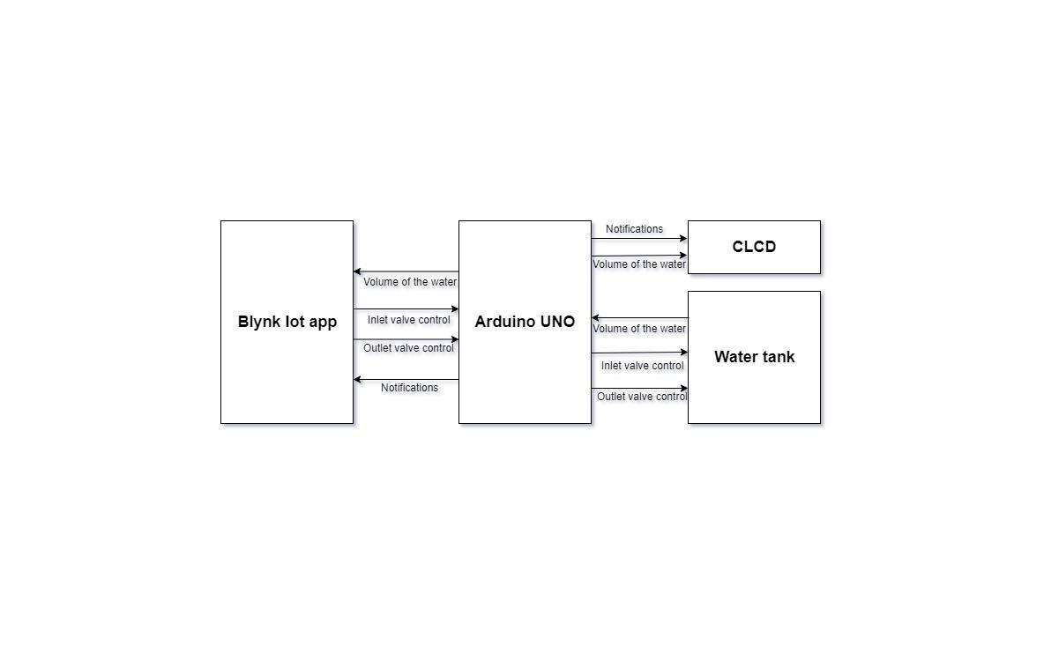
water tank inlet and outlet valve control
Read the volume of the water in the tank through Serial Communication and display it on the CLCD, control the volume of the water in the tank by controlling the inlet and outlet valve, by sending commands through serial communication. Display the volume of water in the tank on the CLCD.

Slide 18
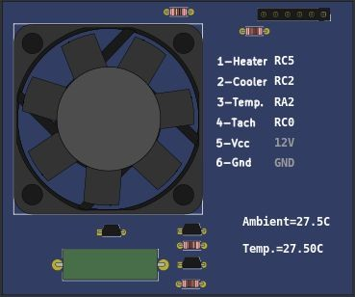
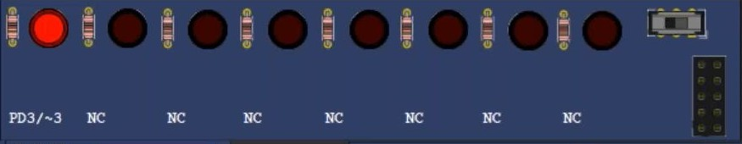
About the Project:
LEDs (Light Emitting Diode)
Temperature System

Slide 19
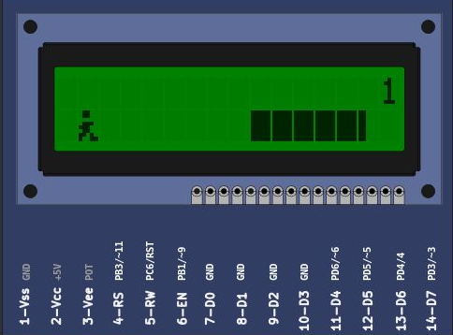
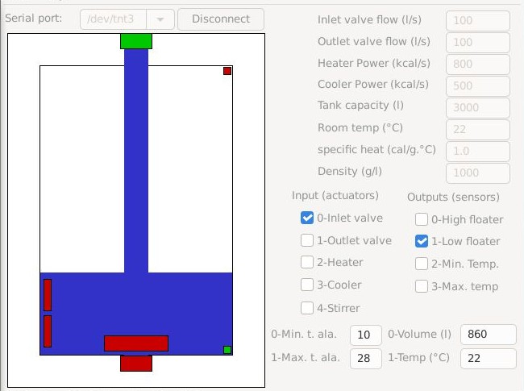
About the Project:
CLCD (16×2) Liquid Crystal Display
Remote serial Tank

Slide 20
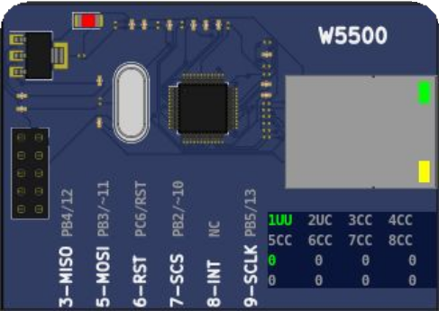
About the Project:
ETH W5500
The W5500 chip is a Hardwired TCP/IP embedded Ethernet controller that provides easier Internet connection to the embedded system.
W5500 enables users to have the Internet connectivity in their applications just by using the single chip in which TCP/IP stack, 10/100 Ethernet MAC and PHY embedded.
Supports Wake on LAN over UDP. Supports High Speed Serial Peripheral Interface(SPI MODE 0,3).

Slide 21
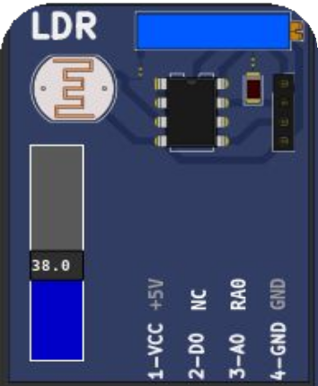

About the Project:
LDR (Light dependent resistor) SENSOR
An LDR is a component that has a (variable) resistance that changes with the light intensity that falls upon it. This allows them to be used in light sensing circuits.
The resistance of a Photo resistor decreases with increasing incident light intensity. In other words, it
exhibits photoconductivity.
Light
1 / Resistance

Slide 22
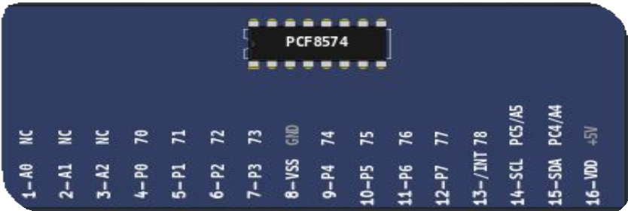
About the Project:
PCF8574
The PCF8574 is a silicon CMOS circuit
It provides general purpose remote I/O expansion for most microcontroller families via the two-line bidirectional bus (12C inter-IC).
The device consists of an 8-bit quasi-bidirectional port and an I2C-bus interface.

Slide 23
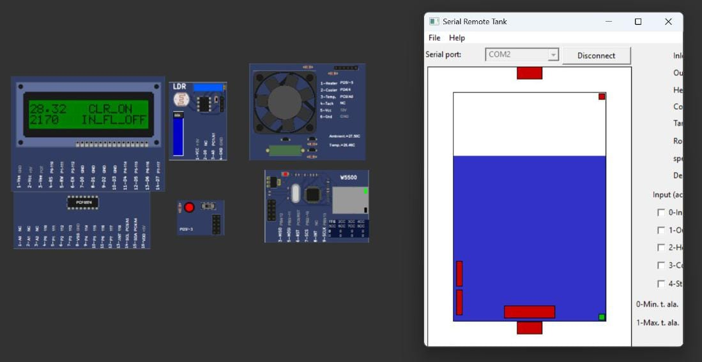
Project Implementation:

Slide 24
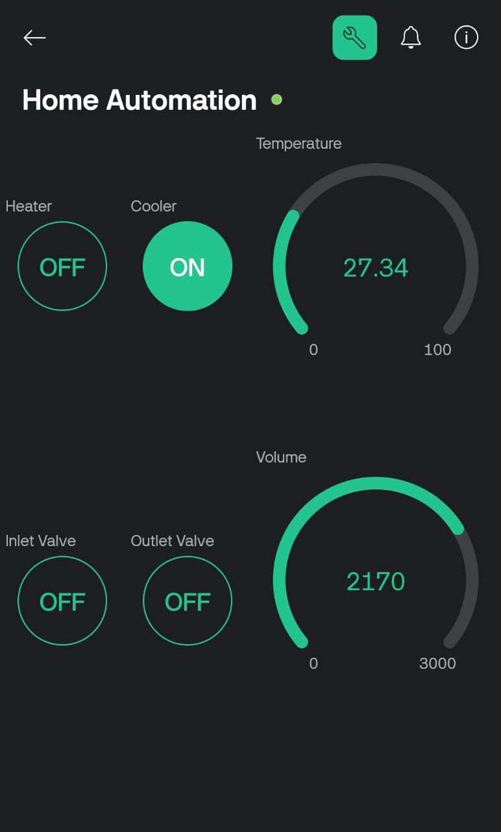
Project Implementation:

Slide 25
Using blynk IoT application and Picsimlab simulator, simulated home automation, where LED, temperature system, Serial tank resembles Light, Heater, Cooler and Water tank in real time.
CLCD acts like a dashboard used for displaying the events, Widgets from Blynk IoT app like button widgets are used to control heater, cooler and inlet valve, outlet valve.
Gauge widgets to display the temperature and volume of the water.
Conclusion

Slide 26
Thank you!

