Slide 1

AI-Powered Customer Support System

Slide 2
What This Solution Does
Provides instant customer support powered by AI
  Understands user queries and accesses real order data
  Fetches product, order, and policy information automatically
  Improves customer experience with fast, accurate responses

Slide 3
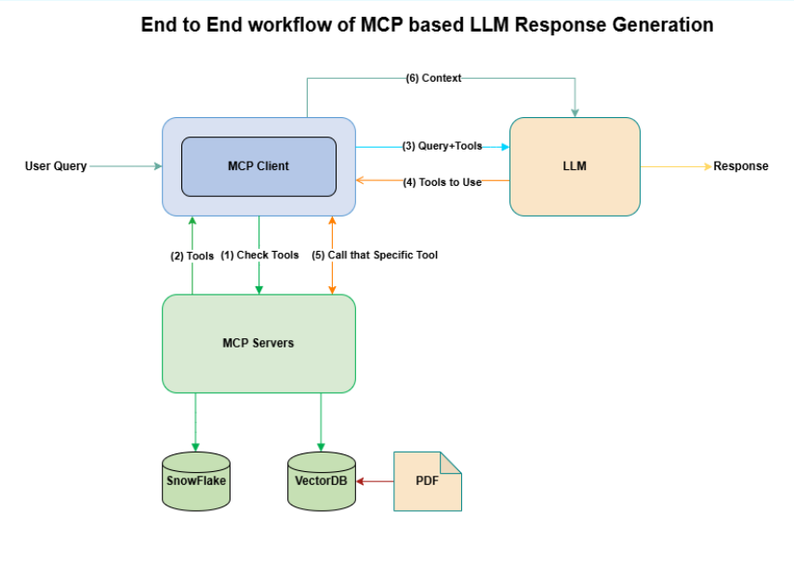
Architecture

Slide 4
How Users Experience the System
Customer logs in → system recognizes them
  User asks: “What is my latest order?”
  AI automatically knows their Customer ID
  AI retrieves the latest order from Snowflake
  Clear, friendly response is shown instantly

Slide 5
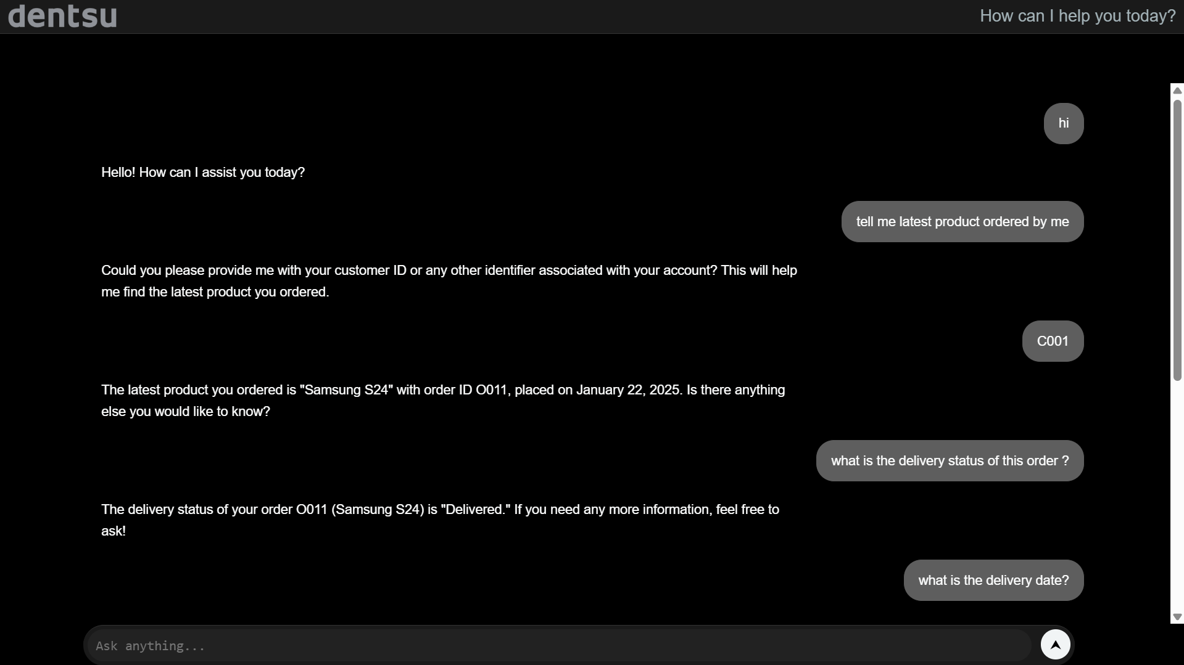
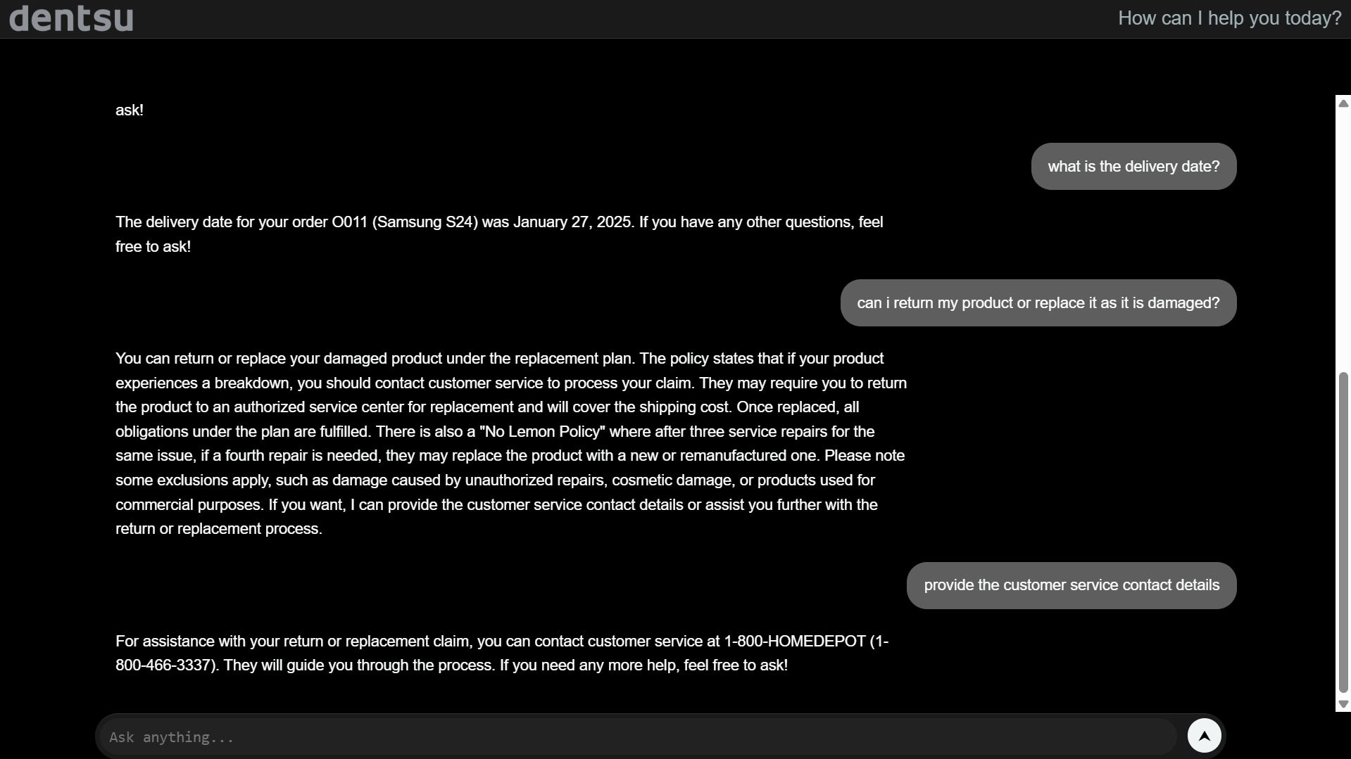
Chat Experience
UI showing conversational support
  AI responds with delivery dates, return eligibility, etc.

Slide 6
How the System Ensures Accuracy
AI uses your real company data — no guessing
  Product ID is cross‑checked with Product Name
  Policies are fetched directly from your knowledge base
  Order and product information always come from Snowflake

Slide 7
Example Customer Scenario
User: 'Can I return my washing machine?'
  AI checks delivery date, order status, and policies
  AI determines return eligibility
  AI explains steps and provides customer service details

Slide 8
Business Impact
Reduces workload on customer support teams
  Fast response = higher customer satisfaction
  Accurate answers reduce escalations and repeated queries
  Improves efficiency without changing backend systems

Slide 9
Summary
AI assistant provides real-time customer support
  Fully integrated with Snowflake and your policy documents
  Business-friendly design and scalable architecture
  Ready for deployment across customer experience channels

