Slide 1

Spotify Analytics Pipeline
By- Pavan Kumar, Ankur Haritosh
DS5110 (Introduction to Data Management and Processing)

Slide 2
AGENDA
1. Introduction
2. Literature Review
3. Methodology
4. Analysis & Results
5. Discussion
6. Conclusion
7. References

Slide 3

INTRODUCTION
Objectives and Goals ->
Build automated data pipeline for music trend analysis
Extract & analyze data from multiple Spotify playlists
Generate actionable insights through Power BI dashboards
Implement scalable serverless architecture
Project Scope ->
Data Sources
Infrastructure
Visualizations
ML Model
Notes:
Objectives and Goals ->
Build automated data pipeline for music trend analysis
Extract & analyze data from multiple Spotify playlists
Generate actionable insights through Power BI dashboards
Implement scalable serverless architecture
Project Scope ->
Data Sources – TopHits, HotHitsIndia, HotHitsUK, HotHitsUSA
Infrastructure – AWS, Snowflake, Power BI, Jupyter Notebook
Visualizations – Artist performance, Song & Album popularity
ML Model – Predict Popularity of a Song for which we used a Random Forest Model

Slide 4
LITERATURE REVIEW
Summary of Relevant Existing work ->
Current Spotify analytics focus on single playlist analysis
Most solutions use batch processing
Manual transformation processes
Relation of your Project to Previous work ->
Automated serverless architecture
Enhanced multi-region playlist analysis
Real-time data processing with Snowpipe

Slide 5
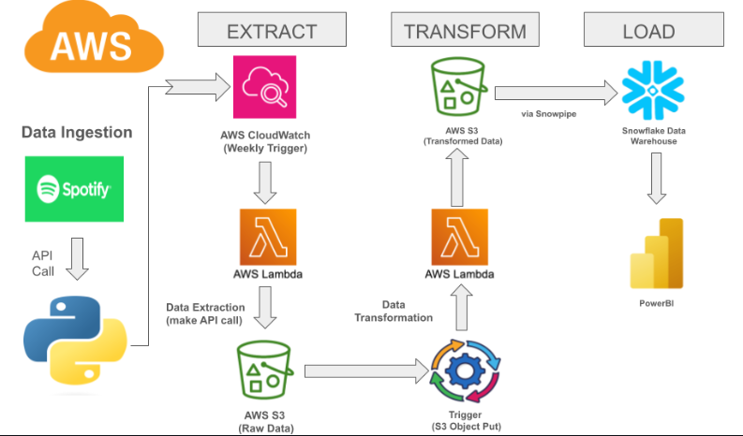
METHODOLOGY
Methods & Techniques Used
Notes:
Data Extraction: Spotify API calls using Python, triggered every 8 hours by AWS CloudWatch.
Data Transformation: AWS Lambda processes raw data into structured formats.
Data Loading: Transferred to Snowflake via Snowpipe for scalable storage and analytics.
Visualization: Insights visualized using Power BI dashboards.
ML Pipeline: Utilized in Jupyter Notebook for training and deploying machine learning models on transformed data.

Slide 6
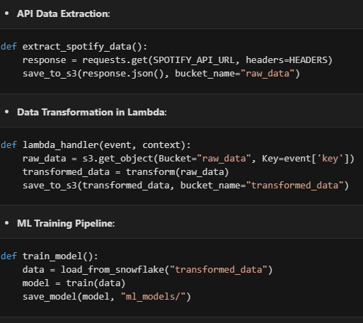
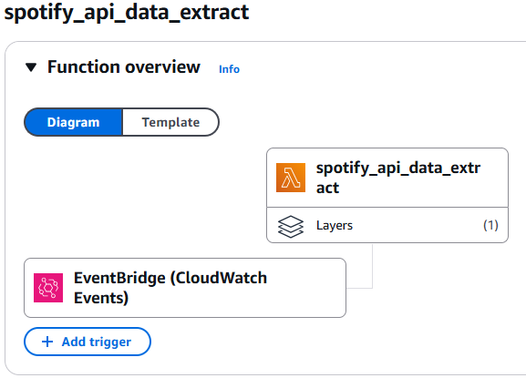
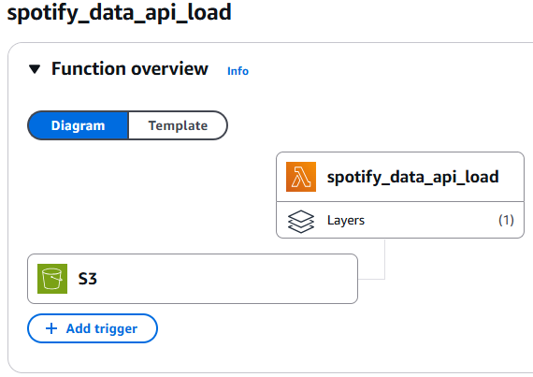
METHODOLOGY
Pseudo Code

Slide 7
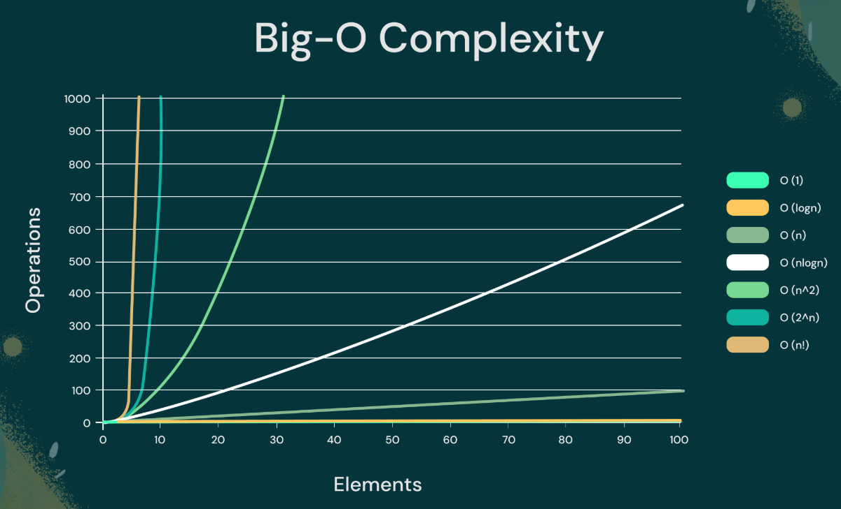
METHODOLOGY
Time Complexity
Data Extraction: O(n)
Data Transformation: O(m×k)
Data Loading: O(1)
ML:
Training: O(T×n×log(d))
Prediction: O(T×log​(n))
Notes:
Data Extraction: O(n) — proportional to the number of API calls.
Data Transformation: O(m×k) — depends on the data size (m) and transformations (k).
Data Loading: O(1) — efficient due to Snowpipe automation.
ML:
Training: O(T×n×log(d))
Prediction: O(T×log​(n))
Where n is the total number of samples, d is the number of features and T are the number of Trees.

Slide 8
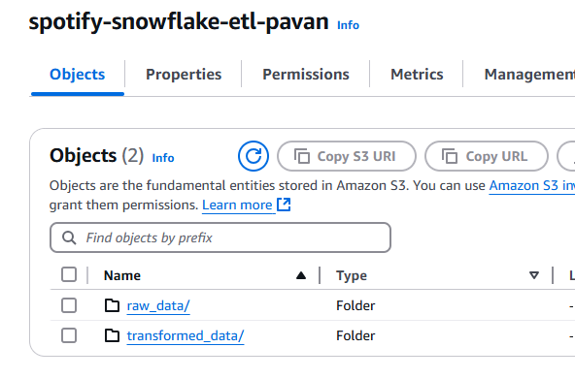
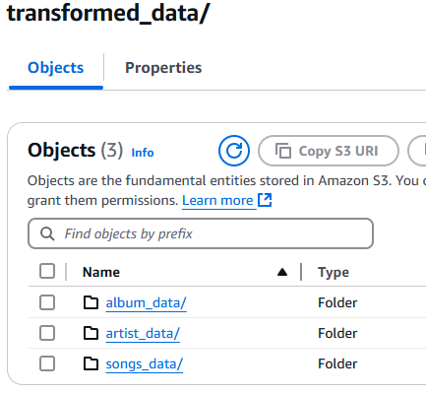
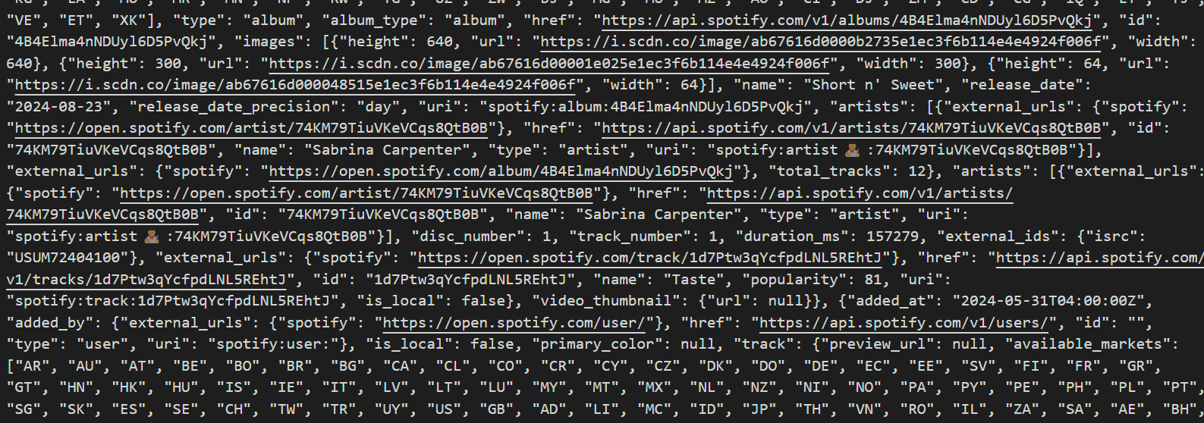
METHODOLOGY
Data Structures
AWS S3
JSON/CSV
Pandas DataFrame
NumPy Arrays
Dictionaries
Notes:
AWS S3: Buckets for raw and transformed data storage.
JSON/CSV: For structured data representation.
Pandas DataFrame: For tabular data manipulation in Jupyter Notebook.
NumPy Arrays: For numerical operations in ML models.
Dictionaries: For metadata and parameter storage.

Slide 9

Analysis
Hours Spent
Per Week:
Data Pipeline Development: 6 hours
AWS Integration & Testing: 2 hours
Snowflake Integration: 5 hours
ML Pipeline in Jupyter Notebook: 5 hours
Documentation and Debugging: 2 hours
Total Weekly Hours: 20 hours
Per Month:
Total Hours: 20 hours / week × 4 = 80 hours

Slide 10
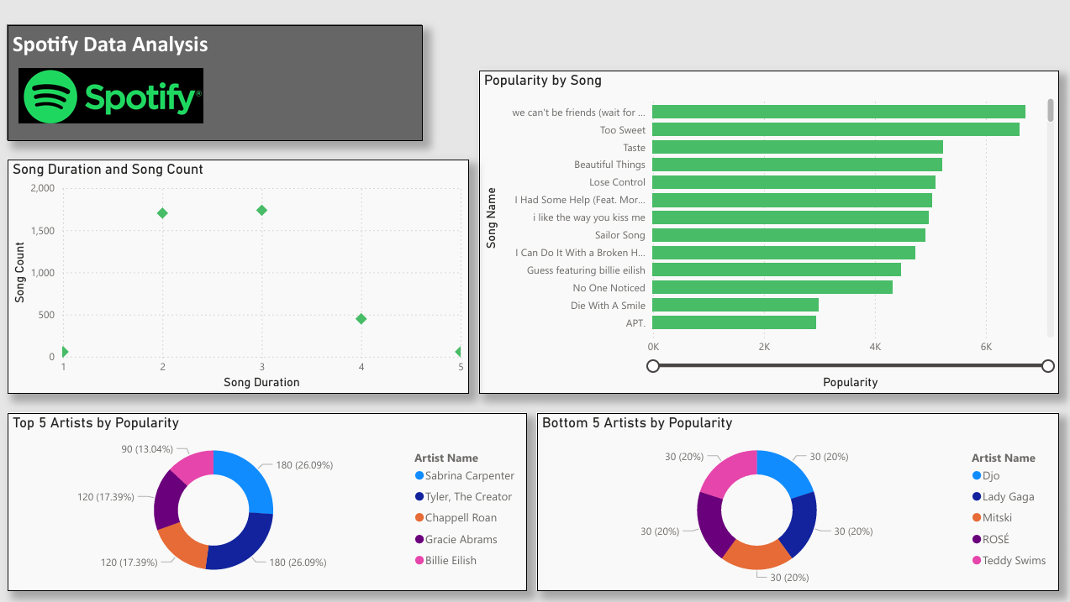
Analysis
Notes:
Top Artists: Sabrina Carpenter, Tyler, The Creator, and Billie Eilish lead with over 26% popularity.
Streaming Trends: Fridays dominate with 71.51% activity, highlighting release-day impact.
Song Insights: Shorter tracks and new releases consistently achieve higher popularity.
Album Performance: Albums like 2 Hands and GNX rank highest in popularity.

Slide 11
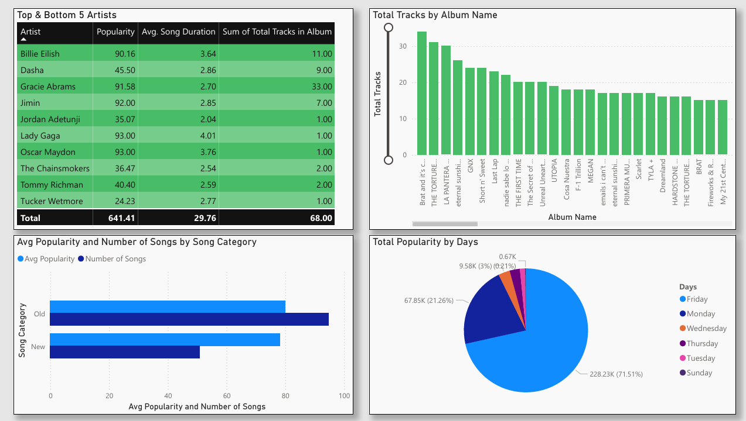
Analysis
Notes:
Engagement: Fridays are key for user activity; mid-week promotions could boost streams.
Artist Trends: Popular artists sustain listenership, while lesser-known ones need targeted strategies.
Track Preferences: Shorter, newer tracks align with user preferences for dynamic content.
Recommendations: Focus on high-engagement days and curate shorter, trend-aligned tracks.

Slide 12
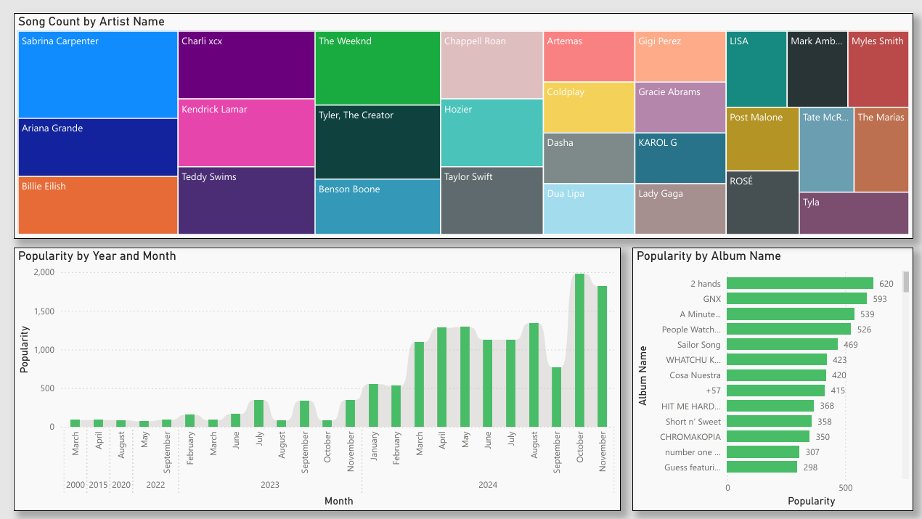
Analysis
Notes:
Engagement: Fridays are key for user activity; mid-week promotions could boost streams.
Artist Trends: Popular artists sustain listenership, while lesser-known ones need targeted strategies.
Track Preferences: Shorter, newer tracks align with user preferences for dynamic content.
Recommendations: Focus on high-engagement days and curate shorter, trend-aligned tracks.

Slide 13
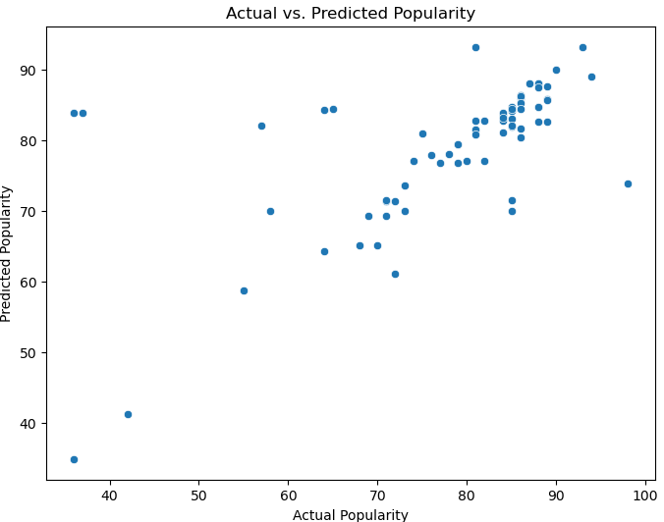
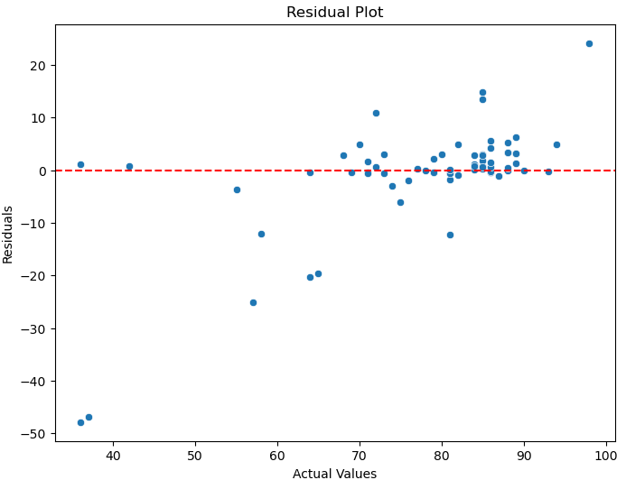
Analysis
Notes:
Random Forest Model Highlights
High Accuracy: Strong correlation between actual and predicted song popularity.
Optimal Choice: Outperformed Linear Regression, SVM, and Gradient Boosting in experiments.
Future-Ready: Reliable for predicting future song trends and aiding playlist curation.
Key Advantages
Handles Complexity: Captures non-linear patterns in data.
Consistent Results: Robust against overfitting, ensuring reliable predictions.
Business Impact
Actionable Insights: Supports smarter playlist recommendations.
Scalable: Adapts easily to new songs and features.

Slide 14
Findings
For Spotify:
Highlight key streaming days (e.g., Fridays) for targeted marketing campaigns.
Promote shorter, engaging tracks in popular genres to boost user interaction.
Focus on trending artists like Sabrina Carpenter and Tyler, The Creator for curated playlists.
For Data Pipelines:
Playlists get updated frequently, reinforcing the need for continuous data flow.
ML predictions can inform user-specific recommendations, enhancing personalization.

Slide 15
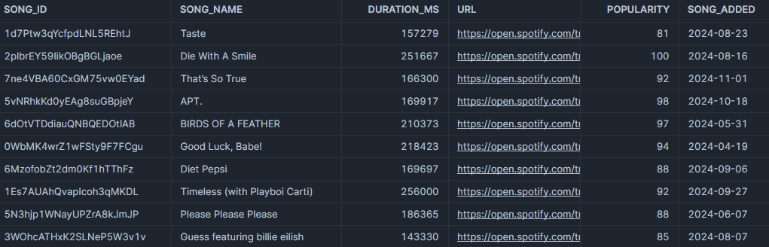
Project Limitations
Data Granularity:
Limited to hourly/weekly updates; more frequent updates could reveal finer trends.
Some artist-specific data lacks sufficient depth.
Model Limitations:
Random Forest regressor’s interpretability is limited compared to simpler models.
Popularity predictions lack non-streaming factors (e.g., marketing, collaborations).

Slide 16
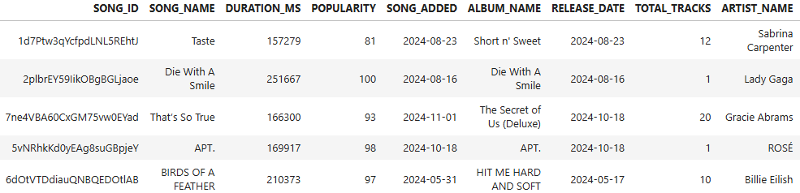
Conclusion
The pipeline effectively automates ETL processes from Spotify API to Snowflake.
Power BI visualizations provided actionable insights on user preferences and trends.
The ML pipeline achieved a predictive framework for user preferences, guiding recommendations.
Popularity peaks align with weekly music release cycles, emphasizing Spotify's dynamic nature.

Slide 17

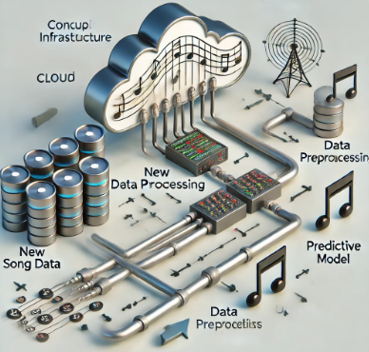
Future Work
Incorporate External Data
Real-Time Analysis
Advanced Visualizations
Expand ML Models
Notes:
Incorporate External Data: Include social media sentiment or artist marketing data to refine popularity predictions.
Real-Time Analysis: Use AWS SageMaker for real-time ML predictions to enhance user experience.
Advanced Visualizations: Add user engagement heatmaps and time-series predictions in Power BI.
Expand Models: Test advanced models (e.g., XGBoost, Neural Networks) for improved accuracy.

Slide 18
References
Spotify API Documentation: Spotify for Developers.
https://developer.spotify.com/documentation
AWS Documentation: Using AWS Lambda, S3, and Snowflake for ETL Workflows.
https://aws.amazon.com/documentation
Random Forest Algorithm: Breiman, L. (2001). "Random Forests." Machine Learning.
https://doi.org/10.1023/A:1010933404324
Power BI Best Practices: Microsoft Power BI Documentation.
https://learn.microsoft.com/en-us/power-bi
Snowflake Integration Guide: Snowflake Data Warehouse for Scalable Analytics.
https://www.snowflake.com/documentation

Slide 19
Thanks !

