Slide 1
Online Task & Productivity Tracker
Final Project Presentation
By: Mahalakshmi

Slide 2
Overview
- Web-based task manager
- Tracks tasks, categories, and time
- Visual analytics for productivity
- Export reports as PDF/CSV

Slide 3
Technology Stack
- Flask (Python)
- SQLAlchemy ORM
- HTML, CSS, Bootstrap
- Chart.js for analytics
- SQLite

Slide 4
Core Features
- 👤 User Authentication
- ✅ Task & Category Management
- ⏱️ Time Tracking with Timer
- 📊 Dashboard Charts
- 📁 Export to PDF/CSV
- 🔐 Secure Login System

Slide 5
Architecture Overview
[Frontend (HTML/CSS/JS)] → Flask App → Routes → Models → DB
↓
PDF/CSV Export | Chart Analytics

Slide 6
Entity Relationship Diagram (ERD)
User --< Task >-- Category
\ \
\--< TimeEntry

Slide 7
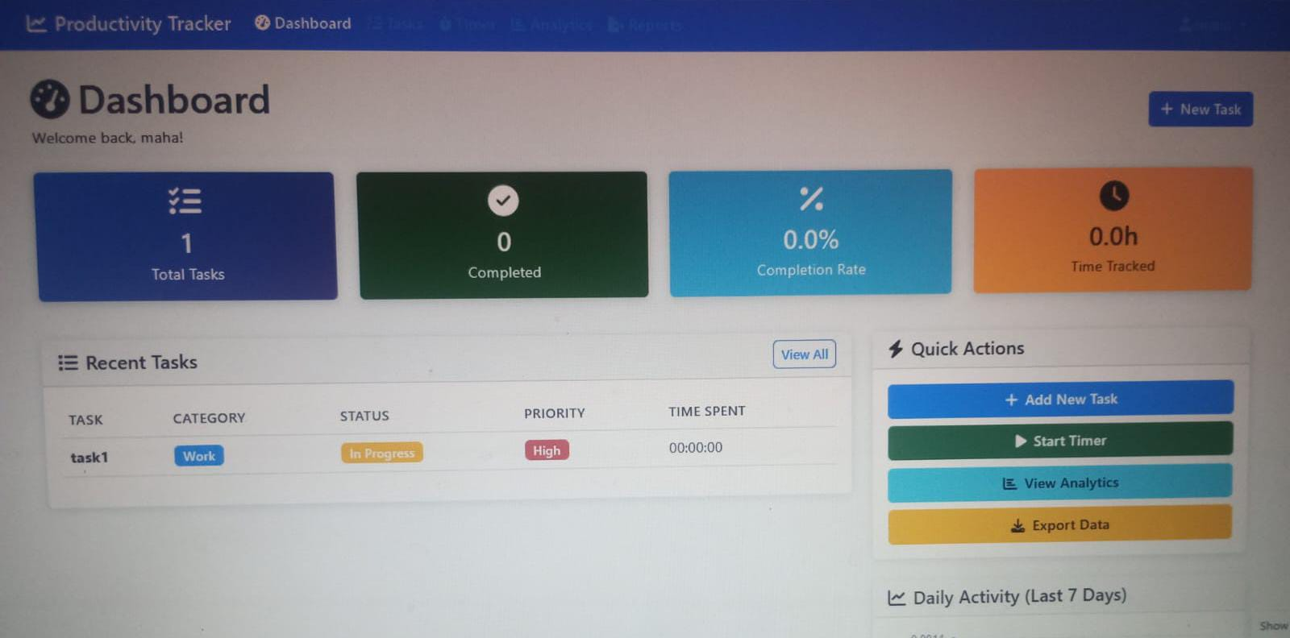
UI Snapshots
Include screenshots of:
- Dashboard
- Task Page
- Timer
- Analytics
- Export Feature

Slide 8
Project Demo
- GitHub Repo: https://github.com/GoruMahalakshmi/task1-completed

Slide 9
Challenges & Future Improvements
- Improve PDF formatting
- Add notifications
- Role-based access
- Implement test coverage

Slide 10
Thank You
Questions?
Contact: gormahalakshmi2@example.com

