Slide 1

Go, change the world
RV College of
Engineering
Design and Analysis of
Analog and Digital Circuits
Summer Internship Phase I Presentation
Student Name: Pradyumna S Athreya Student USN: 1RV21EC119
Guide Name: Dr. Shilpa D R
Designation: Associate Professor
Department of Electronics and Communication Engineering
*
Department of ECE
1

Slide 2

Go, change the world
RV College of
Engineering
Outline
Profile of the organization
Activities of the organization
Tasks performed (in detail)
Outcome of internship
*
Department of ECE
2

Slide 3
Go, change the world
RV College of
Engineering
Internship offer letter / Certificate of completion of internship (with name and duration of internship)
YET TO RECEIVE FROM COE-CICS
*
Department of ECE
3

Slide 4
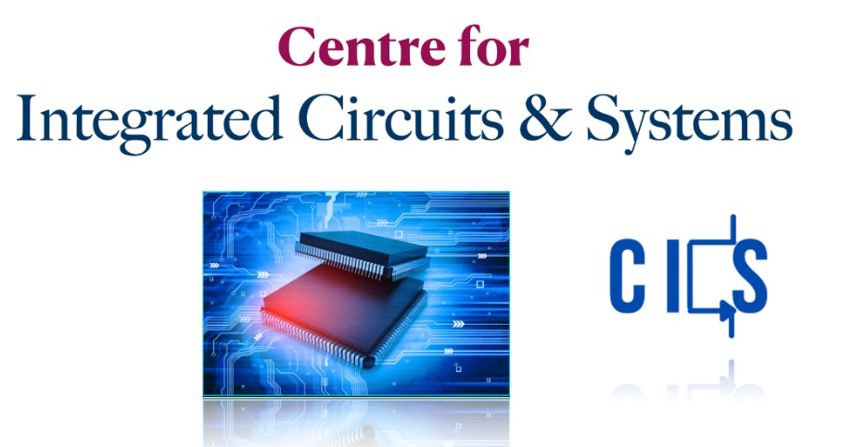
Go, change the world
RV College of
Engineering
Profile of the organization
Centre for Integrated Circuit and Systems is a Centre of Excellence at RVCE, Bengaluru.
Work on Analog Design, Digital Design, Mixed Signal Design and RF Design
*
Department of ECE
4

Slide 5
Go, change the world
RV College of
Engineering
Activities of the organization
Provide internship to undergraduate and postgraduate students
Invited talks, consultancy projects with Lekha Wireless Solutions Inc.
MoUs with several leading tech companies
Paper publications in the field of IC design
*
Department of ECE
5

Slide 6
Go, change the world
RV College of
Engineering
Tasks performed during internship
Workshop on LTSpice simulation software.
Analysis and simulation of analog and digital circuits in LTSpice software
Webinar on MOSFET Fabrication addressed by Ms. Sabiha Sultana, Prof., IISc.
Visit to IDRC Lab.
Team project to design Second order High pass filter using Op-amp.
Quizzes conducted on sessions taken
Assignments based on classes conducted
*
Department of ECE
6

Slide 7
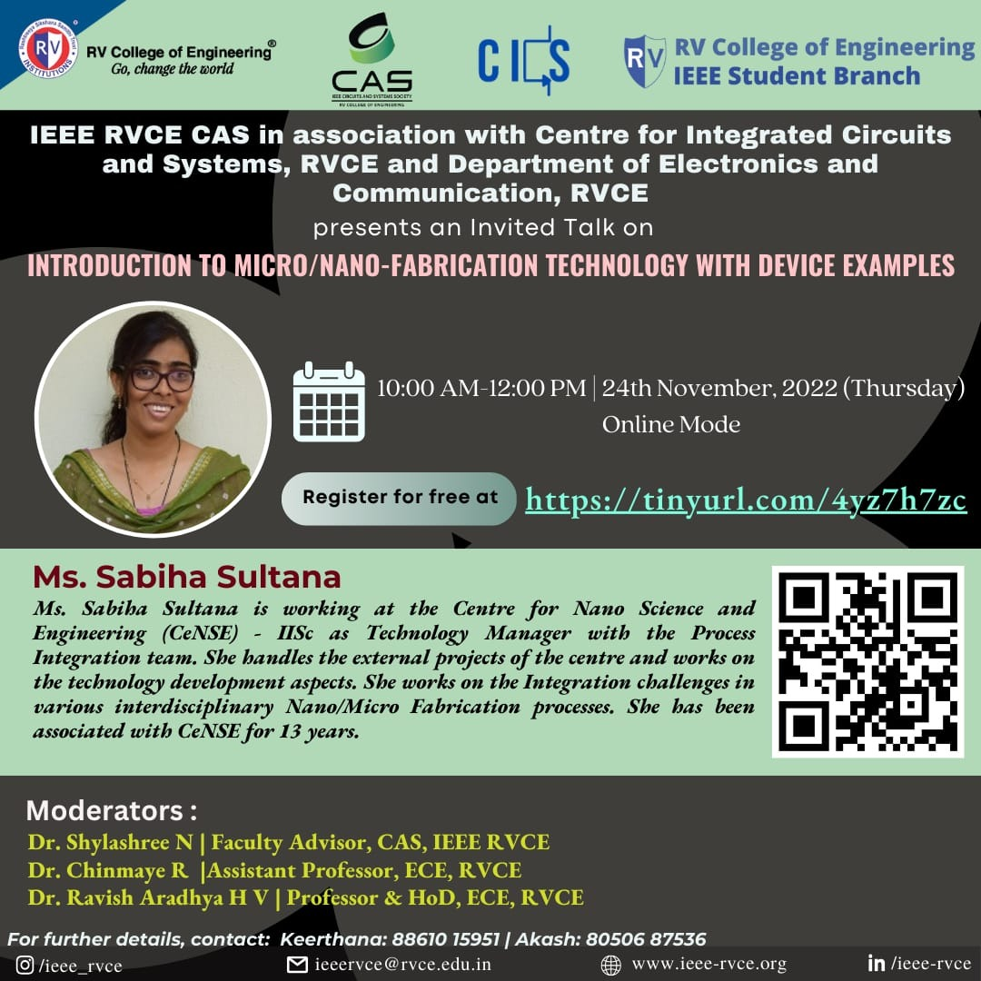
Go, change the world
RV College of
Engineering
Webinar on Fabrication Technology, by Ms.Sabiha Sulthana
*
Department of ECE
7

Slide 8
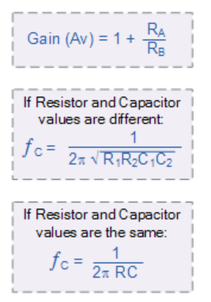
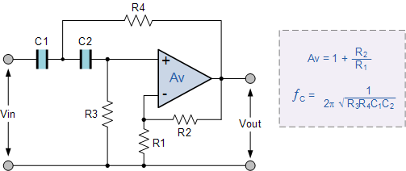
Go, change the world
Active second order hpf using op amp
Using an additional RC network in the input path.
The stop band roll-off will be twice the first-order filters at 40 dB/decade (12dB/octave).
Higher-order high pass active filters, such as third, fourth, fifth, etc are formed simply by cascading together first and second-order filters.
Department of ECE

Slide 9
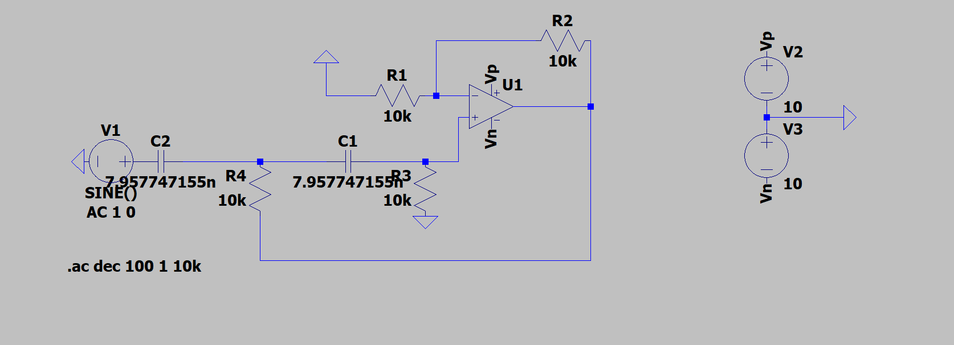
Go, change the world
RV College of
Engineering
Team project to design Active Second order High pass filter using Op-amp
*
Department of ECE
9

Slide 10
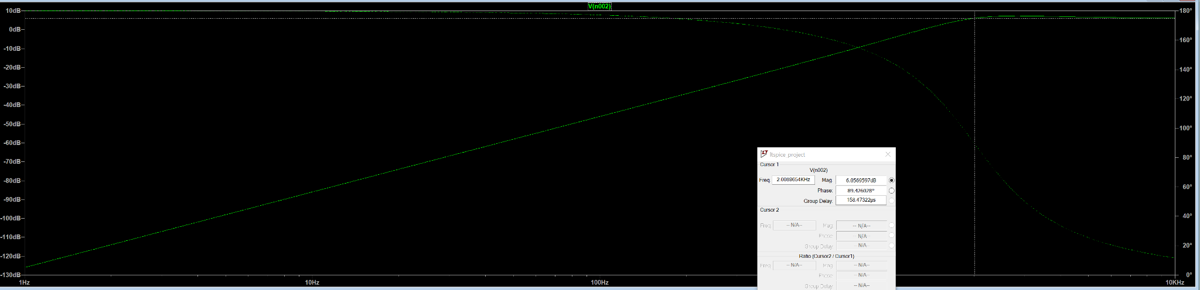
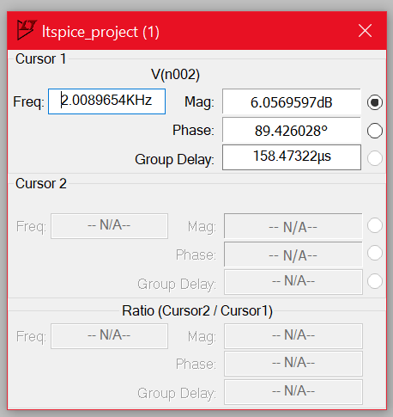
Go, change the world
RV College of
Engineering
Team project to design Second Order HPF
*
Department of ECE
10

Slide 11
Go, change the world
RV College of
Engineering
Outcome of the Internship
LTSpice simulation software
Fundamentals of Digital design / Verilog
Fundamentals of analog design
*
Department of ECE
11

Slide 12
Go, change the world
RV College of
Engineering
Thank You
*
Department of ECE
12

