Slide 1

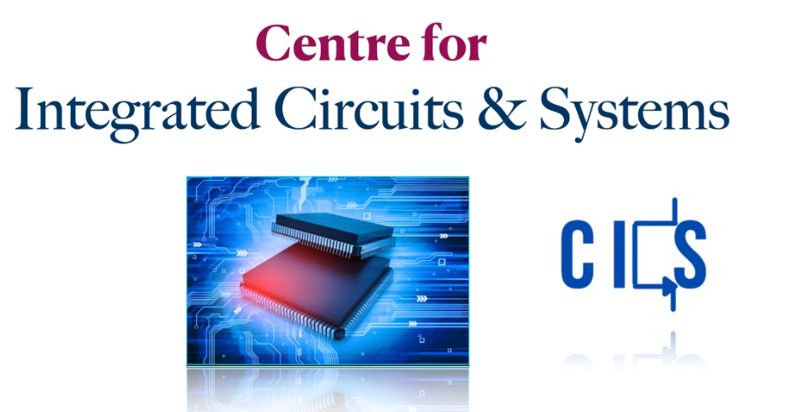
Go, change the world
RV College of
Engineering
Single-Stage RC Coupled Amplifier
Pavan Kumar C Banasode | 1RV21EC116
Shreyas S | 1RV21EC142
Prajwal Sajji | 1RV21EC121

Slide 2

Go, change the world
RV College of
Engineering
Outline of presentation
Introduction
RC Coupled Amplifier
Direct Coupled v/s RC Coupled amplifier
Simulation
Observations
Advantages
Disadvantages
Application
Conclusion

Slide 3
Go, change the world
RV College of
Engineering
Introduction
Amplification is the technique of amplifying a signal's amplitude without affecting its features in order to increase signal intensity.
An RC Coupled Amplifier, is a multistage amplifier, when multiple stages of amplifiers are connected using a combination of a resistor and a capacitor.

Slide 4
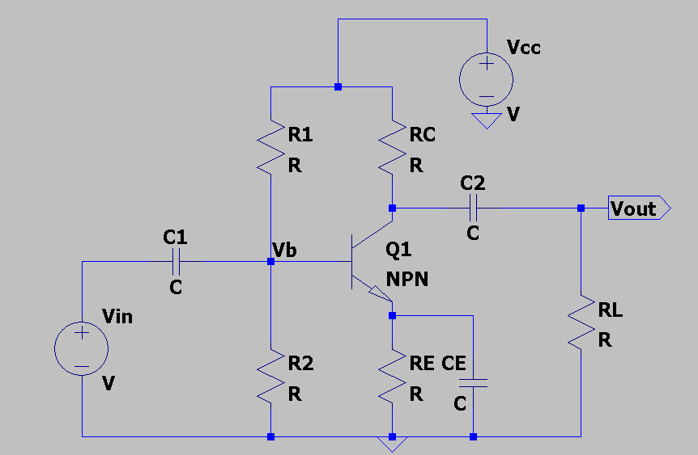
Go, change the world
RV College of
Engineering
Single Stage RC Coupled Amplifier.

Slide 5
Go, change the world
RV College of
Engineering
RC Coupled Amplifier vs Direct Coupled Amplifier
RC Coupled Amplifier | Direct Coupled Amplifier
Contains Resistor and Capacitor as Coupling element | No Coupling element
Low Impedance | High Impedance
Amplifies Only AC | Amplifies AC as well as DC
Low frequency distortions are present | No low frequency distortions

Slide 6
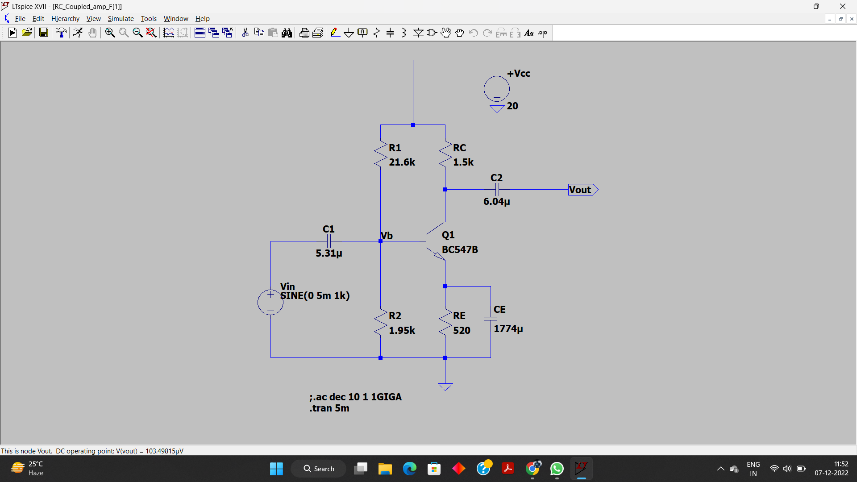
Go, change the world
RV College of
Engineering
Simulation

Slide 7
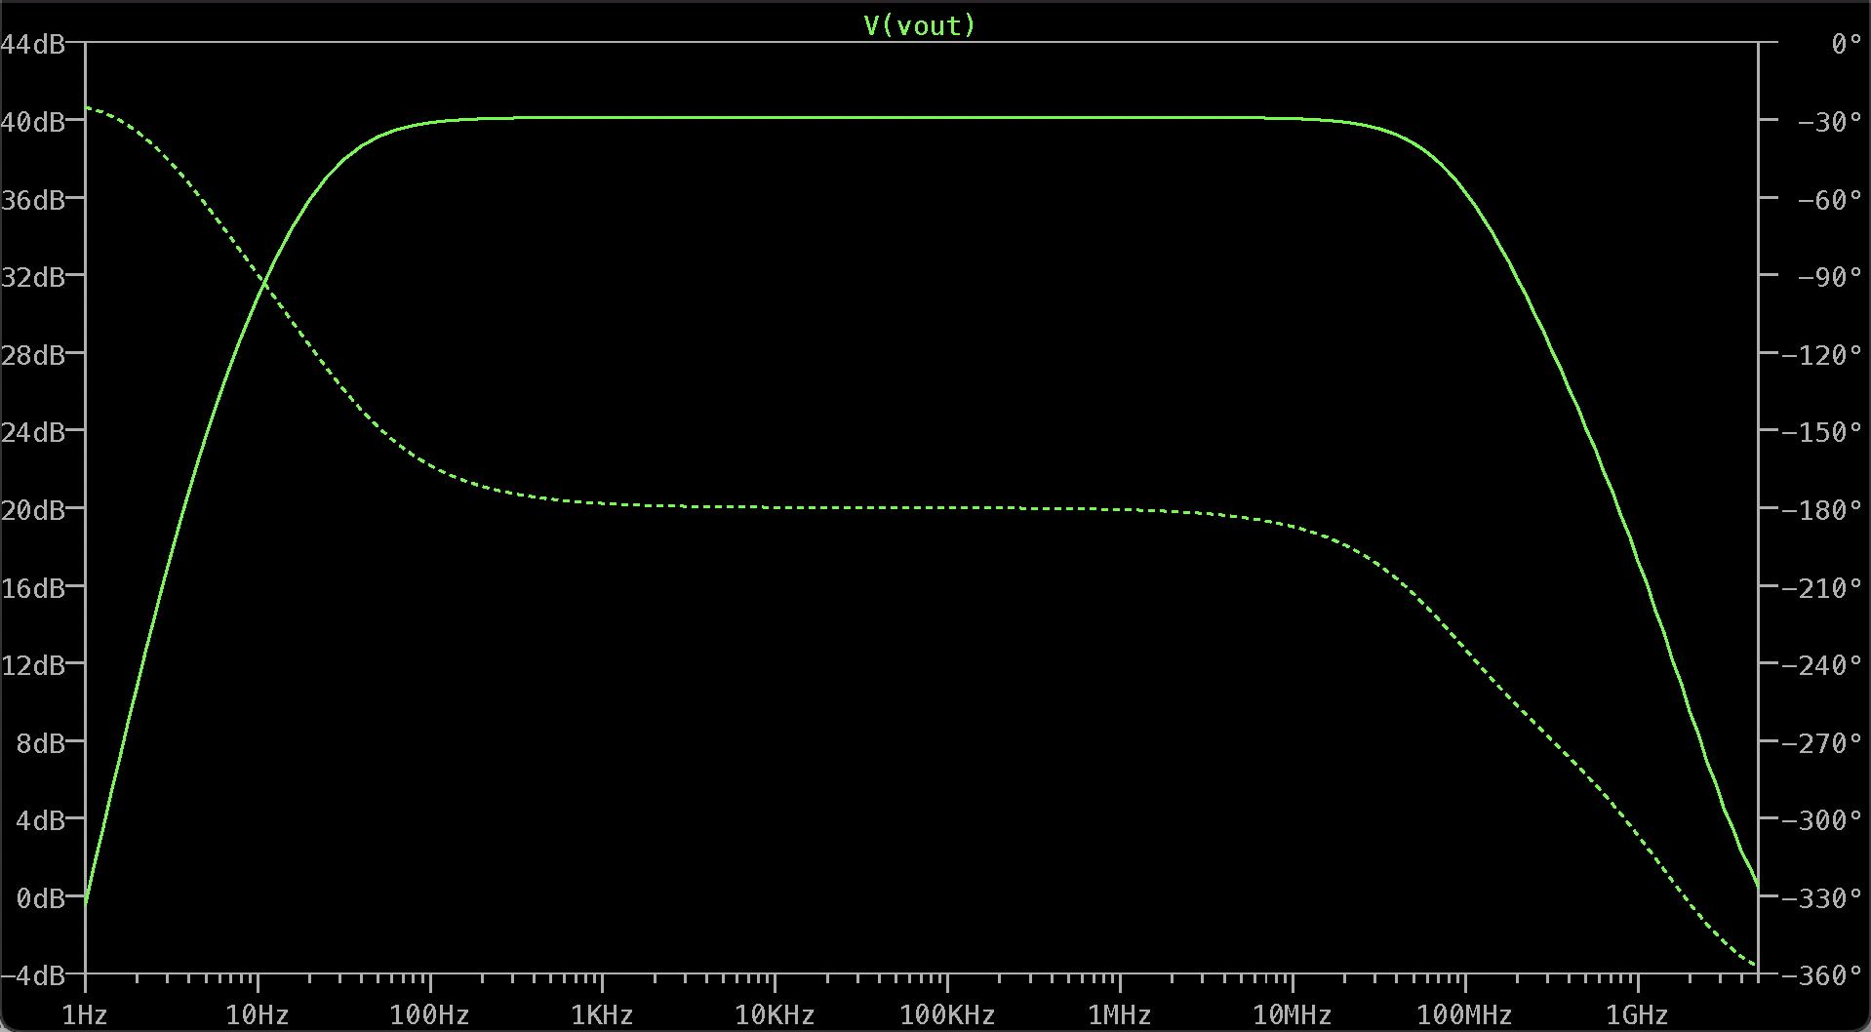
Go, change the world
RV College of
Engineering
Frequency Response

Slide 8
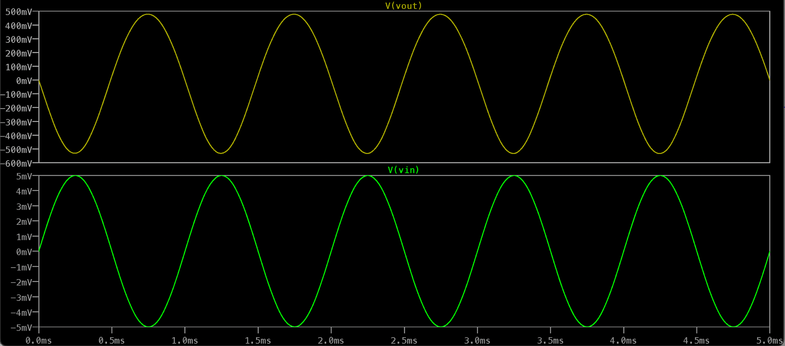
Go, change the world
RV College of
Engineering
RC Coupled Amplifier Output

Slide 9
Go, change the world
RV College of
Engineering
Observations
The gain is first set to the desired value of 100 ie., 40dB.
The amplitude of the input waveform is amplified gain times at the output.
The output waveform is 180° out of phase with respect to the input waveform.

Slide 10
Go, change the world
RV College of
Engineering
Advantages
The RC coupled amplifier offers a constant gain over a wide frequency band.
The circuit is very compact and extremely light.
It used the resistor and the capacitor which are not expensive so the cost is low.
The frequency response of RC coupled amplifier is excellent.

Slide 11
Go, change the world
RV College of
Engineering
Disadvantages
The RC coupled amplifier has poor impedance matching because its output impedance is several times larger than the device, at its end terminal.
It is unsuitable for low frequency application.
It has low voltage and power gain.
It has narrow bandwidth.
It has the tendency to become noisy at times.

Slide 12
Go, change the world
RV College of
Engineering
Application
RF Communications.
Optical Fiber Communications.
Public address systems as pre-amplifiers.
Widely used as Voltage amplifiers
Radio or TV Receivers as small signal amplifiers.

Slide 13
Go, change the world
RV College of
Engineering
Conclusion
A single-stage RC Coupled amplifier circuit, using BJT, was constructed and simulated in LTspice.
The input and output waveforms were analysed.
Theoretical values were verified.

