Slide 1

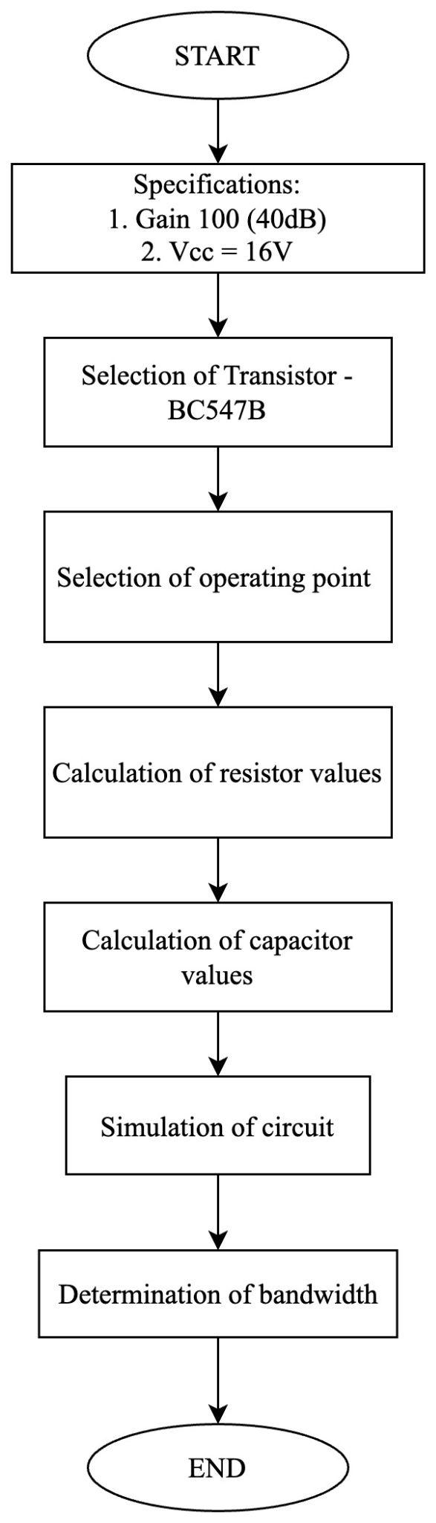

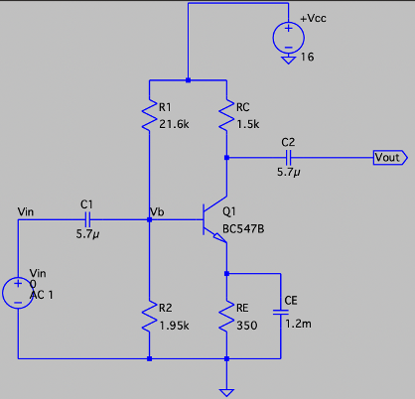
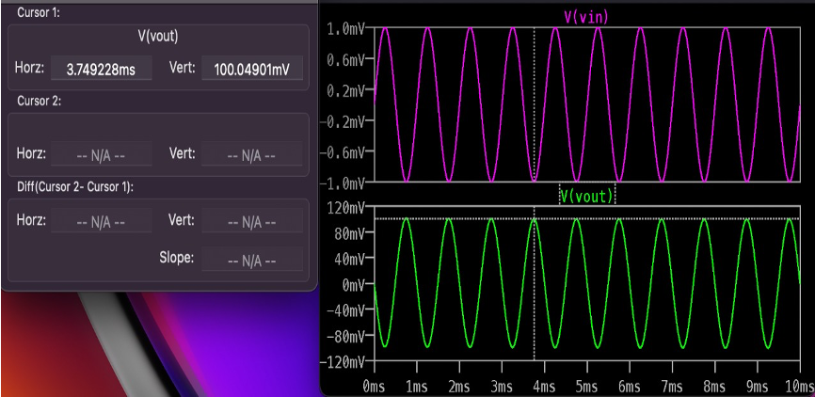
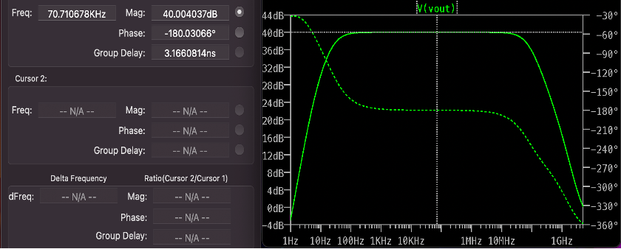
DESIGN OF RC COUPLED AMPLIFIER
PAVAN KUMAR C BANSODE (1RV21EC116)
Internship coordinator : Prof. Rajith Kumar B K, Asst. Professor, Dept. of ECE R.V. College of Engineering, Bangalore-59
1) ABOUT THE COMPANY / THE COE
5) METHODOLOGY
7) APPLICATIONS
10) REFERENCES
The CoE of Centre of Integrated Circuits and Systems consists of passionate students and faculty members willing to create an ecosystem that inspires the VLSI/Electronics system designer, to nurture the skills and innovative ideas, and to promote sustainable and interdisciplinary research, with inclusive societal concerns. The CoE aims at engaging enthusiastic students in design/development activities through funded projects and consultancy works from various organisations thereby contributing to the growth of the nation.
The applications of a RC coupled amplifier include:
RF Communications.
Optical Fiber Communications.
Public address systems as pre-amplifiers.
Controllers.
Radio or TV Receivers as small signal amplifiers.
LTspice – AN Introduction, Jan Hvolgaard Mikkelsen, 2005, Aalborg Uni., Denmark
M. N. Ibrahim, Z. H. C. Soh, I. H. Hamzah, and A. Othman, ‘A SIMULATION OF SINGLE STAGE BJT AMPLIFIER USING LTSPICE’, 2016.
F. Asadi, “Simulation of Electronic Circuits with LTspice®,” Essential Circuit Analysis using LTspice®, pp. 177–364, 2022.
D. G. C. Luck, “A Simplified General Method for Resistance Capacity Coupled Amplifier Design”, in Proceedings of the Institute of Radio Engineers, vol. 20, no. 8, pp. 1401-1406, 2012.
J. Millman and C. C. Halkias, Electronic Devices and circuits. New Delhi: Tata Mcgraw Hill Higher Education, 2007.
R. L. Boylestad and L. Nashelsky, “Electronic Devices and Circuit Theory”. New Delhi: Pearson Education, 2014.
A. S. Sedra, K. C. Smith, T. C. Carusone, and V. Gaudet, Microelectronic circuits. New York: Oxford University Press, 2021.
P. Ptak, “APPLICATION OF THE SOFTWARE PACKAGE LTSPICE FOR DESIGNING AND ANALYSING THE OPERATION OF ELECTRONIC SYSTEMS,” SOCIETY. INTEGRATION EDUCATION”, Proceedings of the International Scientific Conference, vol. 5, pp. 402–409, May 2018.
J. W. Bandler, R. M. Biernacki, Q. Cai and S. H. Chen, "Compression analysis of a high power BJT amplifier,” Third International Workshop on Integrated Nonlinear Microwave and Millimeterwave Circuits, Duisburg, Germany, 1994, pp. 173-178, doi: 10.1109/INMMC.1994.512525.
K. Biswal, S. K. Kar, M. C. Tripathy and S. Swain, "Modelling and Stability Analysis of a Fractional-Order RC Coupled BJT Amplifier," 2022 2nd Odisha International Conference on Electrical Power Engineering, Communication and Computing Technology (ODICON), Bhubaneswar, India, 2022, pp. 1-5, doi: 10.1109/ODICON54453.2022.10009975.
8) CONCLUSION
In conclusion, an RC Coupled amplifier was designed to provide a voltage gain of 100.
The appropriate transistor was selected based on the requirements and values of resistors were selected based on calculations. The values of the coupling and bypass capacitors were carefully calculated and chosen, to achieve the desired gain and frequency response while maintaining stability.
Through software simulations and practical measurements, the design was validated and confirmed that the amplifier met the project requirements. The designed amplifier successfully achieved the desired gain of 100 while maintaining a stable DC bias and good frequency response.
2) TOOLS AND TECHNOLOGIES USED IN INTERNSHIP
.
Table: Softwares used during internship
SOFTWARE COMPONNTS | SPECIFICATIONS
LTspice | LTspice® is a powerful, fast, and free SPICE simulator software, schematic capture and waveform viewer with enhancements and models for improving the simulation of analog circuits.
9) TAKE AWAY
Design and implementation of various analog and digital circuits in LTspice: Implementation of the most basic circuits in LTspice, and building more complex systems by utilizing the basic circuits
Fabrication of MOSFETs: The various techniques involved in the different steps of MOSFET fabrication, the existing technology and future scope of improvements in terms of reduction in size and subsequent increase in performance.
Implementation of various combinational digital circuits such as MUX, DEMUX, encoder, decoder, adders, subtractors: These basic circuits form the basis of all the complex circuits that can be built, and are an integral part in the design of any digital circuit.
Implementation of various sequential digital circuits: Flip-flops and latches are used extensively as memory units or registers. They are used to implement counters, shift registers, analog to digital converters, digital to analog converters, clocks, etc.
Optimization techniques: Various techniques such as pseudo NMOS logic, pass transistor logic, and transmission gate logic which are used to optimize parameters such as power consumed, area occupied, cost, etc.
Verilog programming: Three types of modelling - behavioral modelling, dataflow modelling, structural modelling, and implementation of basic circuits.
3) PROBLEM STATEMENT
The designed RC Coupled amplifier circuit
Design an RC Coupled Amplifier for a gain of 100 or 40dB. Simulate the designed circuit in LTspice software and verify the gain provided by the designed RC Coupled amplifier. Determine the bandwidth of the amplifier designed by using suitable simulation technique
6) RESULTS OBTAINED
Gain of the designed amplifier circuit = 100.05 or 40.004 dB
Bandwidth of the amplifier = 117 MHz
4) OBJECTIVE OF INTERNSHIP
To understand the basic rules and laws commonly used in the designing and analysis of circuits, namely Kirchhoff’s voltage law, Kirchhoff’s current law, DeMorgan’s theorem and many more.
To understand the behaviour and operation of linear and non-linear electronic components such as resistor, capacitor, inductor, diode, MOSFET, operational amplifiers, etc.
To understand the behaviour and operation of digital combinational and sequential logic circuits such as gates, multiplexers, encoders, decoders, latches, etc.
To design circuits using the above components and to analyse them using the LTspice software simulating the circuits and analysing their results.
Input v/s Output Waveforms obtained after simulation of circuit
Frequency response of the designed RC Coupled amplifier circuit
Notes:
1

