Slide 1
Advanced Topics in Software Engineering (CSE 6324)

Slide 2

Team 8 Anupama Rani Neerukonda - 1002007833 Pavan Kumar Chaparla - 1001865675 Lokesh Bogam - 1001946861 Jai Venkata Sai Sriram Batchu - 1001949158 Keerthi Chittineni - 1001967726

Slide 3
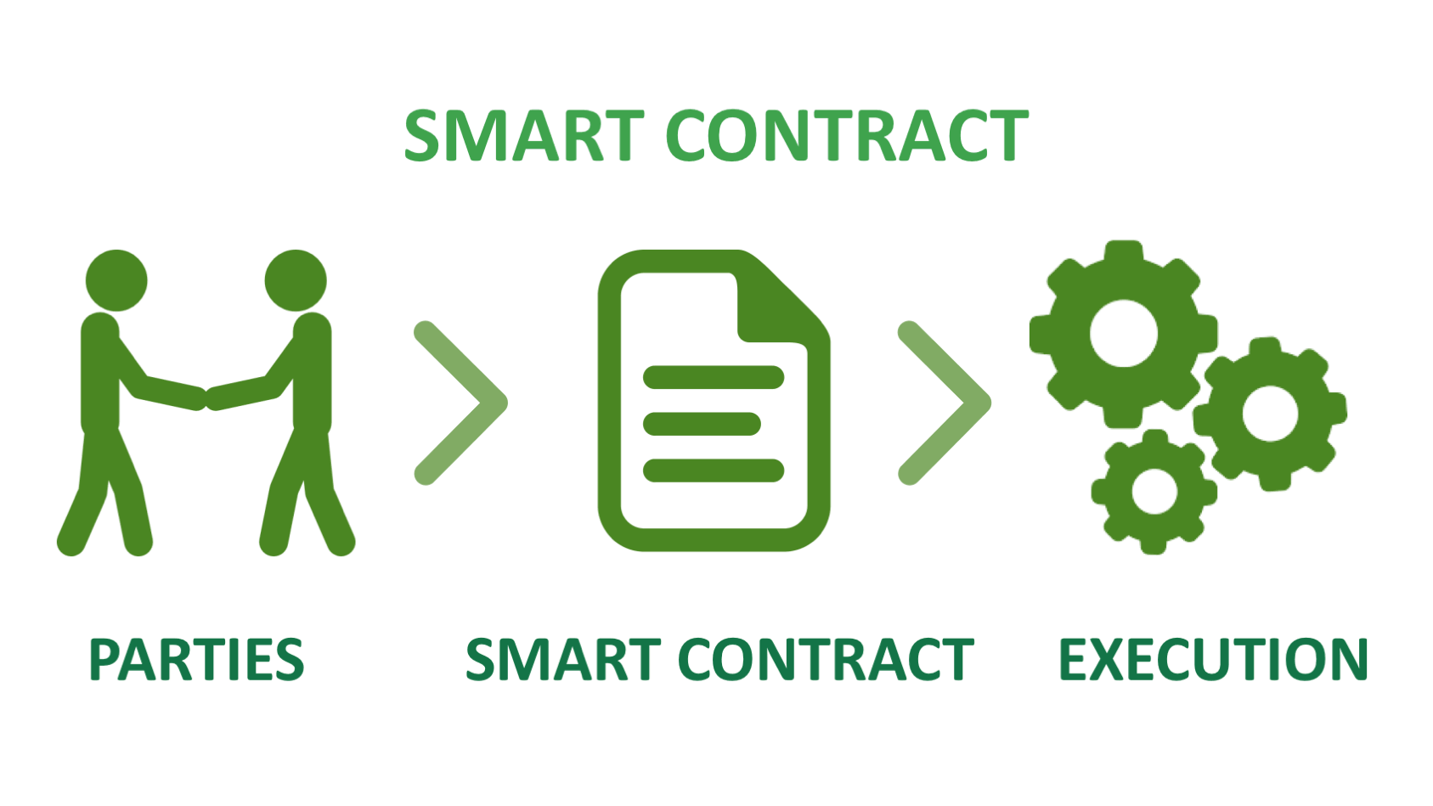

Symbolic analysis for smart contracts using Manticore
Github:https://github.com/PavanKumarChaparla/ADV-TOPICS-IN-SE-CSE-6324

Slide 4

Contents
What is Symbolic Execution
What is Manticore
Resources Used in smart contracts
Uses of Manticore
References

Slide 5
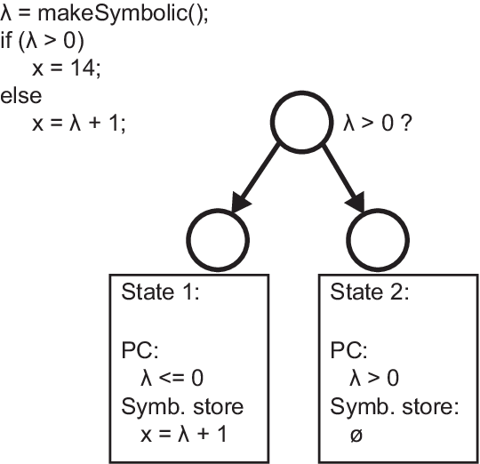
What is Symbolic Execution?
The use of dynamic symbolic execution in software texts improves code coverage by step by step factor the state space of a program[1].
It points out a collection of path predicates, or limitations on program input.[1].
These are used to create program inputs that will cause the corresponding execution routes to be followed.[1].
Because all identified program conditions are met, this approach provides no false positives.[1].

Slide 6

What is Manticore?
We introduce Manticore, an open-source dynamic symbolic execution framework, for the analysis of binaries and Ethereum smart contracts[1].
Manticore's flexible architecture allows it to support both typical and unusual execution contexts, and its API lets users customize their analysis[1].
Manticore is a potent tool for smart contracts and binary analysis[1].
Potential security hazards and vulnerabilities can be identified with its assistance. This tool has previously been employed by Trail of Bits to evaluate the quality of programs' code and search for vulnerabilities[1].

Slide 7


Resources Used
Programming Language :Solidity v0.8.17
Tools: Visual Studio Code v1.69.1
Repository: GitHub
Solc C v0.8.17 compiler
Python Z3 v4.5.0
Manticore

Slide 8

Use Cases of Manticore
Program Exploration[2]
Input Generation[2]
Error Discovery[2]
Instrumentation[2]
Programmatic Interface[2]

Slide 9
References
[1] https://dl-acm-org.ezproxy.uta.edu/doi/epdf/10.1109/ASE.2019.00133
[2] https://github.com/trailofbits/manticore

Slide 10


