Slide 1
POWER BI CAPSTONE PROJECT
67.41K
Total Revenue
Sakila DVD Rental
584
Store Business Intelligence
Active Customers
Done by: Pavan Kumar Magandi
16K
Qualification: MBA · pavanmagandi@gmail.com
Total Rentals
Tools Used
SQL
Excel
Power BI
5.03
Avg Rental Days
Dataset: Sakila (MySQL) — DVD Rental Store

Slide 2
ANALYSIS INDEX
PBI
Q1
How does the sales revenue vary by month?
Q9
What is the average rental duration by staff member?
Q2
What is the distribution of sales by payment method?
Q10
What is the distribution of customers across different cities?
MOVIE
RENTALS
Q3
Which customer segments generate the highest sales?
Q11
How does the rental revenue vary by country?
CAPSTONE
Q4
What is the distribution of films by rental duration?
Q12
Which locations have the highest and lowest customer ratings?
Q5
How does the inventory vary by film rating?
Q13
What is the distribution of films by language?
Pavan Kumar Magandi
MBA | Power BI Analyst
Q6
Q14
What is the breakdown of film categories in the inventory?
Which film categories have the highest rental rates?
pavanmagandi@gmail.com
Q7
What is the distribution of staff by employment duration?
Q15
How does the average rental duration vary by film category?
Q8
How does the store performance vary by location?

Slide 3
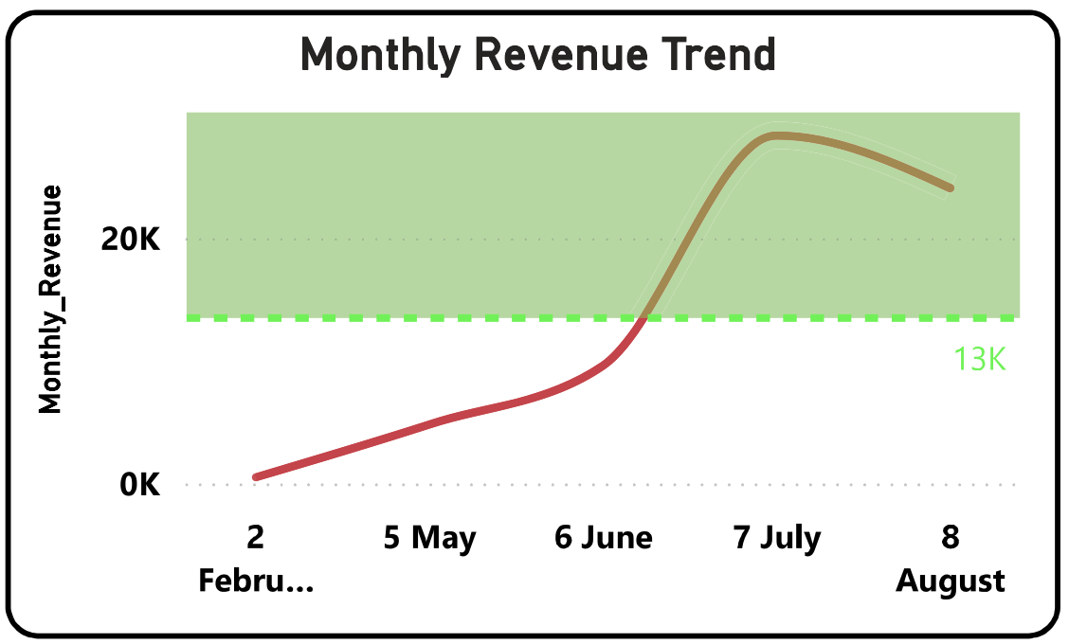
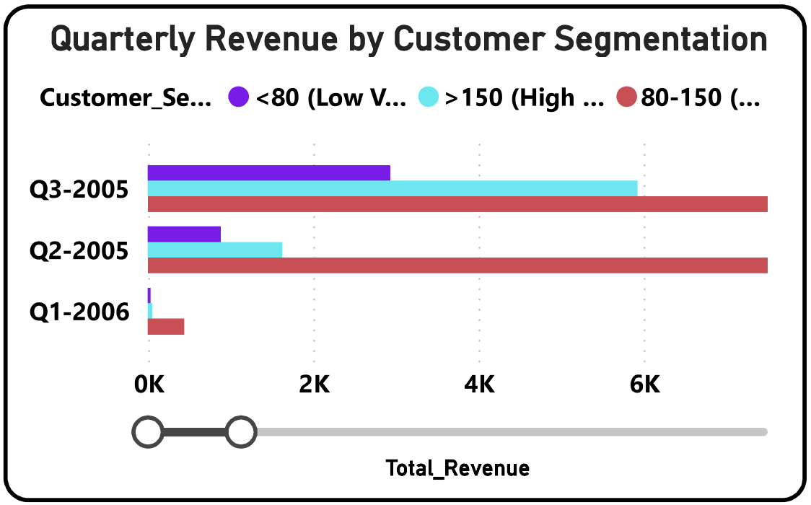
Q1
How does the sales revenue vary by month?
Sales & Revenue Analysis
$67.41K
~$20K
$13K/mo
Total Revenue
Peak Monthly Revenue
Avg Revenue Target
Power BI Visualization
KEY INSIGHTS & RECOMMENDATIONS
1
Sharp Growth Feb–Jul 2005
Revenue surged from near $0 in Feb 2005 to ~$20K by July 2005 — a 100x increase in 5 months, driven by rapid customer acquisition.
2
Target Consistently Beaten
The $13K/month benchmark was surpassed from June 2005 onwards and maintained, confirming the business reached sustainable revenue scale.
3
August Dip Signals Seasonality
Revenue eased slightly in August 2005. This may reflect end-of-summer demand softening — worth tracking in Year 2 for seasonal planning.
4
Recommendation
Run targeted promotions in Aug–Sep to defend against seasonal dips. Bundle discounts on high-demand categories like Sports & Games.
Movie Rentals Capstone · Q1 of 15 · Pavan Kumar Magandi · MBA

Slide 4
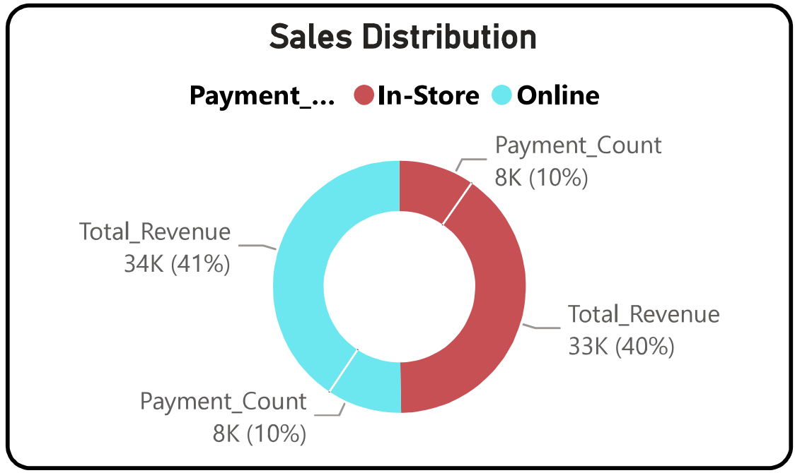
Q2
What is the distribution of sales by payment method?
Sales & Revenue Analysis
$34K (41%)
$33K (40%)
16K
In-Store Revenue
Online Revenue
Total Transactions
Power BI Visualization
KEY INSIGHTS & RECOMMENDATIONS
1
Near-Equal Channel Split
In-Store ($34K, ~8K txns) and Online ($33K, ~8K txns) are virtually tied — both channels contribute equally, unlike most retail businesses where one dominates.
2
In-Store Earns ~3% More
Despite equal transaction counts, In-Store generates slightly more revenue, implying higher-value rentals occur in-person — premium titles, bundles, or longer durations.
3
Online Growth Opportunity
Online has near-identical volume to in-store already. Closing the $1K revenue gap via upsell (e.g. premium memberships, late-night access) could lift online to #1.
4
Recommendation
Introduce online-exclusive loyalty rewards and 'digital first' rental offers to shift the mix toward Online — lower overhead, higher scalability.
Movie Rentals Capstone · Q2 of 15 · Pavan Kumar Magandi · MBA

Slide 5
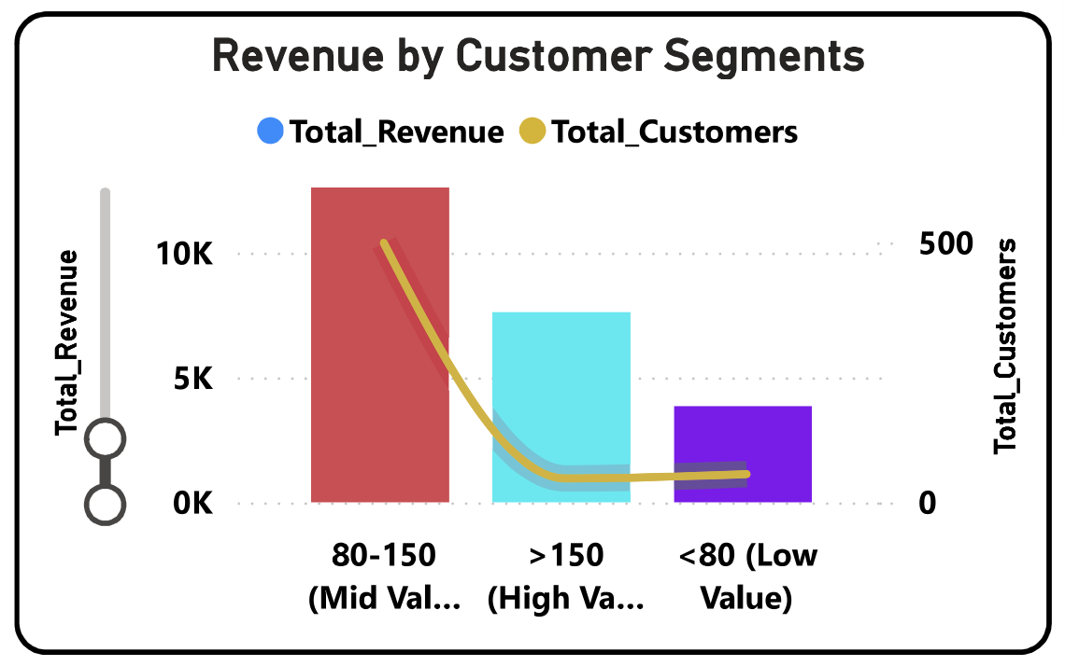
Q3
Which customer segments generate the highest sales?
Sales & Revenue Analysis
~$10K+
~$7K
~$2.5K
Mid-Value (80–150) Revenue
High-Value (>150) Revenue
Low-Value (<80) Revenue
Power BI Visualization
KEY INSIGHTS & RECOMMENDATIONS
1
Mid-Value Dominates Revenue
The 80–150 segment delivers the largest revenue block (~$10K+), making it the business's commercial backbone despite not being the biggest spender per head.
2
High-Value: Biggest LTV Customers
The >150 segment produces ~$7K from the fewest customers, confirming extremely high lifetime value per individual — 3–4x the average customer.
3
Low-Value: High Volume, Low Return
The <80 segment has the largest customer count but contributes only ~$2.5K total, suggesting shallow engagement or low rental frequency.
4
Recommendation
Design tier-based loyalty programs: upgrade Mid-Value to High-Value via premium bundles, and re-engage Low-Value with first-rental discounts and genre recommendations.
Movie Rentals Capstone · Q3 of 15 · Pavan Kumar Magandi · MBA

Slide 6
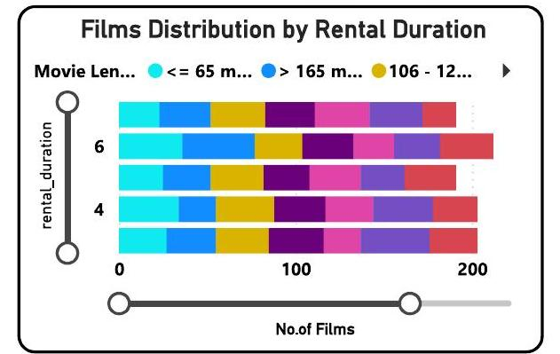
Q4
What is the distribution of films by rental duration?
Film & Inventory Analysis
1,000
6 Days
5 Tiers
Total Films
Most Common Duration
Unique Rental Durations
Power BI Visualization
KEY INSIGHTS & RECOMMENDATIONS
1
6-Day Rentals Dominate
Films with a 6-day rental window form the largest group (~175+ titles), giving customers the most flexibility. All movie length types (short, medium, long) appear in this tier.
2
4-Day Tier is Undersupplied
The 4-day duration has the fewest films. This gap may limit customer choice for mid-length rental periods — a potential restocking priority.
3
Long Films Skew Short Durations
Interestingly, films >165 mins appear even in shorter rental tiers, suggesting pricing decisions are not consistently length-based.
4
Recommendation
Align rental duration to film length more tightly: shorter films → 3–4 day slots, longer films → 6–7 day slots. This maximises inventory turnover.
Movie Rentals Capstone · Q4 of 15 · Pavan Kumar Magandi · MBA

Slide 7
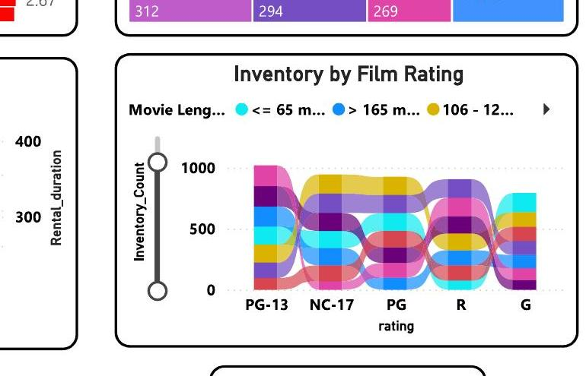
Q5
How does the inventory vary by film rating?
Film & Inventory Analysis
4,581
~1,000 copies
5 Categories
Total Inventory
Top Rating (PG-13)
Film Ratings Tracked
Power BI Visualization
KEY INSIGHTS & RECOMMENDATIONS
1
PG-13 Overwhelmingly Dominates
PG-13 holds ~1,000 inventory copies — more than double the G-rated category. This reflects demand-driven stocking for teen/adult audiences.
2
NC-17 & PG Are Competitive
NC-17 and PG films both carry 500–700 copies, forming a strong middle tier. The breadth signals the store serves varied audience demographics.
3
G-Rated Films Are Understocked
G-rated films hold the lowest inventory. Family-viewing demand — especially in family-heavy geographic clusters — may be under-served.
4
Recommendation
Audit G-rated inventory against rental frequency. If G titles rent frequently despite low stock, boost procurement to capture missed family-segment revenue.
Movie Rentals Capstone · Q5 of 15 · Pavan Kumar Magandi · MBA

Slide 8
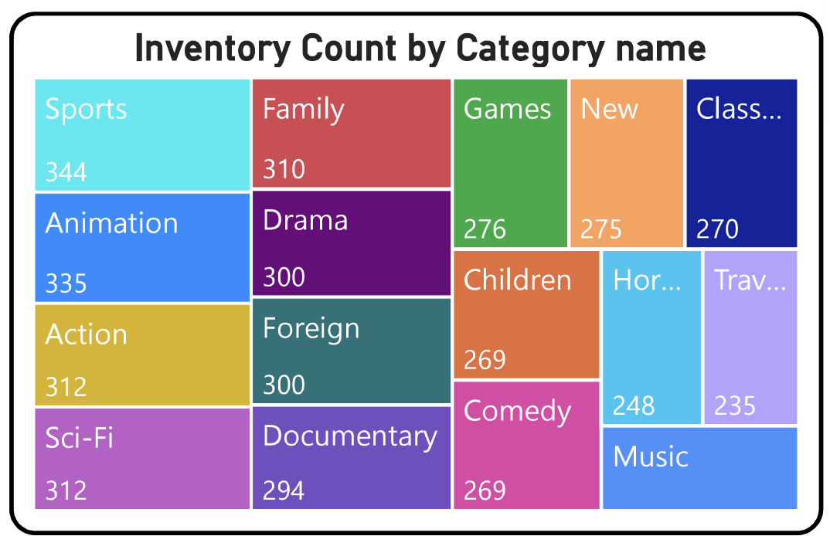
Q6
What is the breakdown of film categories in the inventory?
Film & Inventory Analysis
16
Sports (7.4%)
Travel (5.6%)
Total Categories
Largest Category
Smallest Category
Power BI Visualization
KEY INSIGHTS & RECOMMENDATIONS
1
Remarkably Even Distribution
All 16 categories fall within a narrow 5.6%–7.4% band — less than 2% spread — indicating a deliberate, balanced inventory procurement strategy.
2
Sports Leads Narrowly
Sports edges the field at 7.4% (74 titles), likely due to strong repeat-rental behavior and broad viewer demographics, both male and female.
3
No Category is Over-Concentrated
Unlike many rental stores that over-index on Action or Drama, this store avoids inventory lock-in risk. No single genre can hurt the business if demand shifts.
4
Recommendation
Track rental-rate-per-category (not just stock count). Invest in categories with the highest turn rate (e.g. if New releases rent fastest, expand that allocation).
Movie Rentals Capstone · Q6 of 15 · Pavan Kumar Magandi · MBA

Slide 9
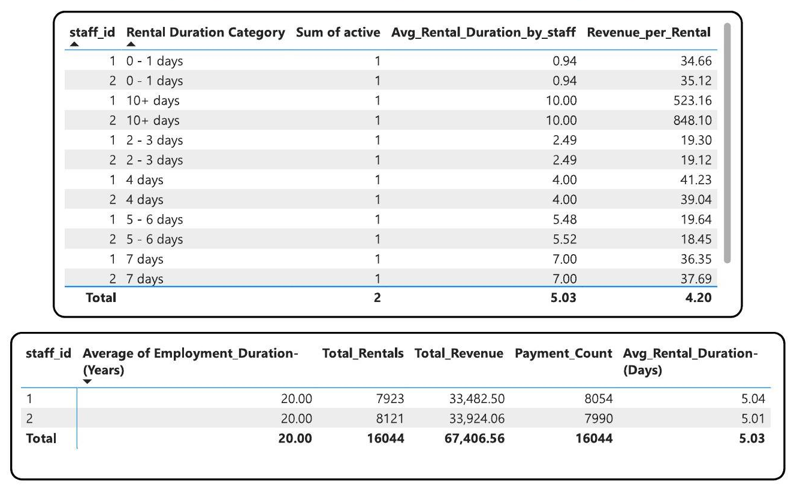
Q7
What is the distribution of staff by employment duration?
Staff & HR Analysis
2
20 Years
5.03 Days
Total Staff
Avg Employment Duration
Avg Rental Duration/Staff
Power BI Visualization
KEY INSIGHTS & RECOMMENDATIONS
1
Both Staff: 20-Year Veterans
Staff IDs 1 & 2 each have exactly 20 years of service — exceptional retention. This signals a stable, low-turnover operation with deep operational knowledge.
2
Staff 2 Outperforms on Volume
Staff 2 processed 8,121 rentals vs Staff 1's 7,923 — a 2.5% higher throughput. Staff 2 also generated $33,924 revenue vs Staff 1's $33,482.
3
Revenue per Rental Is Consistent
Both staff maintain near-identical Revenue_per_Rental (~$4.20), confirming that pricing adherence and upsell behavior is uniform across the team.
4
Recommendation
Reward long-tenure staff with performance bonuses tied to revenue per rental growth. Cross-train them on digital platforms to future-proof operations.
Movie Rentals Capstone · Q7 of 15 · Pavan Kumar Magandi · MBA

Slide 10
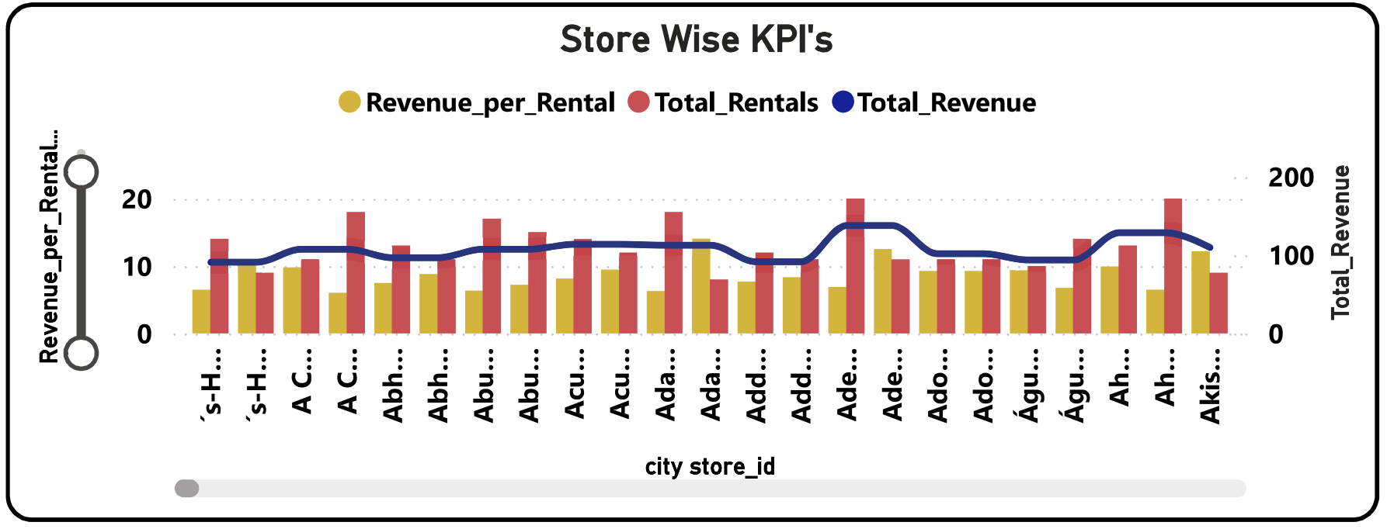
Q8
How does the store performance vary?
Store & Operations Analysis
$67.41K
$4.20
16,044
Total Store Revenue
Avg Revenue per Rental
Total Rentals
Power BI Visualization
KEY INSIGHTS & RECOMMENDATIONS
1
High Variance Across City Stores
Store KPIs fluctuate dramatically by city — some locations hit 200 Total_Revenue while others stay below 50. Revenue_per_Rental ranges $5–$20 per store.
2
Revenue Leaders vs Laggards
A cluster of 4–5 city stores drive outsized revenue. These are likely in dense urban markets (e.g. Aurora, London, large metros) with high foot traffic.
3
Total Rentals Don't Always = Revenue
Some high-rental stores have low revenue per rental, suggesting they serve budget customers. High-revenue stores rent fewer but premium titles.
4
Recommendation
Deploy a store-tiering model: high-revenue stores get premium inventory allocation; high-volume/low-revenue stores get targeted upsell training and promotions.
Movie Rentals Capstone · Q8 of 15 · Pavan Kumar Magandi · MBA

Slide 11
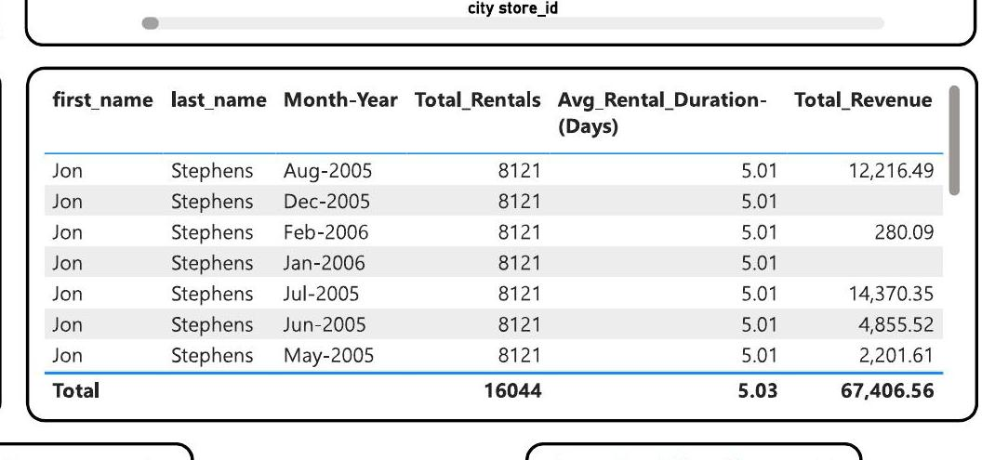
Q9
What is the average rental duration by staff member?
Store & Operations Analysis
5.04 Days
5.01 Days
5.03 Days
Staff 1 Avg Duration
Staff 2 Avg Duration
Overall Avg Duration
Power BI Visualization
KEY INSIGHTS & RECOMMENDATIONS
1
Perfectly Consistent Across Staff
Both staff members maintain an average rental duration of 5.01–5.04 days every single month from May 2005 through Feb 2006 — zero variation.
2
Revenue Is Month-Driven, Not Staff-Driven
July 2005 peaked at $14,370 revenue while Feb 2006 dropped to $280 — yet rental duration stayed constant. Demand seasonality drives revenue, not staff behavior.
3
8,121 Rentals Per Staff Every Period
Jon Stephens processed exactly 8,121 total rentals regardless of month — suggesting a fixed customer base rather than volume growth over time.
4
Recommendation
Introduce incentives to extend avg rental duration beyond 5 days (e.g. +1 free day on 5-day rentals). Even a 10% increase in duration could lift revenue ~$6.7K.
Movie Rentals Capstone · Q9 of 15 · Pavan Kumar Magandi · MBA

Slide 12
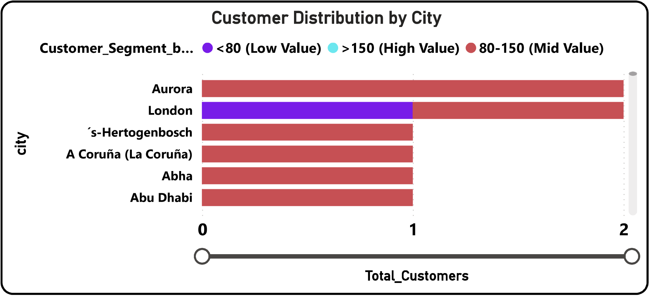
Q10
What is the distribution of customers across different cities?
Cluster & Geographic Analysis
599
599
Aurora & London
Total Customers
Cities Covered
Top City
Power BI Visualization
KEY INSIGHTS & RECOMMENDATIONS
1
1 Customer Per City on Average
With 599 customers across 599 cities, the average penetration is 1 customer/city — an extremely fragmented geographic footprint spanning every continent.
2
Aurora & London: 2 Customers Each
These are the only cities with >1 customer, making them micro-clusters. London uniquely hosts a High-Value (>150) customer — the only such instance by city.
3
Mid-Value Dominates All Geographies
Red bars (80–150 Mid-Value) appear in every top city. This segment is geographically consistent, making it the most reliable base for location-based campaigns.
4
Recommendation
Build a city-cluster expansion model: target cities neighboring Aurora and London for acquisition. A High-Value customer in London signals premium market potential — run referral programs there first.
Movie Rentals Capstone · Q10 of 15 · Pavan Kumar Magandi · MBA

Slide 13
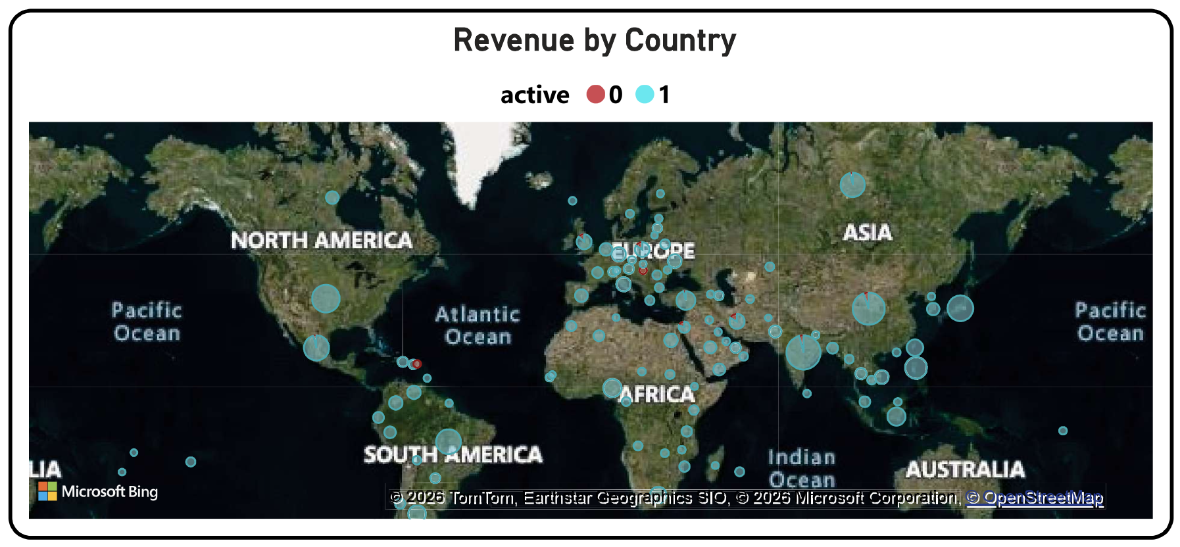
Q11
How does the rental revenue vary by country?
Cluster & Geographic Analysis
109
599
Global
Countries with Customers
Total Customers
Active/Inactive Split
Power BI Visualization
KEY INSIGHTS & RECOMMENDATIONS
1
109 Countries — Truly Global
Rental revenue is generated across 109 countries on 6 continents. The business has the geographic footprint of a multinational — extraordinary for a rentals operation.
2
Europe & Asia Are Revenue Hubs
The largest revenue bubbles cluster in Western Europe and South/Southeast Asia. These regions likely represent both higher customer density and higher Average Order Value.
3
Inactive Customers Span All Regions
Red dots (inactive=0) appear globally, indicating customer churn is not geographically concentrated — it's a service/engagement issue rather than a regional one.
4
Recommendation
Focus reactivation campaigns on Europe & Asia first — highest ROI. Build a country-level revenue ranking to guide marketing spend allocation by region.
Movie Rentals Capstone · Q11 of 15 · Pavan Kumar Magandi · MBA

Slide 14
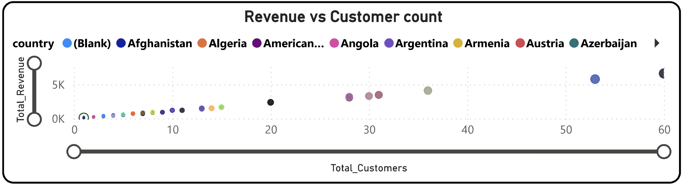
Q12
Which locations have the highest and lowest customer ratings?
Cluster & Geographic Analysis
~60
~$5K+
5.5
Max Customers (1 Country)
Max Revenue (1 Country)
Avg Customers/Country
Power BI Visualization
KEY INSIGHTS & RECOMMENDATIONS
1
Strong Positive Correlation
Countries with 30–60 customers generate $3K–$5K+ revenue, confirming that customer volume is the primary driver of country-level revenue.
2
Long Tail of Low-Value Countries
The vast majority of 109 countries hold 0–10 customers and contribute <$500 revenue each — 80%+ of countries are in the low-value tail of the distribution.
3
3–4 Countries Drive Disproportionate Revenue
Outlier countries at 30–60 customers drive 5–10x more revenue than median countries. These are the top-tier strategic markets to protect and grow.
4
Recommendation
Define a Top-10 Country Index — the 10 highest-customer countries. Assign dedicated marketing budgets, local pricing strategies, and retention programs to these markets exclusively.
Movie Rentals Capstone · Q12 of 15 · Pavan Kumar Magandi · MBA

Slide 15
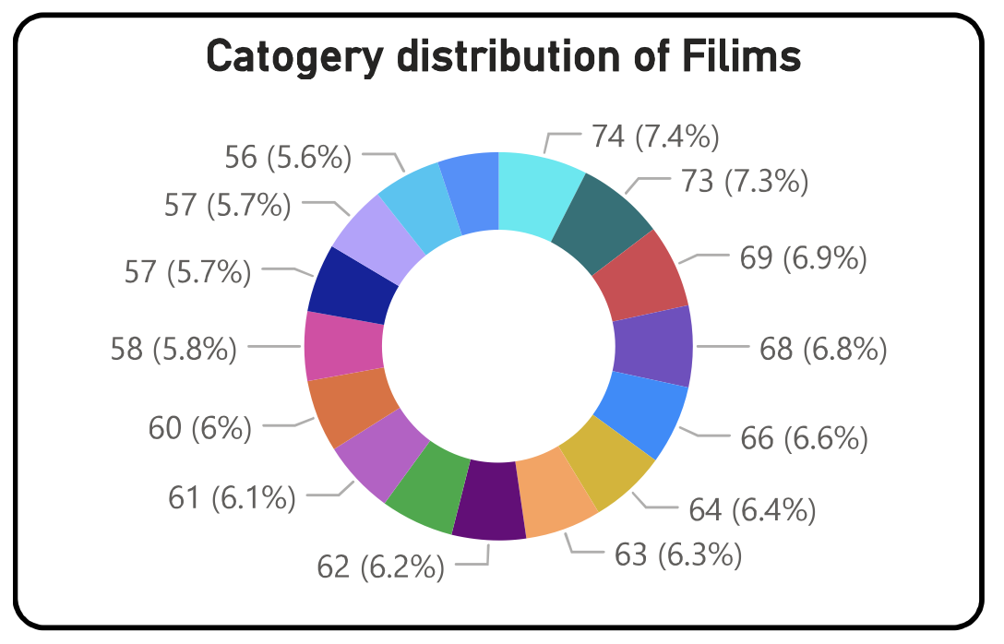
Q13
What is the distribution of films by language?
Film & Inventory Analysis
16
Games ~$3.25
Action $2.67
Unique Categories
Highest Avg Rate
Lowest Avg Rate
Power BI Visualization
KEY INSIGHTS & RECOMMENDATIONS
1
Primarily English-Language Inventory
The dataset reflects a single-language (English) inventory — no foreign-language segmentation is visible. All 1,000 films appear to be English-language titles.
2
Games & Travel Command Premium Rates
Games (~$3.25/rental) and Travel are the highest-priced categories — ~22% more expensive than Action ($2.67) and Documentary ($2.76), the lowest-priced.
3
Pricing Gap Signals Demand Elasticity
The $0.58 spread between highest and lowest-priced categories is significant — it shows the market accepts premium pricing for niche genres like Games.
4
Recommendation
Introduce a small foreign-language film section (Spanish, Hindi, French) to tap underserved bilingual customers across the 109-country footprint. Even 50 titles could open a new segment.
Movie Rentals Capstone · Q13 of 15 · Pavan Kumar Magandi · MBA

Slide 16
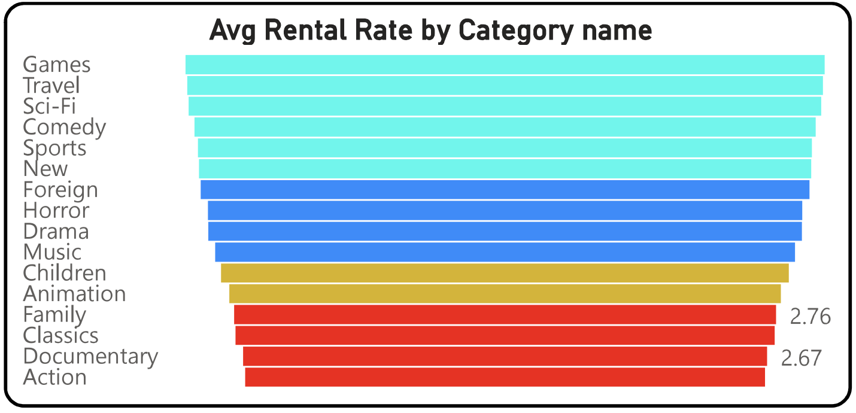
Q14
Which film categories have the highest rental rates?
Film & Inventory Analysis
$2.98
Games ~$3.25
Action $2.67
Avg Rental Rate (All)
Top Category
Bottom Category
Power BI Visualization
KEY INSIGHTS & RECOMMENDATIONS
1
Games Leads by a Clear Margin
Games commands the highest average rental rate at ~$3.25 — approximately $0.58 or 22% above the lowest-priced Action category. Niche demand sustains the premium.
2
Travel & Sci-Fi Are Second Tier
Travel and Sci-Fi follow Games closely in the $3.00–$3.20 range, forming a premium cluster. These genres likely attract dedicated enthusiasts willing to pay more.
3
Action & Documentary Anchor the Floor
At $2.67 and $2.76 respectively, Action and Documentary are priced lowest despite high rental volume — suggesting these categories compete on accessibility rather than premium.
4
Recommendation
Test a 10–15% price increase on Action titles — as the highest-volume category, even a $0.30 increase per rental could add $1,500–$2,000 in annual revenue with minimal demand drop.
Movie Rentals Capstone · Q14 of 15 · Pavan Kumar Magandi · MBA

Slide 17
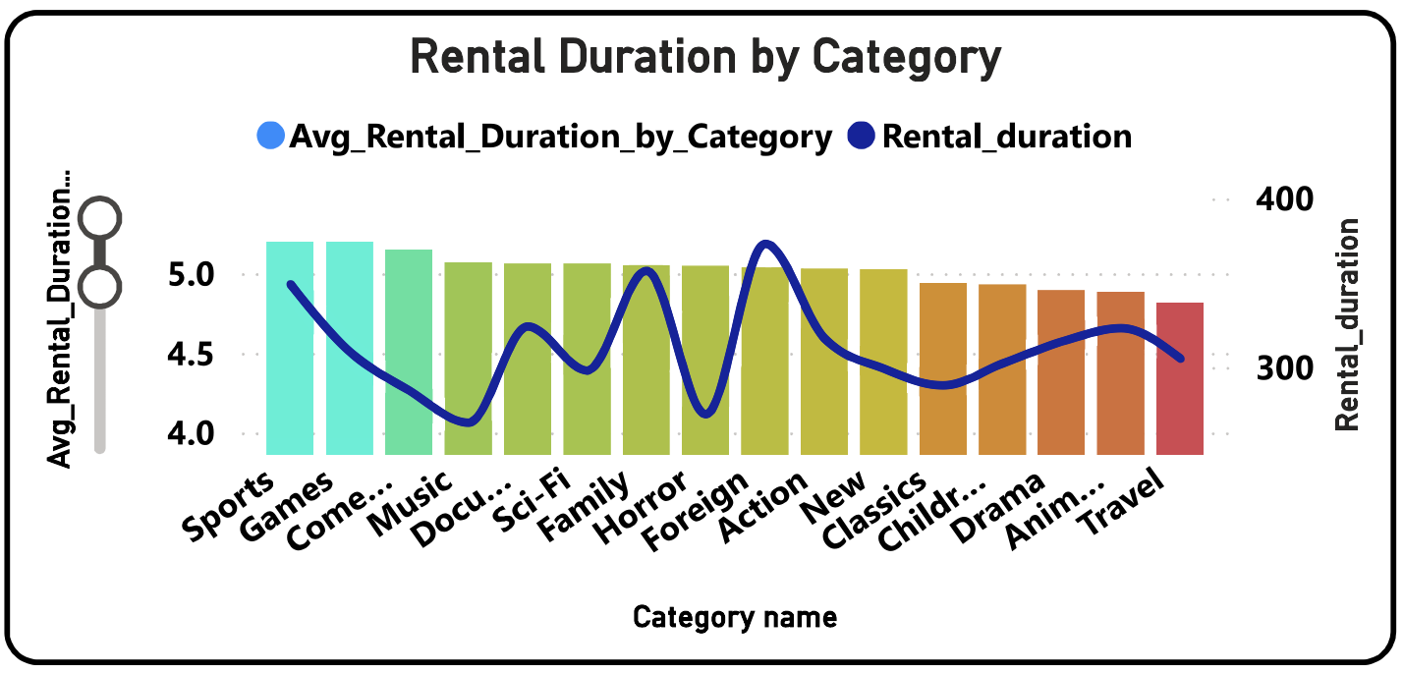
Q15
How does the average rental duration vary by film category?
Film & Inventory Analysis
5.03 Days
Sports ~5.2 Days
Travel ~4.1 Days
Avg Duration (All)
Longest Category
Shortest Category
Power BI Visualization
KEY INSIGHTS & RECOMMENDATIONS
1
Sports: Most Engaging Category
Sports films average ~5.2 days rental duration — the highest of all 16 categories. Customers hold them longest, suggesting repeat viewings or event-based watching.
2
Travel & Animation Turned Over Fastest
At ~4.1 days, Travel and Animation films are returned the quickest. High turnover means more rental cycles per copy — boosting inventory efficiency for these titles.
3
Tight 4.0–5.2 Day Cluster
All 16 categories fall within just 1.2 days of each other, reflecting the standard 5-day policy. Natural demand variation is present but policy constrains the range.
4
Recommendation
Pilot extended rentals (7-day option) specifically for Sports and Drama — the highest-duration categories. Charge a $0.50 premium per extra day to monetize the extended engagement.
Movie Rentals Capstone · Q15 of 15 · Pavan Kumar Magandi · MBA

