Slide 1
POWER BI CAPSTONE PROJECT
67.41K
Total Revenue
Sakila DVD Rental
584
Store Business Intelligence
Active Customers
Done by: Pavan Kumar Magandi
16K
Qualification: MBA · pavanmagandi@gmail.com
Total Rentals
Tools Used
SQL
Excel
Power BI
5.03
Avg Rental Days
Dataset: Sakila (MySQL) — DVD Rental Store

Slide 2
Problem Statement
02
Objective: Build a comprehensive Power BI dashboard using the Sakila DVD Rental Database to enable data-driven decisions across customer behavior, film inventory, staff performance, and store operations.
Customer Segmentation
Sales & Revenue Trends
Analyze 584 active customers by rental frequency, payment behavior, and geographic distribution across 109 countries.
Track $67.41K total revenue, 0.77% MoM growth, and quarterly patterns across In-Store (41%) vs. Online (40%) channels.
Film Inventory Optimization
Store & Staff Performance
Manage 1,000 films across 16 categories, 4,581 inventory items, avg rental rate $2.98, and avg film duration 115.27 mins.
Compare 2 stores, 2 staff members handling 16,044 total rentals with avg rental duration of 5.03 days.
Geographic Expansion Insights
Actionable Recommendations
Identify revenue contribution and customer density across 599 cities in 109 countries to prioritize growth markets.
Deliver targeted marketing campaigns, film collection enhancements, and staff training initiatives for competitive advantage.

Slide 3
Dataset Overview — Sakila Database
03
A MySQL database representing a DVD rental store — actors, films, customers, inventory, payments, rentals, staff & stores
Customer
Rental
Payment
Film
599 customers. ID, Name, Email, Address, Active Status
16K rentals. Inventory ID, Customer, Rental Date, Return Date
16K payments. Amount, Date, Customer ID, Staff ID
1,000 films. Title, Rating, Duration, Category, Rental Rate
Inventory
Staff
Store
Actor / Category
4,581 items. Film copies per store with availability tracking
2 staff. Login, Store, Employment Duration, Rental handling
2 stores. Address, Manager, Revenue & operational metrics
Actors linked to films; 16 categories for film classification

Slide 4
Tools & Approach
04
01 SQL
02 Excel
03 Power BI
Extracted data from 15+ Sakila relational tables via complex JOINs
Preliminary EDA — pivot tables for category-level rental volumes
Star schema: fact Rental & Payment linked to 6 dimension tables
Derived customer segments: <80 (Low), 80–150 (Mid), >150 (High Value)
Validated $67,406.56 total revenue and 16,044 total rental counts
DAX measures: MoM%, Customer Segments, Rental Duration buckets
Aggregated rental counts, revenue, avg duration per staff, store & city
Cross-checked payment splits: In-Store 41% vs Online 40% vs other
6 interactive pages: Dashboard, Sales, Film, Store, Geography, Staff
Calculated MoM revenue growth (0.77%) and employment duration metrics
Cleaned address/city/country data for geographic analysis readiness
Slicers by Rating, Category, Country, City, Payment channel & Date
SQL → Data Extraction & Cleaning | Excel → EDA & Validation | Power BI → Modeling, DAX & Dashboard

Slide 5
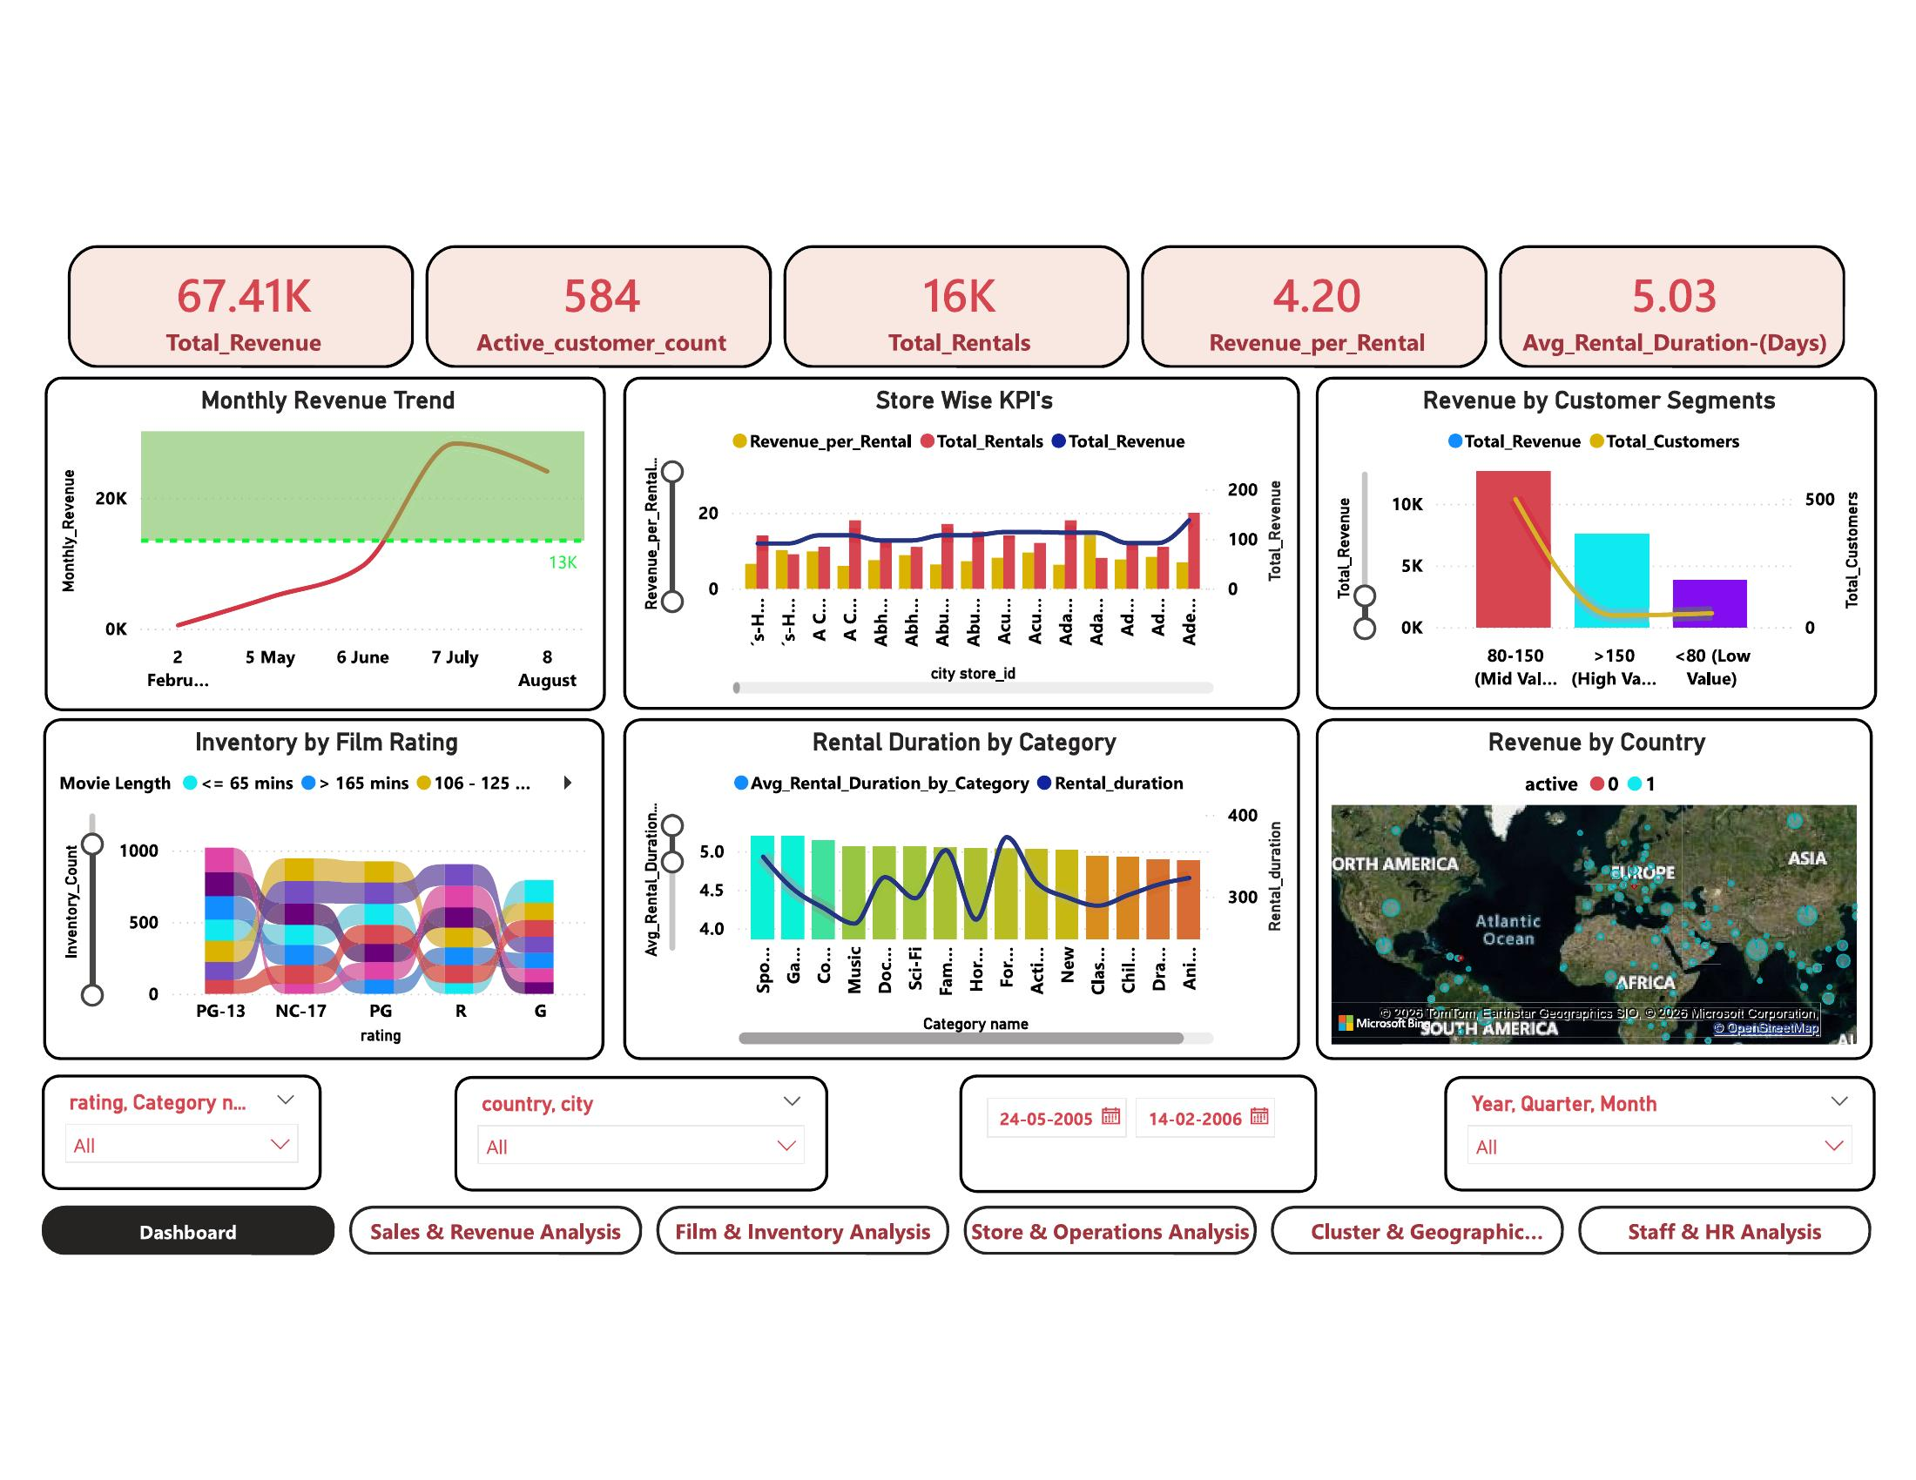
Dashboard Overview
05
67.41K
584
16K
$4.20
5.03
Total Revenue
Active Customers
Total Rentals
Rev / Rental
Avg Rental Days
Revenue peaked in July 2005 (~20K/month)
Monthly revenue trend shows a sharp growth from Feb 2005 baseline of 13K to peak in July–Aug 2005. This indicates a clear seasonality pattern.
Mid-Value customers (80–150) dominate revenue
The Revenue by Customer Segments chart shows the 80–150 segment contributes the highest total revenue with the most customers (~500).
PG-13 & NC-17 hold the largest inventory share
The Sankey chart for Inventory by Film Rating shows PG-13 and NC-17 ratings have the widest flow bands across all movie length categories.
Europe & Asia are active revenue geographies
The Revenue by Country map shows the densest customer/revenue clusters in Europe and South/Southeast Asia, especially for active customers.
★ 6 interactive pages with real-time slicers for Rating, Category, Country, Channel, and Date — enabling complete drill-down for store decision-makers.

Slide 6
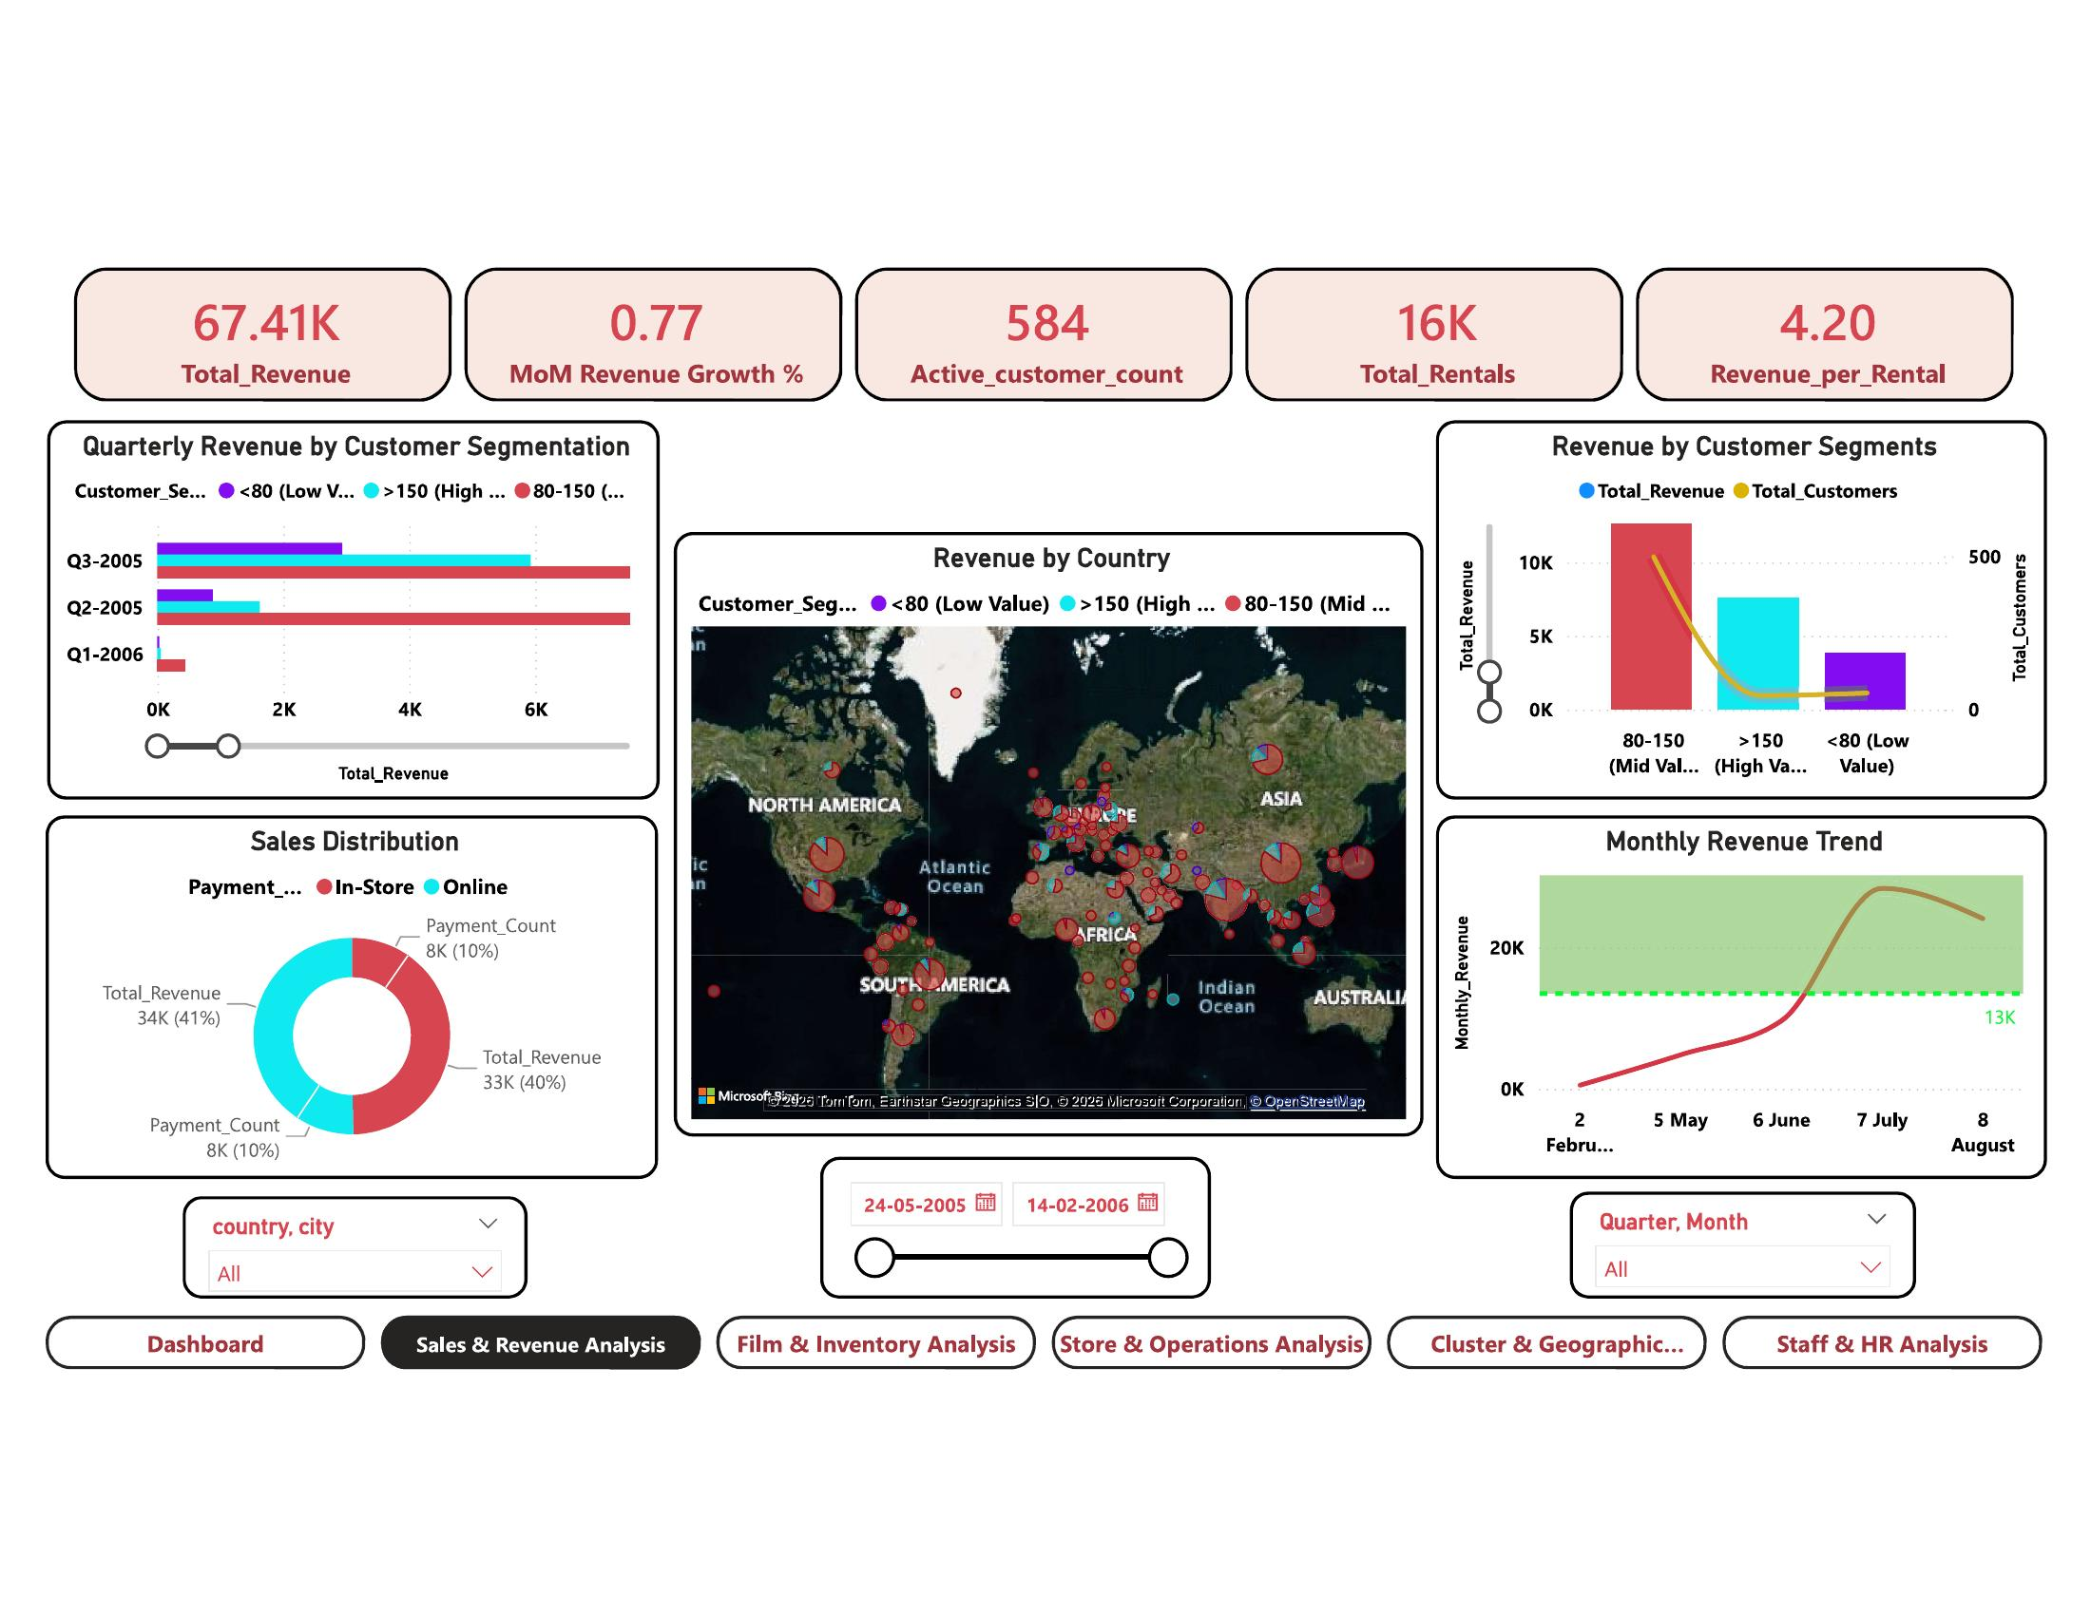
Sales & Revenue Analysis
06
$67.41K
0.77%
584
16K
Total Revenue
MoM Revenue Growth
Active Customers
Total Rentals
Q: How does revenue trend over time and how is it distributed across customer segments and channels?
Mid-Value segment (80–150 rentals) drives peak revenue
1
The segment chart shows 80–150 customers contribute $10K+ total revenue with ~500 customers — the largest and most valuable cohort.
In-Store vs Online split is nearly equal: 41% vs 40%
2
The donut chart shows Payment Count 8K (10%) In-Store and 8K (10%) Online, with Total Revenue $34K (41%) In-Store vs $33K (40%) Online — indicating strong omnichannel balance.
Q3-2005 was the highest revenue quarter ($6K+)
3
The Quarterly Revenue by Segmentation chart shows Q3-2005 and Q2-2005 were the two strongest quarters, with Q1-2006 significantly lower — signalling business decline post-peak.
★ Takeaway: Revenue growth of only 0.77% MoM signals plateau risk — aggressive re-engagement of Low Value (<80 rental) customers could unlock the next growth wave.

Slide 7
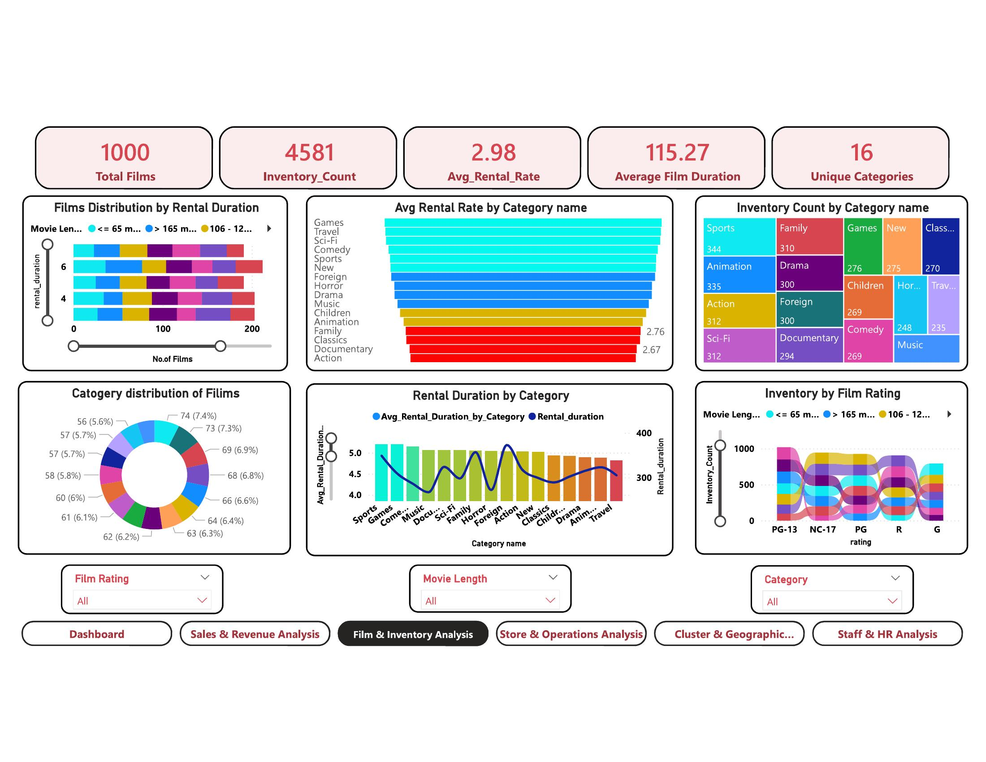
Film & Inventory Analysis
07
1,000
4,581
$2.98
16
Total Films
Inventory Count
Avg Rental Rate
Unique Categories
Q: Which film categories and ratings generate the most rentals, and how is inventory distributed?
Sports leads inventory with 344 items; Family follows with 310
1
The category treemap shows Sports (344), Family (310), Animation (335), Drama (300), and Action (312) as the top 5 inventory categories — reflecting broad customer tastes.
Games & Travel have the highest avg rental rate
2
The horizontal bar chart shows Games and Travel category avg rates far exceed the $2.98 benchmark. Action and Documentary have the lowest rates ($2.67–$2.76), indicating pricing opportunity.
Category distribution is nearly even at ~5.7–7.4%
3
The donut chart shows all 16 categories contribute between 5.6%–7.4% of films — indicating a well-balanced collection with no single category dominating over-proportionately.
★ Takeaway: Games and Travel command premium rental rates but may have lower inventory — increasing stock in these high-rate categories could directly boost per-rental revenue.

Slide 8
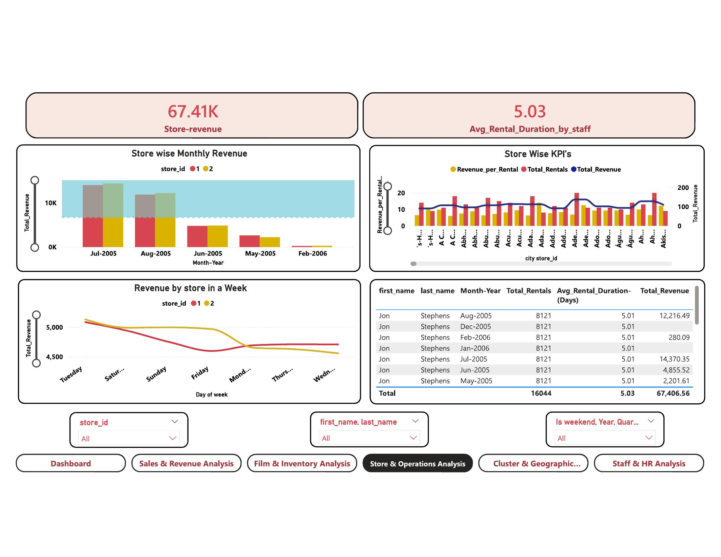
Store & Operations Analysis
08
$67.41K
5.03
16,044
2
Store Revenue
Avg Rental Days (Staff)
Total Rentals
Stores / Staff
Q: How does store revenue vary by month and day of week, and which staff drives the most rentals?
Jul & Aug 2005 are peak months — both stores perform best
1
The Store Wise Monthly Revenue chart shows Jul-2005 and Aug-2005 with $10K+ combined revenue for Store 1 & 2. Feb-2006 drops sharply, indicating seasonal decline.
Tuesday is the highest revenue day of the week
2
The Revenue by Store in a Week line chart shows both Store 1 and Store 2 peak on Tuesday, with a steady decline through to Wednesday. Weekend revenue is moderate.
Jon Stephens handles ALL 8,121 rentals per month
3
The staff table shows Jon Stephens (Staff 2) manages 8,121 rentals with $12,216.49 revenue in Aug-2005, and avg rental duration of 5.01 days — consistent high productivity.
★ Takeaway: Both stores are nearly identical in staff productivity (5.04 vs 5.01 avg days) — store-level differentiation through category specialization could maximize each store's unique revenue potential.

Slide 9
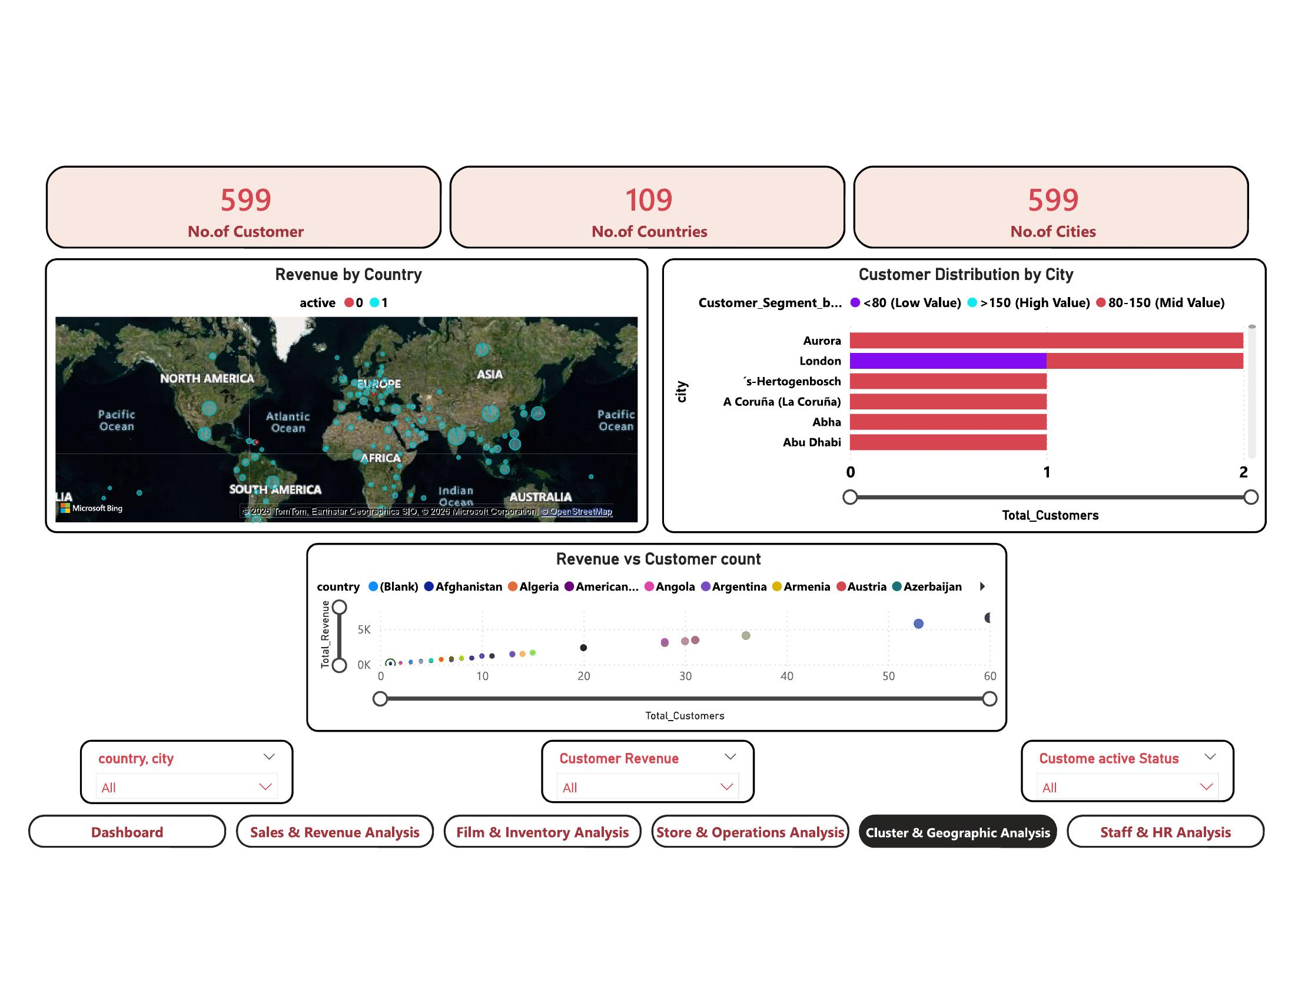
Cluster & Geographic Analysis
09
599
109
599
<80 / 80–150 / >150
Total Customers
Countries
Cities
Customer Segments
Q: How are customers and revenue distributed globally, and which cities/segments drive the most value?
Aurora and London lead city-level customer count
1
The Customer Distribution by City chart shows Aurora and London have the highest customer totals, predominantly Mid-Value (80–150) customers, indicating mature high-spend markets.
High-Value (>150) customers are geographically concentrated
2
London shows the only visible High Value (purple) customer segment at city level, while most cities are dominated by Mid-Value (red) customers — 80–150 rental bracket.
Revenue vs. customer count has a non-linear relationship
3
The scatter plot shows some countries with only 20–30 customers generate $5K+ in revenue, while countries with 50+ customers may generate less — indicating quality beats quantity in revenue terms.
★ Takeaway: With 599 cities across 109 countries, the geographic spread is vast but thin — concentrating marketing efforts on Aurora, London, and countries with high revenue-per-customer ratios would maximize ROI.

Slide 10
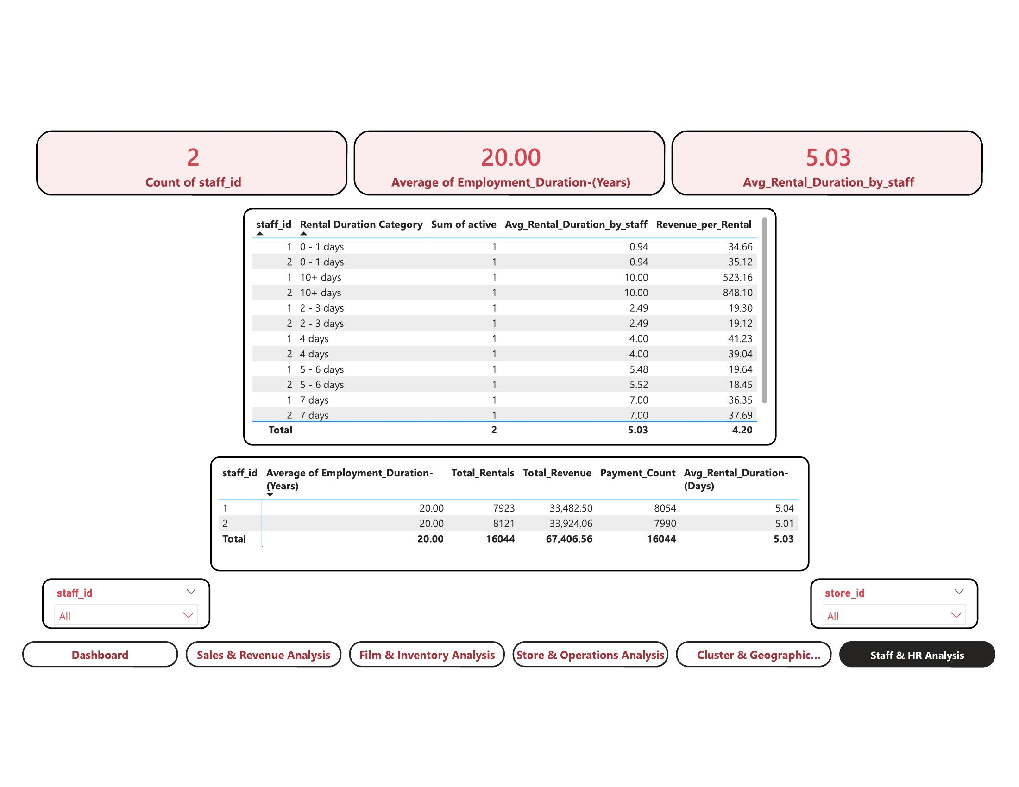
Staff & HR Analysis
10
2
20 yrs
5.03
16,044
Staff Members
Avg Employment Duration
Avg Rental Duration
Total Rentals Managed
Q: How do the two staff members compare in rental performance, revenue contribution, and duration handling?
Both staff have identical 20-year employment tenure
1
Staff 1 and Staff 2 both show Average Employment Duration of 20.00 years — indicating an experienced, long-standing team with high institutional knowledge.
Staff 2 generates slightly more revenue ($33,924 vs $33,482)
2
Despite nearly equal rental counts (8,121 vs 7,923), Staff 2 (Jon Stephens) generates $441 more revenue — suggesting a marginally better ability to convert rentals into higher-value transactions.
10+ day rental duration bucket generates highest revenue per rental
3
The duration table shows the '10+ days' rental bucket has Revenue_per_Rental of $523 (Staff 1) and $848 (Staff 2) — far exceeding shorter rental durations, indicating long-term rentals are the most profitable.
★ Takeaway: With only 2 staff managing 16,044 rentals across 2 stores, the team is highly efficient. Training staff to upsell 10+ day rental durations could significantly boost per-rental revenue from $4.20 toward $500+ brackets.

Slide 11
Key Insights
11
Sales & Revenue
$67.41K total revenue with 0.77% MoM growth. Q3-2005 was peak quarter. In-Store (41%) and Online (40%) are nearly equal — strong omnichannel balance established.
Film & Inventory
1,000 films, 16 categories, 4,581 inventory items. Sports leads with 344 items. Games & Travel command the highest rental rates — but may be under-stocked relative to demand.
Store Operations
Jul–Aug 2005 were peak revenue months ($10K+). Tuesday is the highest-performing day. Both stores perform comparably — specialization could unlock differentiated growth.
Geography
599 customers across 109 countries, 599 cities. Aurora and London lead city-level count. Revenue-per-customer is non-linear — quality of customer > quantity of customers.
Staff & HR
2 staff, both with 20-year tenures managing 16,044 rentals. 10+ day rental duration generates $500–$848 per rental — vs $4.20 average. Massive upsell opportunity exists.

Slide 12
Business Recommendations
12
R1
Re-engage Low-Value Customers (<80)
R2
Increase Games & Travel Inventory
Target <80 rental customers with personalized promotions to move them into the 80–150 Mid-Value bracket, which delivers the highest total revenue.
These categories command the highest avg rental rates. Stocking more titles here directly improves revenue per rental without discounting.
R3
Leverage Tuesday Peak for Promotions
R4
Focus Geographic Marketing on Aurora & London
Tuesday consistently generates peak daily revenue. Launch weekly deal campaigns on Mondays to pull forward demand and extend the Tuesday–Wednesday revenue window.
These cities lead in customer count and Mid-Value segment density. Targeted loyalty programs here would yield the highest return on marketing spend.
R5
Train Staff on 10+ Day Rental Upselling
R6
Stabilize Post-Peak Revenue (2006 Decline)
10+ day rentals generate $500–$848/rental vs the $4.20 average. A structured upsell script for both staff could dramatically increase per-rental revenue.
Q1-2006 shows a sharp revenue decline. Introduce seasonal bundles, extended rental offers, and new title promotions to rebuild momentum in early-year slow periods.

Slide 13
Conclusion
5
Analysis Modules
This Power BI dashboard for Sakila DVD Rental transforms raw transactional data into a fully interactive BI system — covering 5 analysis domains across 599 customers, 16K rentals, 1,000 films, 2 stores, and 109 countries.
1,000
Films Analyzed
SQL + Excel pipeline: clean, validated data from 15+ Sakila tables
16K
Rentals Processed
DAX measures: MoM%, Customer Segments, Duration Buckets, Rev/Rental
6 interactive Power BI pages with slicers for Rating, Category, Country
67.41K
Revenue Tracked ($)
5 business domains analyzed with insights + actionable recommendations
6 strategic recommendations to drive revenue, inventory & customer growth
109
Countries Covered
Pavan Kumar Magandi · MBA · pavanmagandi@gmail.com

