Slide 1
BUSINESS INTELLIGENCE REPORT
Northwind Traders
Analytics Dashboard
Power BI · Excel · SQL
Prepared by: Pavan Kumar Magandi | MBA
pavanmagandi@gmail.com

Slide 2
Problem Statement
Objective of the Power BI Report
The objective of this Power BI report is to create a visually appealing and user-friendly dashboard that communicates key performance metrics for Northwind Traders effectively.
The report aims to generate insights into customer behavior, sales patterns, and employee performance to aid decision-making processes. It covers sales analysis, customer segmentation, inventory trends, and employee performance — consolidating data from multiple tables for a comprehensive view of the company's operations.
The report empowers stakeholders to make data-driven decisions by offering valuable insights and facilitating data exploration through interactive visualizations and dynamic filters.
Expected Impact: Revolutionize how Northwind Traders interacts with its data, enabling the company to remain competitive and drive its business forward in the wholesale market landscape.

Slide 3
Dataset Overview
Northwind Traders — A fictitious company importing & exporting specialty foods worldwide
Customers
Orders
Order Details
Products
Customer ID, company, contact, address, country, phone — 90 customers
Order ID, customer/employee ID, dates, shipping info — 830 orders
Order ID, product ID, unit price, quantity, discount
Product ID, name, supplier, category, price, stock levels
Suppliers
Employees
Shippers
Categories
Supplier ID, company, contact, address, country, phone
Employee ID, name, title, hire date, region — 9 employees
Shipper ID, company name, phone — 3 shipping companies
Category ID, category name, description

Slide 4
Tools & Methodology
A structured 3-stage analytics workflow
SQL
Excel
Power BI
Data Extraction
Data Cleaning & EDA
Visualization & Reporting
Queried Northwind relational database
Joined multiple tables (Customers, Orders, Products, etc.)
Filtered, grouped and aggregated data
Exported clean datasets for analysis
Imported SQL-exported datasets
Handled missing values & duplicates
Exploratory Data Analysis (EDA)
Pivot tables for preliminary insights
6-page interactive report
Custom DAX measures & KPIs
Dynamic filters & slicers
Maps, charts, treemaps & org charts

Slide 5
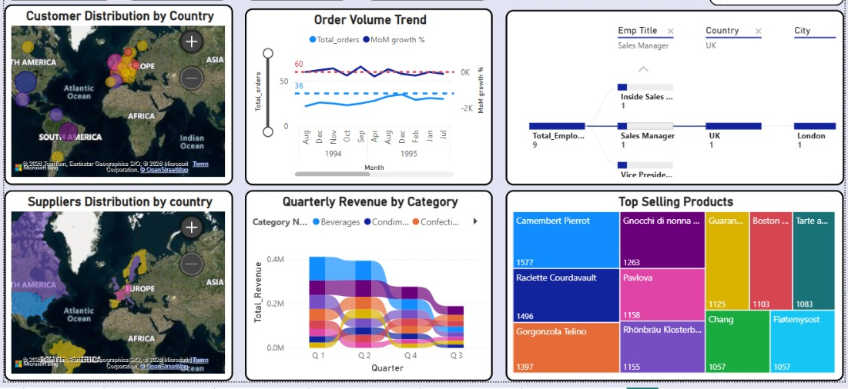
Dashboard Overview
Top-level KPIs across the entire Northwind Traders dataset | Period: Aug 1994 – May 1996
90
830
Total Customers
Total Orders
8.49
1.27M
Avg. Shipping Days
Total Revenue (₹)
37
1.53K
Late Shipments
Avg. Order Value ($)
Report Pages: Dashboard · Customer Analysis · Order Analysis · Employee Analysis · Product Analysis · Supplier Analysis

Slide 6
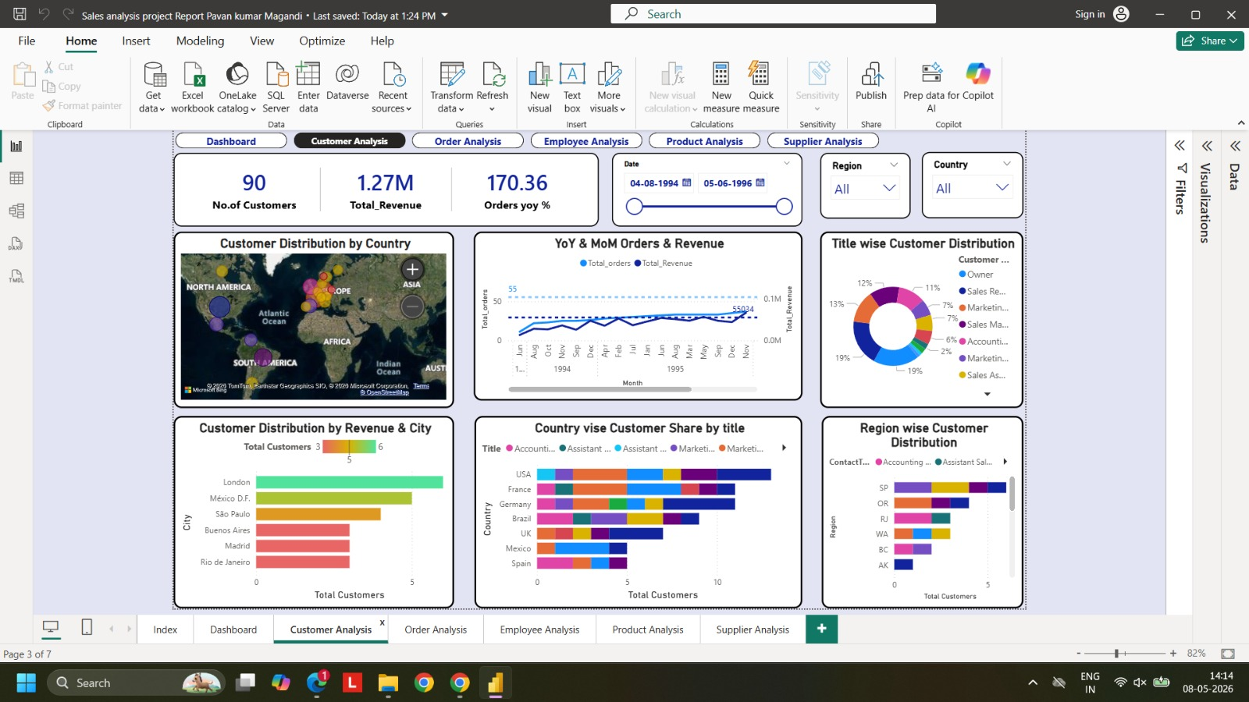
Customer Analysis
Key Insights
✦ USA dominates with the highest customer share (~highest bubble on map), while Europe collectively accounts for ~40–50% across multiple countries.
✦ London leads city-level revenue & customer count, followed by México D.F. and São Paulo.
✦ Around 6–8 European countries show mid-level volumes, indicating distributed demand rather than a single dominant market.
✦ South America & parts of Asia contribute <10–15% combined — strong growth potential.
✦ Order YoY growth of 170% signals strong business momentum across all regions.

Slide 7
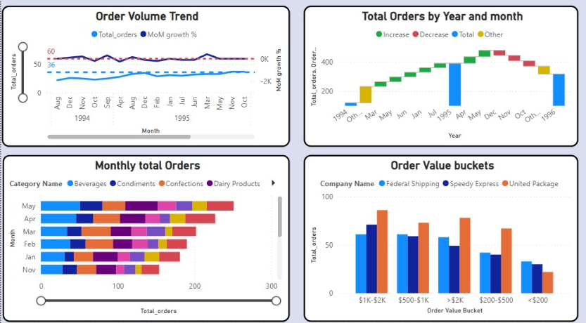
Order Analysis
830
$1.53K
8.49
37
Total Orders
Avg Order Value
Avg Shipping Days
Late Shipments
Key Insights
→ Stable Growth Phase: Order volume shows a steady upward trend through 1994–1995, consistently staying above the baseline (~35–40 orders).
→ Sharp Volatility in 1996: A significant drop is observed in early 1996, followed by ~100% MoM recovery — indicating temporary disruption, not long-term decline.
→ Revenue Growth Alignment: Strong YoY growth (223%) and high revenue (₹5.9L in 1995) confirm increasing order volume is translating into business growth.
→ Beverages, Condiments & Confections consistently contribute across all months, with peak activity in Apr–May.
→ Most orders fall in $1K–$2K bucket across all 3 shipping companies.

Slide 8
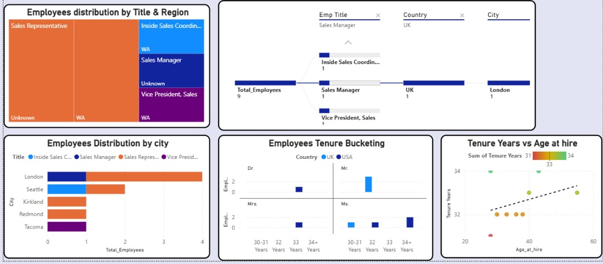
Employee Analysis
9
2
32.56
Total Employees
Managers
Avg Tenure (yrs)
Key Insights
Total Employees
9
→ Lean Organization: Only 9 employees — a small, tightly structured team.
→ Flat Hierarchy: Each role (Sales Manager, Inside Sales Coord., VP) has ~1 employee, reflecting minimal management layers.
Inside Sales Coord.
1
→ Centralized Operations: Reporting chain shows UK/London concentration.
→ High Retention: Employees exhibit ~32–34 years tenure across roles — a stable, experienced workforce.
→ Age–Tenure Relationship: Positive trend between age at hire (~25–55) and tenure (~31–34 yrs), showing long-term retention.
→ London hosts the most employees (4), followed by Seattle and Kirkland.

Slide 9
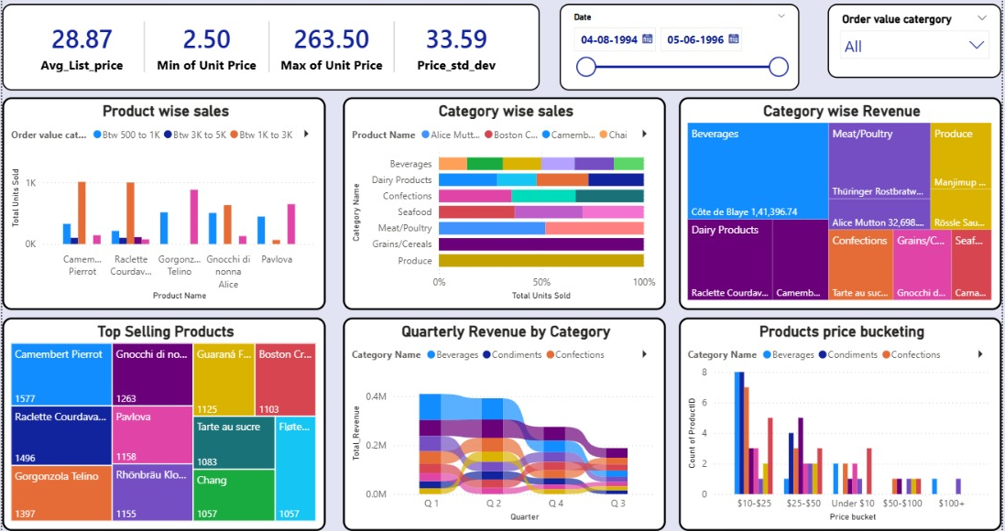
Product Analysis
Key Insights
✦ Camembert Pierrot leads all products with 1,577 units sold.
✦ Top 3 products (Camembert, Raclette, Gorgonzola Telino) are all dairy/cheese products — high demand segment.
✦ Beverages, Condiments & Confections are top categories by quarterly revenue.
✦ Pricing ranges widely: $2.50 (budget) to $263.50 (premium), targeting diverse customer segments.
✦ 74.05K total inventory value with 780 units currently on order.
✦ Q1 generates the highest revenue; Q3 shows the lowest — seasonal demand patterns exist.

Slide 10
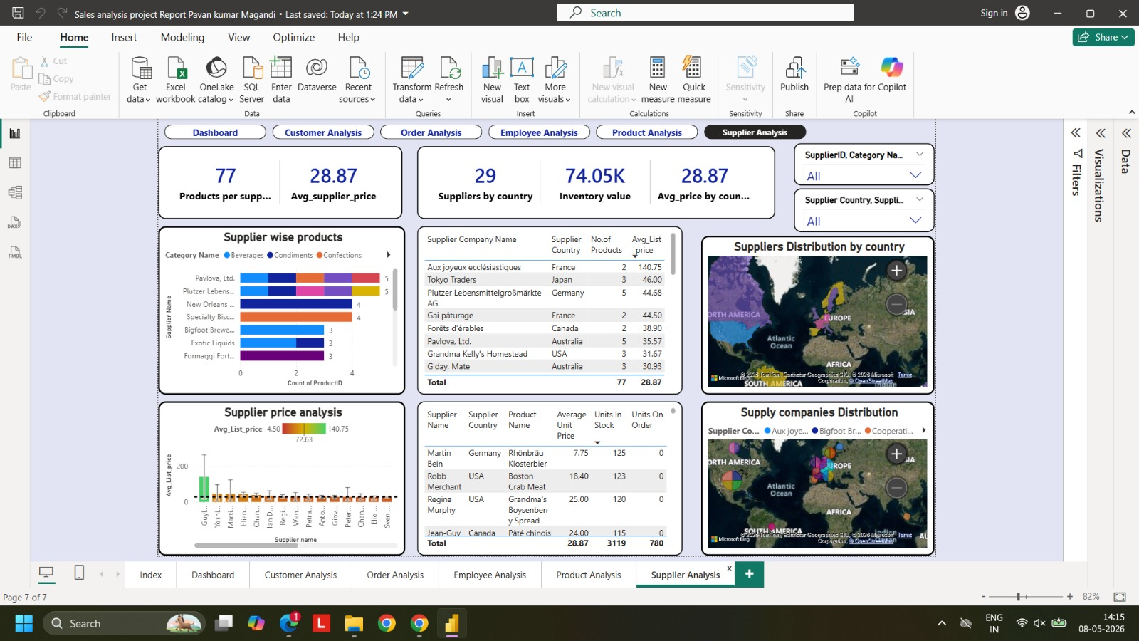
Supplier Analysis
29
$28.87
74.05K
77
Supplier Countries
Avg Supplier Price
Inventory Value
Products / Supplier (avg)
Key Insights
→ Globally diversified: Suppliers span North America, Europe, South America & Australia.
→ USA (~4 suppliers) and multiple European countries form the core supply base.
→ Wide pricing gap: $4.50 to $140.75, with most clustered in the $15–$40 mid-range.
→ USA generates ~₹1.22L revenue (244 orders, 6,828 units sold) — strongest region.
→ Australia contributes ~₹65.6K with 2,108 units — emerging market.
→ Premium suppliers like Aux joyeux ecclésiastiques (France) indicate niche offerings.

Slide 11
Key Insights Summary
Consolidated findings across all five analytical dimensions
👥 Customers
📦 Orders
👤 Employees
USA leads globally; London is top city. Europe (~6–8 countries) contributes 40–50% of total. 170% YoY orders growth signals expanding customer base.
830 total orders, $1.53K avg value. Stable 1994–1995 growth with a brief 1996 dip recovered via 100% MoM rebound. Apr–May peak months.
9 employees, flat hierarchy, 32.5-yr avg tenure. Operations centralized in London (UK). Highly experienced and stable workforce.
🏷️ Products
🏭 Suppliers
🚚 Shipping
Camembert Pierrot is #1 product. Dairy/cheese dominates top sellers. Beverages & Confections lead category revenue. Q1 is highest-revenue quarter.
29 countries, well-diversified. USA is #1 revenue region. Avg price $28.87. Premium niche and budget segments coexist across supplier portfolio.
Avg 9.44 shipping days. Ireland & Belgium slowest (~13–15 days). USA & Spain more efficient (~8–10 days). Speedy Express often the slowest carrier.

Slide 12
Business Recommendations
Data-driven actions to drive growth and efficiency
Expand in Emerging Markets
Optimize Shipping Logistics
Double Down on Top Products
01
South America & Asia show low penetration (<15%). Targeted campaigns in Brazil, Mexico, and Japan can capture growth.
02
Ireland & Belgium average 13–15 days. Partner with faster carriers or renegotiate SLAs in these regions to reduce late shipments.
03
Invest in supply chain for dairy/cheese products (Camembert, Raclette). These top sellers drive volume and should maintain sufficient stock.
Strengthen US Supplier Ties
Workforce Growth Planning
Leverage Q1 Revenue Peak
04
USA generates the highest revenue. Building stronger partnerships with US suppliers will ensure pricing stability and supply security.
05
With only 9 employees managing 830+ orders, scaling the team — especially in sales roles — is critical for sustained growth.
06
Q1 consistently outperforms Q3. Plan product launches, promotions, and inventory builds in advance to capitalize on Q1 demand.

Slide 13
Conclusion
This Power BI report successfully transforms raw Northwind Traders data into actionable intelligence. By integrating customer, order, employee, product, and supplier dimensions, the dashboard provides 360° visibility into business performance.
◆ 90 customers, $1.27M revenue, and 830 orders analysed across the full dataset
◆ Interactive filters enable drill-down by date, region, category, and shipper
◆ Delivers a data-first culture for Northwind Traders to remain competitive
◆ Foundation for future ML/predictive analytics extensions
Pavan Kumar Magandi | MBA | pavanmagandi@gmail.com

