Slide 1


DevOps

Slide 2
What is DevOps ?
Why do we need DevOps ?
Cloud and DevOps
Benefits of DevOps
DevOps Practices
Tools and Technologies
Questions
1
2
3
4
Agenda
5
6
7

Slide 3
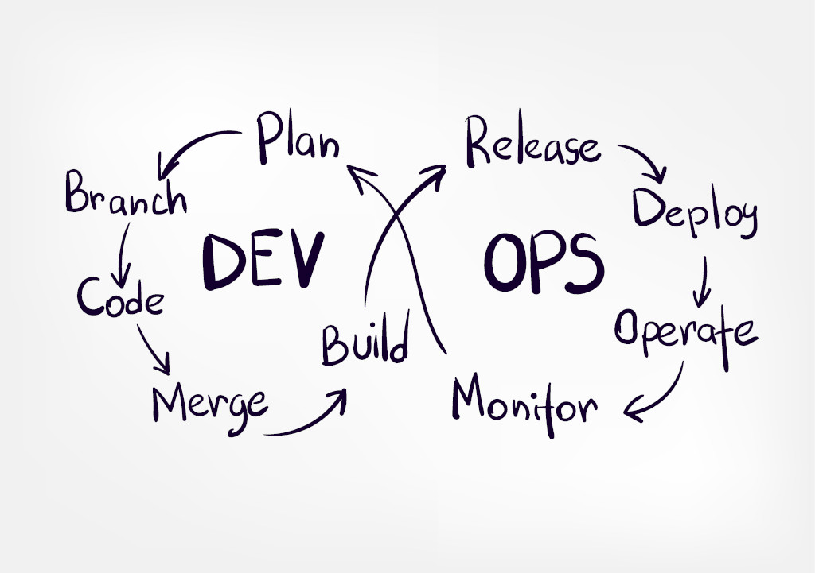
What is DevOps ?

Slide 4
Why do we need DevOps ?
 | Traditional IT | DevOps
Build Sizes | Bigger build size which are good only if a project is simple and easy-going | Smaller build size, smaller the risk of failure
Organizational Silos | The developers with same knowledge will sit togather | Based on Project, it helps developers, testers, project managers, etc to collaborate more efficiently
Scheduling | scheduling is centralized and common | local or cell level scheduling to better identify their deadlines and work accordingly
Release | A high risk event, filled with issues | smaller build size, high collaboration and CI of code makes build release risk-free
Project Matrics | measures cost and capacity | along with cost and capacity, considering “flow” helps agile teams to calculate end-to-end cycle time and not the overall time

Slide 5
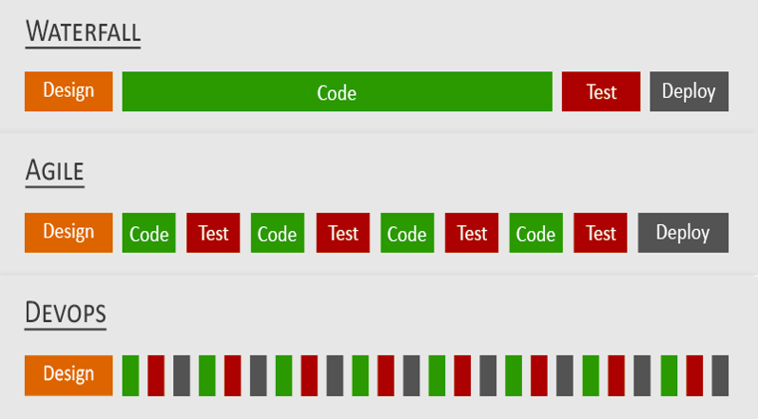
Why do we need DevOps ?
DevOps isn’t just development and operations. It’s an evolution of Continuous Delivery (CD) and Continuous Integration (CI) that encompasses a lot of different factors

Slide 6
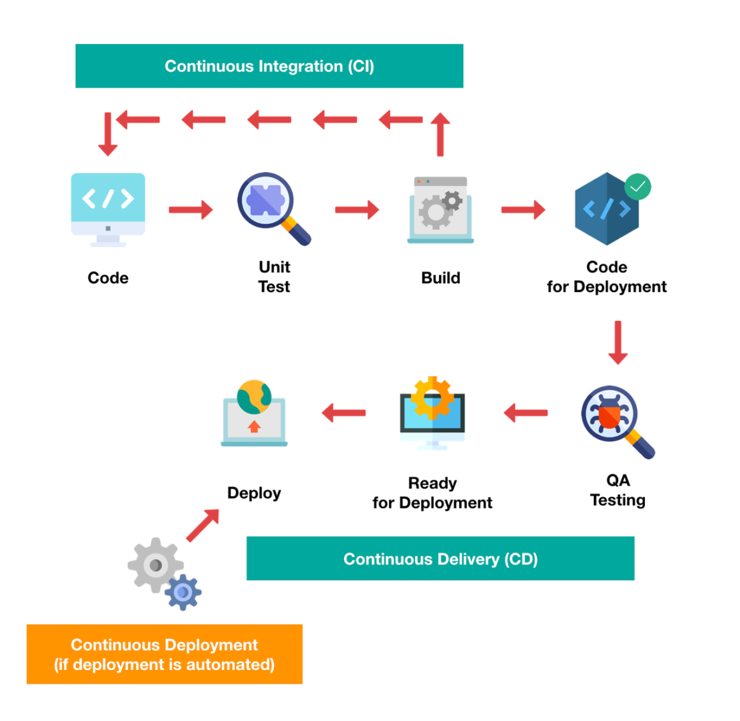
Why do we need DevOps ?

Slide 7
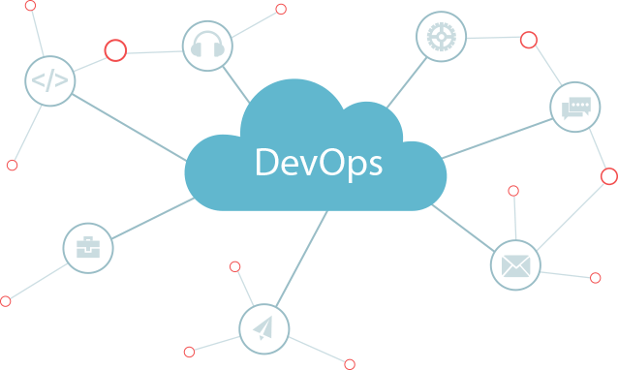
Cloud and DevOps
DevOps is about the process and process improvement, while Cloud computing is about technology and services.
Cloud-Centric automation options
Centralised platform
Scalable Infrastructure
Agile Development
Uptime and Stability

Slide 8
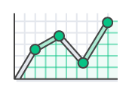
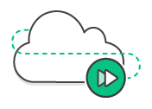
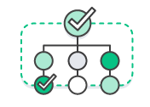

Benefits of DevOps
Speed
Microservices and continuous delivery let teams take ownership of services and then release updates to them quicker.
Rapid Delivery
Continuous integration and continuous delivery are practices that automate the software release process, from build to deploy.
Reliability
Practices like continuous integration and continuous delivery to test that each change is functional and safe. Monitoring and logging practices help you stay informed of performance in real-time.
Scale
Infrastructure as code helps you manage your development, testing, and production environments in a repeatable and more efficient manner.
Security
Infrastructure as code and policy as code, you can define and then track compliance at scale.

Slide 9
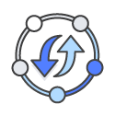
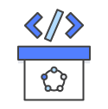
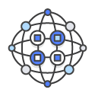
DevOps Practices
Continuous Integration
The key goals of continuous integration are to find and address bugs quicker, improve software quality, and reduce the time it takes to validate and release new software updates.
Continuous Delivery
Continuous delivery is a software development practice where code changes are automatically built, tested, and prepared for a release to production.
Microservices
Microservices are built around business capabilities; each service is scoped to a single purpose. You can use different frameworks or programming languages to write microservices and deploy them independently, as a single service, or as a group of services.

Slide 10



DevOps Practices
Infrastructure as Code
The cloud’s API-driven model enables developers and system administrators to interact with infrastructure programmatically, and at scale, instead of needing to manually set up and configure resources.
Monitoring and Logging
Active monitoring becomes increasingly important as services must be available 24/7 and as application and infrastructure update frequency increases. Creating alerts or performing real-time analysis of this data also helps organizations more proactively monitor their services.
Communication and Collaboration
Increased communication and collaboration in an organization is one of the key cultural aspects of DevOps.

Slide 11
Tools and Technologies
Name | Definition | Software/Tools
Source Code Management Tools | Version control is a way to keep a track of the changes in the code | Git, SVN, CVS, Mercurial
Continuous Integration Tools | CI is the practice of merging all developers' working copies to a shared mainline several times a day | Bitbucket Pipelines, Jenkins, AWS CodePipelines, CircleCI, Gitlab-CI
Continuous Deployment Tools | Continuous delivery is a practice in which teams produce software in short cycles, ensuring that the software can be reliably released at any time and, when releasing the software, without doing so manually | Spinnaker, Gitlab, Azure DevOps, Google Cloud Build, Jenkins, Gitlab, Bitbucket Deployment
Infrastructure as Code | Infrastructure as code is the process of managing and provisioning computer data centers through machine-readable definition files, rather than physical hardware configuration or interactive configuration tools | Terraform, AWS Cloudformation, Chef

Slide 12
Tools and Technologies
Name | Definition | Software/Tools
Container / Container Orchatration Tools | Containers are a form of operating system virtualization. A single container might be used to run anything from a small microservice or software process to a larger application. | Docker, Kubernetes, Openshift, Docker swarm, Docker compose
Configuration Management Tools | Configuration management is a systems engineering process for establishing and maintaining consistency of a product's performance, functional, and physical attributes with its requirements, design, and operational information throughout its life | CHEF, Puppet, Ansible, Teamcity
Monitoring tools | To monitor resources as well as application performance and send appropriate alerts to take actions | Grafana, Prometheus, Alertmanager, Datadog, Elasticsearch-Kibana, Slunk, Nagios

Slide 13
References
https://aws.amazon.com/devops/what-is-devops
https://d0.awsstatic.com/whitepapers/AWS_DevOps.pdf
https://www.invensislearning.com/blog/devops-vs-agile-vs-traditional-it
https://www.credencys.com/blog/what-is-devops-as-a-service
https://www.youtube.com/watch?v=a9_oMNSgX2g
https://www.youtube.com/watch?v=cfzJfa9N2qo
https://techbeacon.com/app-dev-testing/top-10-devops-myths-debunked

Slide 14


Slide 15

THANK YOU

