Slide 1
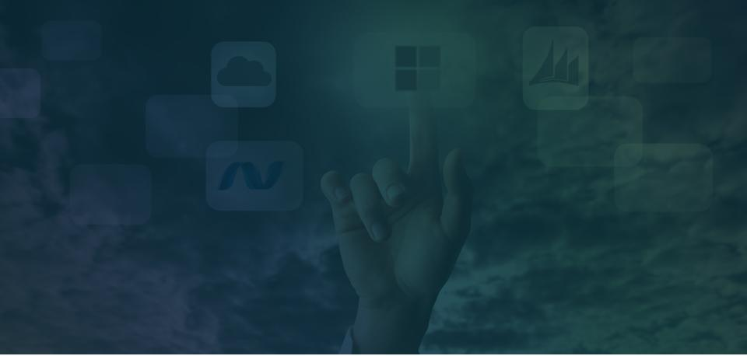

DevOps

Slide 2
Cloud Technologies
Introduction to AWS IAM
Introduction to AWS EC2
What is Docker?
Why is Docker needed?
Demo
Questions
1
2
3
4
Agenda
5
6
7

Slide 3

Cloud Technologies

Slide 4
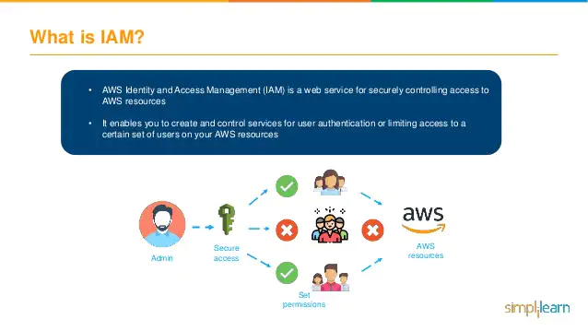
Introduction to AWS IAM
AWS Identity and Access Management (IAM) is a web service for securely controlling access to AWS resources
It enables you to create and control services for user authentication or limiting access to a certain set of users on the AWS resources

Slide 5
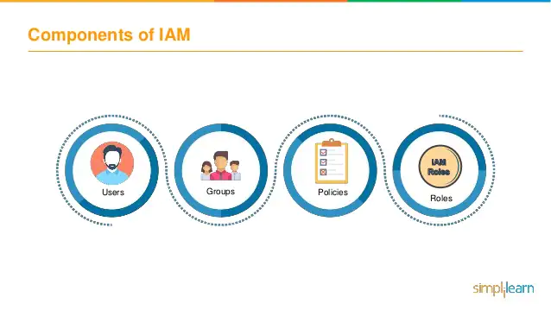
Components of IAM

Slide 6
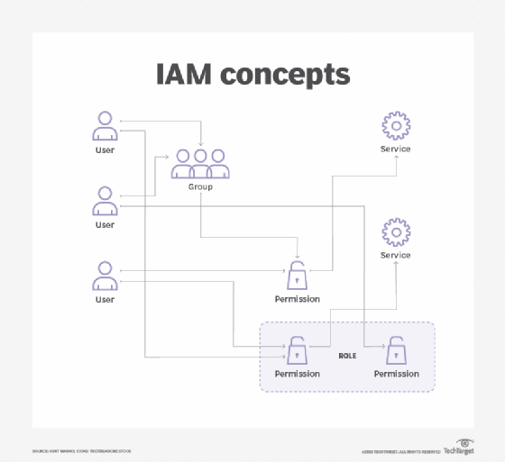
Components of IAM

Slide 7

Introduction to AWS EC2
Amazon Elastic Compute Cloud (Amazon EC2) provides scalable computing capacity in the Amazon Web Services (AWS) cloud
Can use Amazon EC2 to launch as many or as few virtual servers as you need, configure security and networking, and manage storage
Amazon EC2 enables you to scale up or down to handle changes in requirements or spikes in popularity, reducing your need to forecast traffic

Slide 8





Components of EC2
Instances
Virtual computing environments
Instance Type
Various configurations of CPU, Memory, Storage and networking capacity for instances
Amazon Machine Images (AMI)
Preconfigured templates for instances, that package the bits you need for the server ( including the operating system and additional software )
Key Pairs
Secure login information for instances
EBS Volumes
Persistent storage volumes for data using Amazon Elastic Block Storage

Slide 9
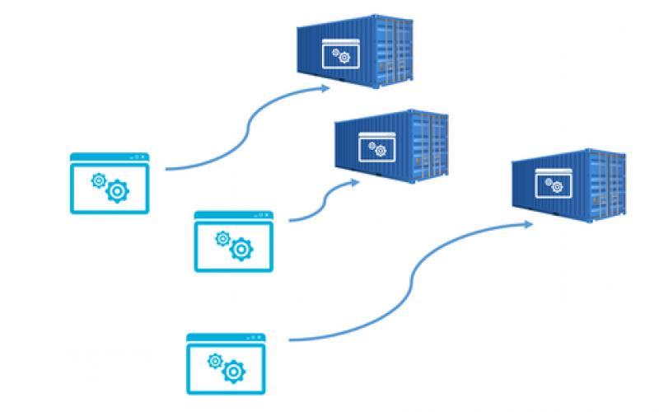
What is Docker ?
Docker is an open-source containerization platform.
It enables developers to package applications into containers-0standardized executable components combining application source code with the operating system (OS) libraries and dependencies required to run that code in any environment.
Docker is essentially a toolkit that enables developers to build, deploy, run, update, and stop containers using simple commands and work-saving automation through a single API.

Slide 10
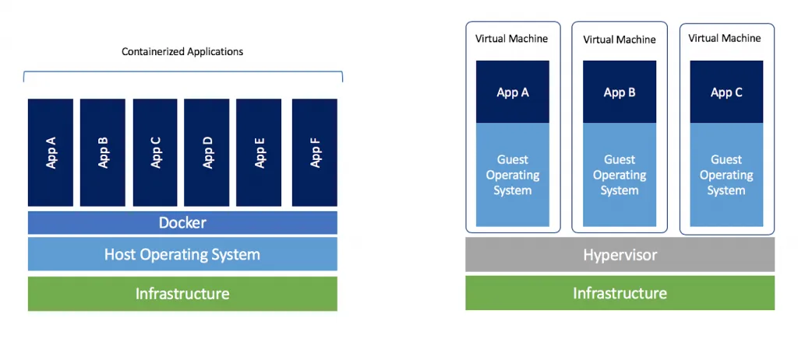
Docker Containers vs VMs

Slide 11
Docker Containers vs VMs

Slide 12
Why do we need Docker ?
Improved—and seamless—portability
Even lighter weight and more granular updates
Automated container creation
Container versioning
Container reuse
Shared container libraries

Slide 13
References
https://docs.aws.amazon.com/IAM/latest/UserGuide/introduction.html
https://docs.aws.amazon.com/IAM/latest/UserGuide/access_policies_create.html
https://docs.microsoft.com/en-us/dotnet/architecture/microservices/container-docker-introduction/
https://docs.docker.com/get-started/overview/
https://www.slideshare.net/AmazonWebServices/introduction-to-amazon-ec2-76030632
https://www.edureka.co/blog/introduction-to-amazon-ec2-2/
Demo
https://github.com/PavanMakadia/node-server

Slide 14


Slide 15

THANK YOU

