Slide 1


DevOps

Slide 2
What is Kubernetes?
Why Kubernetes is needed?
Features of Kubernetes
Components of Kubernetes
Demo
Questions
1
2
3
Agenda
4
5
6

Slide 3
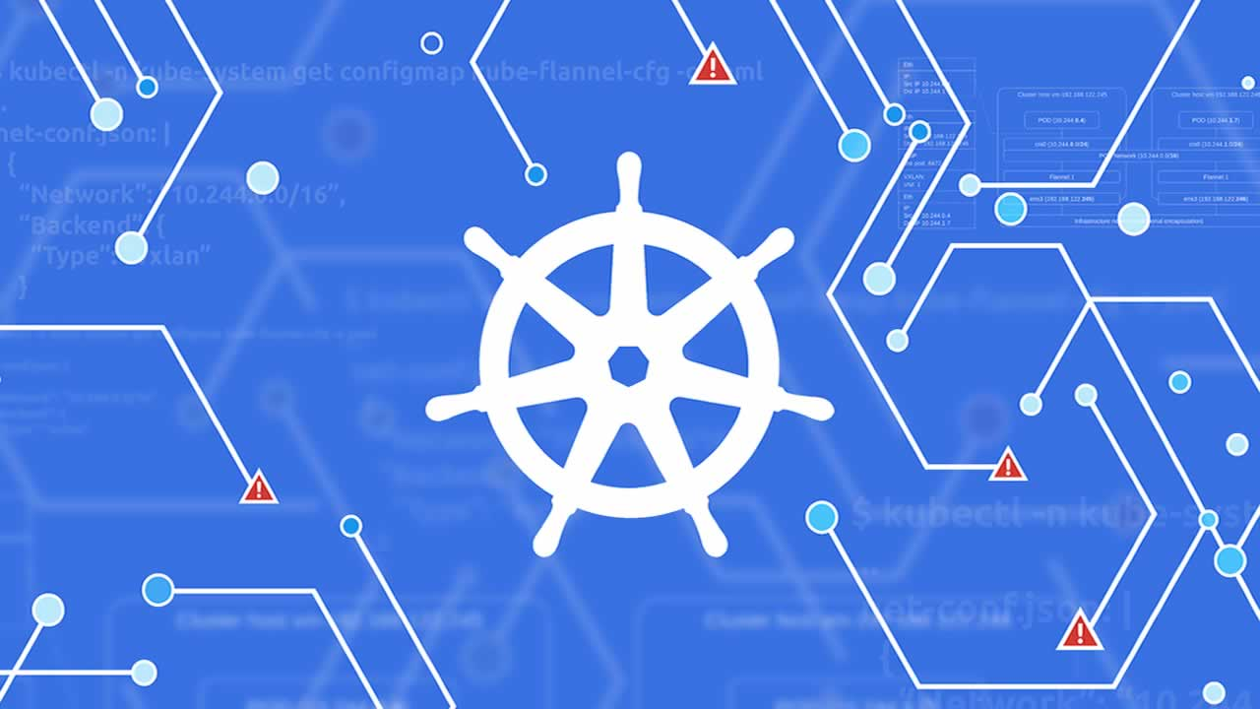
What is Kubernetes?

Slide 4
Why Kubernetes is needed?

Slide 5
Features of Kubernetes
Automatic Binpacking
Service Discovery & Load Balancing
Storage Orchestration
Self Healing
Secrets and Configuration Management
Batch Execution
Horizontal Autoscaling
Automatic Rollbacks and Rollouts

Slide 6
Components of Kubernetes

Slide 7
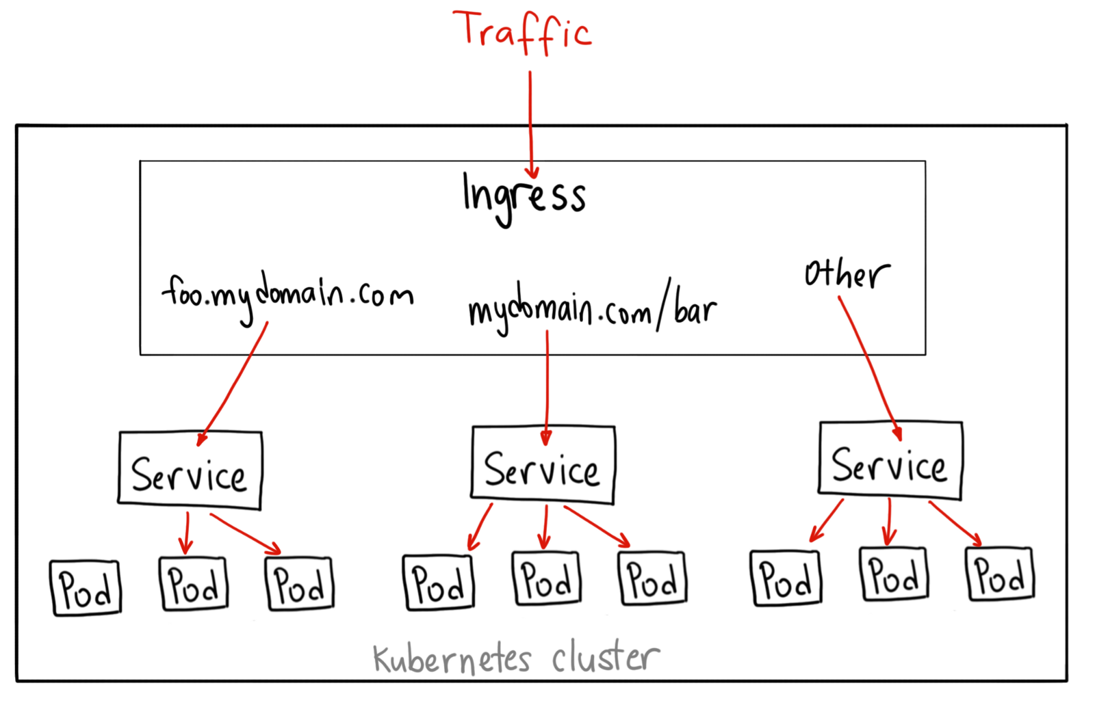
Traffic workflow on Kubernetes

Slide 8
References
https://www.digitalocean.com/community/tutorials/an-introduction-to-kubernetes
https://kubernetes.io/docs/concepts/overview/components/
https://www.redhat.com/en/topics/containers/kubernetes-architecture
https://www.youtube.com/watch?v=ISUmszlMQPU
https://cloud.google.com/kubernetes-engine/docs/concepts/network-overview
Demo
https://github.com/PavanMakadia/Kubernetes

Slide 9


Slide 10

THANK YOU

