Slide 1


DevOps

Slide 2
What is CI/CD?
Differnece between CI and CD
Benefits of a Streamlined CI/CD Pipeline
CI/CD Tools and Platforms
Demo
Questions
1
2
3
Agenda
4
5
6

Slide 3

What is CI/CD?

Slide 4
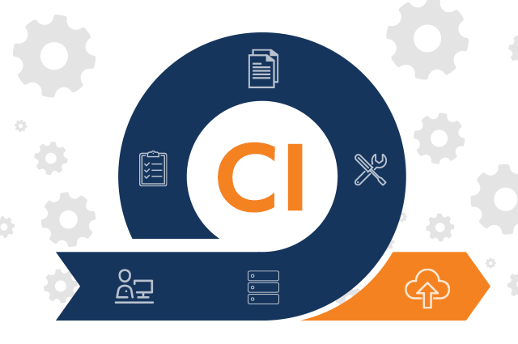
Differnece between CI and CD
The "CI" in CI/CD always refers to continuous integration, which is an automation process for developers
Successful CI means new code changes to an app are regularly built, tested, and merged to a shared repository
Continuous integration (CI) enables software development teams and workflows.

Slide 5
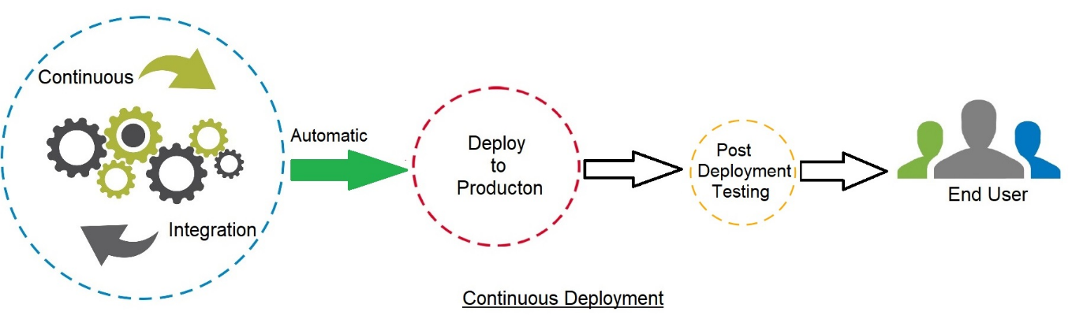
Differnece between CI and CD
Continuous Delivery is an extension of CI since it enables automation to deploy all the code changes to an environment (dev, qa, stage, prod, etc) after the changes have been merged.

Slide 6
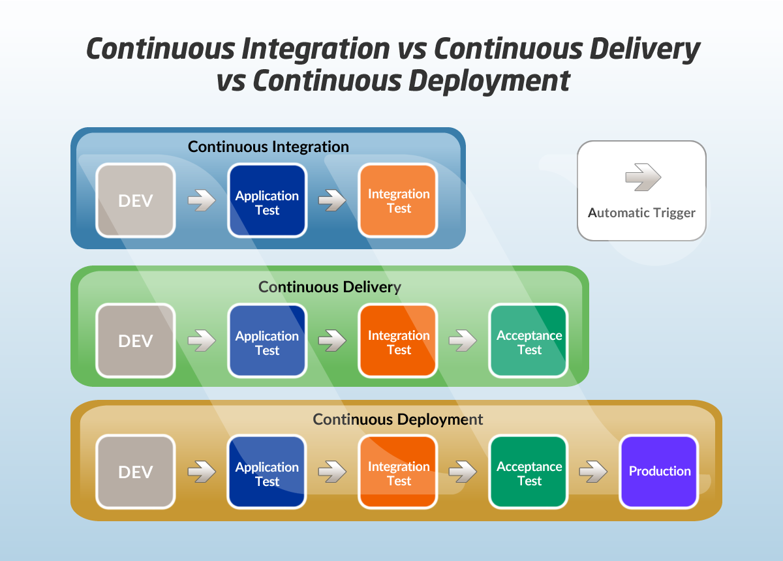
Continuous Delivery and Continuous Deployment

Slide 7
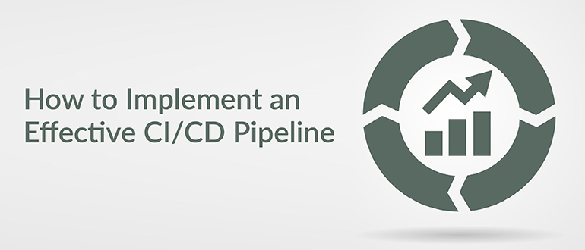
Benefits of a Streamlined CI/CD Pipeline
Fault Isolation
Faster Release Rates
Faster Mean Time To Resolution
Improved Test Reliability
Smaller Code Changes

Slide 8

CI/CD Tools and Platforms
Gitlab
Azure Pipelines
Jenkins
Circle CI
TeamCity
Bamboo
AWS Codepipelines
...

Slide 9
Demo

Slide 10
References
https://codete.com/blog/streamlining-your-coding-process-and-releasing-error-free-software-more-quickly
https://cprimestudios.com/blog/top-cicd-tools-2021-most-complete-guide-33-best-picks-devops
https://www.atlassian.com/continuous-delivery/principles/continuous-integration-vs-delivery-vs-deployment

Slide 11


Slide 12

THANK YOU

