Slide 1
Secure Data Hiding in image using Steganography
CAPSTONE PROJECT
Presented By:
Student Name : Pavan Manikumar Pinisetti
College Name & Department : Swarnandhra College of Engineering and Technology (CSE)

Slide 2
OUTLINE
Problem Statement
Technology used
Wow factor
End users
Result
Conclusion
Git-hub Link
Future scope

Slide 3
Problem Statement
Design a Python Application for Secure Image Steganography
Sensitive Information: How do we securely transmit messages without drawing attention?
Digital Vulnerability: Traditional communication methods are easily intercepted.
Need for Concealment: There's a growing demand for discreet data exchange.

Slide 4
Technology used
Programming Language: Python
Libraries: OpenCV
Operating System: Windows 10
Operating System Interaction: OS module
Coding Platform: Visual Studio Code

Slide 5
Wow factors
Hidden Communication: Python enables concealing data within images, offering invisible information transfer.
Enhanced Security: Steganography provides a layer of privacy by hiding the very existence of a message.
Creative Potential: From subtle watermarks to hidden art, Python unlocks diverse steganographic applications.
Technical Power: Python's libraries facilitate sophisticated techniques, making robust data hiding possible.

Slide 6
End users
Security-Conscious Individuals: Users seeking private communication channels to protect sensitive information.
Digital Artists & Content Creators: For embedding hidden watermarks, copyright information, or secret messages in their work.
Cybersecurity Professionals & Researchers: Analysing and developing steganography/steganalysis tools for digital forensics and security testing.
Educators & Students: Exploring image processing, security concepts, and data manipulation through practical Python projects.

Slide 7
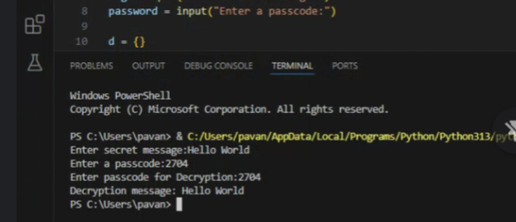
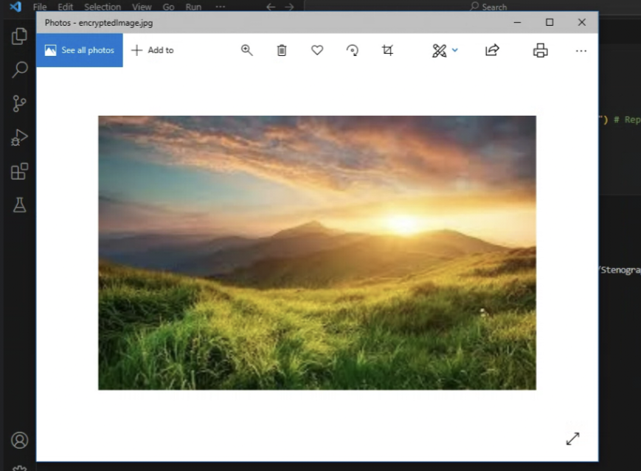
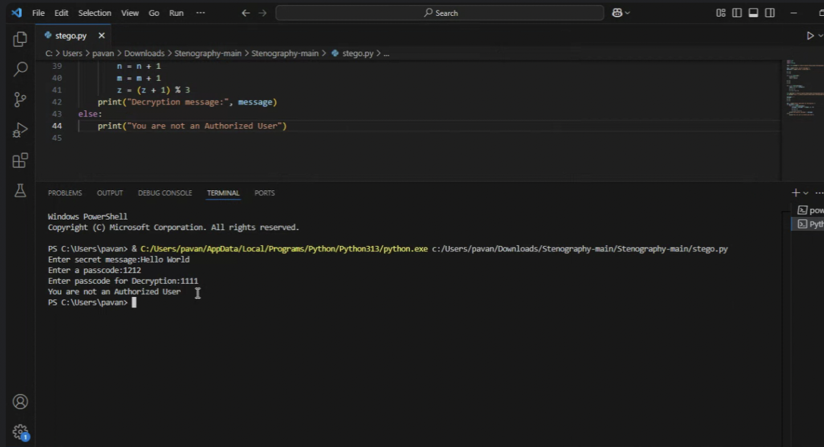
Results
Encryption and Decryption with Correct Passcode
Output Encrypted Image
Encryption and Decryption with Incorrect Passcode

Slide 8
Conclusion
Python-based image steganography offers a powerful blend of security and creativity. It caters to diverse users, from those seeking private communication to artists embedding hidden messages. Its versatility extends to cybersecurity research and educational exploration. As digital landscapes evolve, Python's steganographic capabilities remain a valuable tool for secure and innovative applications.

Slide 9
GitHub Link
Link: https://github.com/PavanManikumarPinisetti/Steganography-Python

Slide 10
Future scope(optional)
AI-Powered Steganography and Steganalysis: Deep learning models will enhance both hiding and detection. AI can optimize embedding for imperceptibility and create robust steganalysis tools.
Integration with Emerging Technologies: Steganography will find applications in IoT, blockchain, and augmented reality, embedding data within digital assets and sensor data.
Adaptive and Dynamic Steganography: Systems will dynamically adjust embedding based on image content, network conditions, and potential threats, improving robustness and security.

Slide 11
THANK YOU

