Slide 2
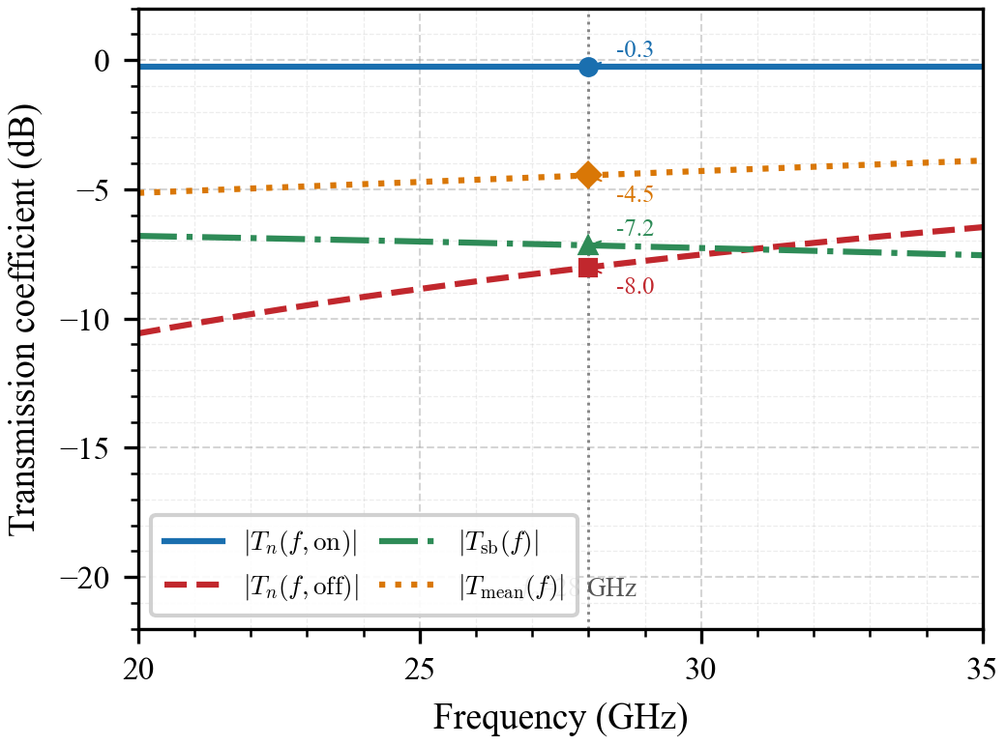

Slide 3
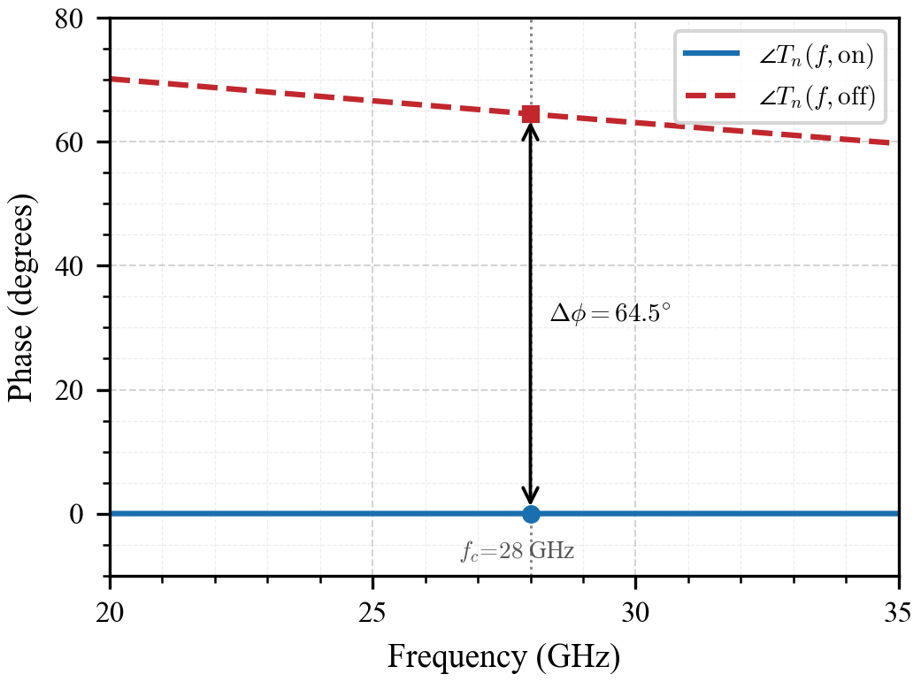

Slide 4
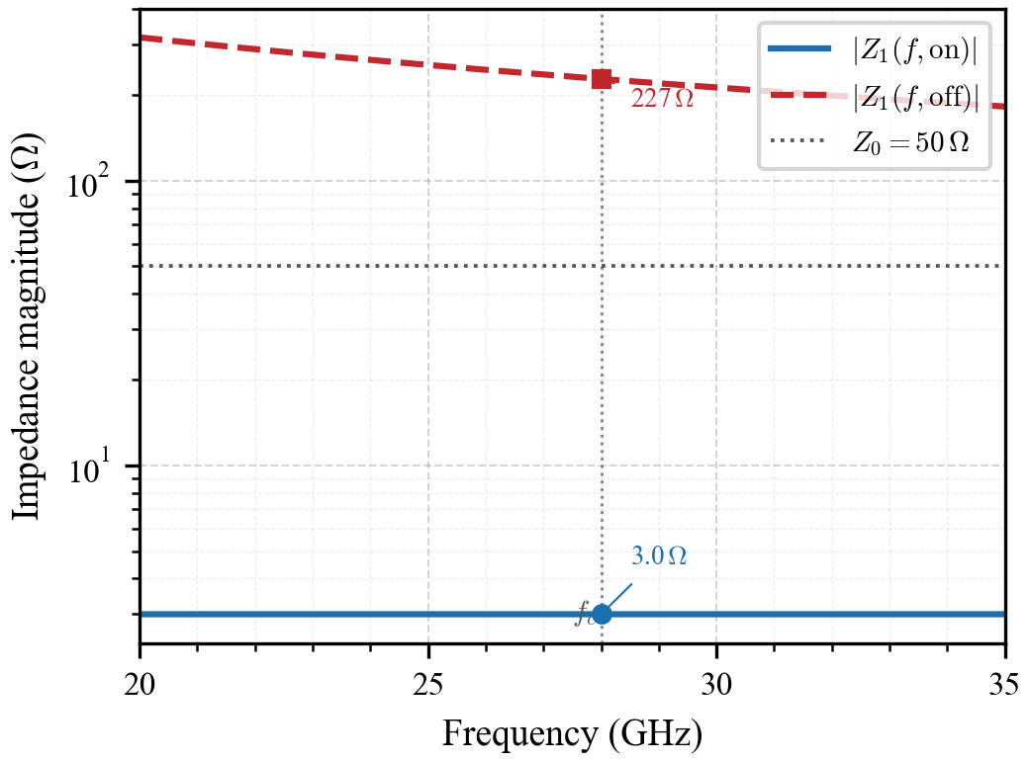

Slide 5
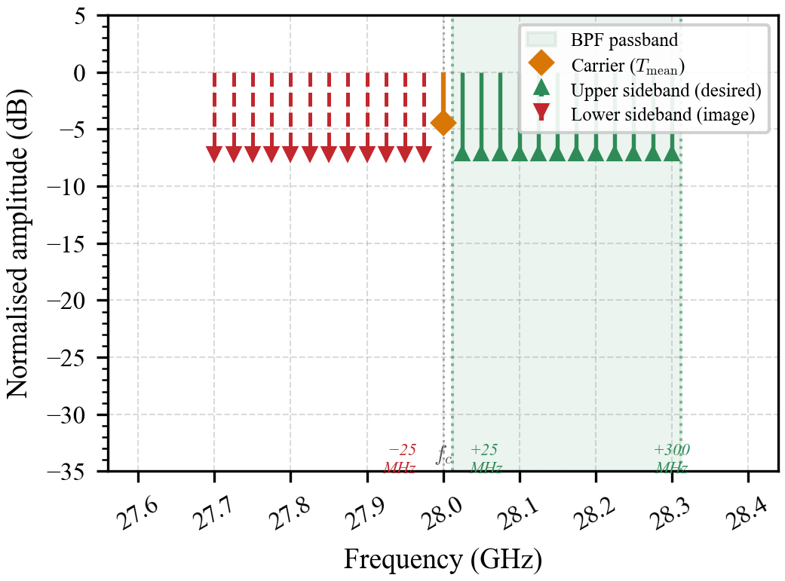

Slide 6
Next Tasks
Finish setting-up Reflective RIS (R-RIS) and the receiver
Check their functionality

Slide 7
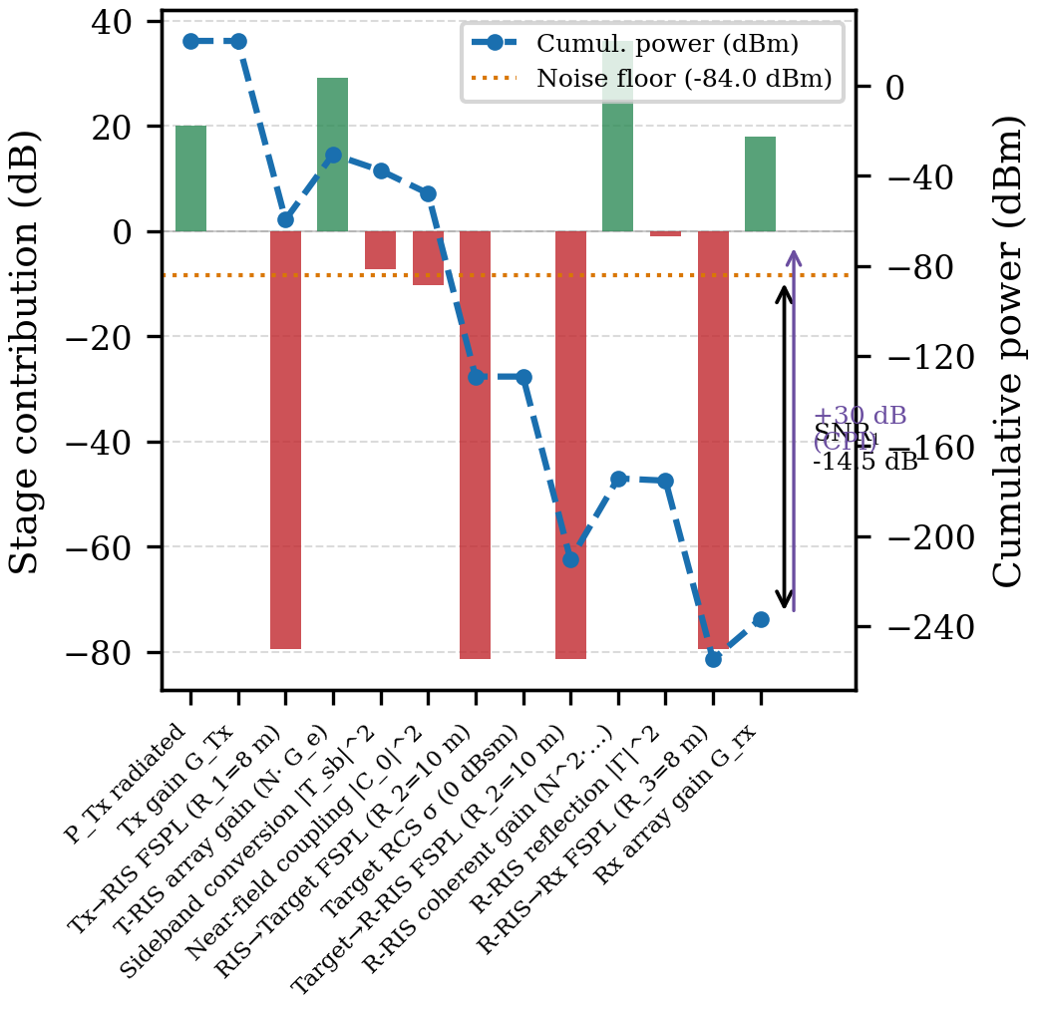

Slide 8
