Slide 1
Contents
a. Title Slide b. Synopsis c. Introduction d. Overall Explanation with Design Diagram e. Dataset Description f. Implementation Tools/Software g. Output h. Conclusion i. Future Enhancement j. Outcome k. References

Slide 2
Plant diseases are one of the major factors affecting agricultural productivity and crop quality. Early detection of these diseases is essential to prevent large-scale damage and ensure better yield. However, traditional methods rely on manual inspection by experts, which is time-consuming, inconsistent, and not suitable for large-scale . To address this problem, this project proposes an automated plant leaf disease detection system using a hybrid deep learning approach. The model combines EfficientNetV2-S, which is effective in extracting detailed local features such as textures and disease patterns, with MobileViTv2, which captures global contextual relationships using attention mechanisms. A gated feature fusion technique is used to integrate these features, improving the model’s ability to accurately classify different plant diseases. The system is trained and evaluated on Apple and Grape leaf datasets with proper preprocessing and data augmentation techniques to improve robustness and generalization. The proposed model achieves high accuracy of up to 96.67%, along with strong performance across precision and recall metrics. Additionally, Grad-CAM visualization is used to interpret the model’s predictions by highlighting disease-affected regions. Overall, the proposed system provides an efficient, reliable, and scalable solution for automated plant disease detection, making it suitable for real-world agricultural applications.
Synopsis

Slide 3
Introduction
Agriculture plays a crucial role in sustaining global food production and supporting rural livelihoods.
A significant portion of the population depends on agriculture for income and survival.
Plant diseases are a major factor affecting crop growth, yield, and overall food quality.
Leaf-based diseases often appear at early stages and act as key indicators of plant health conditions.
If diseases are not detected at the right time, they can spread rapidly and cause severe crop damage.
Delayed or inaccurate diagnosis leads to reduced productivity and economic losses for farmers.
Therefore, early, accurate, and reliable disease detection is essential to improve crop yield and ensure food security.

Slide 4
System Design
The proposed system uses a hybrid deep learning model combining EfficientNetV2-S and MobileViTv2 for plant disease detection.
It takes plant leaf images as input under different environmental conditions such as lighting and background variations.
Image preprocessing and data augmentation are applied to improve robustness and model generalization.
EfficientNetV2-S is used to extract detailed local features such as textures, spots, and color variations.
MobileViTv2 captures global contextual information using attention mechanisms.
A gated feature fusion mechanism combines features from both models to enhance classification performance.
The system performs multi-class classification to identify different plant diseases.
The final output includes predicted disease class along with confidence score for better decision-making.

Slide 5
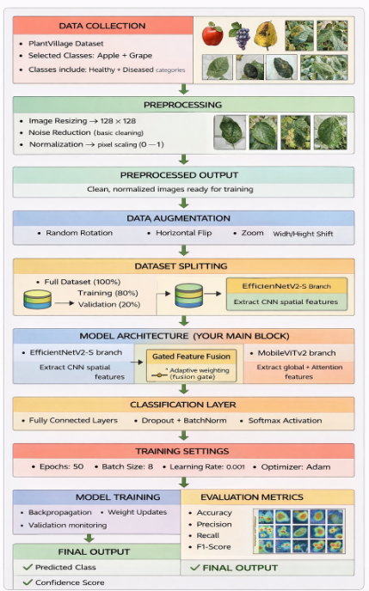
Design Diagram

Slide 6
Modules List and Detailed Explanation
Image Input, Preprocessing & Data Handling Module
Image Input Module
The system accepts plant leaf images from Apple and Grape datasets stored in Google Drive.
Supports multi-class classification with automatic label generation.
Ensures reproducibility by using fixed random seed values.
Data Preprocessing Module
Images are resized to 128 × 128 pixels to reduce computational complexity.
Pixel values are normalized using rescaling (1/255) for stable training.
Dataset is split into training (80%) and validation (20%) sets.
Efficient Data Loading
Uses batch-based loading through ImageDataGenerator.
Shuffling is applied during training to improve generalization performance.

Slide 7
2. Data Augmentation & Training Optimization Module
Data Augmentation Module
Rotation is applied to simulate different viewing angles.
Width and height shifting introduce positional variations.
Shearing helps simulate geometric distortions.
Zooming captures variations in leaf size.
Horizontal and vertical flipping increase dataset diversity.
Brightness variation helps handle different lighting conditions.
Training Optimization Module
Mixed precision training (mixed_float16) is used to reduce memory usage and speed up computation.
Early stopping is applied to prevent overfitting by monitoring validation loss.
Learning rate is dynamically adjusted using ReduceLROnPlateau.
ModelCheckpoint is used to save the best-performing model during training.

Slide 8
3. Feature Extraction & Hybrid Model Architecture Module
CNN Feature Extraction (EfficientNetV2-S)
EfficientNetV2-S is used as the backbone with pretrained ImageNet weights.
Lower layers are frozen to retain learned features.
Extracts fine-grained features such as leaf textures, spots, and disease patterns.
Transformer-Based Feature Extraction (MobileViTv2)
MobileViTv2 block combines convolution and attention mechanisms.
Uses Multi-Head Self-Attention for capturing global dependencies.
Helps understand relationships across different regions of the leaf.
Feature Fusion Module
Features from both branches are globally pooled.
Projected into a common feature space.
Combined using gated feature fusion to improve discrimination capability.

Slide 9
4. Classification, Evaluation & Result Visualization Module
Disease Classification Module
Fused features pass through dense layers.
Uses Swish activation for better learning performance.
Batch normalization improves stability.
Dropout is applied to reduce overfitting.
Final softmax layer outputs class probabilities.
Performance Evaluation Module
Model is evaluated using:
Accuracy
Precision
Recall
F1-score
Confusion matrix provides detailed class-wise performance.
Classification report gives complete evaluation metrics.
Result Visualization & Inference Module
Training curves (accuracy, loss, precision, recall) are plotted.
Random test images are predicted with confidence scores.
Grad-CAM visualization highlights important regions influencing predictions.
Final trained model is saved for future deployment.

Slide 10
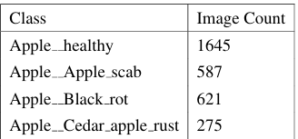
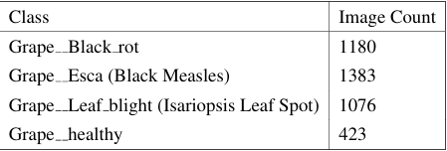
DataSet Description
The dataset used in this project consists of plant leaf images belonging to Apple and Grape crops, covering both healthy and diseased classes. The dataset is collected from publicly available sources such as PlantVillage and organized into multiple categories based on disease type.
Each image represents a single leaf captured under controlled or natural environmental conditions. The dataset includes variations in lighting, background, orientation, and disease severity, which helps the model learn robust and generalized features.
The dataset is divided into training and validation sets using an 80:20 split. The training set is used to train the model, while the validation set is used to evaluate its performance during training.

Slide 11
Implementation Tools/Software
1) Programming Language
i) Python
Used to develop and implement the entire model .Easy to use and supports many AI and deep learning libraries
2) Deep Learning Framework
i) TensorFlow
Used to build and train the deep learning model
Works efficiently on both CPU and GPU
ii) Keras (TensorFlow API)
Used to design the model easily
Helps in faster model building, training, and testing
3) Libraries Used
i) NumPy : Used for mathematical calculations and handling data
ii) OpenCV : Used for image processing like resizing and preprocessing
iii) Matplotlib : Used to plot graphs such as accuracy and loss
iv) Seaborn : Used to display confusion matrix clearly
v) Scikit-learn : Used to calculate performance metrics like precision, recall, and F1-score

Slide 12
4) Development Environment i) Jupyter Notebook and Google Colab Used for writing and testing code step by step ii) VS Code Used for coding and managing the project 5) Hardware Requirements i) CPU Used for running and training the model ii) GPU Speeds up training and reduces time 6) Techniques Used i) Transfer Learning Uses pretrained EfficientNetV2-S to improve accuracy ii) Mixed Precision Training Reduces memory usage and speeds up training iii) Early Stopping Stops training when performance stops improving iv) Learning Rate Scheduling Adjusts learning rate automatically during training

Slide 13
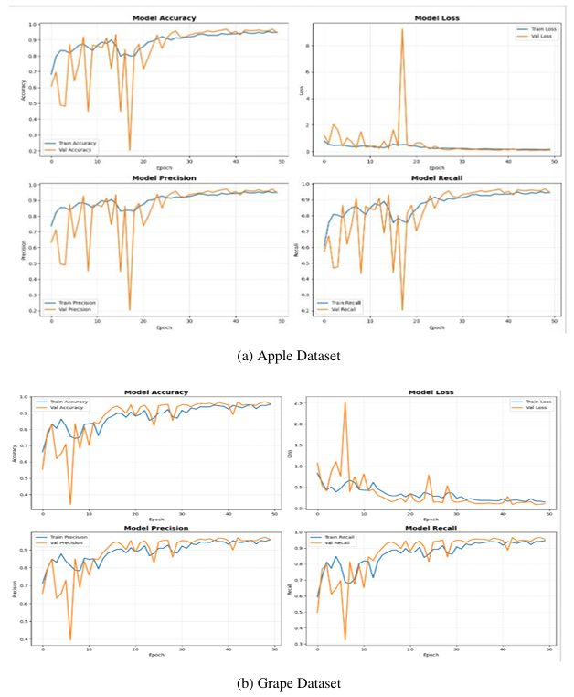
Training Graphs:
Output

Slide 14
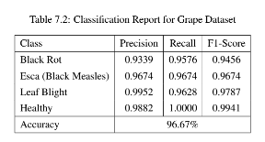
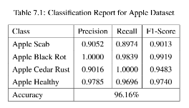
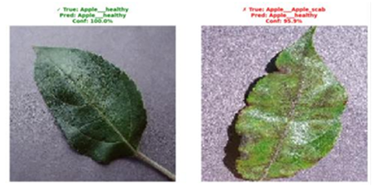
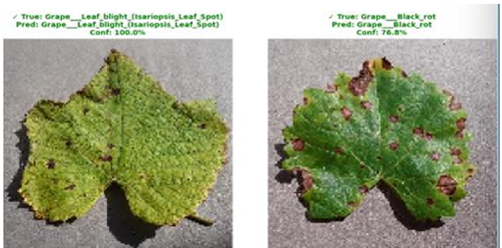
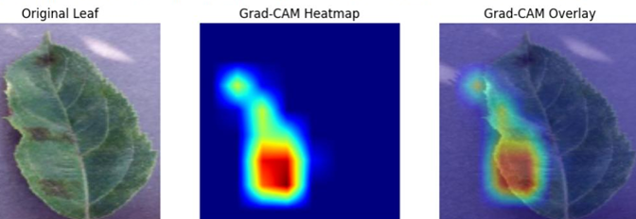
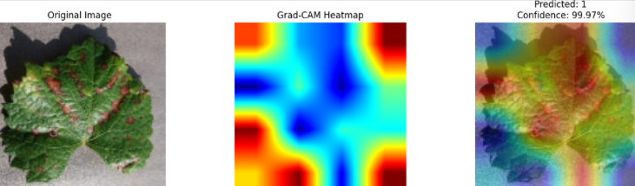

Slide 15
Conclusion
The proposed system successfully demonstrates an effective approach for automatic plant leaf disease detection using a hybrid deep learning model. By combining EfficientNetV2-S and MobileViTv2, the model is able to capture both detailed local features and global contextual information from leaf images. This combination improves the model’s ability to accurately distinguish between healthy and diseased leaves.
The use of preprocessing techniques such as image resizing, normalization, and data augmentation helps in improving the robustness of the model and reducing overfitting. The training process is further optimized using techniques like mixed precision training, early stopping, and learning rate adjustment, which contribute to stable and efficient model performance.

Slide 16
Future Enhancement
Although the proposed system performs well, there are several areas where it can be further improved and extended.
The current model is trained only on Apple and Grape datasets. In the future, the system can be expanded to include more crops such as tomato, potato, and maize to make it more general and widely applicable.
The system can be developed into a mobile or web-based application, allowing farmers to capture leaf images in real time and get instant disease predictions directly in the field.
Real-time disease detection can be integrated using camera-based systems, enabling continuous monitoring of crops without manual effort.
The dataset can be enhanced with more diverse and real-world images, including variations in lighting, background, and environmental conditions, to improve model generalization.
Advanced techniques such as self-supervised learning or lightweight models can be explored to reduce computational cost and make the system more efficient for low-resource devices.
Integration with IoT-based smart agriculture systems can further improve decision-making by combining disease detection with environmental data such as temperature and humidity.
Overall, these improvements can make the system more practical, scalable, and suitable for real-world deployment in modern agriculture.

Slide 17
References
1.Sunil CK, Jaidhar CD, Patil N (2021) Cardamom plant disease detection approach using Efficient NetV2. IEEE Access 10:789–804
2. Shovon MSH, Mozumder SJ, Pal OK, Mridha MF, Asai N, Shin J (2023) PlantDet: a robust multi-model ensemble method based on deep learning for plant disease detection. IEEE Access 11:34846–34859
3. Hosny MK, El-Hady WM, Samy FM, Vrochidou E, Papakostas GA (2023) Multi-class classification of plant leaf diseases using feature fusion of deep convolutional neural network and local binary pattern. IEEE Access 11:62307–62317
4. Jiang P, Chen Y, Liu B, He D, Liang C (2019) Real-time detection of apple leaf diseases using deep learning approach based on improved convolutional neural networks. IEEE Access 7:59069–59080
5. Annabel LSP, Annapoorani T, Deepalakshmi P (2019) Machine learning for plant leaf disease detection and classification–a review. In: 2019 International conference on communication and signal processing (ICCSP), IEEE, pp 0538–0542
6. Amin H, Darwish A, Hassanien AE, Soliman M (2022) End-to-end deep learning model for corn leaf disease classification. IEEE Access 10:31103–31115

Slide 18
7. Sajid M, Ali N, Dar SH, Ratyal NI, Butt AR, Zafar B, Shafique T, Baig MJA, Riaz I, Baig S (2018) Research article data augmentation-assisted makeup-invariant face recognition. Math Probl Eng 2018:1–10 8. Xiao Z, Shi Y, Zhu G, Xiong J, Wu J (2023) Leaf disease detection based on lightweight deep residual network and attention mechanism. IEEE Access 11:48248–48258 9. Sharma P, Berwal YPS, Ghai W (2020) Performance analysis of deep learning CNN models for disease detection in plants using image segmentation. Inf Process Agric 7(4):566–574 10. Masood M, Nawaz M, Nazir T, Javed A, Alkanhel R, Elmannai H, Dhahbi S, Bourouis S (2023) Mai zeNet: a deep learning approach for effective recognition of maize plant leaf diseases. IEEE Access 11:52862–52876 11. Vishnoi VK, Kumar K, Kumar B, Mohan S, Khan AA (2022) Detection of apple plant diseases using leaf images through convolutional neural network. IEEE Access 11:6594–6609. 12. V. Singh and A. K. Misra, “Detection of plant leaf diseases using image segmentation and soft computing techniques,” Inf. Process. Agricult., vol. 4, pp. 41–49, Mar. 2017. 13. M. H. Saleem, S. Khanchi, J. Potgieter, and K. M. Arif, “Image-based plant disease identification by deep learning meta-architectures,” Plants, vol. 9, no. 11, p. 1451, Oct. 2020.

Slide 19
14. J. Hang, D. Zhang, P. Chen, J. Zhang, and B. Wang, “Classification of plant leaf diseases based on improved convolutional neural network,” Sensors, vol. 19, no. 19, p. 4161, Sep. 2019. 15. D. Morris, “A pyramid CNN for dense-leaves segmentation,” in Proc. 15th Conf. Comput. Robot Vis. (CRV), May 2018, pp. 238–245. 16. S. P. Mohanty, D. P. Hughes, and M. Salathé, “Using deep learning for image-based plant disease detection,” Frontiers Plant Sci., vol. 7, p. 1419, Sep. 2016. [Online]. 17. Ü. Atila, M. Uçar, K. Akyol, and E. Uçar, “Plant leaf disease classification using efficientnet deep learning model,” Ecol. Informat., vol. 61, Mar. 2021, Art. no. 101182. 18. C. Sarkar, D. Gupta, U. Gupta, and B. B. Hazarika, “Leaf disease detection using machine learning and deep learning: Review and challenges,” Appl. Soft Comput., vol. 145, Sep. 2023, Art. no. 110534. 19. W. B. Demilie, “Plant disease detection and classification techniques: A comparative study of the performances,” J. Big Data, vol. 11, no. 1, p. 5, Jan. 2024. 20. P. Bansal, R. Kumar, S. Kumar, “Disease detection in apple leaves using deep convolutional neural network,” Agriculture, 11 ( 7 ), 617–2021. Apple & grape dataset https://github.com/digitalepidemiologylab/plantvillage_deeplearning_paper_dataset

