Slide 1
Biometric Security System Using C++
Designed with the intention to reduce Identity Fraud.

Slide 2
Aim of this Project
As the title suggests, this Project aims to use Smart Security Features like Facial Detection/Recognition for Register/Login pages to reduce the risk of Information Fraud/Identity Fraud caused by Hacking.
Team Leader: | Pavan Sastry NVSS
Used Programming Concepts: | Intermediate-Advanced C++ (Functions , I/O Streams etc) , Basic CV(Computer Vision) Concepts using C++.
Programming languages: | C++.
Unique Feauture | Used Facial Detection .
Can be Used by : | This project can be used in versatile industries, including but not limited to : Employee Administration , Student Attendance , Banking sector etc.
Can be improved: | This project is still in infancy, it can be improved by adding more sophisticated features like iris detection ,Speech Recognition.

Slide 3
Table of contents
01
02
03
Theme
Problem Statement
Advantages
04
05
06
Limitations
Gui
Conclusions
Artifical Intelligence and Cyber-Security.
Biometric Identification to tackle Information theft.
Strengthened Security, Increased Efficiency etc.
Limitations of technologies used in this project
Used C++ and Computer Vision Libraries.
Conclusion reached by making inferences during the project

Slide 4
THEME
01

Slide 5
A.I & Cyber-Security

Slide 6
Why AI & Cyber-Security?
Why AI?
Why Cyber-Security?
AI is the fastest growing and most vastly used field of CSE.
As Technology grows ,our control over it must also grow.

Slide 7
—Bruce Schneier
“Amateurs hack systems,
Professionals hack people.”

Slide 8
Problem Statement & Solution
02

Slide 9
Situation & problems statement
1
2
3
Current situation
Employee
Finance
Private
Presently,most of the authentication in digital world is done by username and password , if details are lost ,we can rely on our mail,but what if that was also hacked?
Problems

Slide 10
Solution
Biometric Identification
Examples
Facial Recognition
Biometric Identifiers are those which use a distinguishable ,physiological or behavioural attribute of the user authentication , in other words who you are.
Most Comon Biometric Identifiers are : Facial Recognition , Fingerprint Recognition , Palm Recognition , Iris Scanning etc.
It is a technology capable of matching human face from a digital image or a video frame against a database of faces.

Slide 11
Advantages of Facial Recognition and C++
03

Slide 12
Advantages of Facial Recognition
Protects businesses against theft.
Strengthens security measures in banks and airports.
Makes shopping more efficient.
Helps find missing people and identify prepetrators.

Slide 13
Advantages of C++
Portability
Low-Level Manipulation
Large Community support
Scalability.
Extremely Fast.

Slide 14
Limitations of Facial Recognition
04

Slide 15
Limitations
High Requirement on device
Privacy
As we are dealing with biometric identifiers,it is highly dependant on hardware
As we are dealing with facial recognition,privacy concerns are expected
Storage of Data
Technology not mature yet
Storage of the data can be problomatic .
Most importantly , Technlogy is not matured yet , some small vulnerability still exist.

Slide 16
05
GUI of Project

Slide 17
GUI
Login
User Logs in by using username,password and finally facial detection.
Register
User creates an account; facewill be registered and saved in the database.
Menu
Forgot Credentials
If user has forgotten any of his credentials , he can retrieve them.
Exit
Exits the Program.

Slide 18
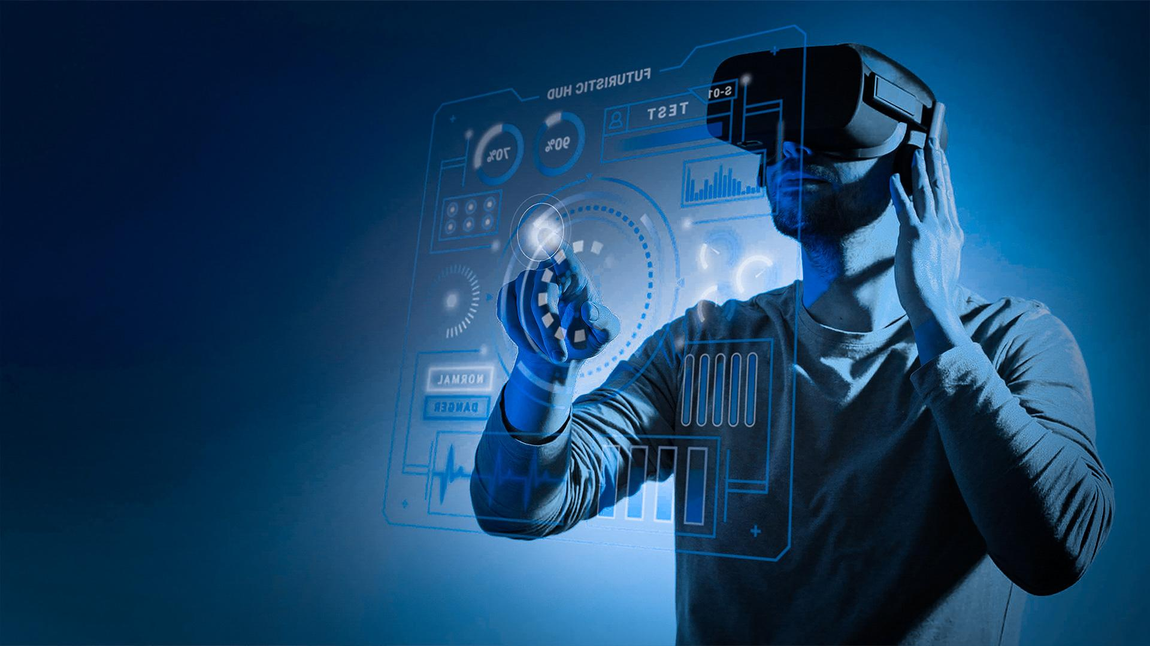

The Great Growling Engine of Change-Technology

Slide 19
Conclusion
06

Slide 20
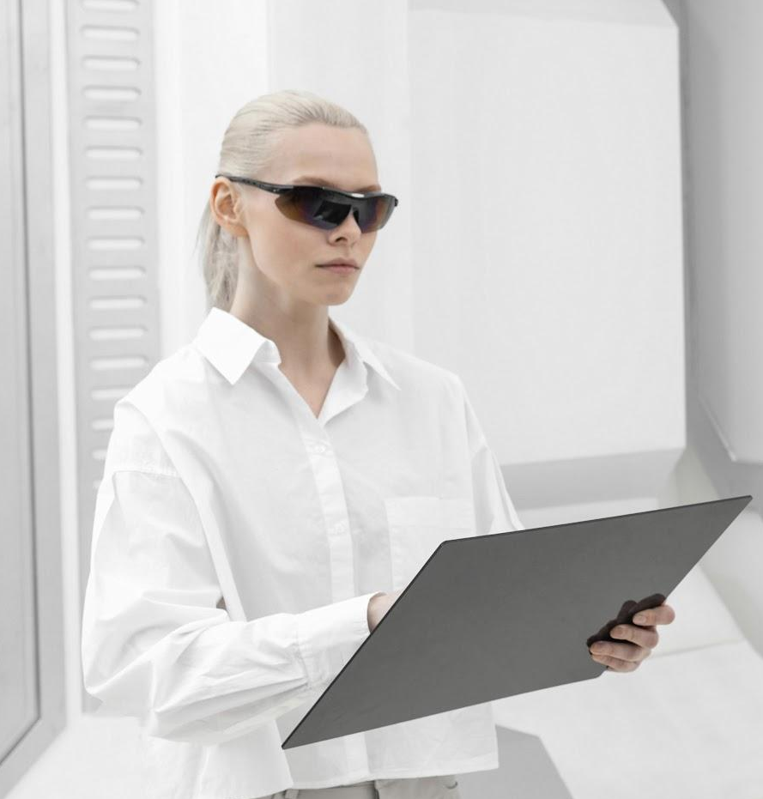
Conclusion
Although this field is not matured, it also proves as an opportunity to think out of the box.
C++ is an important skill used in almost all domains.
We can combine multiple branches of Computer Science to bring our Ideas to life.
Facial Recognition is not the limit.
Technology is always evolving , and so are we.

Slide 21
Thanks!
Do you have any questions?
subrahmanyasastry_n@srmap.edu.in
Stoic Coders

Slide 22
Reference
YouTube
Google
Slidesgo

