Slide 1
Analysis of Superstore
Superstore analysis : Sales, Profits, Regions, Products and shipping Insights
By Pavan Sastry NVSS

Slide 2

Internship Profile
Name:
Pavan Sastry NVSS
E-Mail:
Pavan3457.us@gmail.com
University:
SRM University , AP
Domain:
Data Analytics
Start Date:
12-06-2023
End Date:
24-07-2023
By Pavan Sastry NVSS

Slide 3
Menu of Contents:
-Introduction
-Data Exploration
-Data Visualizations
-Conclusion
By Pavan Sastry NVSS

Slide 4
01.
Introduction
Exploring Superstore data for insights using pandas and seaborn
By Pavan Sastry NVSS

Slide 5
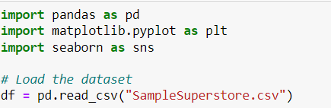
In this analysis , the Python libraries pandas , matplotlib and seaborn have been imported to manipulate and visualize data. The Dataset has been successfully loaded into a Data frame variable named “df” for further exploration.
By Pavan Sastry NVSS

Slide 6
02.
Data Exploration
Understanding Superstore Insights with usage of methods like “info” and “describe”
By Pavan Sastry NVSS

Slide 7
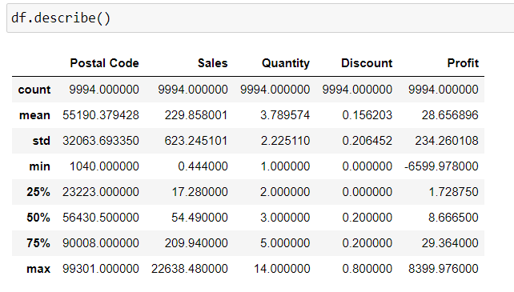
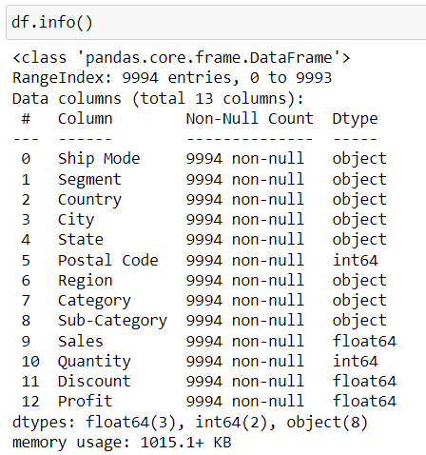
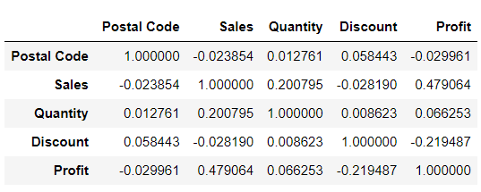
By Pavan Sastry NVSS

Slide 8
03.
Data Visualizations
Visualizing Superstore Data: Gaining Insights with Seaborn and Matplotlib.
By Pavan Sastry NVSS

Slide 9
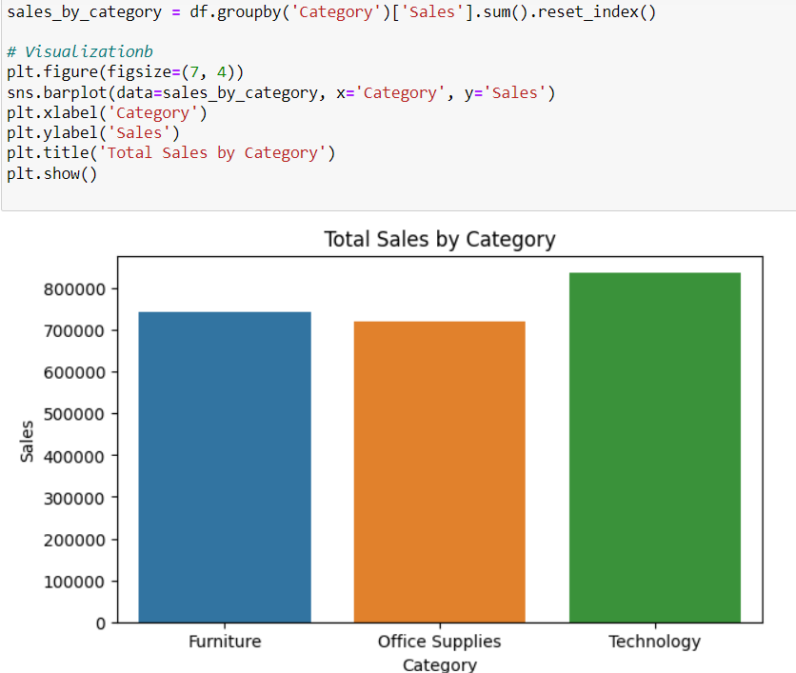
Visualizations
Technology category has the highest total sales
By Pavan Sastry NVSS

Slide 10
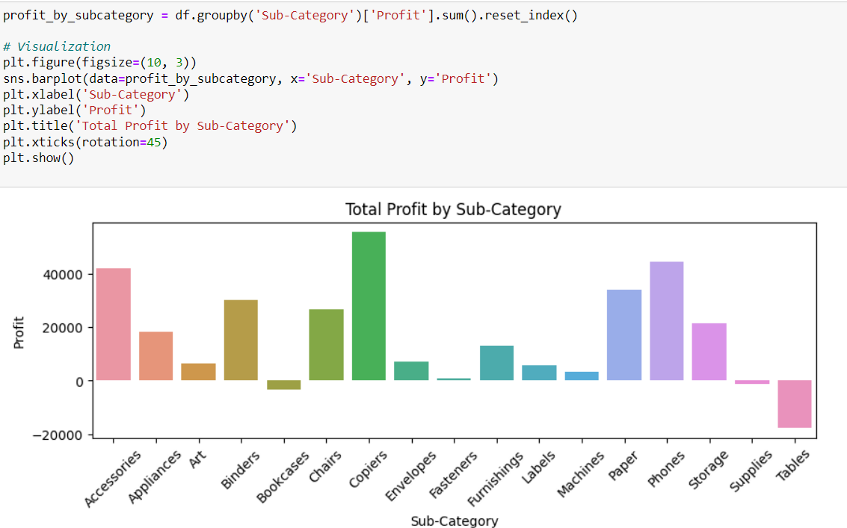
Visualizations
Copiers and Phones are the most profitable sub categories
By Pavan Sastry NVSS

Slide 11
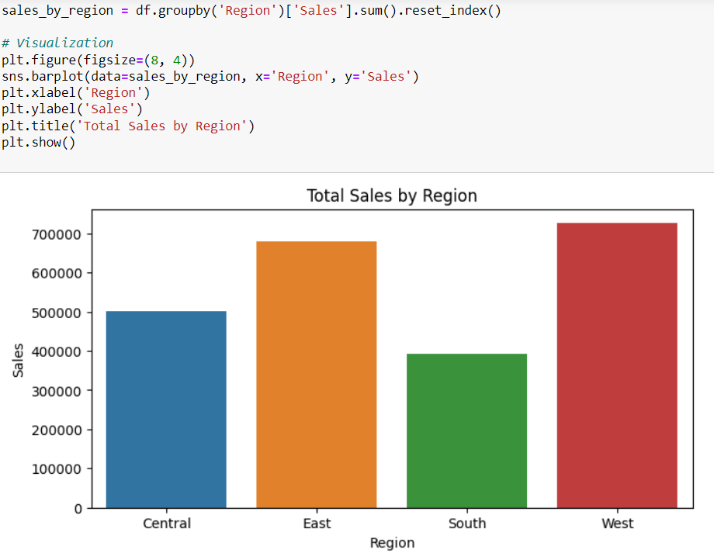
Visualizations
West Region has the highest sales
By Pavan Sastry NVSS

Slide 12
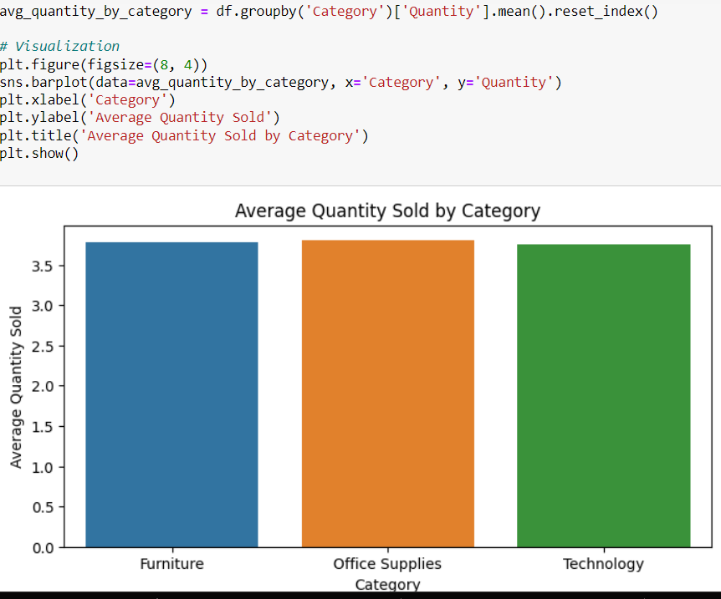
Visualizations
Looks like quantity sold is same in all categories
By Pavan Sastry NVSS

Slide 13
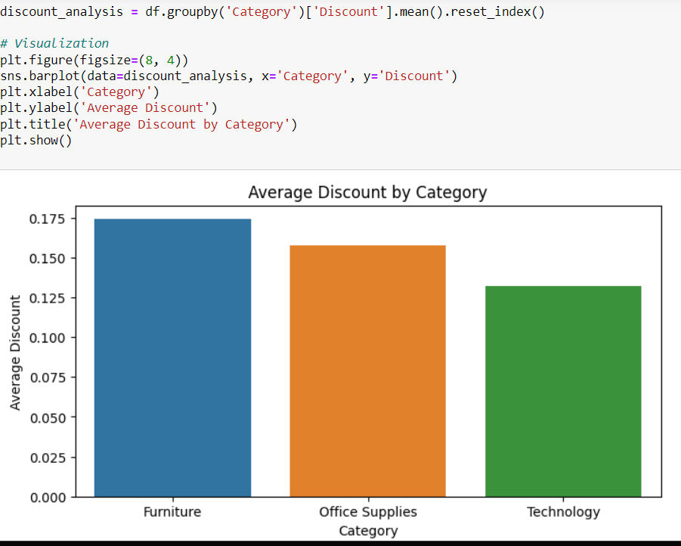
Visualizations
Furniture Category has the highest average Discount
By Pavan Sastry NVSS

Slide 14
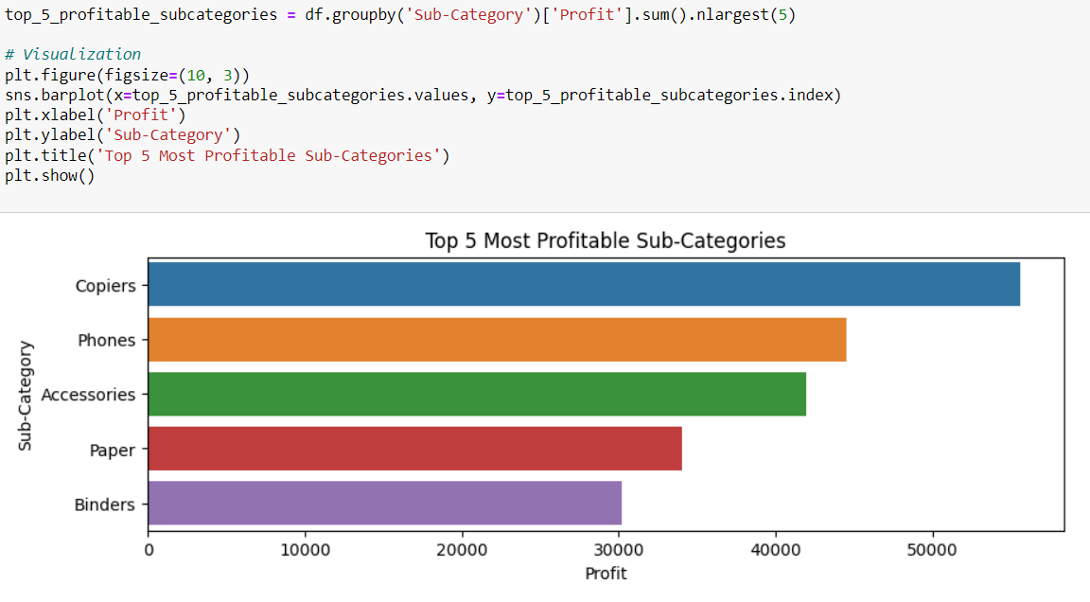
Visualizations
Copiers,Phones are the most profitable
By Pavan Sastry NVSS

Slide 15
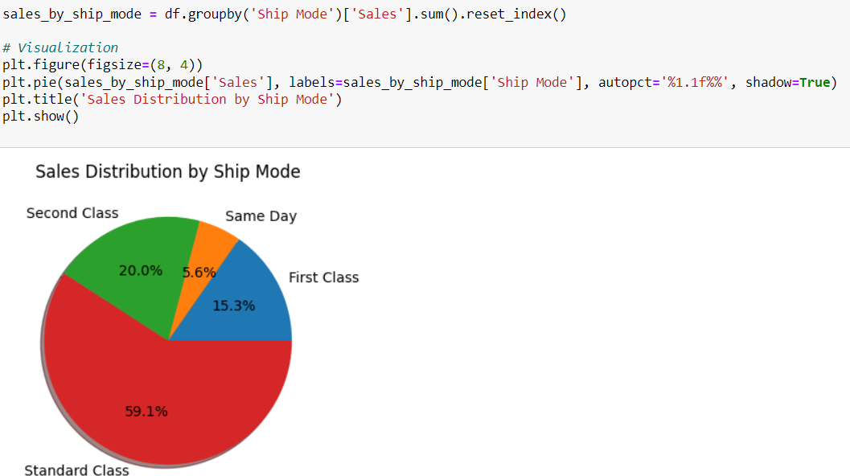
Visualizations
Most Sales are from Standard Class
By Pavan Sastry NVSS

Slide 16
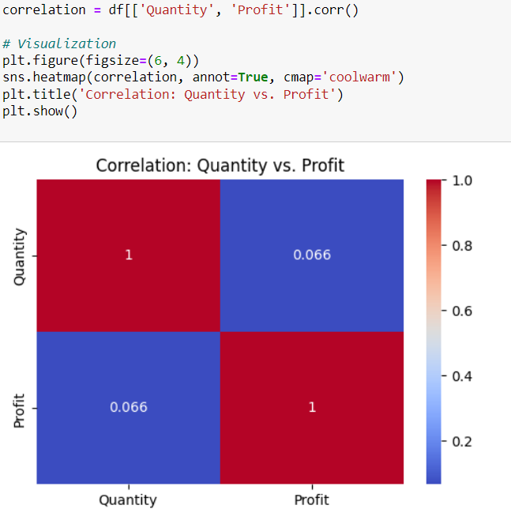
Visualizations
There is weak positive correlation between quantity and profit
By Pavan Sastry NVSS

Slide 17
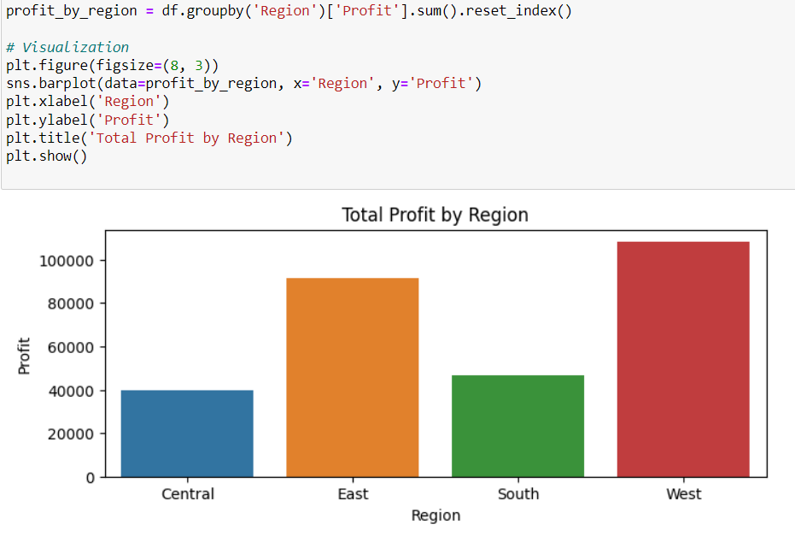
Visualizations
West Region has the highest total profit
By Pavan Sastry NVSS

Slide 18
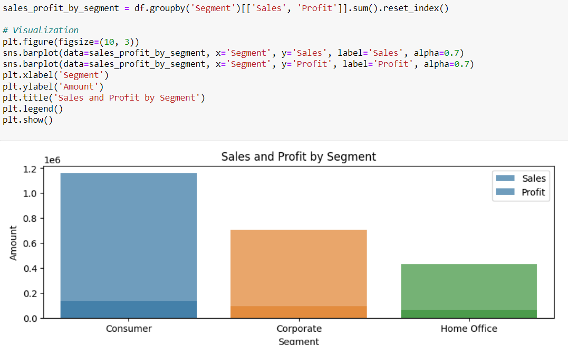
Visualizations
Consumer Segment contributes the most for both sales and profit
By Pavan Sastry NVSS

Slide 19
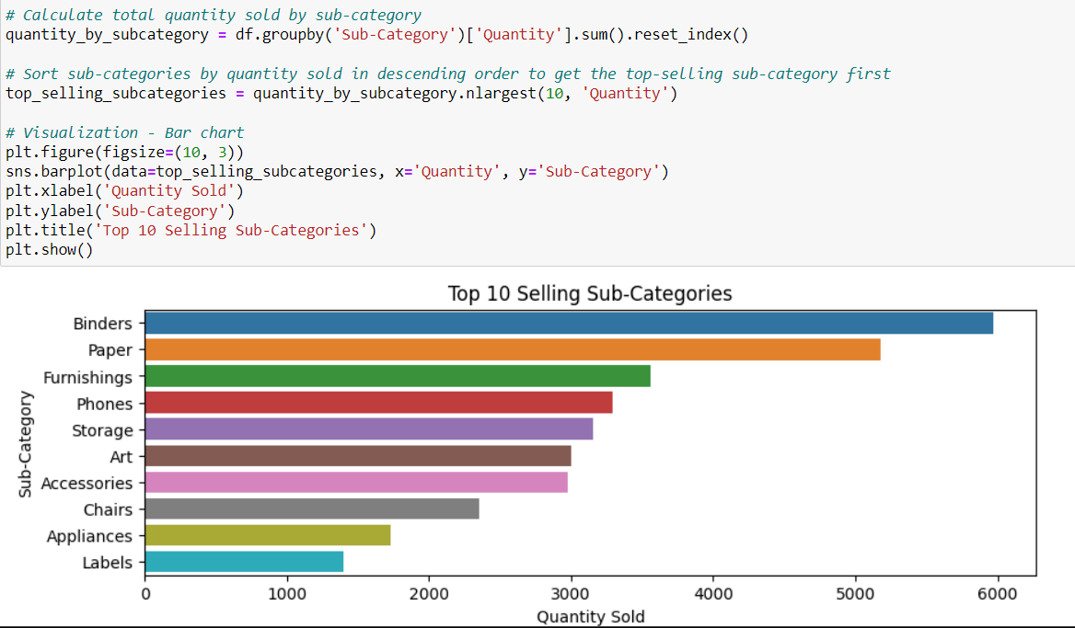
Visualizations
Binders is the top selling sub category with highest quantity sold
By Pavan Sastry NVSS

Slide 20
Conclusion
The "Office Supplies" category stands out with the highest total sales, reflecting strong demand for everyday business essentials.
"Phones" and "Chairs" emerge as the most profitable sub-categories, indicating potential growth areas for the business.
The Central region leads in total sales, while the West region dominates in total profits.
The "Technology" category boasts the highest average quantity sold, implying a popular choice among customers.
"Furniture" category offers the highest average discount, potentially attracting more customers with competitive pricing.
The Consumer segment significantly contributes to both sales and profit, requiring targeted marketing strategies.
By Pavan Sastry NVSS

Slide 21
Conclusion
"Standard Class" shipping mode is the most preferred choice among customers, possibly due to its cost-effectiveness.
There is a weak positive correlation between quantity sold and profit, implying that increasing sales may lead to higher profits.
The West region exhibits the highest total profit, highlighting its lucrative market potential.
In-depth discount analysis is essential to optimize pricing strategies and ensure sustainable profitability.
These insights provide valuable information to drive strategic decision-making and improve overall business performance for the Superstore.
By Pavan Sastry NVSS

Slide 22


Slide 23
References:
https://github.com/PavanNVSS/Superstore_DA
Google
YouTube
Medium
Kaggle
Elegant Lines Pitch Deck // 2021

