Slide 1

Predicting Majority Rating of TED Talks
Pavan Poosarla
Springboard Capstone 1

Slide 2
Problem Statement
Predict the most prominent audience rating to a TED talk based on the transcript of the talk and available metadata
Data Set : Transcripts and metadata on 2550 talks till Sep, 2017
Source : https://www.kaggle.com/rounakbanik/ted-talks/version/3

Slide 3
Data Set
Column | Description
comments | Number of first-level comments on the talk
description | A short note about the talk, usually 1-2 sentences
duration | In seconds
event | Event the talk was presented in
film_date | Unix timestamp of the filming
languages | Number of languages talk is available in
main_speaker | Main Speaker
name | Official name of TED talk, including speaker and title
num_speaker | Number of speakers
published | Unix timestamp of when talk appeared on ted.com
ratings | A stringified dictionary of the various ratings given to the talk (inspiring, fascinating, jaw dropping, etc.)
related_tags | A list of dictionaries of recommended talks to watch next
speaker_occupation | The occupation of the main speaker
tags | The themes associated with the talk
title | The title of the talk
url | The URL of the talk. This is common column with transcripts file, used for merging the two files on
views | The number of views on the talk
ted_main.csv : Metadata on TED talks
transcripts.csv : Transcript of the talks
Column | Description
transcript | This is the transcript of the talk. Text is not divided into paragraphs. It includes comments and audience reactions in parenthesis. For example (Applause), (Laughter), etc.
url | URL link of the talk. This is the common column with the ted_main.csv used to merge both files on

Slide 4
Data Preparation
Join ted_main.csv and transcripts.csv on url
Drop talks with more than 1 speaker
Extract new columns for sentence_count, word_count, max_rating. One hot encoding for ratings
Add columns for most common tags by one-hot encoding
Drop extra columns
Column | Description
comments | Number of first-level comments on the talk
description | A short note about the talk, usually 1-2 sentences
duration | In seconds
event | Event the talk was presented in
film_date | Unix timestamp of the filming
languages | Number of languages talk is available in
main_speaker | Main Speaker
name | Official name of TED talk, including speaker and title
num_speaker | Number of speakers
published | Unix timestamp of when talk appeared on ted.com
ratings | A stringified dictionary of the various ratings given to the talk (inspiring, fascinating, jaw dropping, etc.)
related_tags | A list of dictionaries of recommended talks to watch next
speaker_occupation | The occupation of the main speaker
tags | The themes associated with the talk
title | The title of the talk
url | The URL of the talk. This is common column with transcripts file, used for merging the two files on
views | The number of views on the talk
Column | Description
transcript | This is the transcript of the talk. Text is not divided into paragraphs. It includes comments and audience reactions in parenthesis. For example (Applause), (Laughter), etc.
url | URL link of the talk. This is the common column with the ted_main.csv used to merge both files on

Slide 5
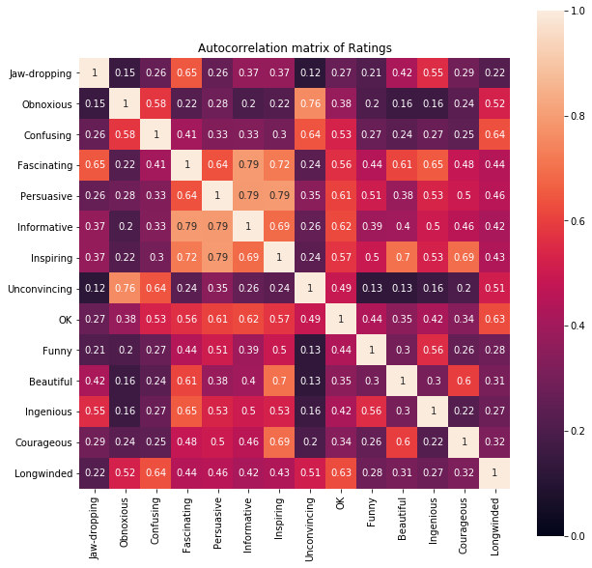
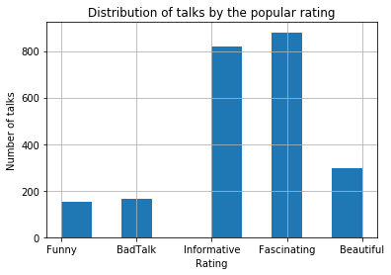
Data Wrangling
CONSOLIDATED TO

Slide 6
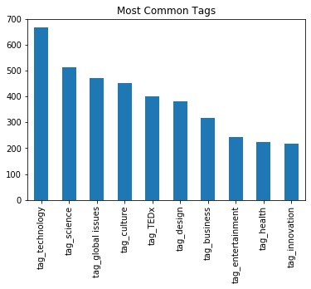
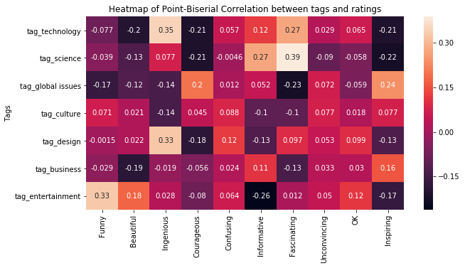
Exploratory Data Analysis

Slide 7
Text Analysis
Goal : Find the strongest predictive words for each rating
Steps
Pre-processing of transcript
Create bag-of-words word vector from transcript
Use count vector to predict rating using Naïve Bayes
Use trained model to predict probabilities of each rating on each word in vocabulary
Extract the five most common words that are predictive for each rating
Rating | Fascinating | BadTalk | Beautiful | Informative | Funny
Best words | light (0.65) | god (0.10) | song (0.21) | country (0.61) | Humor(0.11)
 | robots (0.65) | tapirs (0.10) | girl (0.21) | government (0.62) | comedy (0.11)
 | universe (0.68) | concussion (0.11) | poetry (0.22) | companies (0.62) | flag (0.11)
 | cells (0.68) | glamorous (0.11) | compassion (0.22) | women (0.63) | laughter(0.11)
 | robot (0.74) | glamour (0.12) | hum (0.22) | global (0.64) | dh (0.13)
Rating | Fascinating | BadTalk | Beautiful | Informative | Funny
Worst words | women (0.18) | data (0.02) | data (0.02) | robot (0.16) | percent (0.01)
 | governments (0.23) | brain (0.02) | information (0.03) | universe (0.21) | world (0.01)
 | rights (0.23) | two (0.02) | percent (0.03) | art (0.22) | years (0.01)
 | sector (0.24) | cells (0.02) | brain (0.03) | object (0.22) | us (0.01)
 | refugees (0.25) | see (0.02) | technology (0.03) | robots (0.22) | human(0.01)

Slide 8
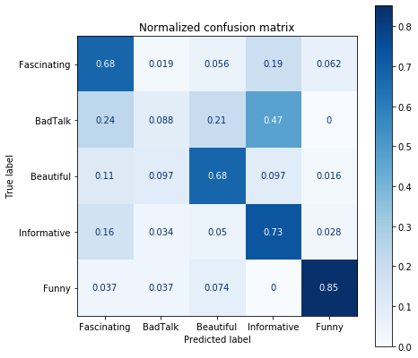
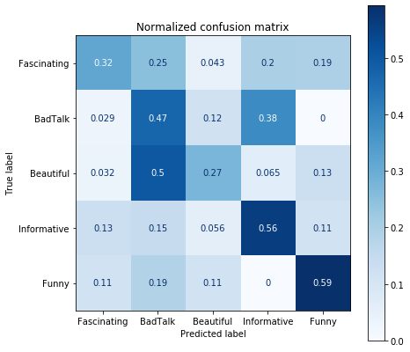
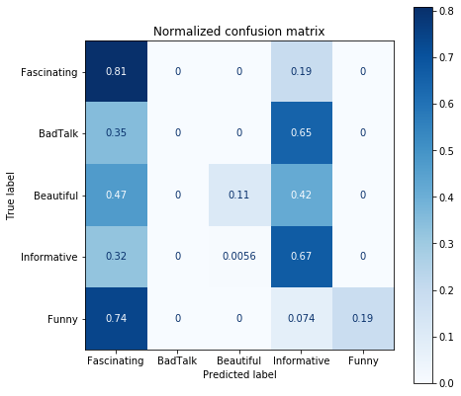
Modelling
Logistic Regression
Naïve Bayes
Random Forest
Logistic Regression shows the best performance amongst the models tested

Slide 9
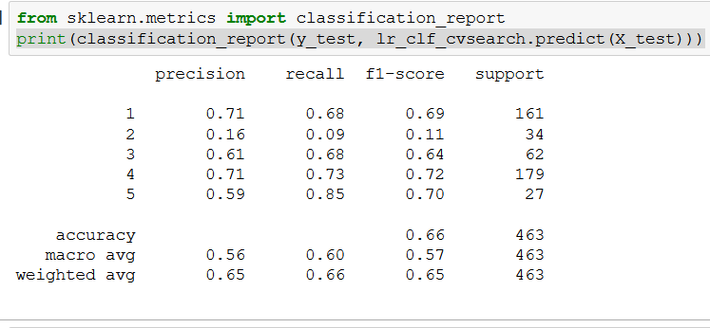
Logistic Regression
Model is trained with class weights proportional to the inverse of class frequencies to compensate for unbalanced classes
Balanced accuracy score is used as scoring metric
Grid Search CV with 3-fold cross validation is used for model tuning. Best C found is 0.0016

Slide 10
Thank You

