Slide 2
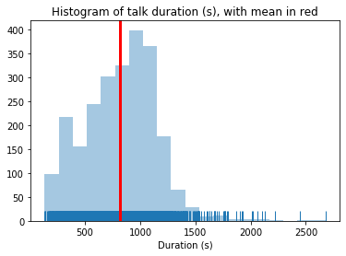
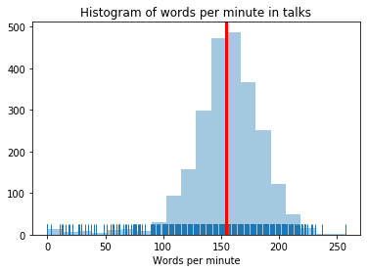

Slide 3
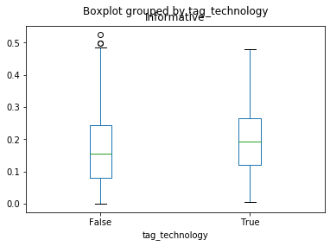
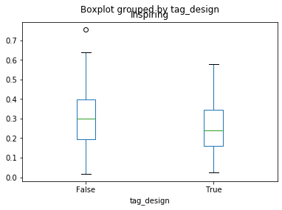

Slide 4
Rating | Fascinating | BadTalk | Beautiful | Informative | Funny
Best words | light (0.65) | god (0.10) | song (0.21) | country (0.61) | Humor(0.11)
 | robots (0.65) | tapirs (0.10) | girl (0.21) | government (0.62) | comedy (0.11)
 | universe (0.68) | concussion (0.11) | poetry (0.22) | companies (0.62) | flag (0.11)
 | cells (0.68) | glamorous (0.11) | compassion (0.22) | women (0.63) | laughter (0.11)
 | robot (0.74) | glamour (0.12) | hum (0.22) | global (0.64) | dh (0.13)
Rating | Fascinating | BadTalk | Beautiful | Informative | Funny
Worst words | women (0.18) | data (0.02) | data (0.02) | robot (0.16) | percent (0.01)
 | governments (0.23) | brain (0.02) | information (0.03) | universe (0.21) | world (0.01)
 | rights (0.23) | two (0.02) | percent (0.03) | art (0.22) | years (0.01)
 | sector (0.24) | cells (0.02) | brain (0.03) | object (0.22) | us (0.01)
 | refugees (0.25) | see (0.02) | technology (0.03) | robots (0.22) | human (0.01)

