Slide 1

Extracting Sentiment text from tweets
Pavan Poosarla
Springboard Capstone 2

Slide 2
Problem Statement
Extract the best phrases related to the sentiment from a tweet, knowing the sentiment of the overall tweet.
Data Set : More than 25000 tweets and their sentiments (either positive, negative or neutral) along ith the selected texts from the tweets that represents the sentiment
Source : https://www.kaggle.com/c/tweet-sentiment-extraction/data

Slide 3
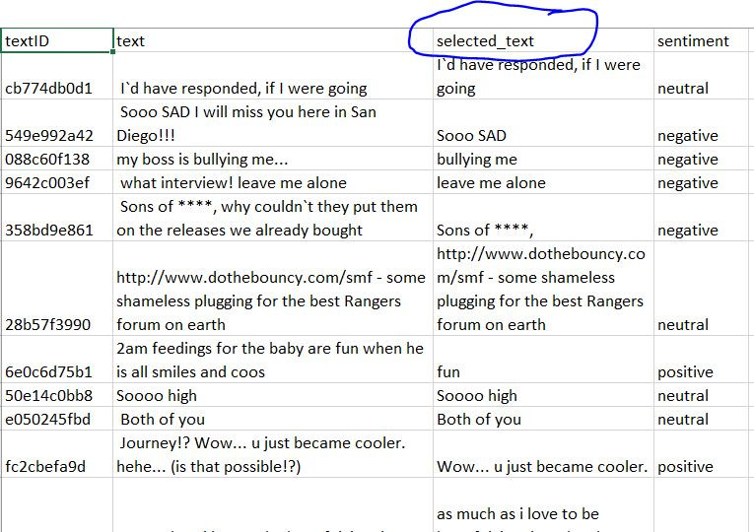
Data Set
Text fields
textID : Unique ID for each tweet
Text : total text of the tweet. All in English. Upto 140 characters
Selected_text : excerpt from the tweet signifying the sentiment. This varies from a single word to the entire tweet.
Sentiment : Sentiment of the overall tweet. Can be positive, negative or neutral

Slide 4
Approach
Step 1 : Data Wrangling
Step 2: Exploratory Data Analysis
Step 3: Modeling and Prediction
Bag-of-words approach (Logistic Regression)
Parse tress approach (Extract relevant noun-chunks )
Deep Learning approach (DistilBERT)

Slide 5
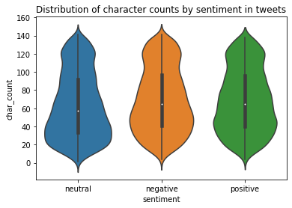
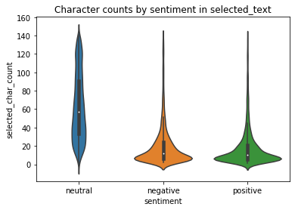
Exploratory Data Analysis
Observations
Distribution of character lengths in tweets is common for all sentiments
Character counts in selected text tend to be much lower than full tweet for negative and positive sentiments
For tweets with neutral sentiment, actual tweets and selected tweets have similar length distribution
Figure Distribution of character lengths by sentiment in the full tweet and in the selected text

Slide 6
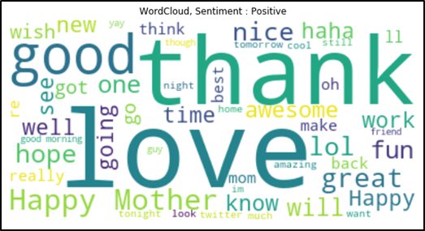
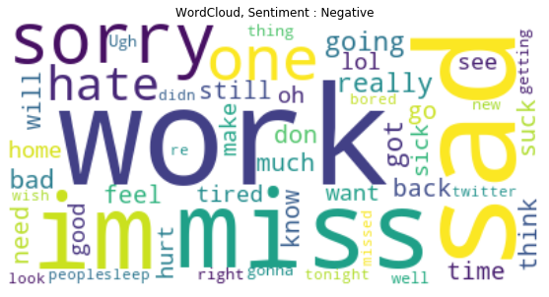
Text Analysis
Word clouds corresponding to different sentiments show that even individual words can show differentiation between sentiments

Slide 7
Modelling and Prediction

Slide 8
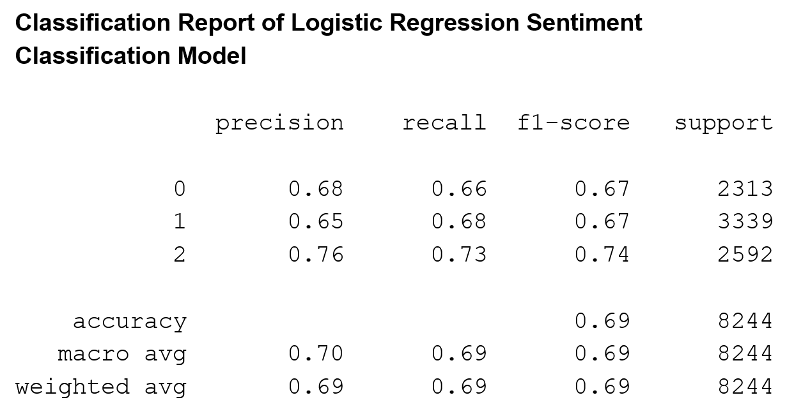
Bag-of-Words Approach
Goal : Main goal of this approach is to identify the word in the tweet with the strongest probability of the sentiment.
To get probability of sentiments for each word, we do as follows
1. Train a logistic regression sentiment classification model from the training dataset
2. Get prediction probabilities of each of sentiment for each single word

Slide 9
Post processing
Use model trained in previous section to get probabilities of each sentiment for each word
In each tweet, find the word with highest probability of said sentiment
Extract selected text by multiple approaches as described
The closeness of predicted ‘selected text’ and ‘selected text’ is found using ‘Jaccard score’
Version | Approach | Mean Jaccard score
Trivial score | Return entire tweet as prediction | 0.589
1 | Select best word in each tweet for the sentiment | 0.240
2 | For ‘neutral’ sentiment, return full tweet. Return best predictive word for rest | 0.593
3 | Return complete tweet for ‘neutral’ sentiment or if original tweet contains fewer than 6 words | 0.605

Slide 10
Classification Report of Logistic Regression Sentiment Classification Model
precision recall f1-score support
0 0.68 0.66 0.67 2313
1 0.65 0.68 0.67 3339
2 0.76 0.73 0.74 2592
accuracy 0.69 8244
macro avg 0.70 0.69 0.69 8244
weighted avg 0.69 0.69 0.69 8244

Slide 11
Parse Trees Approach
Main drawback of bag-of-trees approach is that its performance is poor on tweets where more than one word is to be selected
We can use parse trees to select a phrase around the most predictive word and check the performance
The performance is not good because improvement gained on tweets with larger selected texts is lost for tweets with one word as selection
Version | Approach | Mean Jaccard score
Trivial score | Return entire tweet as prediction | 0.589
4 | Use parse trees to select the noun chunk containing the best predictive word and return it as predicted selection | 0.584
5 | Return a 5 word interval around the best predictive word as predicted selection. | 0.589

Slide 12
Deep Learning Approach
Deep learning approaches have good chance of improving the performance
Transformer based model, DistilBERT is selected and a pretrained model is trained on current dataset by transfer learning
The problem is cast as a Q&A problem where the answer is a selected excerpt from main text
In this case, sentiment is given as ‘question’ input and model is supposed to predict excerpt from the tweet
This shows best performance of all approaches

Slide 13
Conclusions
Deep learning based approaches outperform traditional NLP methods
This shows the power of deep learning based approaches to language understanding
This is a demonstration of rapid progress in NLP recently
DistilBERT model, used in this project is less than a year old since first published
Conclusions

Slide 14
Thank You

