Slide 1
Anomaly Detection Using Federated Learning
Presented By Team 11
Pavan Raj Dasari
Sahithi Thota
Sai Ganesh Pamarti

Slide 2
Presentation Outline
Introduction
Objectives & Challenges
Working Model
Results
Team Contribution
Conclusion
Q&A

Slide 3
Recap
Discussed about federated learning architecture
Discussed anomaly detection techniques
Presented about functioning of algorithms
Approaches on how we were implementing FL

Slide 4
Objectives & Challenges
To simulate anomaly detection using Federated learning.
To eliminate the Malicious data and nodes in the network, mainly focused on sudden spikes and lows
Maintaining energy efficiency - due to processing of FL algorithms they might waste energy if not configured properly.
Lack of standardization - there is no single standard for implementing FL
Lack of labeled data - very less number of datasets present for sensor data with anomalies to label their output

Slide 5
Working Model

Slide 6
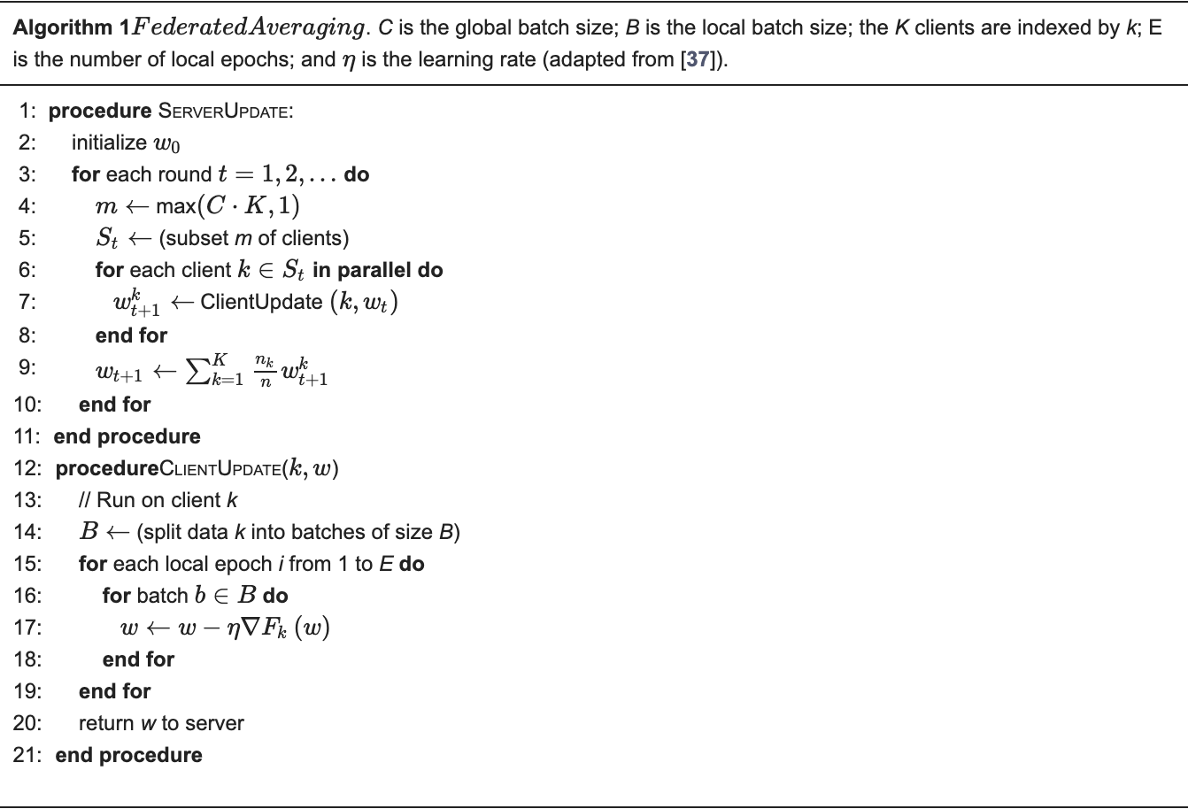
Fed Averaging
Federated Averaging is a distributed machine learning technique that allows for model training using decentralized data from numerous devices or clients without having to share the data.
Reference: https://www.mdpi.com/2076-3417/8/12/2663

Slide 7
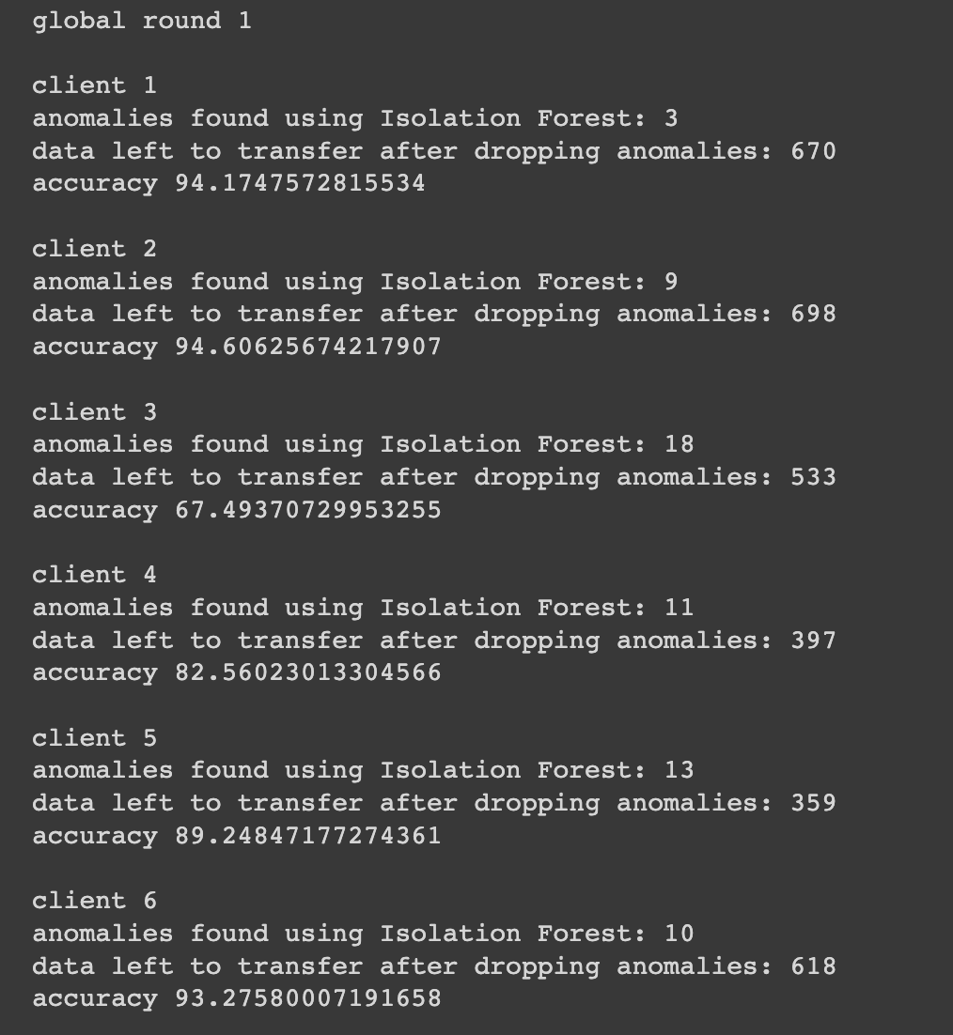
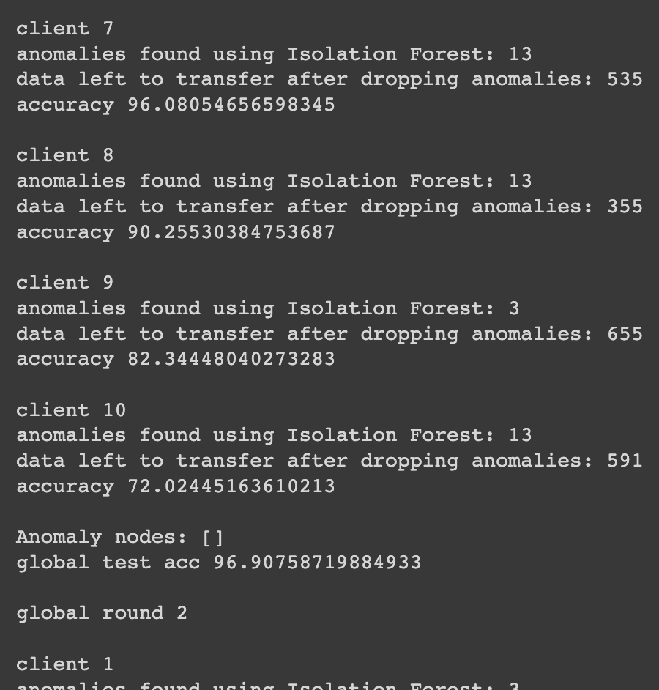
Results
Data level anomaly detection

Slide 8
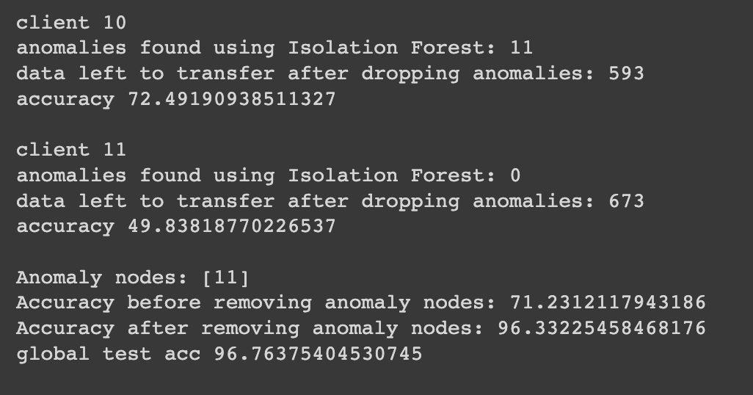
Results
Node level anomaly detection

Slide 9
Energy Efficiency
Anomaly detection without federated learning : 102 Kwh/MB
Data Transfering from sensor to the server
Detecting anomalies
Anomaly detection using federated learning : 125 Kwh/MB
Data transferring from server to sensor
Data transferring from sensor to the server
Isolation forest Algorithm
Fed Averaging Algorithm

Slide 10
Problems Faced During Implementation
Faced multiple platform issues while integrating NS3 with ML Packages.
Minimal number of federated learning references.
No code or low code examples due to active research in WSN using FL

Slide 11

Team Contribution
Content | Pavan Raj | Sahithi | Ganesh
Project Research | 40% | 30% | 30%
Code Implementation | 35% | 35% | 30%
Data Collection | 35% | 35% | 30%
Calculating Energy Constraints | 30% | 40% | 30%
Presentation | 30% | 35% | 35%
Overall | 34% | 33% | 33%

Slide 12
Conclusion
The implementation of the federated learning anomaly detection bypasses the drawbacks of existing anomaly detection.
Improves the privacy
Low computing power
Model updations
We mainly focused on anomalies present in data level and node level.
Energy efficiency is more for federated learning.

Slide 13
References
A Joint Learning and Communications Framework for Federated Learning over Wireless Networks (arxiv.org/pdf/1909.07972.pdf)
A Federated Learning Approach to Anomaly Detection in Smart Buildings (https://arxiv.org/pdf/2010.10293.pdf)
Reference: https://www.mdpi.com/2076-3417/8/12/2663
Federated Learning with Anomaly Client Detection and Decentralized Parameter Aggregation (ieeexplore.ieee.org/document/9833835)

Slide 14

Any Queries??

